Slide 1
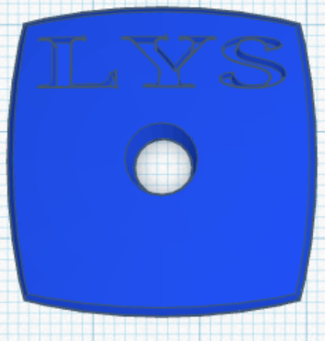





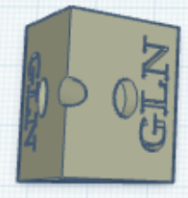





 | Leucine (4) | Valine (3) | Phenylalanine (4)
 |  | Glutamine (4) | Glycine (10)
Threonine (3) | Serine (3) | Arginine (4) | Methionine (3)
Lysine (3)
Alanine (4)
Glutamic Acid (3)

