Slide 1
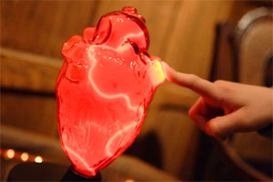
Bioelectricity and Cardiac Function
The Strongest Pump of All
Notes:
Bioelectricity and Cardiac Function Presentation > The Strongest Pump of All lesson >TeachEngineering.org
///
Image source (human heart): Image source: http://www.thebakkan.org/education/

Slide 2
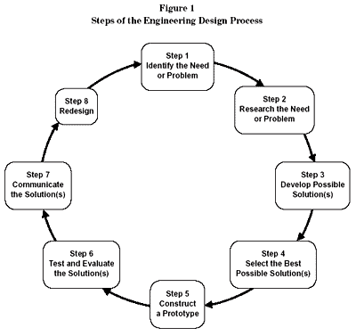
The Importance of Engineering
Examples of engineering are around you everywhere
Engineers follow a problem solving process that anyone can use:
  engineering
  design
  process
Five main steps➔
Notes:
Image source (EDP graphic): http://www.doe.mass.edu/frameworks/scitech/2001/standards/strand4.html

Slide 3
The Engineering Design Process
Five main steps:
Problem identification
Research
Solution design
Implement & test
Iteration & improvement
Notes:
Image source (EDP graphic): http://www.doe.mass.edu/frameworks/scitech/2001/standards/strand4.html

Slide 4
So easy, anyone can do it
No problem is out of your reach
Break down the problem into
manageable pieces
Do not jump to conclusions

Slide 5
What IS the Problem?
It can be anything you want to investigate
A 100% right answer does not exist; rather, many possible solutions exist
Your challenge is to find the best solution for the situation

Slide 6
Researching the Problem
Takes time and patience
Look at ways other people have tried to answer the problem or similar problems
Look at solutions to similar problems
See what can be improved upon in your solution

Slide 7
Your Design Solution
Use research to help you
Brainstorm — make it original & creative
Even if it is wrong (or does not work as you ultimately want), find something to learn from it
Then modify it (again and again… = design iterations) to improve it

Slide 8
Testing & Improvement
Check your solution for accuracy
Test to get data
Analyze your data to see how well it fixed the problem
Keep improving the design until it is an acceptable solution = iterations

Slide 9
Importance of Heart Bioelectricity
Cardiovascular disease is the leading cause of death in the U.S.
Technologies need to be improved and invented to help people with this disease
Before you can design a solution, you need to understand how the heart works

Slide 10
What makes your heart pump?
Your heart works off an electrical current
This current is produced by your body
…somewhat like
a water pump
that is powered
by electricity
Notes:
Image source (human heart): Image source: http://www.thebakkan.org/education/

Slide 11
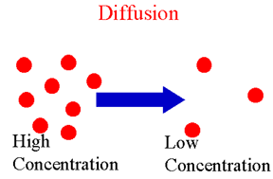
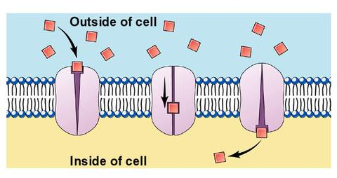
Diffusion
Potassium and
sodium ions
Each has a +1 charge
They move across the cell’s membrane through diffusion

Slide 12
Generating Action Potentials
The diffusion of the Na+ and K+ ions generates an electrical current
These are the same ions, or electrolytes, in Gatorade
This is the science behind why Gatorade can be helpful for high-performance athletes

Slide 13
What do action potentials do?
Give your body the ability to send messages
These electrical messages are sent throughout the body to tell muscles to contract and relax
Without the varying concentrations of the ions, your cells could not send these messages

Slide 14
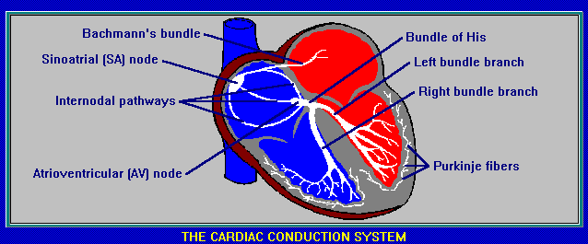
Action Potentials in the Heart
Millions of cells in your heart do this at once
Creates a current
Occurs first in SA node of the heart, at the top
Goes to the bottom of your heart to pump blood to your body

Slide 15
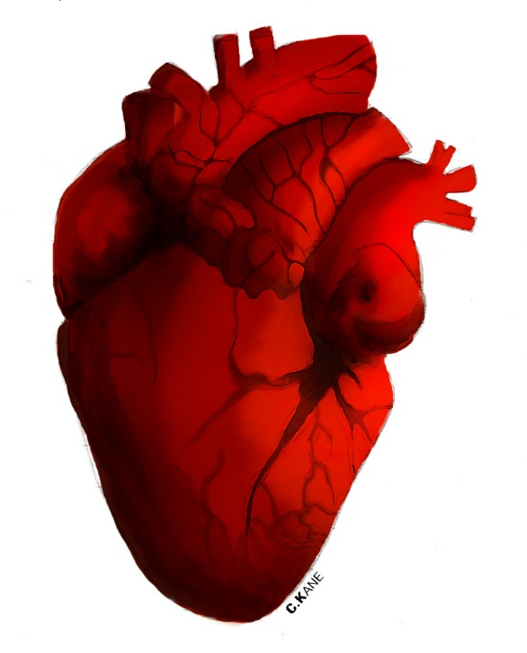
RECAP: How the heart pumps
Electrical signals called action potentials are created from the change in concentration of sodium and potassium ions
The signals tell the muscles
to contract
They start at the top of the
heart and push the blood to
the bottom of the heart
Then they continue to the
bottom of the heart to push the blood to the body
Notes:
Image source (human heart drawing): C. Kane from http://www.cliparthut.com/human-heart-clipart-RISJxi.html (The best online collection of FREE to use clipart)

Slide 16
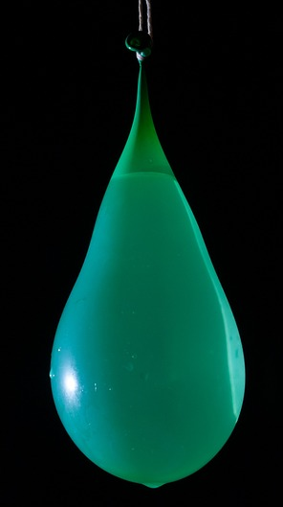
DEMO: Water balloons…
(that’s right, water balloons!)
Imagine a water balloon represents your heart:
Squeeze the top
> all the water goes to the bottom
Squeeze the bottom
> all the water goes to the top
This is what happens with the electrical currents in your heart; they tell the muscles to squeeze, and that’s how the blood moves.
Notes:
Image source: (green water balloon) Christoph, Pixabay (CC0 Public Domain) https://pixabay.com/en/water-balloon-water-bomb-shot-523966/

Slide 17
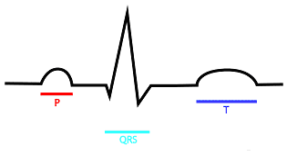
The Electrical Wave Form
Notes:
Image source: www.utpb.edu/courses/.../qrs_complex.htm

Slide 18
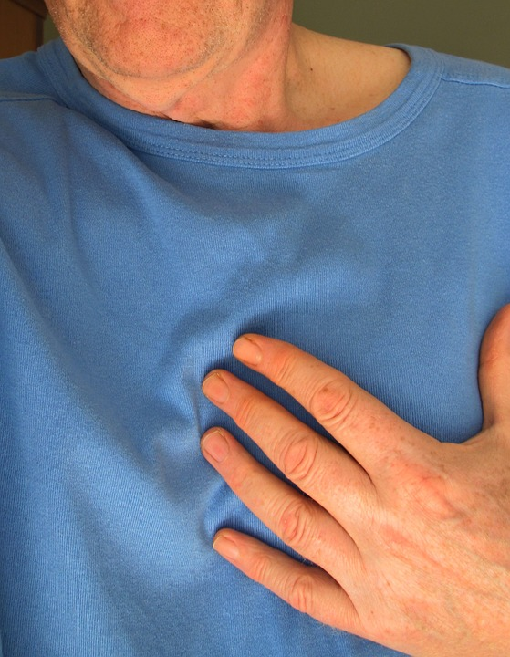
Class Discussion Question
Problem: A person does not produce enough electrical current to make his/her heart pump correctly.
Challenge Question: How could you, as engineers, solve this problem?
Notes:
Image source (person with hand over heart): geralt, Pixabay (CC0 public domain) https://pixabay.com/en/body-upper-body-hand-t-shirt-keep-116585/

Slide 19
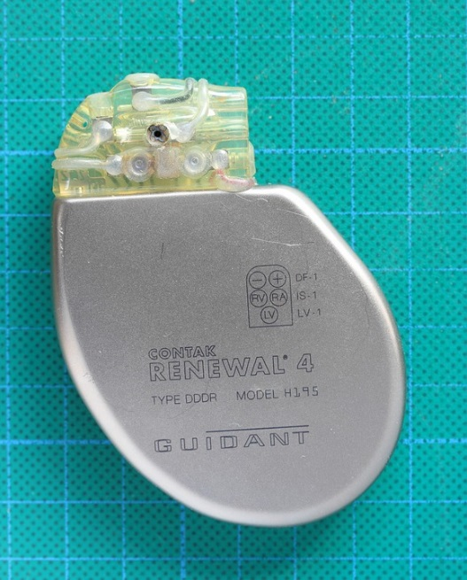
Engineering Design Solutions?
Current technologies include pacemakers
  A surgically inserted device
  that shocks the heart to
  make sure it beats correctly
What are your ideas?
Engineers need to think outside the box
to find innovative solutions
to everyday problems!
Notes:
Image source (cardiac pacemaker): olafpictures, Pixabay (CC0 public domain) https://pixabay.com/en/pacemaker-medical-implant-heart-1755727/

Slide 20
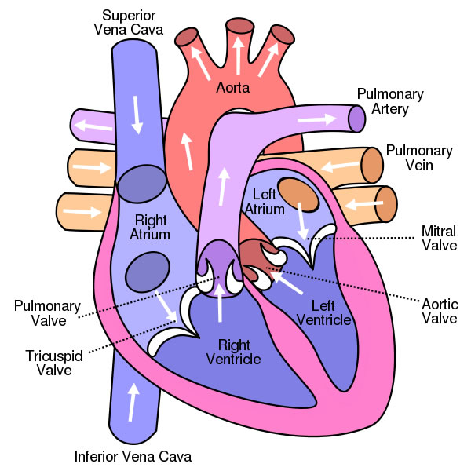
Notes:
Image source (human heart diagram labeled): ClipArtHut (The best online collection of FREE to use clipart) http://www.cliparthut.com/human-heart-diagram-clipart-CbZTyW.html

