Slide 1
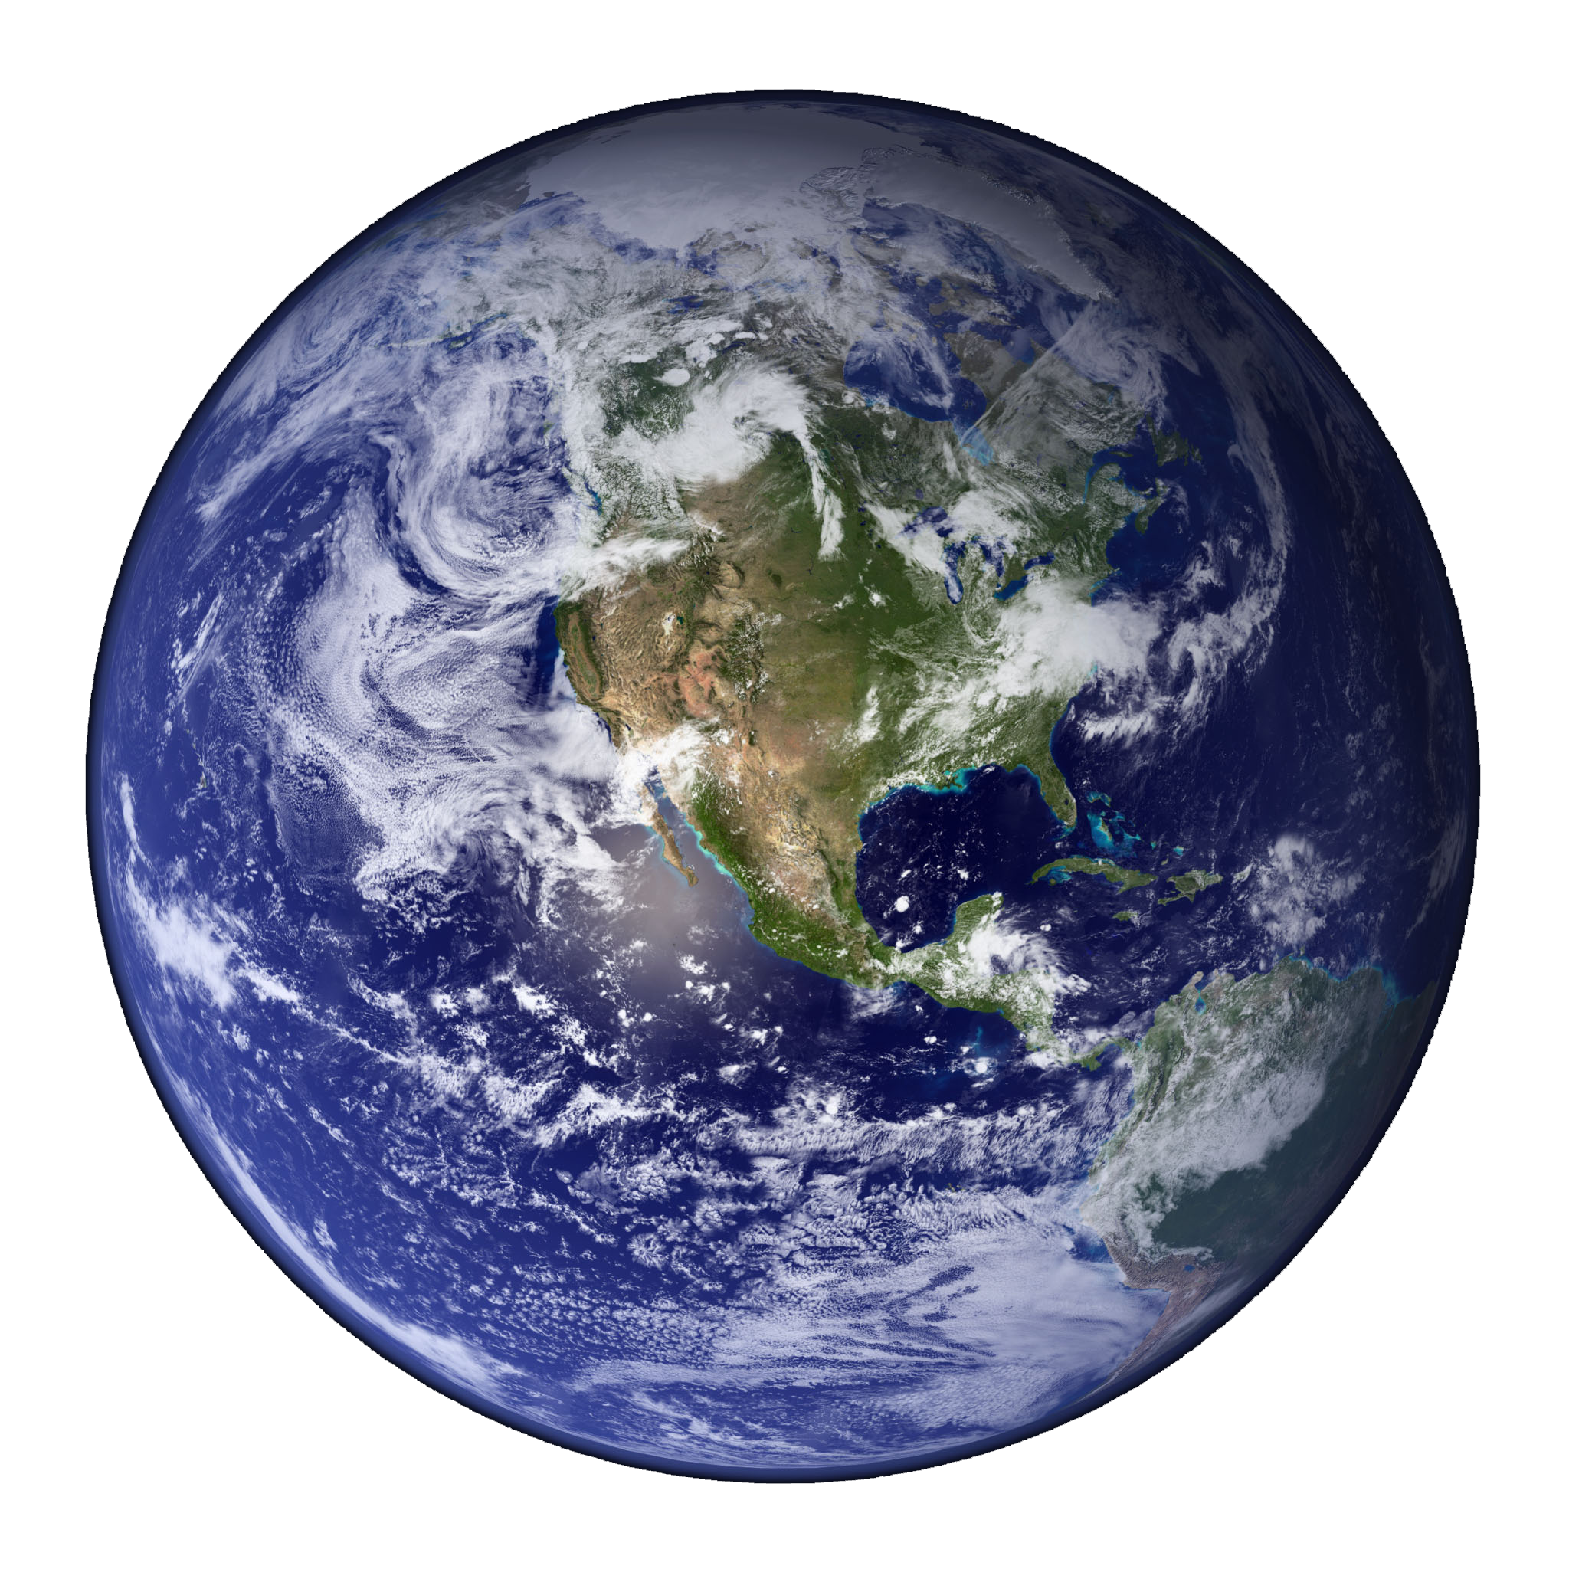
Natural and Urban
“Stormwater” Water Cycles
Our planet is covered by water, an astonishing 71 percent!
“Planet Water?”
If the world was uniform all the way around, water would cover the planet to a depth of 2.6 km (1.6 miles).
From where did all this water come?
Notes:
Natural and Urban “Stormwater” Water Cycles Lesson > TeachEngineering.org

Slide 2
Natural and Urban
“Stormwater” Water Cycles
How much water is that?
It would take 15.5 billion years for that volume of water to go over the Niagara Falls. (Scientists measure our planet to be 4.54 billion years old.)
It takes the average American 7.5 years to use the amount of water that flows over Niagara Falls every second.
That’s a lot of water. Is it enough for everyone?

Slide 3
Natural and Urban
“Stormwater” Water Cycles
2.5% of the water on our planet is considered fresh water.
  1.7% trapped as polar ice
  0.76% fresh groundwater
  0.1% in the planet’s surface and atmosphere
Groundwater sources are not evenly distributed around the world, and excessive groundwater pumping has negative environmental impacts.
So, surface and atmospheric water are the most accessible and renewable sources of drinking water.
Global freshwater availability is estimated at 131 gallons per person per day.

Slide 4
Natural and Urban
“Stormwater” Water Cycles
When we turn on the faucet, water always comes out. But how does it get there? And how do we know that it is safe to drink?
Civil and environmental engineers design systems to move this water from surface and groundwater sources to water treatment facilities and then to our homes. It is their job to provide quality drinking water, assuring our health and safety, and a sufficient quantity of water.

Slide 5
Natural and Urban
“Stormwater” Water Cycles
Civil and environmental engineers use the rates of reaction to design treatment systems and must understand the phase transformation occurring as a result of the reaction, in order to provide water that is safe to drink and release back into nature.
For example, denitrification, the transformation of nitrate (NO₃, a fertilizer) to nitrogen gas (N₂) is a critical component in the design and management of wastewater treatment systems.

Slide 6
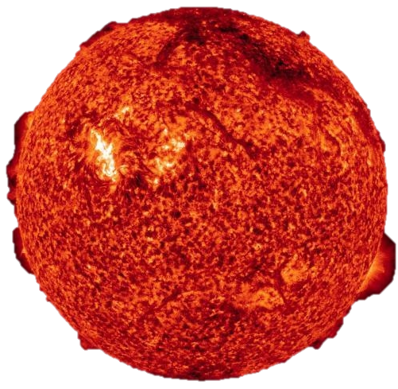
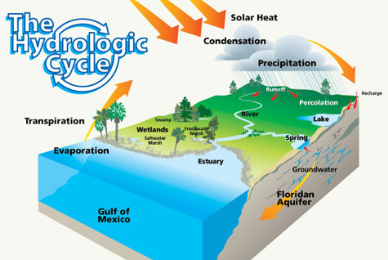
Natural and Urban
“Stormwater” Water Cycles
The driving force for the water cycle is the sun!
Name the different parts of the water cycle…
evaporation
condensation
precipitation
infiltration
stormwater runoff
groundwater flow
plant uptake
transpiration
6

Slide 7


Evaporation
Definition: When water changes from a
liquid to a gas (water vapor).
Phase change: Heat from the sun creates energy that breaks the bonds holding water molecules together.
Rate: Net evaporation occurs when the rate of evaporation exceeds the rate of condensation.
Examples: Boiling water, steam off a lake, river or road

Slide 8
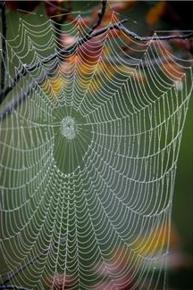
Condensation
Definition: When water vapor changes from
its gaseous state (vapor) to the liquid phase.
Phase change: Evaporated water vapor
condenses in the atmosphere due to lower
temperatures resulting from less atmospheric pressure encountered at higher elevations.
Rate: On average, the residence time for moisture in the atmosphere is 8.2 days.
Question: A large cumulonimbus cloud can weigh as much as a 747 jumbo jet. So why does it not come crashing down to the ground?
Notes:
Answer: The rising air responsible for the cloud formation keeps the cloud floating in the air because the air below the cloud is denser than the cloud.

Slide 9


Precipitation
Definition: Condensed water vapor
that falls to Earth as rain, snow or hail.
Phase change: Water molecules combine (via condensation) with tiny dust that act as a nucleus to form cloud droplets. An increase in collisions occur with other droplets until the mass of the droplet creates a fall velocity that is greater than the cloud updraft speed, resulting in precipitation.
Rate: When the evaporation rate is less than the condensation rate, a droplet can grow into a cloud.

Slide 10
Infiltration and Percolation
Infiltration: The movement of water into the media layer.
Percolation: The movement of water within the media layer.
Transformation: When precipitation falls onto a pervious surface, it may infiltrate into the media layer.
A media layer is the combination of inorganic and/or organic earth materials (for example, sand, soil, mulch, compost, limestone, granite, gravel).
Infiltration and percolation rates are typically calculated in (V or L)/(T) units, such as ml/s or in/s.

Slide 11

Stormwater Runoff
Definition: The flow of rainwater that occurs as a result of the precipitation rate exceeding the soil infiltration and percolation rates.
Also generated from impervious surfaces such as roofs, roads and sidewalks.
Collects particulates, nutrients
and heavy metals as it travels
down the street and into
the storm sewer.

Slide 12
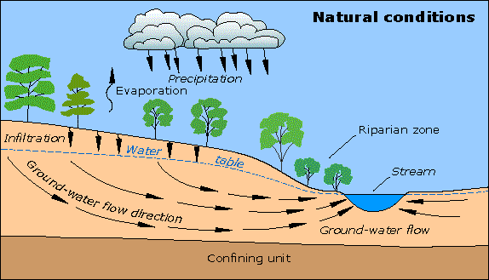
Groundwater Flow
Definition: The lateral or
horizontal flow of water beneath the ground surface.
Groundwater levels are typically the surface level at which you can see water in a lake, or the level of a well.
Storm water replenishes the groundwater table and underground aquifer through infiltration and percolation.
Then this groundwater is available to flow into lakes, streams, rivers or be accessed by wells and pump stations.

Slide 13

Plant Uptake
Definition: The process of plants absorbing
water and nutrients from roots in order to grow.
Phase change: Plants use the energy from the sun (photosynthesis) and capillary action to draw up water and nutrients and transform inorganic nutrients into organic above-ground and below-ground biomass.
Rate: Above-ground biomass uptake begins in spring, peaks in mid-summer, and is very minimal during fall and winter months.

Slide 14

Transpiration
Definition: The process by which plants release water into the air.
Trees typically drop their leaves to conserve
water, which eliminates the pathway for transpiration.
Transformation: Process occurs to remove
heat from the plant and facilitate plant uptake.
Rate: Dependent on moisture content of plant vs. surrounding air. (The engineering word is “concentration gradient.”)
Transpiration rate examples:
  An acre of corn can give off 3,000–4,000 gallons of water per day.
  A large oak tree can give off 40,000 gallons of water per year.

Slide 15
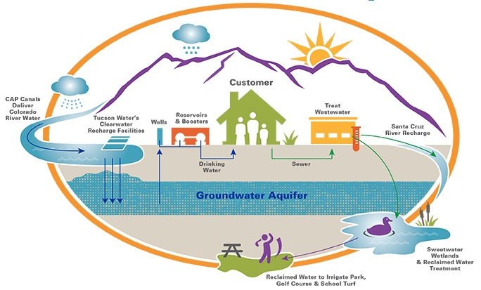
Urban “Stormwater” Water Cycle
Notes:
New vocabulary words related to the urban water cycle: impervious surface, pervious surface, storm sewer, combined sewer, surface water, wastewater, sanitary sewer, urban infrastructure.
Overview: Water is drawn from natural surface water sources > cleaned at drinking water facility > delivered to homes via water pipes > leaves homes as wastewater > sewer system > cleaned at water treatment facility > released into surface water collection systems or used for irrigation.
An alternate diagram for the urban water cycle may be found at http://www.pacificwater.org/pages.cfm/water-services/water-demand-management/water-distribution/the-water-cycle.html.
Or, another diagram at http://www.phila.gov/water/PublishingImages/urbanwatercycle.jpg

Slide 16
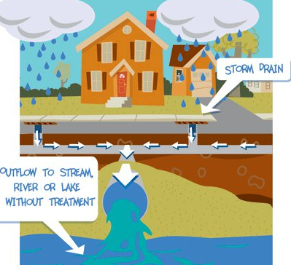
Rain collected and moved by urban infrastructure
Transpiration
You are a travel magazine journalist for Urban Environment Weekly.
Your assignment this week is to
follow the life of a drop of water
as it makes its way through
the urban environment.
In your article, include all the
descriptive details of whom
the drop met and what it
encountered along the way.
Notes:
Use the vocabulary words you have learned in this presentation.

Slide 17
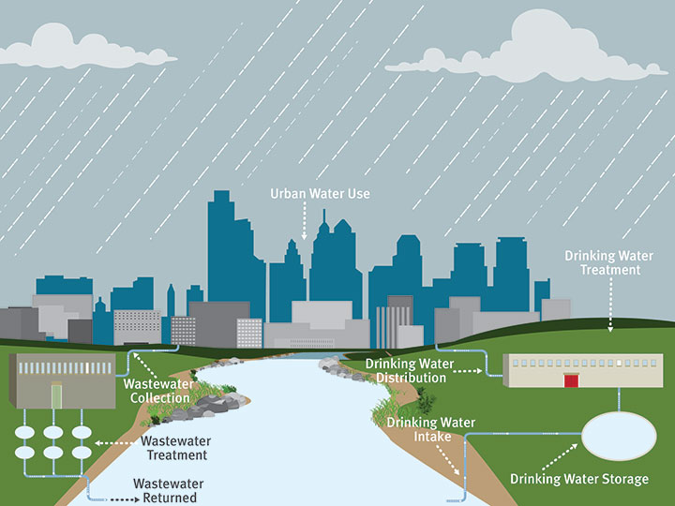
Urban Water Cycle

Slide 18
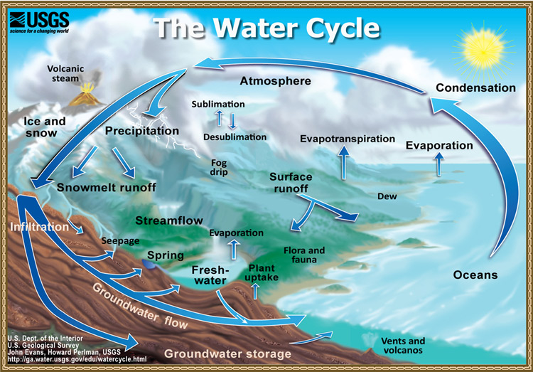
Natural Water Cycle

Slide 19
Image Sources
Slide 1: Image of the Earth — U.S. Environmental Protection Agency at http://www.epa.gov/region6/rsc/converses_students.html
Slide 6: X-ray photograph of the sun — NASA via Science daily at http://www.sciencedaily.com/releases/2010/08/100802165451.htm
Slide 6: Diagram of the water cycle – Southwest Florida Water Management District via Miami-Dade County, FL at http://www.miamidade.gov/water/water-cycle.asp
Slides 7, 8, 9: evaporation-condensation-precipitation diagram — Microsoft clipart at http://office.microsoft.com/en-us/images/results.aspx?qu=evaporation&ex=1#ai:MC900278850|
Slide 7: steaming coffee cup — Microsoft clipart at http://office.microsoft.com/en-us/images/results.aspx?qu=steam&ex=1#ai:MC900239561|
Slide 8: dew droplets on web — Microsoft clipart at http://office.microsoft.com/en-us/images/results.aspx?qu=condensation&ex=1#ai:MP900442455|
Slide 9: rain — Microsoft clipart at http://office.mirosoft.com/en-us/images/results.aspx?qu=rain&ex=1#ai:MC900311120|
Slide 9: snowflakes — Microsoft clipart at http://office.microsoft.com/en-us/images/results.aspx?qu=snow+flakes&ex=1#ai:MC900331453|
Slide 11: runoff drainage pipe — Microsoft clipart at http://office.microsoft.com/en-us/images/results.aspx?qu=runoff&ex=1#ai:MC900298021|
Slide 12: Diagram of groundwater flow — U.S. Geological Survey at https://water.usgs.gov/edu/earthgwdecline.html
Slide 13: Plant with roots in ground — Microsoft clipart at http://office.microsoft.com/en-us/images/results.aspx?qu=plant&ex=1#ai:MC900383120|
Slide 14: Tree without leaves — Microsoft clipart at http://office.microsoft.com/en-us/images/results.aspx?qu=falling+leaves&ex=1#ai:MC900187917|
Slide 15: Diagram of urban water cycle — City of Tucson AZ at http://www.tucsonaz.gov/water/cycle
Slide 16: Storm drain system diagram — Monroe County, NY at https://www.monroecounty.gov/des-stormwater-coalition
Slide 17: Diagram of urban water cycle — U.S. Geological Survey http://water.usgs.gov/edu/watercycle.html
Slide 18: Diagram of natural water cycle — City of Philadelphia PA http://www.phila.gov/water/PublishingImages/urbanwatercycle.jpg

