Slide 1
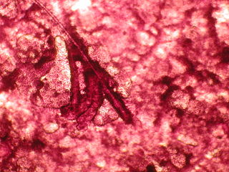
Get in My Body
Drug Delivery
Notes:
Get in My Body Presentation: Drug Delivery, Get in My Body: Drug Delivery Lesson, TeachEngineering.org
Imagehttps://commons.wikimedia.org/wiki/File:Drugdelivery.jpg
source: [drug delivery through skin] © 2008 Ahbinavg3, Wikimedia Commons

Slide 2
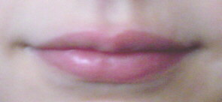
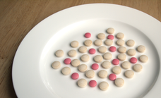
Challenge Question
You are a doctor, physician assistant or nurse practitioner.
Your patient has a condition that requires her to keep constant levels of a medication in her body. However, she is unable to swallow.
What are some other methods of administering a drug to her?
Remember: She needs to take the drug at least twice a day for the rest of her life and to ensure patient compliance, the drug delivery method must be as simple as possible.
Notes:
Have students brainstorm ideas in small groups, and then discuss ideas as a class.
Image sources:
[mouth] © 2004 Saintswithin, Wikimedia Commons https://commons.wikimedia.org/wiki/File:Mouth.jpg
[pills on a plate] © 2010 epSos.de, Wikimedia Commons https://commons.wikimedia.org/wiki/File:Medicine_Drug_Pills_on_Plate.png

Slide 3
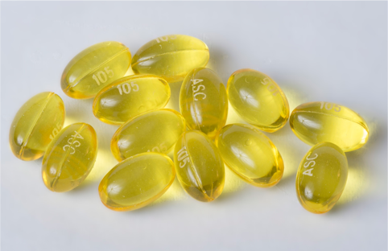
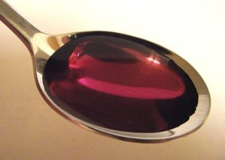
Oral Administration
Taken by mouth through the digestive tract – in liquid or pill form
Advantages:
Easy, preferred by people
Slow release of drugs; can extend the duration of action
Drugs can be protected from harmful digestive tract enzymes and acids
Disadvantages:
Drugs are absorbed slowly
Won’t work if vomiting profusely
Unpredictable adsorption due to stomach acid and enzyme degradation
Common usage: aspirin, Advil®, Tylenol®, cough syrup, painkillers, steroids
Notes:
Image sources:
[capsules] © 2014 Revision17 at English Wikipedia, Wikimedia Commons https://commons.wikimedia.org/wiki/File:100mg_generic_Benzonatate_Capsules.jpg
[spoonful cough syrup] © 2010 Stickpen, Wikimedia Commons https://commons.wikimedia.org/wiki/File:Coughsyrup-promethcode.jpg

Slide 4
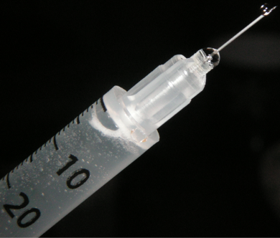
Injection
By needle into the skin
Three methods:
Intravenous: infusion directly into the vein
Intramuscular: injection directly into muscle
Subcutaneous: injection into the cutis layer of the skin
Notes:
Image source: [medical syringe and needle] © 2010 Psychonaught, Wikimedia Commons https://commons.wikimedia.org/wiki/File:Syringe_Needle_IV.jpg

Slide 5
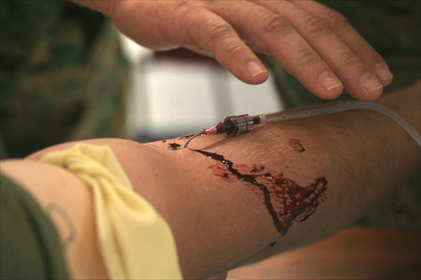
Injection: Intravenous
Intravenous (IV): Infusion directly into a vein
Advantages:
Dependable and reproducible effects
Entire administered dose reaches circulatory system immediately
Disadvantages:
Requires a cannula (IV line)
More labor intensive and costly
More prone to infections
Distressing, especially to children
Common usage: blood transfusions, saline (for dehydration), painkillers, propofal (sleeping drug), anesthesia
Notes:
Image source: [intravenous line in arm] © 2006, Lance Cpl. Adam Johnston, U.S. Marines, U.S. Department of Defense http://www.lejeune.marines.mil/Photos/tabid/1100/igphoto/9686/Default.aspx

Slide 6
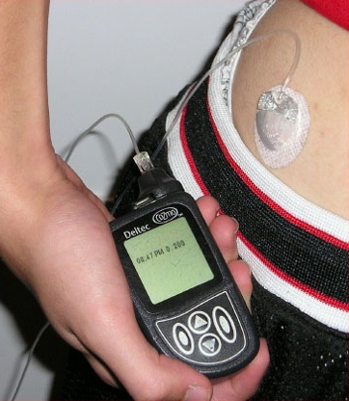
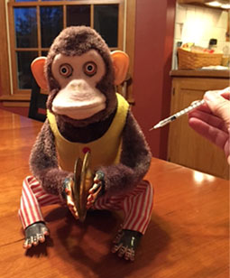
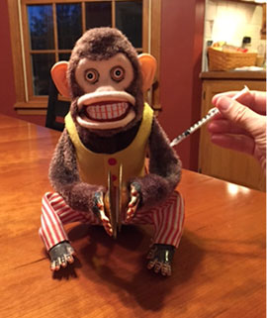
Injection:
Intramuscular & Subcutaneous
Injection: Intravenous
Intramuscular: injection directly into muscle
Subcutaneous: injection into the cutis skin layer
Advantages:
Good adsorption, especially for
those with poor oral bioavailability
Rapid effects
Long duration of activity
Disadvantages:
Unpredictable adsorption
Painful with bruising
Not for needle-phobic people
Common usage: insulin (for diabetes), morphine, vaccines (hepatitis A, rabies, influenza), penicillin, diazepam (Valium)
Notes:
Image sources:
[insulin pump with infusion set] © 2006, Mbbradford at English Wikipedia, Wikimedia Commons https://commons.wikimedia.org/wiki/File:Insulin_pump_with_infusion_set.jpg
[monkey photos] © 2015 Megan Ketchum, University of Houston(author)

Slide 7
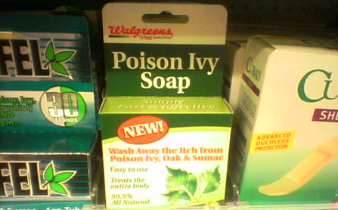
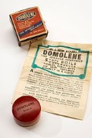
Topical
Drug delivery directly to the site
Advantages:
Easy, non-invasive
High patient satisfaction
Disadvantages:
Very slow adsorption
Difficult to control dosage
Most drugs have a high molecular weight and low lipid solubility, causing them to not be adsorbed via skin or mucous membranes
Common usage: skin ointments and creams (for rashes, poison ivy), eye drops, ear drops (for infections), birth control (patches)
Notes:
Image sources:
[poison ivy soap] © 2006 Sarah Marriage, Wikimedia Commons http://commons.wikimedia.org/wiki/File:Poison_Ivy_Soap.jpg
[Domolene ointment] © 2014 Wellcome Images, Wikimedia Commons https://commons.wikimedia.org/wiki/File:Jar_of_%27Domolene%27_ointment,_London,_England,_1945-1965_Wellcome_L0058221.jpg

Slide 8
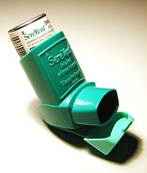
Inhalation
Medications taken into the blood stream via the lungs
Advantages:
Rapid adsorption due to high surface area
Fastest way to deliver drug to brain
Disadvantages:
Requires proper inhaler technique to get correct dosage
Unpleasant taste; mouth irritation
Bioavailability of drug depends on its size
Common usage: adrenocorticoid steroids (such as beclomethasone), bronchodilators (such as isoproterenol, metaproterenol, albuterol) and antiallergics (such as cromolyn)
Notes:
Image source: [asthma inhaler] © 2005 Mendel, Wikimedia Commons https://commons.wikimedia.org/wiki/File:AsthmaInhaler.jpg

Slide 9
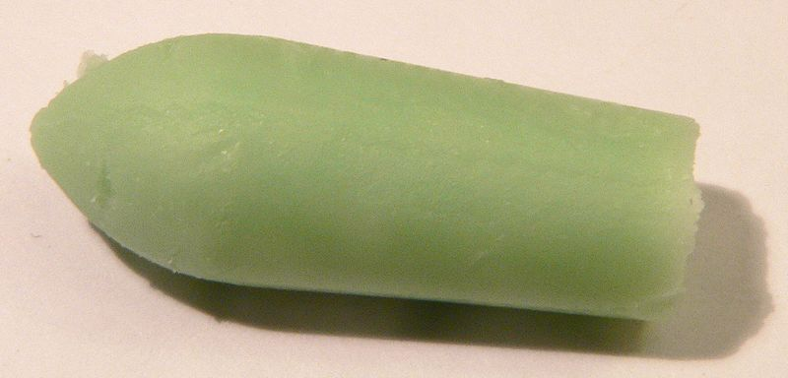
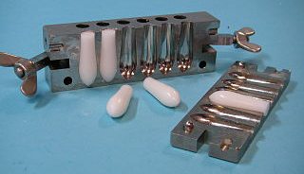
Suppository
Drug delivery via rectum, vagina or urethra
Advantages:
Good adsorption due to hemorrhoidal vein draining directly to inferior vein cava
Disadvantages:
Cannot be used after anal or rectal surgery
Some people dislike and/or find the method uncomfortable
Common usage: laxatives, diclofenac (nonsteroidal anti-inflammatory drug), hemorrhoid medication treatment
Notes:
Image sources:
[Eucalyptol suppository] © 2007 Shattonbury, Wikimedia Commons https://commons.wikimedia.org/wiki/File:Eucalyptol_suppository.jpg
[suppository casting mold] © 2007 Alcibiades, Wikimedia Commons https://commons.wikimedia.org/wiki/File:Suppository_casting_mould_1.jpg

Slide 10
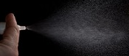
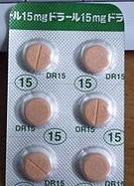
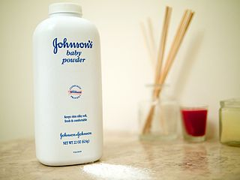
Design Considerations
Toxicity
Efficacy
Drug size
Solubility / bioavailability
Drug release duration
Notes:
Image sources:
[nasal spray] © 2010 robin_24, Wikimedia Commons https://commons.wikimedia.org/wiki/File:Action_photo_of_nasal_spray_on_a_black_background.jpg
[six tablets in packet] © 2012 Phi2528, Wikimedia Commons https://commons.wikimedia.org/wiki/File:Doral(Quazepam)Tablets_15mg.JPG
[Johnson’s baby powder container] © 2014, Austin Kirk, Wikimedia Commons https://commons.wikimedia.org/wiki/File:Johnsons_Baby_Powder_massage.jpg

Slide 11
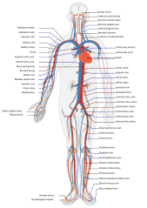
Circulatory System
Circulatory system transports drugs to the organs of the body
Different areas of the body
have different pHs, which
affects bioavailability/solubility:
Stomach = pH 1.5 – 3.5
Duodenum = pH 6
Small intestine = pH 6 increasing to 7.4
Large intestine = pH 5.7
Rectum = pH 6.7
Blood = pH 7.35 – 7.45
Notes:
Image source:
[simplified drawing of the human circulatory system in anterior view] © 2009 LadyofHats, Mariana Ruiz Villarreal, Wikimedia Commons https://commons.wikimedia.org/wiki/File:Circulatory_System_en.svg

Slide 12
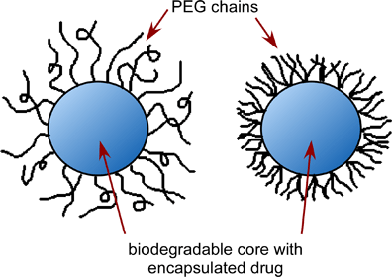
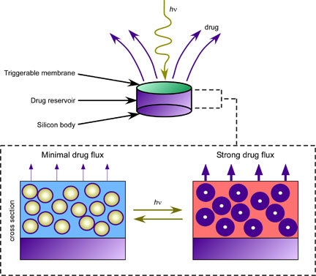
Polymers
Polymers are useful to encapsulate high molecular-weight drug molecules
Depending on the polymer, the diffusion rate through the shell can be controlled
Attached polymer chains can act as specific lock-and-key receptors
With a lock-and-key receptor, the drug release location can be controlled
One problem: The possibility of rapid drug release if certain regions degrade faster than others—causing a toxic pharmaceutical overdose
Notes:
Image sources: [PEG chains diagram, encapsulated drug diagram] © 2016 Megan Ketchum, University of Houston (author)

Slide 13
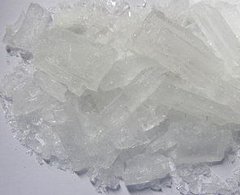
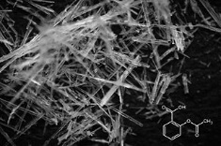
Cocrystallization
Most drugs are actually crystals
However, the properties of certain drugs cause them to not be bioavailable
To alter drug properties while maintaining efficacy, cocrystals are made
A cocrystal is a crystal composed of two or more components (ions, atoms or molecules) in a specific stoichiometric ratio
Notes:
Image sources:
[top; lead acetate trihydrate crystals] © 2007 Dormroomchemist at English Wikipedia, Wikimedia Commons https://commons.wikimedia.org/wiki/File:Lead(II)Acetate.jpg
[bottom; aspirin-acetylsalicylic acid crystals ] © 2013 Steve Mike Neef, Wikimedia Commons https://commons.wikimedia.org/wiki/File:Aspirin.jpg

Slide 14
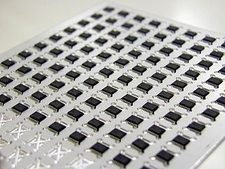
New Devices
Computer chips provide inspiration for new pharmaceutical technologies
Biocompatible chip devices are made with wells filled with certain drugs
The wells are covered with a biodegradable metal covering that is removed when and electrical charge is applied
Drugs can be released from each well individually at specific, desired times
Example: birth control
Notes:
Image source: [IC circuit computer chip board] © 2006 Kimmo Palosaari, Wikimedia Commons https://commons.wikimedia.org/wiki/File:IC_circuit_chip_board.JPG

Slide 15
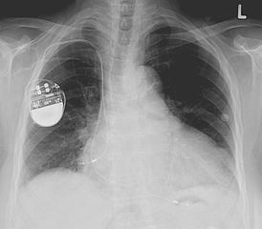
Problems with Devices
Body considers devices to be foreign objects
Medical devices have blood surface interactions, which can cause infections, blood clotting and antibiotic resistance—leading to device failure
To negate these interactions, artificial surfaces are developed
One method is a drug eluting surface
Notes:
Image source: [x-ray of chest shows pacemaker] © 2008 Lucien Monfils, Wikimedia Commons https://commons.wikimedia.org/wiki/File:Pacemaker.jpg

Slide 16
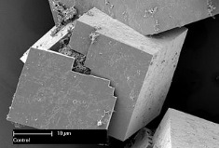
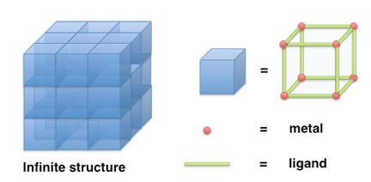
Metal Organic Frameworks (MOF)
Drug eluting surface: a drug is released over time by the device surface Drugs can be made catalytically (produce inside the body by chemical reaction) by the device surface
MOF – compounds consisting of metal ions coordinated to organic molecules creating one-, two- or three-dimensional porous structures
Nitric oxide – helps neurotransmission for chronic wound treatments
MOFs can last 2 to 12 weeks to provide sustained nitric oxide release
Notes:
Image sources:
[MOF (metal-organic frameworks) ultra-porous crystals] © 2011 Dr. Paolo Falcaro and Dr. Dario Buso, CSIRO, Wikimedia Commons
https://commons.wikimedia.org/wiki/File:CSIRO_ScienceImage_11637_Scanning_electron_microscope_image_of_the_seed_inside_the_MOF_crystals.jpg
[drawing of MOF and supramolecular coordination complexes] © 2015 Carolineneil, Wikimedia Commons https://commons.wikimedia.org/wiki/File:Illustrations_of_a._metal-organic_frameworks_and_b._supramolecular_coordination_complexes.png

