Slide 1


Designing Magnifiers

Slide 2




Let’s review …
Matter - Anything that takes up space
Examples:
Can you think of any other examples?

Slide 3
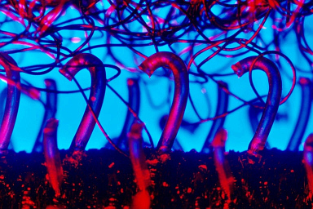
What matter is this?
Notes:
Image file: Micrograph_of_hook_and_loop_fastener,(Velcro_like).jpeg
• ADA Description: Magnified image of Velcro.
• Source/Rights: By Natural Philo - Own work, CC BY-SA 3.0, https://commons.wikimedia.org/w/index.php?curid=25882473

Slide 4


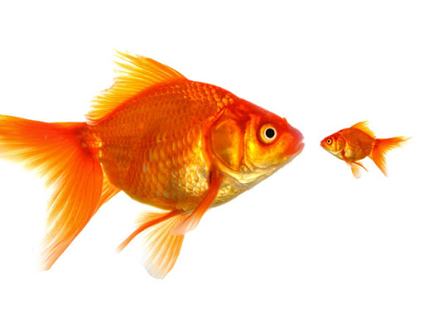
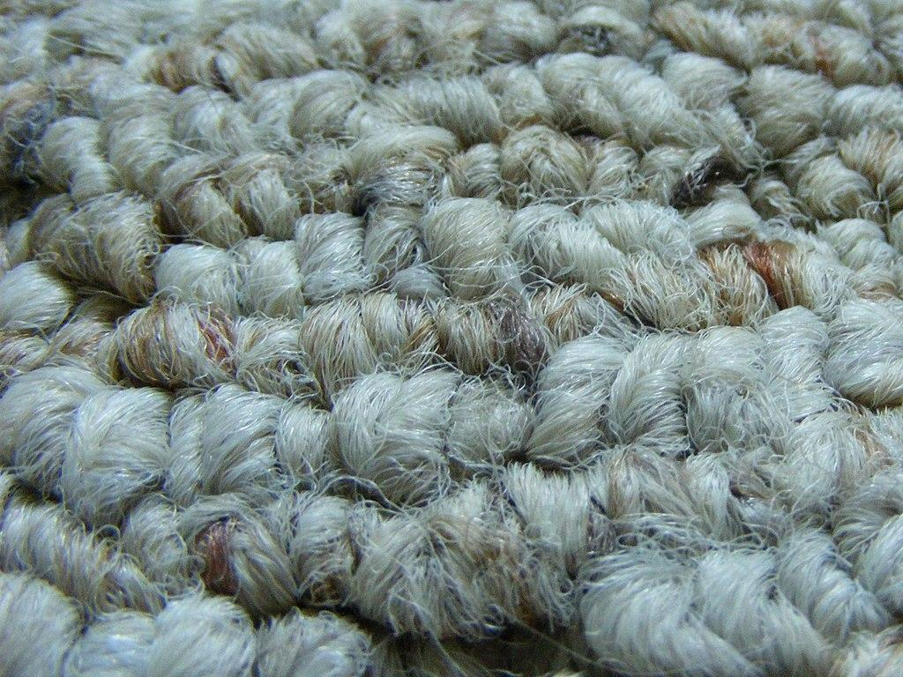


Let’s review …
Properties of Matter:
-Smell -Size -Shape -Texture - Taste -Color
Notes:
Image file:Fish istock photo.jpeg
• ADA Description: A big gold fish next to a small gold fish.
• Source/Rights: https://media.istockphoto.com/photos/different-picture-id121029544?k=20&m=121029544&s=612x612&w=0&h=aiL41MrYbuJ_LoW2KixsgrNP8QIym3UeCBXRue2iuK4=
Image file:Berber_Carpet_(macro).jpeg
• ADA Description: Magnified image of carpet.
• Source/Rights: By Pi_Guy_31415 (talk) (Uploads) - Own work, CC BY 2.5, https://commons.wikimedia.org/w/index.php?curid=108822417
Image file: Color_circle_(RGB).jpeg
• ADA Description: Color wheel.
• Source/Rights: By Crossover1370 - Own work, CC BY-SA 4.0, https://commons.wikimedia.org/w/index.php?curid=92880308

Slide 5
What properties of matter can you observe?
- Texture:
- Shape:
- Color:
- Size:
- Smell:
- Taste:
Notes:
Image file: Micrograph_of_hook_and_loop_fastener,(Velcro_like).jpeg
• ADA Description: Magnified image of Velcro.
• Source/Rights: By Natural Philo - Own work, CC BY-SA 3.0, https://commons.wikimedia.org/w/index.php?curid=25882473

Slide 6
What matter is this????!
This is Velcro, just like the piece on your desk.
Observe the piece of Velcro on your desk.
What do you notice?
Why could you not figure out what my picture is?
Notes:
Image file: Micrograph_of_hook_and_loop_fastener,(Velcro_like).jpeg
• ADA Description: Magnified image of Velcro.
• Source/Rights: By Natural Philo - Own work, CC BY-SA 3.0, https://commons.wikimedia.org/w/index.php?curid=25882473

Slide 7
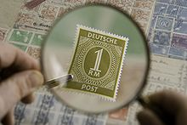
What is magnification?
Magnify - to make matter appear larger
Magnification - happens when you magnify something.
It is like zooming in on an image.
Notes:
Everyone pinch your fingers in and out and say magnify
Image file: Magnifiying_glass2.jpeg
• ADA Description: Magnified image of stamp
• Source/Rights: By Heptagon - Own work, CC BY-SA 4.0, https://commons.wikimedia.org/w/index.php?curid=3767948

Slide 8
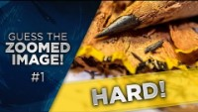
What is magnification?
Let’s take a look at some other examples:
Notes:
https://www.youtube.com/watch?v=WA4Lf2Q8fNw&feature=emb_logo

Slide 9
Making Magnifiers
Day 2

Slide 10
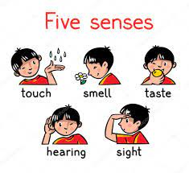

Why is magnification important?
We use our 5 senses to observe the world around us to learn and stay safe.
Magnification helps use observe things we can not see with our naked eye.
Did you know your eye was naked?
When we magnify matter, we are better able to stay safe, for example lets read:
Do not lick this book!
Notes:
Image file: five-senses.jpeg
• ADA Description: Visual display of the senses: touch, smell, taste, hearing, sight
• Source/Rights: https://www.capefearbg.org/wp-content/uploads/five-senses.jpeg

Slide 11
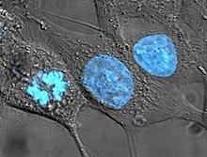
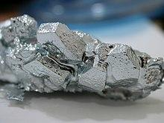
Why is magnification important?
Magnification is also important because it helps us problem solve!
Engineers work hard to invent magnifiers or tools that can magnify matter to solve a variety of problems. Can you think of any?
For example:
Biomedical engineers rely on magnification technology for the evaluation of cells.
Materials engineers rely on magnification technology in order to evaluate the properties of existing materials to assist them in making more new ones.
Notes:
Image file: HeLa_cells_stained_with_Hoechst_33258.jpeg
• ADA Description: Magnified image of cancer cells stained blue.
• Source/Rights: By TenOfAllTrades at English Wikipedia - Own work, Public Domain, https://commons.wikimedia.org/w/index.php?curid=1583880
Image file: Gallium_crystals.jpeg
• ADA Description: Magnified image of silver colored metal.
• Source/Rights: By en:user:foobar - Own work, CC BY-SA 3.0, https://commons.wikimedia.org/w/index.php?curid=12703

Slide 12
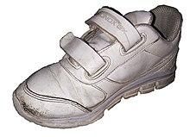
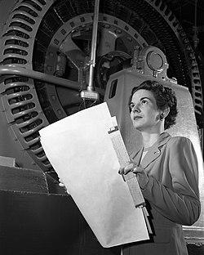
Our Engineering Problem
Today I need your help as engineers.
I need you to invent a magnifier to help figure out how the Velcro on my shoes is broken! The Velcro is not sticking together anymore! I can not see what is wrong with the Velcro with my naked eye, so I need a magnifier. Will you please help me? Other wise I’ll have to hop around on only 1 shoe!
Notes:
Image file: Kitty_Joyner_-_Electrical_Engineer_-_GNP-2000-001933.jpeg
• ADA Description: Image of female engineer next to machinery.
• Source/Rights: By NACA - Great Images in NASA Archived, Description Archived, Backup, Public Domain, https://commons.wikimedia.org/w/index.php?curid=6455408
Image file:Toddler-Size_Shoe.jpeg
• ADA Description: Image of white Velcro shoe
• Source/Rights: By Couch-scratching-cats - I took this picture on April 21, 2021 at 8:29 PM, in a bedroom with a box full of shoes. Previously published: No, CC BY-SA 4.0, https://en.wikipedia.org/w/index.php?curid=67467159

Slide 13







Materials
Cup of water
Pipette
Plastic cup
Scissors
Saran Wrap
Plastic Bag
Velcro Square
Notes:
Review expectations for lab material safety and demonstrate how to cut safely.

Slide 14




Partner Expectations
Must collaborate:
Make a plan, take turns, listen to ideas, use our communication script for disagreements.

Slide 15
Activity Instructions
You will have 10 minutes to collaborate with your partner to make a a magnifier from the materials provided.
  You will start by discussing your plans using active listening skills
  Deciding who will do what, remember to take turns
  Carrying out the plan
  Test the design
  Repeat with iterations
How will you know if your invention is a magnifier?
How will you record your observation like an engineer?
What will you do if your done early?
Be ready to share
Notes:
Set activity expectations, introduce checklist sheet, tie into engineering process.

Slide 16
Any Questions?

Slide 17
Go Engineers Go!
10 Min Timer

Slide 18
Present
Each group will get 1 minute to share their findings

Slide 19
We observed that…

Slide 20
One more iteration…
The class design should have…

Slide 21
Compare
Did our magnifier make the Velcro look like this? Why or why not?
Notes:
Tie into idea it has greater magnification
Image file: Micrograph_of_hook_and_loop_fastener,(Velcro_like).jpeg
• ADA Description: Magnified image of Velcro.
• Source/Rights: By Natural Philo - Own work, CC BY-SA 3.0, https://commons.wikimedia.org/w/index.php?curid=25882473

Slide 22
What could we do differently?
You only had these materials this time, could we use others?
Engineers use research to help them problem solve. What research could we conduct?

