Slide 1
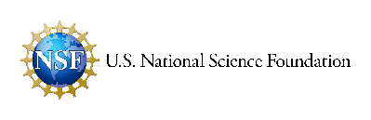

Cybersecurity
Encryption Using Shift Ciphers

Slide 2
Pre-Assessment
Please complete the pre-assessment questions.

Slide 3
Warm-Up
🧩 Try it: Decode this message:
Wklv lv d whvw phvvdjh.
Discussion:
What do you think is happening here?
Have you ever tried to keep a message secret?
What does the word ‘encryption’ mean to you?
Notes:
Give student 5-10 minutes to decipher and answer question in class discussion

Slide 4
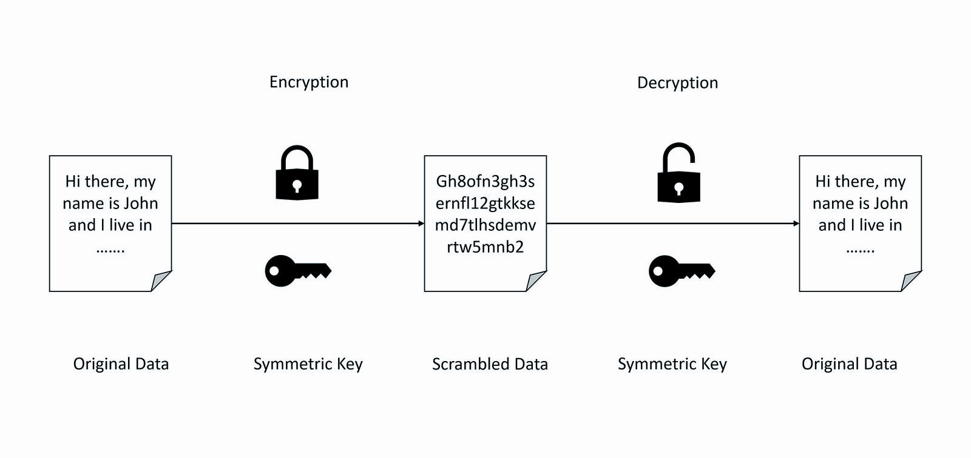
What Is Encryption?
The encoding of information to make it unreadable
Notes:
What is encryption? Encryption is the encoding of information to make it unreadable. Computers do this everyday. Encryption allows us to keep data safe such as credit card information, our login information, etc.

Slide 5

What Is Cryptography?
A technique that transforms data and prevents it from being read.
Uses algorithms to encode information.
Examples:
Digital signatures
Block ciphers
Random bit generation
Caesar ciphers
Notes:
What is cryptography? Cryptography is a technique that transforms data and prevents it from being easily read. It uses algorithms to encode information. Some examples include digital signatures, block ciphers, random bit generation, and Caesar ciphers. We will explore one of these methods today with a hands-on activity.

Slide 6
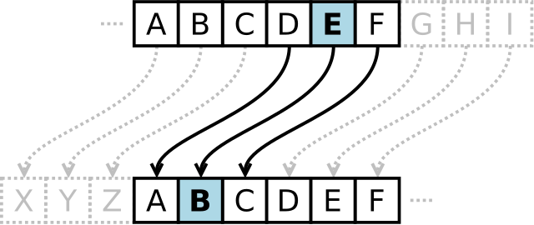
What Is a Caesar Cipher?
Caesar cipher: a substitution cipher where each letter is shifted a fixed number of spaces.
A simple example:
D→ A (shift of -3), E → B, etc.
Notes:
What Is a Caesar Cipher?
A Caesar cipher is a substitution cipher where each letter is shifted a fixed number of spaces. It is also called a shift cipher.

Slide 7
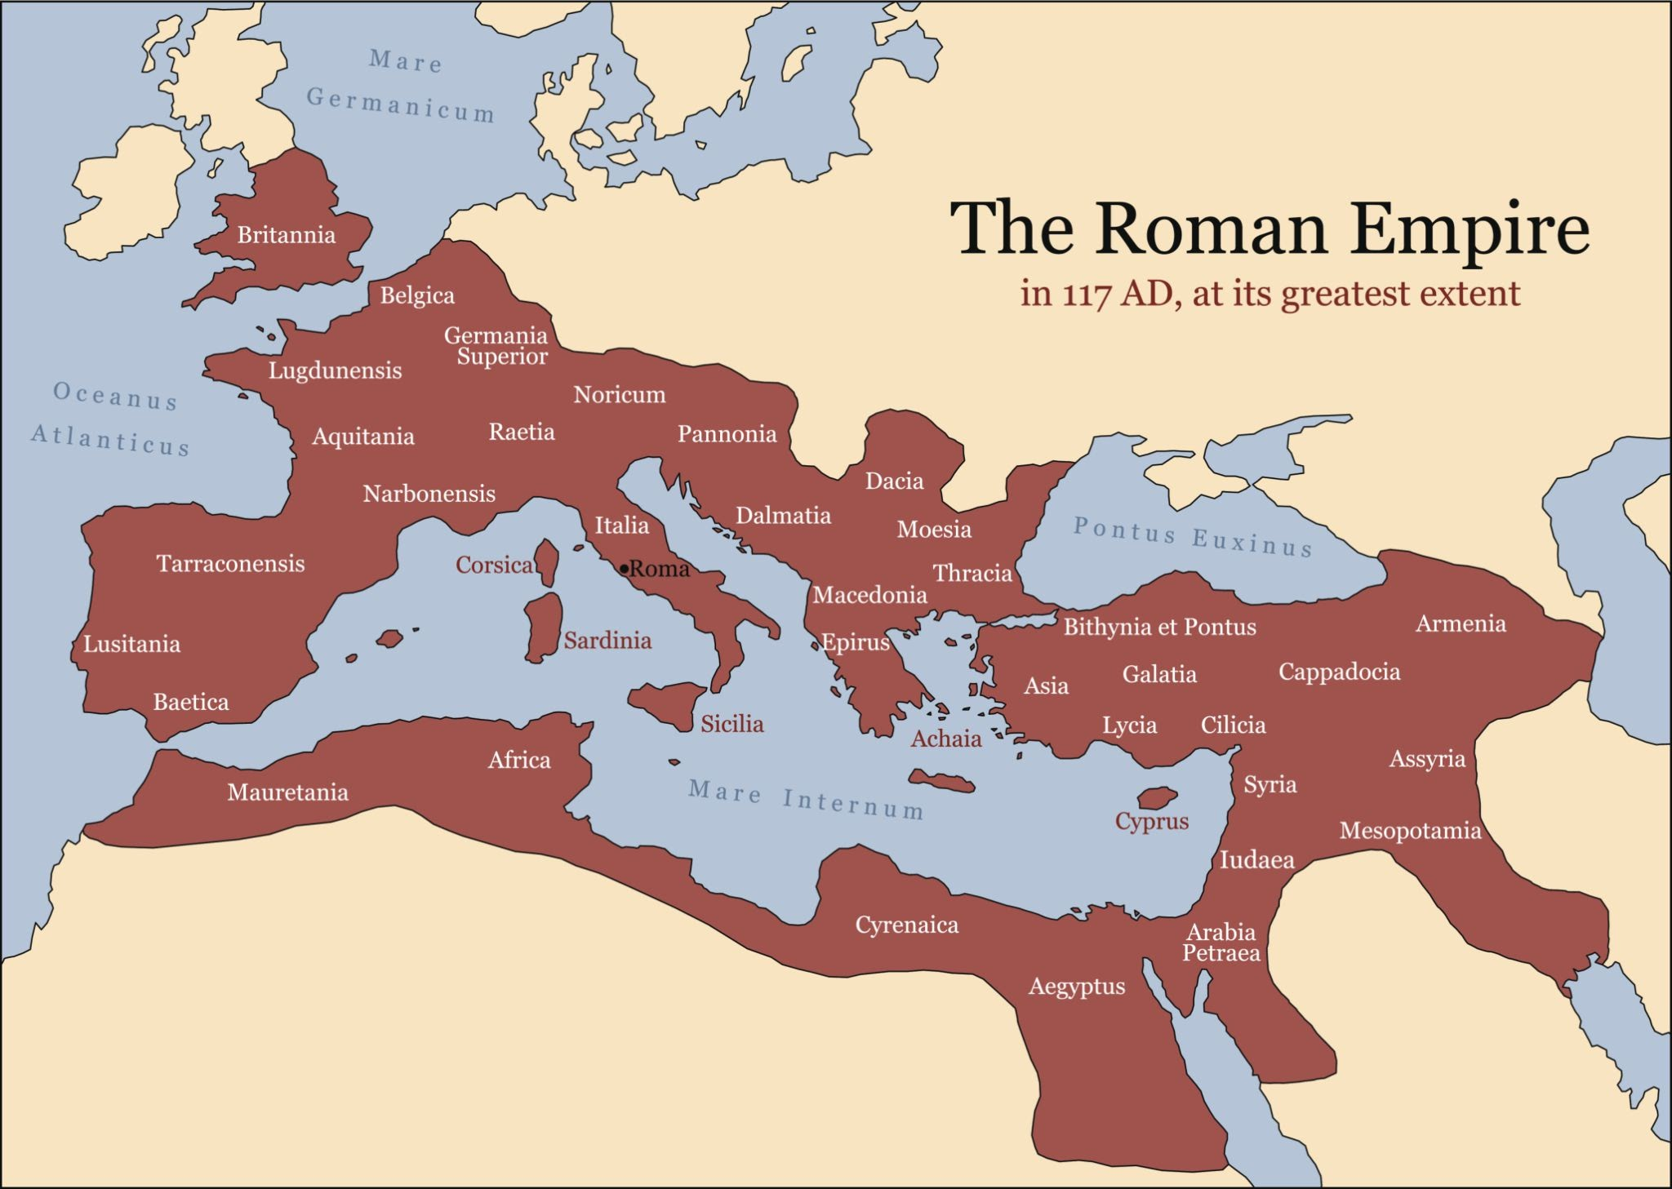
Fun Fact!
Caesar Cipher
Caesar ciphers were used 2,000 years ago as a way to protect information throughout the Roman Empire from enemy spies.
Notes:
Fun Fact! Caesar Ciphers were used 2,000 years ago as a way to protect information throughout the Roman Empire from enemy spies. The Roman Empire controlled most of Europe, parts of Northern Africa, and parts of the Middle East.

Slide 8
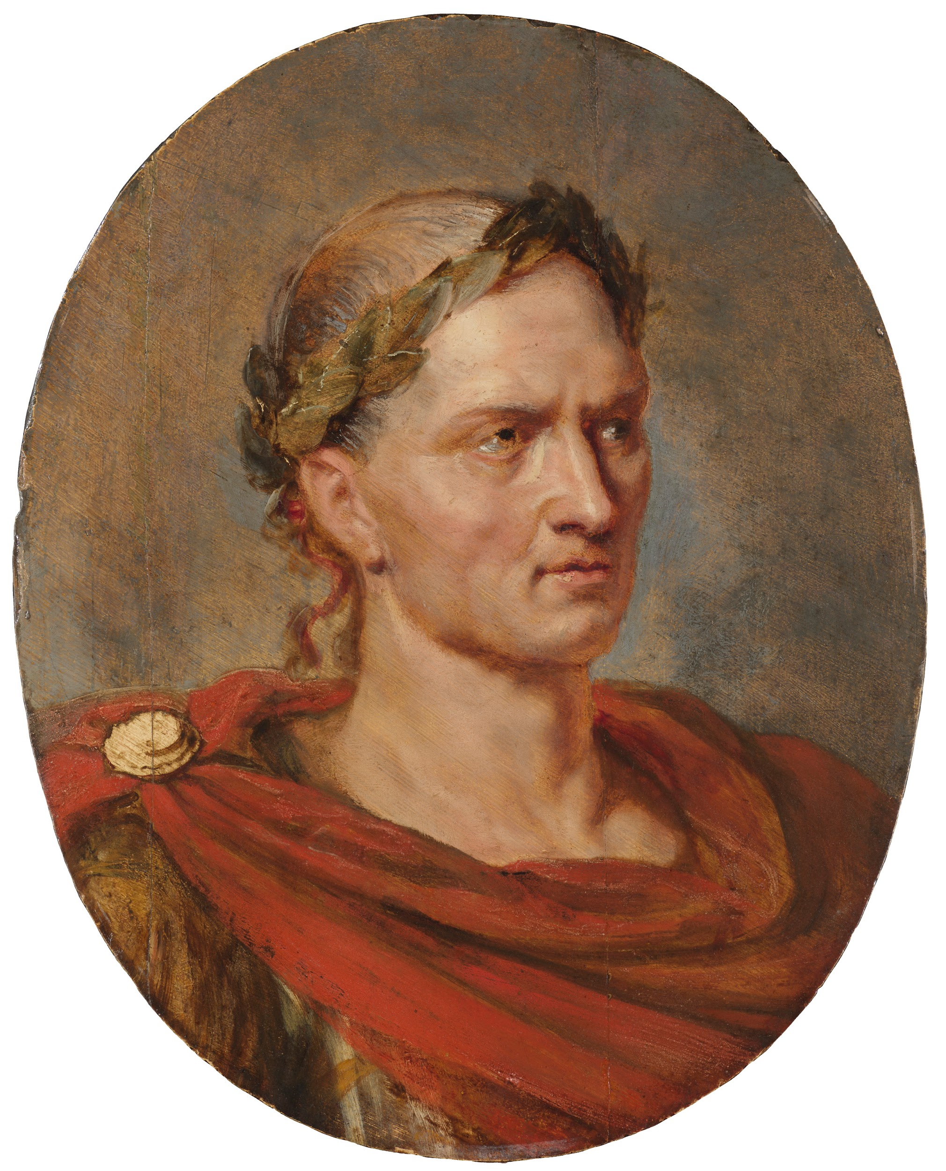
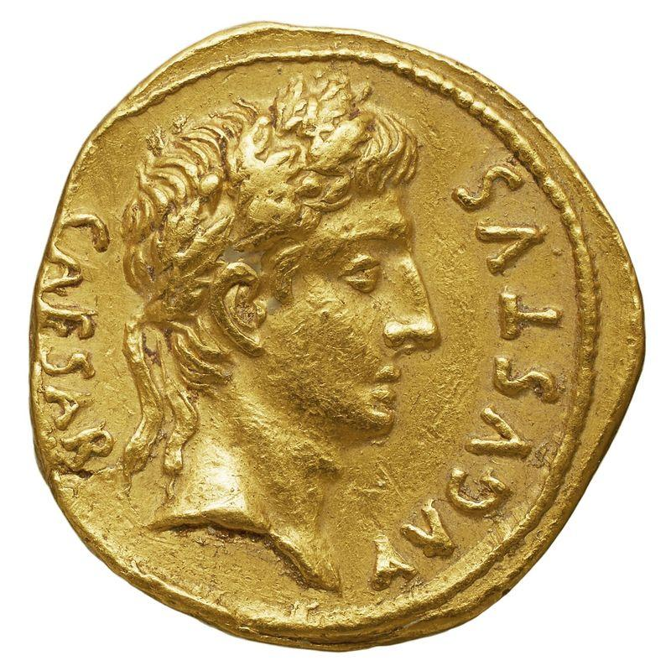
Caesar Cipher!
At the peak of the Roman Empire’s power,the civilization was often at war with other empires. Spies, enemy soldiers, and thieves would often try to intercept messages from messengers. To keep anyone from discovering top secret information, it was often the practice of military leaders to encode messages using a cipher. This cipher was also known as a shift cipher. The person to whom the message was sent would use a special tool to decipher the message and read what it had to say.
Jura lbh jvfu hcba n fgne Znxrf ab qvssrerapr jub lbh ner
Nalguvat lbhe urneg qrfverf Jvyy pbzr gb lbh
Notes:
The encrypted message: When you wish upon a star makes no difference who you are anything your heart desires will come to you.

Slide 9

Symmetric Encryption
Symmetric encryption uses a single key.
Less secure , but more efficient.
Notes:
Symmetric encryption is an encryption method that uses a single key to encrypt and decrypt data. Though less secure than asymmetric encryption, it’s often considered more efficient because it requires less processing power.

Slide 10
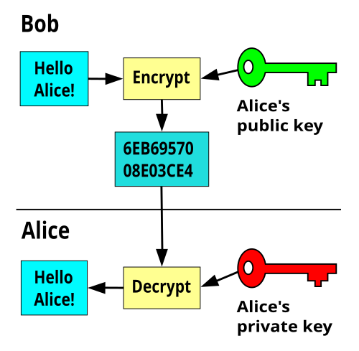
Asymmetric Encryption
Asymmetric encryption uses two keys—a public key and a private key—to encrypt and decrypt data
Public Key
Shared openly
Encrypts data
Verifies digital signatures
Private Key
Never shared
Decrypts data
Creates digital signatures
Notes:
Asymmetric encryption uses two keys, a public key and a private key. The public key gets shared with the computer that wants to send information. The sender then sends the message to the receiver computer. The receiver computer then uses the private key to decrypt the message. The private key is never shared. This allows for better encryption and more secure data sharing.

Slide 11
Hands-On Activities
Activity 1: Create Your own decoder wheel or shift chart using blank handouts.
Activity 2: Encode your name or a short phrase using a Caesar shift of your choice. Exchange encrypted messages with a classmate and decode each other's messages.
Activity 3: Decrypt encoded messages in the Encoding/Decoding Practice Sheet.

Slide 12

How Does This Relate to Cybersecurity
Discussion Questions:
Why is encryption important today?
How is Caesar’s idea still used in modern technology?
<Think-Pair-Share> - Discuss ideas (10 mins)
Simple ciphers are not very secure.
They lay the foundation for stronger algorithms.
Modern encryption: HTTPS, end-to-end encryption, etc.
Notes:
Take a few minutes to discuss how this relates to cybersecurity. Some possible discussion starters include: How do we keep credit card information, login information, bank account information safe?
You could also talk about possible data breaches by companies.
Why is encryption important today?
Potential answers: To protect personal information and privacy; to secure passwords; to protect online banking and credit card information; to secure text messages, emails, and online communications; to prevent identity theft and fraud; to protect medical records and other sensitive data; to secure online shopping and digital payments; to ensure only authorized users can access information.
How is Julius Caesar's idea still used in modern cybersecurity?
Potential answers: Modern encryption still converts readable information into coded information; encryption uses keys to encode and decode data; advanced mathematical algorithms have replaced simple letter shifts; secure websites (HTTPS), messaging apps, online banking, and password protection all rely on encryption; Caesar's cipher introduced the basic concept of protecting information by encoding it.
Why are simple ciphers no longer considered secure?
Potential answers: They are easy for computers to break; they use predictable patterns; they have too few possible keys; hackers can use brute-force attacks to try every possible key; modern computers can decode simple ciphers in seconds; they do not provide enough protection for sensitive information.
How do stronger encryption methods help protect personal and sensitive information?
Potential answers: They use longer, more complex keys; they are much harder for hackers to crack; they protect data while it is stored and transmitted; they help prevent unauthorized access, identity theft, and fraud; they keep online communications, financial transactions, and personal information secure.

Slide 13
Digital Extension
Caesar Cipher
Use an online Caesar cipher tool to try encrypting and decrypting messages faster.
https://www.dcode.fr/caesar-cipher
Challenge: Try brute-forcing a Caesar cipher by checking all 25 possible shifts.
Symmetric and Asymmetric Keys
Go to: https://www.kerryveenstra.com/cryptosystem.html
Notes:
Here are some links to digital resources:
The first is a Caesar cipher website.
The second is a website that can show students the difference between symmetric and asymmetric encryption.

Slide 14
Post-Assessment
Please complete the post-assessment.

Slide 15
📝 Assessment / Exit Ticket:
Encode this sentence with a Caesar cipher using shift 5:
“Cybersecurity is important.”
Write 1–2 sentences explaining why encryption matters in cybersecurity.

Slide 16
References
https://www.ibm.com/think/topics/cryptography
https://www.ibm.com/think/topics/asymmetric-encryption
https://www.ibm.com/think/topics/symmetric-encryption
https://www.ibm.com/docs/en/sia?topic=osdc-private-keys-public-keys-digital-certificates-27

