Slide 1
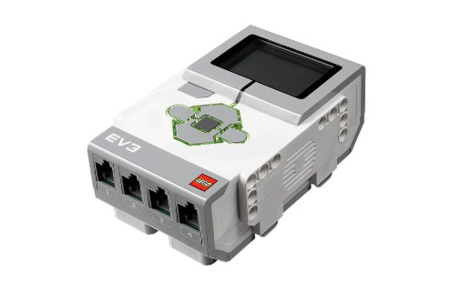

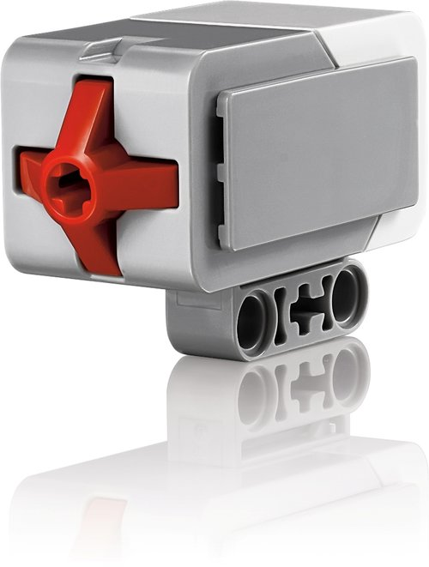
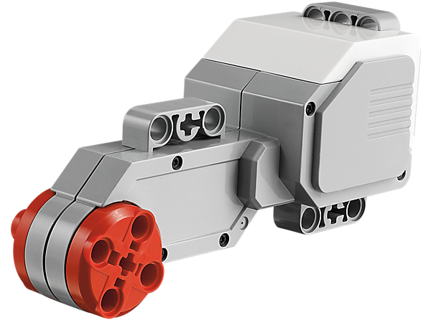
How Does a Touch Sensor Work?
Notes:
How Does a Touch Sensor Work? Presentation > TeachEngineering.org

Slide 2
Touch Sensors Pre-Quiz
Where on our bodies do we have touch sensors?
Provide an example of “stimulus-sensor-coordinator-effector-response” framework using the human touch sensor.
When you press the LEGO touch sensor, what exactly happens and how does it convey the signal to the LEGO brick?
Give examples of sensors in engineering systems that are similar to the human touch sensor.
Notes:
Same questions/answers as Pre-Quiz

Slide 3
Touch Sensors Pre-Quiz Answers
Where on our bodies do we have touch sensors?
  We have touch (or tactile) sensors on our skin all over our bodies since we feel the sense of touch everywhere.
Provide an example “stimulus-sensor-coordinator-effector-response” framework using the human touch sensor.
  Hot object > touch it using a finger > nervous system > muscle > move finger back
When you press the LEGO touch sensor, what exactly happens and how does it convey the signal to the LEGO brick?
  When the touch sensor button is pressed, it closes a circuit (similar to when you turn on a switch) and sends a current to the LEGO brick, which then knows that the touch sensor button was pressed.
Give examples of sensors in engineering systems that are similar to the human touch sensor.
  Examples: LEGO touch sensor, sensors in the gripper of a robot
Notes:
Same questions/answers as Pre-Quiz

Slide 4
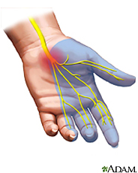
Review: What is a Sensor?
A sensor is a device that measures a physical quantity. For example, when you touch an object, sensors on your fingers send signals to your brain so that it recognizes it as being hot or cold.
The skin on your fingers contains millions of sensitive nerve endings that can detect stimuli such as temperature. This stimulus is converted to neuronal impulses that are sent via nerves to a specific region in the brain, which interprets it as being hot or cold.
The same happens with other physical quantities such as pressure and pain.

Slide 5
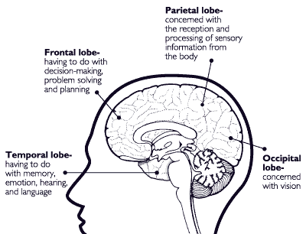
Details about the Skin Touch Sensor
Watch the “How the Body Works: The Sensory Cortex and Touch” video: (1:07 minutes)
http://www.youtube.com/watch?v=IC3YTJNu0Ec&feature=related

Slide 6
Review: How do you sense something by touch?
When you touch something, the senses at the tip of your fingers send signals to your brain through nerves.
These signals travel to the brain through the spinal cord.
All signals related to the human body travel through the spinal cord. The spinal cord can be referred to as the “common pathway” for brain signals.
The brain processes the signal information and then sends its decision back through the same neural “wires” to the muscles in your hand to react appropriately.
Example: When you touch a hot object, the nerves carry signal to the brain and the brain decides it is bad for you, and quickly sends back a signal to the muscles in your hand to withdraw the fingers immediately. This signal transmission takes place in a fraction of a millisecond.

Slide 7
Review: From Stimulus to Response
stimulus > sensor > coordinator > effector > response
touch > pain receptor > nervous system > muscle > movement
From the sequence of steps above, this is what happens when you touch something hot:
The stimulus is touch, the sensor is the temperature receptor on your finger that senses it and relays it to the nervous system (spinal cord and brain), which is the coordinator.
The coordinator makes the decision of how to react, and then commands the hand muscles (the effector) to jerk back quickly.
So, we go from stimulus (touch) to response (movement of hand).
Do This: Sketch out the stimulus-to-response sequence for how this
might be implemented in a robot. Identify all the components,
as in the example listed above. (Answer on slide 17)

Slide 8
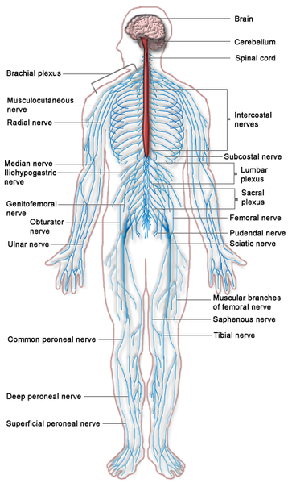

Review: How does your hand jerk back when touching a hot object?
brain
Sensors on your finger take the information about how hot it is to the spinal cord and brain via nerves.
digital nerve ➔
These are all part of your nervous system.

Slide 9
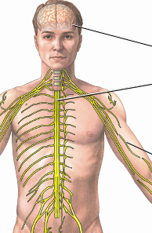
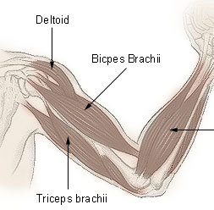
Review: How does your hand jerk back when touching a hot object?
Your nervous system decides that it is too hot and orders the muscles of your hand to jerk the finger back.
finger moved back
contract biceps

Slide 10
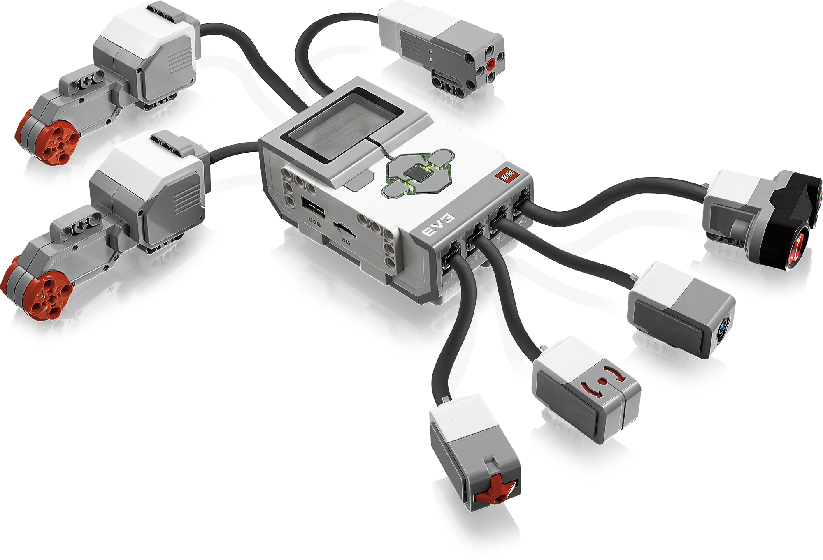
Review: Robot Sensors
(As stated in an earlier activity,) robot sensors:
  Gather information from the surroundings and send it to the computer brick
  Robot sensors can only be used if the robot’s program asks for information from them!
  Similarly, the robot can only act on information from the sensors if its program tells it to do so!
How do sensors send signals to the computer brick?
  The sensors send information through the wires (similar to the nervous system in a human body) that connect them to the computer brick, which uses the information if its program requires it.

Slide 11
How are touch or tactile sensors made?
In engineering, the term “tactile” sensor is also used to refer to touch sensors.
Touch sensors are made using light (optical), electricity or magnetism.
  The LEGO touch sensor has a button-like protrusion. When bumped, it sends an electrical signal to the computer brick saying that it has been touched.
  How does this sensor work?
  What happens when the button is pressed?
  Can you guess?
  Let’s put all your ideas on the classroom board.

Slide 12
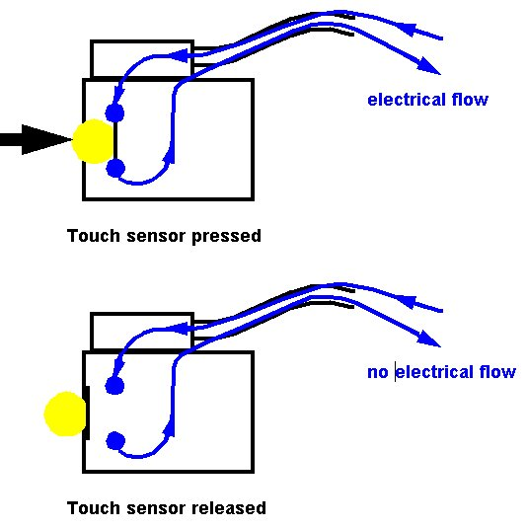
How do touch sensors work?
The LEGO touch sensor works like a light switch in your house.
When the button is pressed, an electrical circuit is connected inside the sensor, sending an electric current to the computer.
When the button is released, the circuit is broken and no electricity flows.
The LEGO brick can sense this flow of electricity, so it knows if the touch sensor is pressed or released.

Slide 13
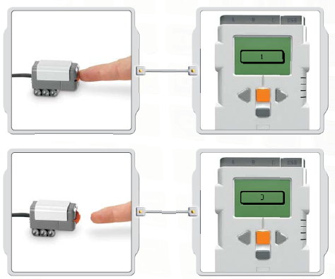
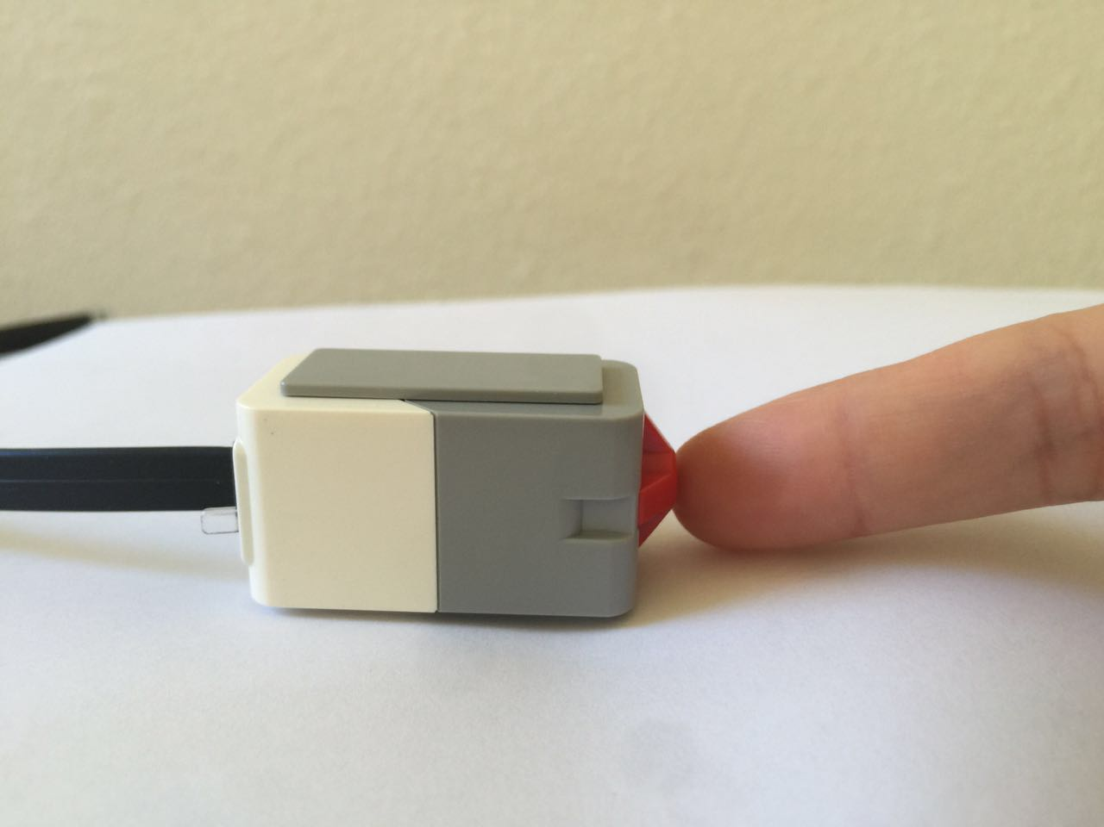
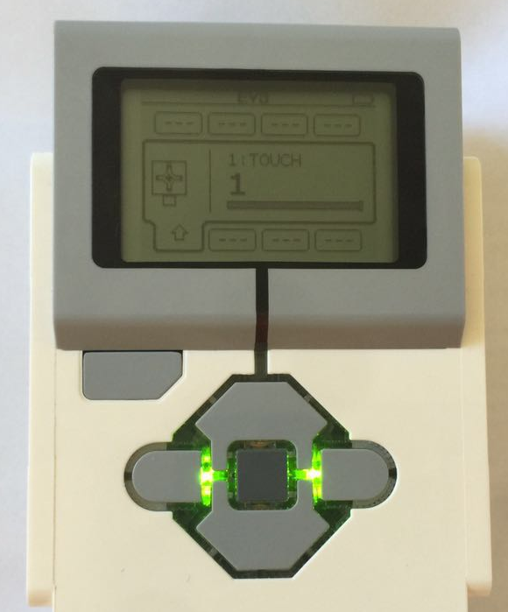
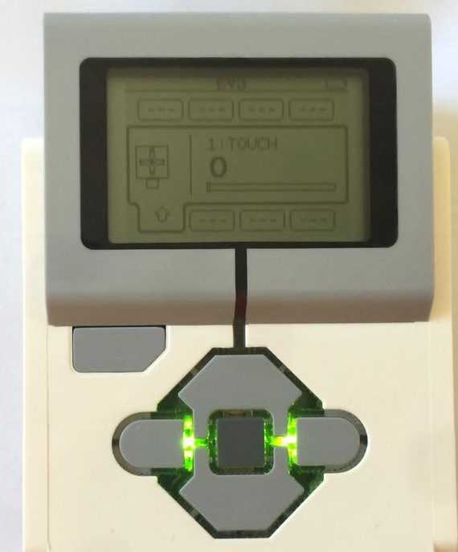
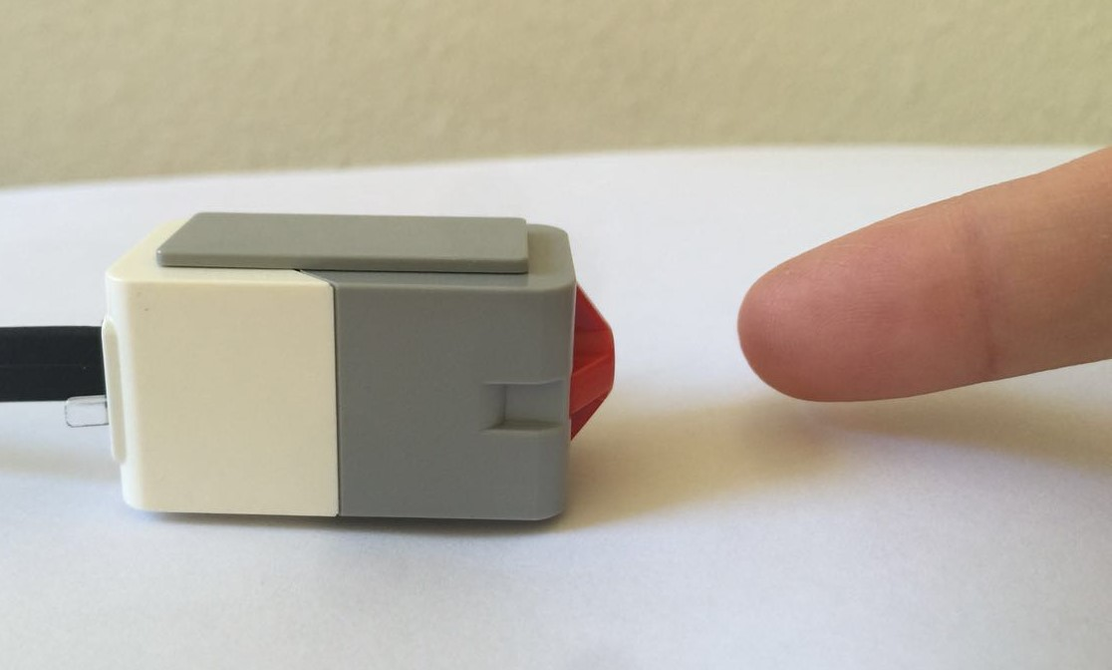
Let’s Investigate
How does the brick read the signal from the touch sensor?
Do This: Attach the sensor to the LEGO brick, as shown below.
Use the VIEW command and go to the touch sensor.
The display should show 1 when the sensor is pressed, and 0 when not pressed.
So, pressing the button closes the circuit and sends a signal sent to the computer.

Slide 14
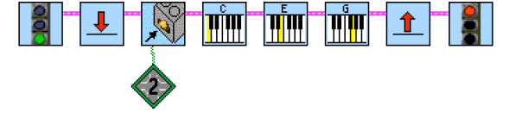
Mini-Activity
Below is a program that uses the touch sensor to play music.
Do this:
Program it using your computer and download to the same setup as in the previous slide, that is, the LEGO brick connected to the touch sensor (plug the sensor into port 2).
Go to the Functions Palette for the music button. Run it and explain your observations, including a step-by-step explanation of how the program works.
Bonus: For something more challenging, try to make your own musical notes (see Context Help).
(Answer on slide 18)

Slide 15
Touch Sensors Post-Quiz
Where on our bodies do we have touch sensors?
Provide an example of “stimulus-sensor-coordinator-effector-response” framework using the human touch sensor.
When you press the LEGO touch sensor, what exactly happens and how does it convey the signal to the LEGO brick?
Give examples of sensors in engineering systems that are similar to the human touch sensor.
Notes:
Same questions/answers as Pre-Quiz

Slide 16
Touch Sensors Post-Quiz Answers
Where on our bodies do we have touch sensors?
  We have touch (or tactile) sensors on our skin all over our bodies since we feel the sense of touch everywhere.
Provide an example “stimulus-sensor-coordinator-effector-response” framework using the human touch sensor.
  Hot object > touch it using a finger > nervous system > muscle > move finger back
When you press the LEGO touch sensor, what exactly happens and how does it convey the signal to the LEGO brick?
  When the touch sensor button is pressed, it closes a circuit (similar to when you turn on a switch) and sends a current to the LEGO brick, which then knows that the touch sensor button was pressed.
Give examples of sensors in engineering systems that are similar to the human touch sensor.
  Examples: LEGO touch sensor, sensors in the gripper of a robot
Notes:
Same questions/answers as Pre-Quiz

Slide 17
Answer for Slide 7 Question
stimulus > sensor > coordinator > effector >response
object in front > touch sensor > brick-computer > motor > move back

Slide 18
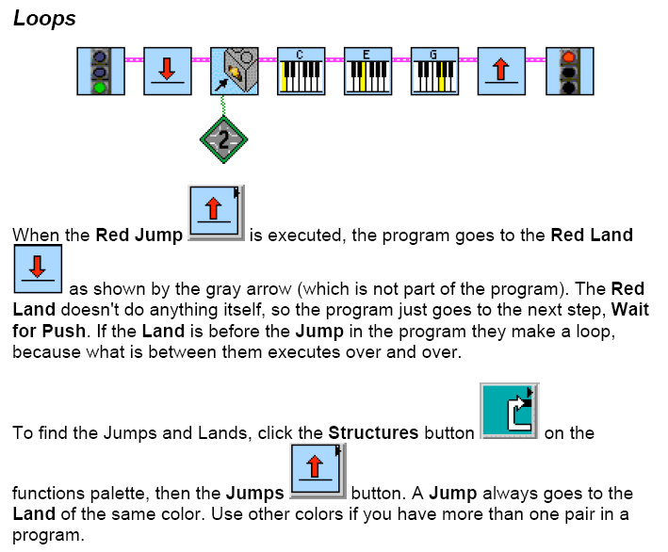
Mini-Activity Answer for the Teacher

Slide 19
Vocabulary
sensor: A device that converts one type of signal to another; for instance, the speedometer in a car collects physical data and calculates and displays the speed the car is moving.
stimulus: A thing or event that causes a reaction, such as a specific functional reaction in an organ or tissue.
tactile: Related to touch.
transducer: Another term for a sensor (see above).

Slide 20
Image Sources
Slide 1, 8: pointing finger; source: Microsoft® clipart: http://office.microsoft.com/en-us/images/results.aspx?qu=pointing+finger&ex=1#ai:MC900098047|
Slide 1, 10, 11, 12, 13: LEGO device images; source: LEGO MINDSTORMS EV3 User’s Guide
Slide 4: nerves in human hand; source: Adam, U.S. National Library of Medicine, National Institutes of Health: http://www.nlm.nih.gov/medlineplus/carpaltunnelsyndrome.html
Slide 5: human brain; source: NIDA for Kids: http://teens.drugabuse.gov/educators/curricula-and-lesson-plans/mind-over-matter/mom-teachers-guide/brain-anatomy
Slide 8: nervous system diagram; source: 2006 Persian Poet Gal, Wikimedia Commons: http://commons.wikimedia.org/wiki/File:Nervous_system_diagram.png
Slide 9: human nervous system; source: Adam, U.S. National Library of Medicine, National Institutes of Health: http://www.nlm.nih.gov/medlineplus/ency/imagepages/8679.htm
Slide 9: arm muscles-biceps; source: National Cancer Institute: http://training.seer.cancer.gov/anatomy/muscular/groups/upper.html
Slide 9: pointing finger; source: Microsoft® clipart: http://office.microsoft.com/en-us/images/results.aspx?qu=pointing+finger&ex=1#ai:MC900233154|
Slide 12: how does a touch sensor work? schematic diagram; source: Carnegie Mellon Robotics Academy: http://www.education.rec.ri.cmu.edu/roboticscurriculum/multimedia/howtouch.shtml
Slides 14, 15: Screen capture images by the author. Mini-activity adapted from http://www.compchal.org

