Slide 1
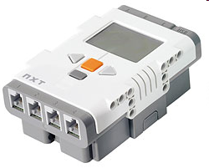
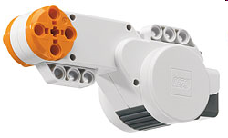
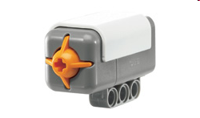
Music by Touch
Notes:
Music by Touch Presentation > TeachEngineering.org

Slide 2
Music by Touch Pre-Quiz
Provide an example “stimulus-sensor-coordinator-effector-response” framework for both your (human) sense of touch and the robotic touch sensor.
Explain how the LEGO touch sensor works.

Slide 3
Music by Touch Pre-Quiz Answers
Provide an example “stimulus-sensor-coordinator-effector-response” framework for both your (human) sense of touch and the robotic touch sensor.
  For human touch: hot object > touch using finger > nervous system > muscle > move finger back
  For LEGO setup: button pressed > touch sensor > cable connecting to brick > motor > move the motor
Explain how the LEGO touch sensor works.
  When the touch sensor button is pressed, it closes a circuit (similar to when you turn on a light switch) and a current is sent to the LEGO brick, which then knows that the touch sensor button was pressed.

Slide 4
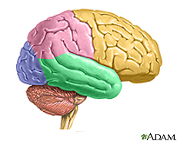

Human-Robot Similarities
Your hand is commanded by your brain.
Similarly, the LEGO MINDSTORMS NXT intelligent brick commands its motor to move.
The next slide provides a design challenge to show how this might be done. ➔

Slide 5
Music by Touch Activity
Engineering Design Challenge
Do This:
Attach 2 touch sensors to the input ports, and a motor to an output port.
Write a program to do the following:
If one touch sensor is touched, play a piece of music and keep rotating the wheel (attached to the motor) slowly.
If the other sensor is also touched, play the music faster and make the wheel turn faster.
Do this in a loop, continuously, until the program is stopped.
Write your program on a separate page and have your teacher check it before you begin.

Slide 6
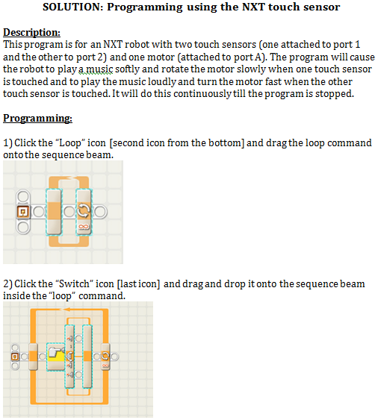
Answer: Programming the NXT Touch Sensor

Slide 7
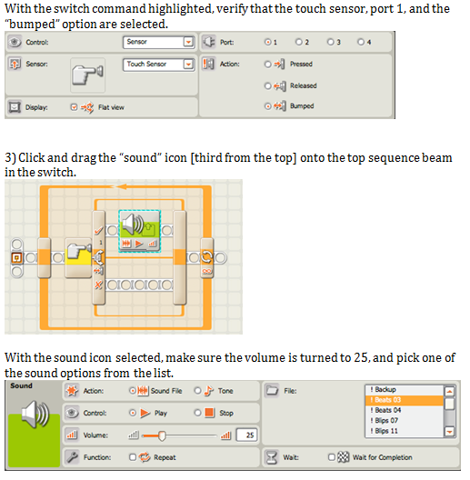
Notes:
Answer: Programming the NXT Touch Sensor (continued)

Slide 8
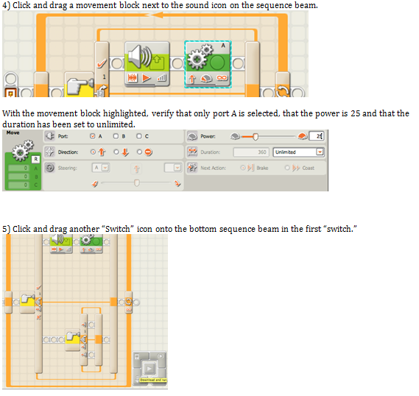
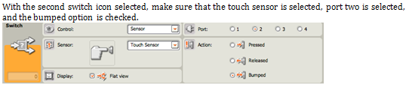
Notes:
Answer: Programming the NXT Touch Sensor (continued)

Slide 9
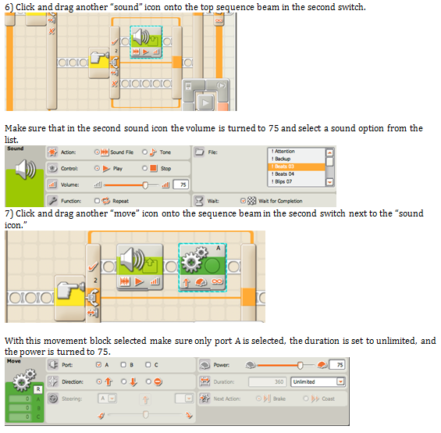
Notes:
Answer: Programming the NXT Touch Sensor (continued)

Slide 10
Music by Touch Post-Quiz
Provide an example “stimulus-sensor-coordinator-effector-response” framework for both your (human) sense of touch and the robotic touch sensor activity you performed.
Explain how the LEGO touch sensor works.
Assume the brick is connected to a touch sensor and a motor. Sketch a simple program to move a motor when a touch sensor is pressed.

Slide 11
Music by Touch Post-Quiz Answers
Provide an example “stimulus-sensor-coordinator-effector-response” framework for both your (human) sense of touch and the robotic touch sensor activity you performed.
  For human touch: hot object > touch using finger > nervous system > muscle > move finger back
  For LEGO setup: button pressed > touch sensor > cable connecting to brick > motor > move the motor
Explain how the LEGO touch sensor works.
  When the touch sensor button is pressed, it closes a circuit (similar to when you turn on a light switch) and a current is sent to the LEGO brick, which then knows that the touch sensor button was pressed.
Assume the brick is connected to a touch sensor and a motor. Sketch a simple program to move a motor when a touch sensor is pressed.
  See #3 programming solution on next slide. ➔

Slide 12
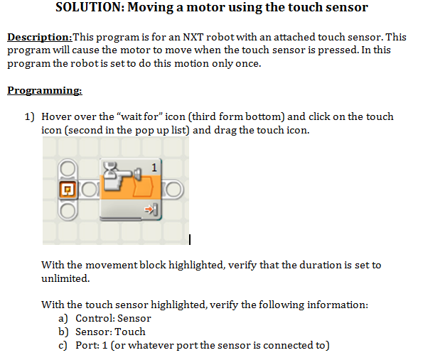
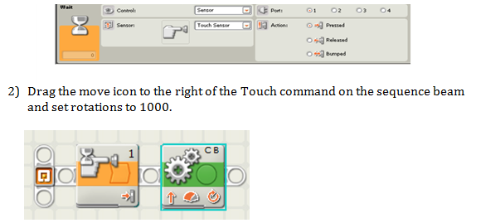
Quiz Answer #3: Moving a Motor Using the Touch Sensor

Slide 13
Vocabulary
sensor: A device that converts one type of signal to another; for instance, the speedometer in a car collects physical data and calculates and displays the speed the car is moving.
tactile: Related to touch.
stimulus: A thing or event that causes a reaction.
transducer: Another term for a sensor (see above).

Slide 14
Image Sources
Slide 1, 4, 5: LEGO parts; source: LEGO MINDSTORMS NXT User’s Guide
Slide 4: brain; source: ADAM, Medline Plus, U.S. National Library of Medicine, National Institutes of Health: http://www.nlm.nih.gov/medlineplus/braindiseases.html
Slide 4: writing hand; source: Microsoft® clipart: http://office.microsoft.com/en-us/images/results.aspx?qu=hand&ex=1#ai:MC900382613|mt:1|
Slides 6, 7, 8, 9, 12: Screen capture images by the author. Mini-activity adapted from http://www.compchal.org

