Slide 1
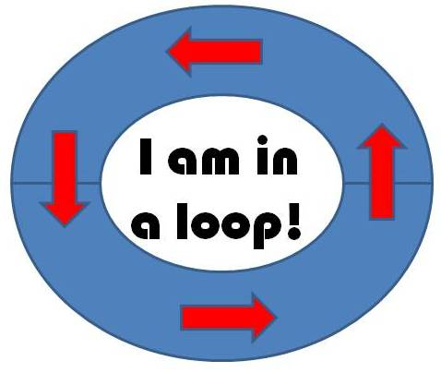
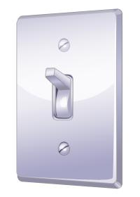
Using Waits, Loops and Switches
WAIT
please!

Slide 2
Waits, Loops and Switches Pre-Quiz
1. In programming, what is a loop?
When is a loop useful?
2. How can you control the duration for which a loop repeats?
3. In programming, what is a switch?

Slide 3
Waits, Loops and Switches Pre-Quiz
Answers
1. In programming, what is a loop? When is a loop useful?
A loop is an operator that allows us to repeat a set of commands indefinitely. Loops are useful when you need to repeat a set of commands multiple times.
2. How can you control the duration for which a loop repeats?
You can control how many times a loop repeats by clicking the dropdown arrow next to “Control” on the loop block and setting it to forever, time, sensor, count or logic.
3. In programming, what is a switch?
In programming, a switch is an object that gives different commands depending on the state it is in.

Slide 4
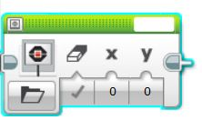
Wait Block Activity
Objective: Combine wait blocks, loops and switches to perform a task
Do This: First, attach 2 touch sensors (name them A and B)
Then program the robot to perform the following task:
Stay at rest and display “Ready” on the screen.
Move left and display “Forward” whenever touch sensor 4 is pressed.
Move right and display “Reverse” whenever touch sensor 1 is pressed
Stay at rest and display “Stop” when no buttons are pressed.
***Hint: Click on the icon, drag the block into the program, and select “Text” from the dropdown menu to display text on screen.

Slide 5
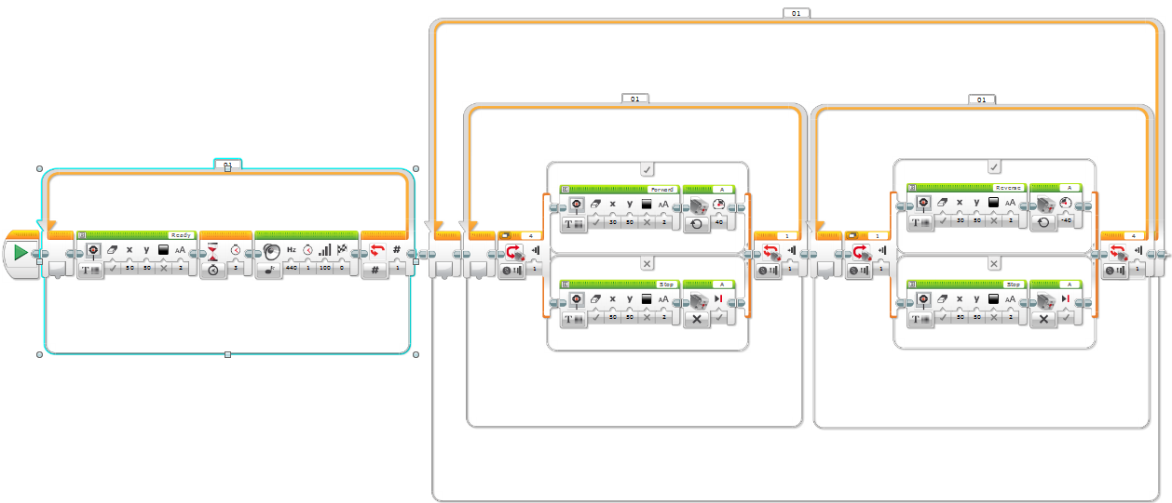
Wait Block Activity Solution
10
11
4
7
6
1 2
3
5
8
9
12

Slide 6



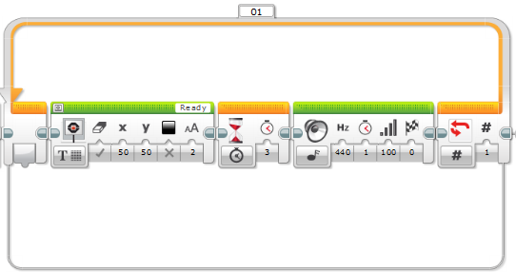
various settings
Wait Block Activity Solution
1
2
3
4

Slide 7
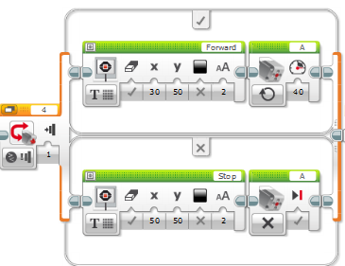


various settings
(continued)
Wait Block Activity Solution
5
6
7

Slide 8


various settings (continued)
Wait Block Activity Solution
8
9

Slide 9
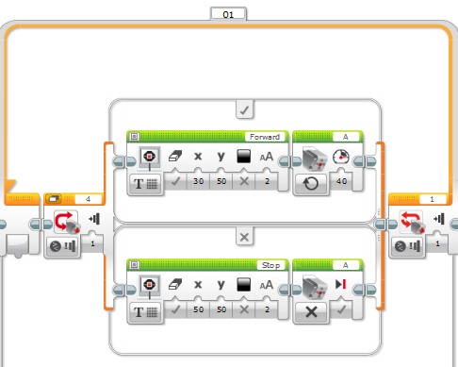
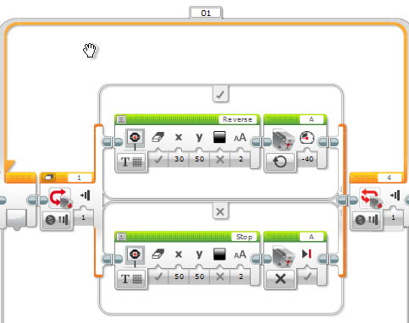
various settings (continued)
Wait Block Activity Solution
10
11

Slide 10
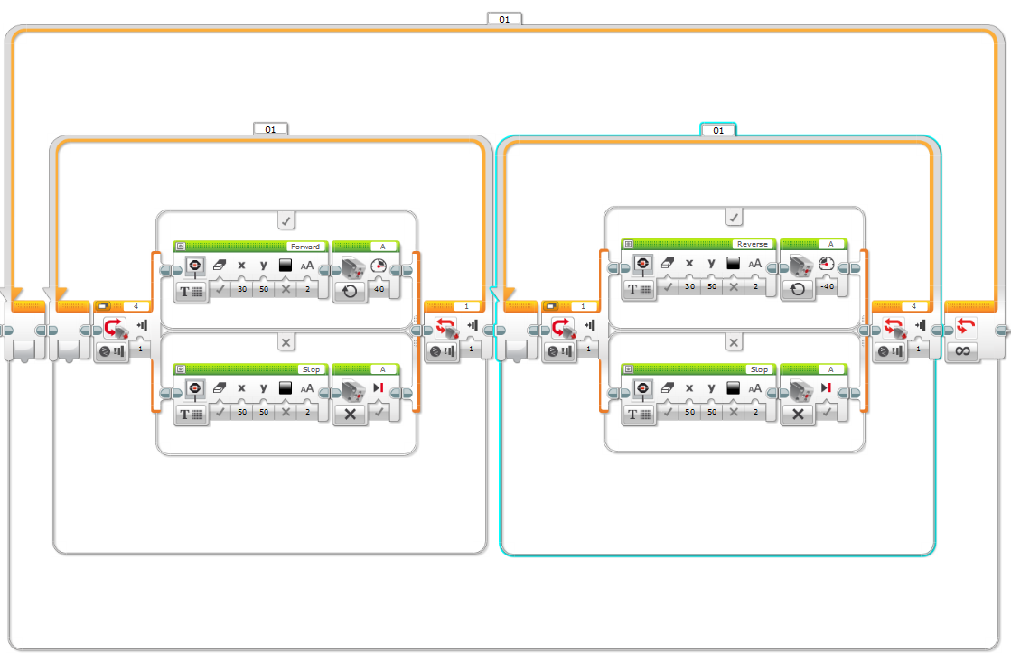
various settings (continued)
Wait Block Activity Solution
12

Slide 11
Waits, Loops and Switches Post-Quiz
1. In programming, what is a loop?
When is a loop useful?
2. How can you control the duration for which a loop repeats?
3. In programming, what is a switch?

Slide 12
Waits, Loops and Switches Post-Quiz
Answers
1. In programming, what is a loop? When is a loop useful?
A loop is an operator that allows us to repeat a set of commands indefinitely. Loops are useful when you need to repeat a set of commands multiple times.
2. How can you control the duration for which a loop repeats?
You can control how many times a loop repeats by clicking the dropdown arrow next to “Control” on the loop block and setting it to forever, time, sensor, count or logic.
3. In programming, what is a switch?
In programming, a switch is an object that gives different commands depending on the state it is in.

Slide 13
Vocabulary
brainstorming: Thinking of ideas as a group.
iteration: Doing something again, especially with the intent to make improvements.
loop: An operator that repeats a set of commands.
switch: In programming, a switch is an object that gives different commands, depending on the state it is in.

Slide 14
Images Sources
Slides 1: wall switch drawing; source: Microsoft® clipart: http://office.microsoft.com/en-us/images/results.aspx?qu=light+switch&ex=1#ai:MC900441745|
Device and programming images from LEGO MINDSTORM NXT User’s Guide http://goo.gl/wuhSUA
Screen captures, diagrams and drawings by author

