Slide 1

Wait Program!
WAIT
please!

Slide 2
Wait Program! Pre-Quiz
1. Why is it often better to use conditional commands rather than program a robot to move exact distances?
2. What is the function of a wait block? Explain how to use a wait block in a program.
3. What should the move block that comes right before a wait block have its duration set to?

Slide 3
Wait Program! Pre-Quiz Answers
1. Why is it often better to use conditional commands rather than program a robot to move exact distances?
It can be tedious to measure exact distances and the robot does not always move consistently, depending on factors beyond your control (battery charge, motor speed fluctuations, etc.).
2. What is the function of a wait block? Explain how to use a wait block in a program.
A wait block causes a program to wait until a specified stimulus occurs before proceeding to the next command. A wait block must specify the stimulus being waited on and follow a move block with duration set to unlimited.
3. What should the move block that comes right before a
wait block have its duration set to? Unlimited

Slide 4
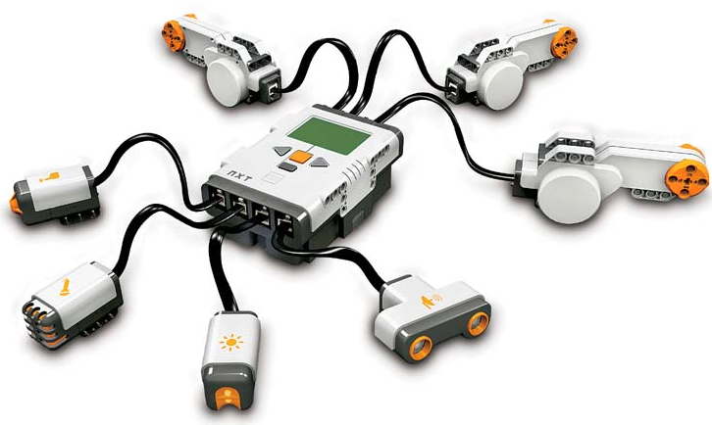
Challenge 1:
Program the robot to move forward
until it hears a clap, then turn left
Make sure the sound sensor is attached to port 2 of your robot.
Questions to think about
while you program:
What do you want the robot to do before it hears a sound?
What should the duration of this action be set to?
Which sensor do you want the wait block to depend on?
What do you want the robot to do after it hears a sound?

Slide 5

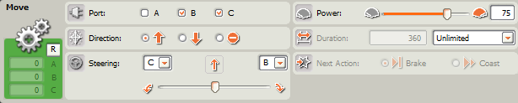
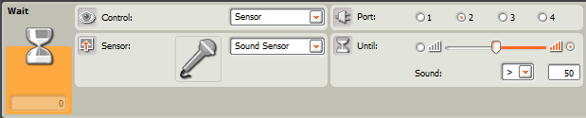
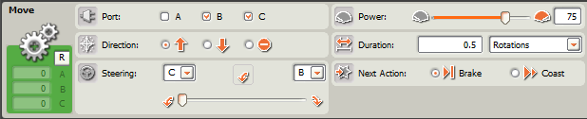
Challenge 1 Programming Solution

Slide 6
Challenge 2:
Wait Block Programming Challenge
Do This: Write a program so that your robot:
Remains at rest until you press the touch sensor.
Once you press the touch sensor, moves slowly forward until you press the touch sensor again.
Once the touch sensor is pressed a second time, moves twice as fast.
Once the touch sensor is pressed a third time, moves twice as fast as before.
Once the touch sensor is pressed a fourth time, stops.
**HINT** Robot speed can be controlled by adjusting
the power setting on a move block.

Slide 7
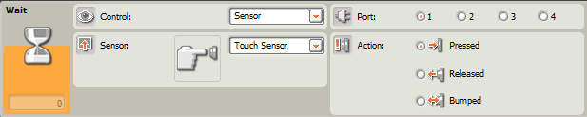
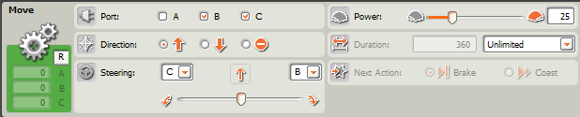
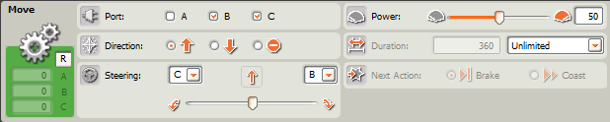
Challenge 2 Programming Solution
A B C D E F G H
A
B
C
D

Slide 8
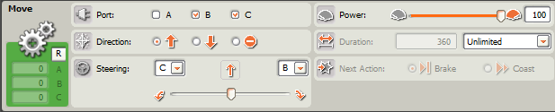
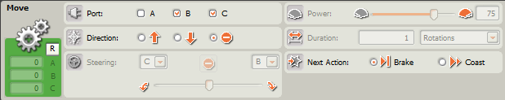
Challenge 2 Programming Solution
A B C D E F G H
(continued)
E
F
G
H

Slide 9
Wait Program! Post-Quiz
1. Why is it often better to use conditional commands rather than program a robot to move exact distances?
2. What is the function of a wait block? Explain how to use a wait block in a program.
3. What is an algorithm?

Slide 10
Wait Program! Post-Quiz Answers
1. Why is it often better to use conditional commands rather than program a robot to move exact distances?
It can be tedious to measure exact distances and the robot does not always move consistently, depending on factors beyond your control (battery charge, motor speed fluctuations, etc.).
2. What is the function of a wait block? Explain how to use a wait block in a program.
A wait block causes a program to wait until a specified stimulus occurs before proceeding to the next command. A wait block must specify the stimulus being waited on and follow a move block with duration set to unlimited.
3. What is an algorithm? An algorithm is a clear and specific procedure for solving a problem in a finite number of steps.

Slide 11
Vocabulary
algorithm: A clear and specific procedure for solving a problem in a finite number of steps.
conditional command: A command in which the completion of an action depends on a condition being satisfied. For example, if I see a stop sign (condition), I stop (action).
engineering design process: A series of steps used by engineering teams to guide them as they develop new solutions, products or systems.
iteration: Doing something again.
stimulus: Something that rouses or incites to activity. For the purposes of this lesson, it is an action that can be perceived by a robot that causes it to move on to the next part of the program.

Slide 12
Images Sources
Slide 1: Boy holding stop sign; source: Microsoft® clipart: http://office.microsoft.com/en-us/images/results.aspx?qu=stop&ex=1#ai:MP900422690|mt:2|
Device and programming images from LEGO MINDSTORM NXT User’s Guide http://goo.gl/wuhSUA
Screen captures and diagrams by author

