Slide 1

Robot Soccer Challenge
Notes:
Robot Soccer Challenge activity > TeachEngineering.org
Image source: Microsoft clipart at http://office.microsoft.com/en-us/images/results.aspx?qu=soccer&ex=1#ai:MP900422624|

Slide 2
Pre-Activity Quiz
What kind of wireless electrical connection can EV3 robots use to communicate with other electrical devices (including other EV3s)?
Can you think of a way to use a Bluetooth connection to enable one EV3 robot to remotely control another? Describe it.

Slide 3
Pre-Activity Quiz Answers
What kind of wireless electrical connection can EV3 robots use to communicate with other electrical devices (including other EV3s)?
  Bluetooth technology is a wireless connection that enables communication between electrical devices.
Can you think of a way to use a Bluetooth connection to enable one EV3 robot to remotely control another? Describe it.
  Let’s call one EV3 the “controller” and the other EV3 the “receiver.”
Answer continues on next page ➔

Slide 4
Pre-Activity Quiz Answers (continued)
When each button (orange, left, right) is pressed on the controller EV3, have the controller send a distinct message (“1”, “2”, “3”) via Bluetooth to the receiver.
When no controller button is pressed on the controller EV3, have the controller send another distinct message (“0”) to the receiver.
Program the receiver so that:
when it receives “1” it moves forward
when it receives “2” it moves left
when it receives “3” it moves right
when it receives “0” it does nothing

Slide 5
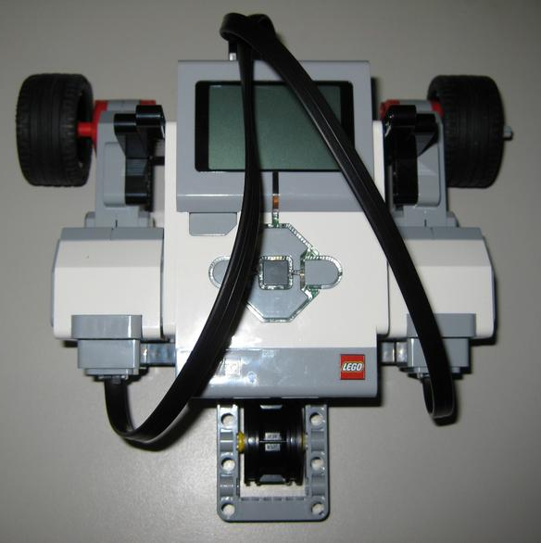
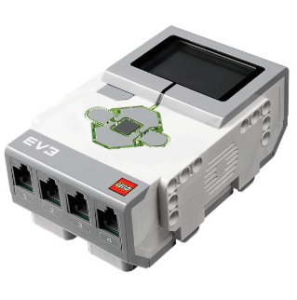
Your Design
Challenge
To program two EV3s (a “controller” and a “receiver”) so that one can be used to remotely control the other via a wireless Bluetooth connection so that…
When you press the middle button on the controller EV3, the receiver EV3 moves forward.
When you press the left arrow button on the controller EV3, the receiver EV3 turns left.
When you press the right arrow button on the controller EV3, the receiver EV3 turns right.
Notes:
Images sources: (LEGO EV3 intelligent brick) 2008 Hugo12, Wikimedia Commons http://commons.wikimedia.org/wiki/File:EV3-brique.jpg; (LEGO robot on wooden floor) 2006 Eirik Refsdal, Wikimedia Commons http://commons.wikimedia.org/wiki/File:Lego_Mindstorms_EV3-FLL.jpg

Slide 6
Design Challenge Objectives (continued)
When we are done, we will be able to control the LEGO MINDSTORMS EV3 taskbot (the “receiver”) similarly to how the robot in this video is controlled: http://youtu.be/zohDeKxXUPo?t=1m.
If several groups are able to run their programs
at the same time, they can use their EV3 taksbots
to “play soccer” with a small ball.
To do this, each group remotely controls its taskbot, which acts as one of the soccer players.
Notes:
The LEGO EV3 battle tank (remote controlled) video is 1:58-minutes long at http://youtu.be/zohDeKxXUPo?t=1m

Slide 7
Part 1: Understanding the Programs
Before you use one EV3 to remotely control another, you must understand how the programs for the controller and receiver EV3s work and how they interact with one another.
Notes:
Images sources: (LEGO EV3 intelligent brick) 2008 Hugo12, Wikimedia Commons http://commons.wikimedia.org/wiki/File:EV3-brique.jpg; (LEGO robot on wooden floor) 2006 Eirik Refsdal, Wikimedia Commons http://commons.wikimedia.org/wiki/File:Lego_Mindstorms_EV3-FLL.jpg

Slide 8
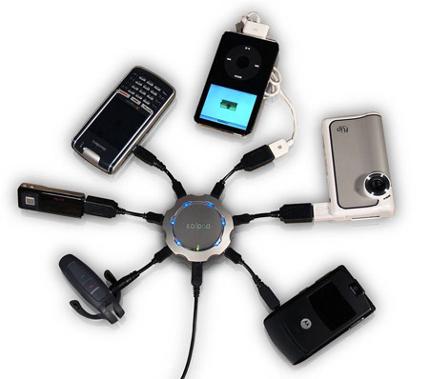
Review:
What is an electrical connection?
An electrical connection is the link or bond that passes electricity between two or more things.
Wireless electrical
connections allow two
devices to be linked
remotely without
being joined by a wire.
Notes:
Image source: (six devices connected to chargepod multi-device charger hub; source): http://www.techgadgets.in/misc-gadgets/2007/21/callpod-chargepod-a-multi-device-charger-announced/ and CallPod Mobile Necessities http://www.callpod.com/products/chargepod

Slide 9
Review:
Bluetooth with the EV3
EV3 robots can use a wireless connection called Bluetooth® to communicate.
Like many other devices (such as smartphones), the EV3 can send text messages through Bluetooth.
Example: If you were worried about an intruder coming into your room, you could program the EV3 to use the ultrasonic sensor to “watch” the door to your bedroom. If the ultrasonic sensor detects the door moving, it could send you a message saying “intruder alert.”

Slide 10
Bluetooth Program Overview
In this activity, we need one EV3 to be the remote control device (the “controller”) and the other to be the vehicle that responds to the controller (the “receiver”).
So one EV3, the controller, sends messages via Bluetooth when you press different buttons on the EV3 brick.
The other EV3, the receiver, receives those messages via Bluetooth and is programmed to move forward, left, right or backwards when it receives the messages.

Slide 11
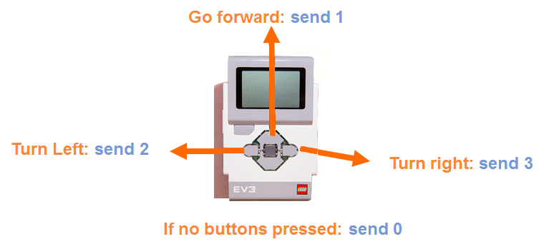
Controller Program
When any one of the three LEGO brick buttons (see above) is pressed, we want the controller to send a corresponding message (“1”, “2,” or “3”) to the receiver.
When no buttons are pressed,
the controller sends the message “0.”
Notes:
Image sources (LEGO EV3 intelligent brick) 2008 Hugo12, Wikimedia Commons http://commons.wikimedia.org/wiki/File:EV3-brique.jpg

Slide 12
Receiver Program
When the receiver EV3 receives the “0” message via Bluetooth, it knows that the controller EV3 does not have any buttons being pushed and stops moving.
When the receiver receives “1,” it knows that the controller’s orange button is being pushed and the receiver moves forward.
When the receiver receives “2,” it knows that the controller’s left button is being pushed and the receiver turns left.
When the receiver receives “3,” it knows that the controller’s right button is being pushed and the receiver turns right.

Slide 13
Summary:
EV3 Interactions Using Bluetooth
Controller Program
Receiver Program
controller button pushed ⬇ | Via Bluetooth, the controller sends this message ⬇ | Via Bluetooth, the receiver receives this message ⬇ | receiver action ⬇
no button | “0” | “0” | does not move
orange | “1” | “1” | moves forward
left | “2” | “2” | turns left
right | “3” | “3” | turns right

Slide 14

Part 2: Running the Programs!
Now that you understand how the programs work, let’s download them onto the EV3s!
Once groups have the controller/receiver programs working and have some practice with remotely
controlling their
taskbots, we’ll
organize a game of
robot soccer!
Notes:
Image source: (girl chases soccer ball): Microsoft clipart: http://office.microsoft.com/en-us/images/results.aspx?qu=soccer&ex=1#ai:MP900422170|

Slide 15
Change the Receiver EV3 Name
Since the class will have more than one EV3 robot using Bluetooth at the same time, it is best to change the receiving EV3s’ names to something unique so that they are easily recognizable from each other.
To do this, follow the instructions below and on the following slides:
Turn on the receiving EV3 and use the USB cord to plug it into the computer.
Launch “LEGO MINSTORMS EV3” software on the computer.
Open a new or existing program.

Slide 16

(continued)
Change the Receiver EV3 Name
Look for a gray panel of buttons to appear in the bottom right corner of the screen.
Click on the button with a picture of the EV3 brick on it.

Slide 17
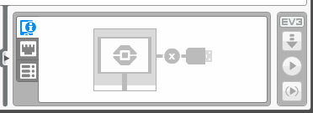
(continued)
Change the Receiver EV3 Name
A window appears (see below)

Slide 18
Downloading Instructions
Now you are ready to download the controller and receiver programs onto both EV3 bricks.
Note: These two programs are provided so you do not have to create them—no programming is necessary for this challenge.
Download the receiver program, Receiver.ev3, onto the EV3 that will be receiving messages, which should be an EV3 on a taskbot that can move.

Slide 19

Downloading Instructions
(continued)
Download the controller program by performing these steps:
  Open the controller program, Controller.ev3, on the computer and highlight the second block.
  In the field next to “Connect To,” type in the unique name you gave your receiver robot.

Slide 20
Downloading Instructions
(continued)
  Download the controller program, Controller.ev3, onto the EV3 that you want to use as a remote control device.
  (This order is important →) Begin running the receiver program on the receiving EV3. Then run the controller program on the EV3 that remotely controls it.
Have fun!

Slide 21
Post-Activity Quiz
Explain how we used messages sent over a Bluetooth connection to enable one EV3 to be used to remotely control another.
What ideas do you have for how you might change the programming to accomplish different tasks using two EV3 bricks?
In your own words, what are the steps of the engineering design process? Which is your favorite step?

Slide 22
Post-Activity Quiz Answer
Explain how we used messages sent over a Bluetooth connection to enable one EV3 to be used to remotely control another.
  Let’s call one EV3 the “controller” and the other EV3 the “receiver.”
  When each button (orange, left, right) is pressed on the controller, it sends a distinct message (“1”, “2”, “3”) via Bluetooth to the receiver. When no button is pressed on the controller, it sends another distinct message (“0”) to the receiver.
  We programmed the receiver EV3 so that…
    when it receives “1” it moves forward
    when it receives “2” it moves left
    when it receives “3” it moves right
    when it receives “0” it does nothing
What ideas do you have for how you might change the programming to accomplish different tasks using two EV3 bricks? Answers will vary.
In your own words, what are the steps of the engineering design process? And which is your favorite step?
The main steps: 1) understand the problem or challenge, 2) brainstorm and research to generate solution ideas and preliminary designs, 3) choose the
best solution to pursue as the definitive design, 4) create a prototype,
5) test it and make improvements, 6) present the results and final solution.

Slide 23
Vocabulary
Bluetooth technology: A type of wireless electrical connection used for communication between two devices.
electrical connection: The link or bond that passes electricity between two or more things.
soccer field ➔
Notes:
Image source (soccer field diagram): 2014 Denise W. Carlson, College of Engineering, University of Colorado Boulder. Used with permission.

