Slide 1


What Is Engineering? What Is Design?

Slide 2
Pre-Lesson Quiz
What is engineering?
List some example design challenges.

Slide 3
Pre-Lesson Quiz Answers
What is engineering?
  Engineering is using science and mathematics to solve problems that improve the world around us. For instance, engineers design skateboards, traffic lights, power plants, airplanes, computers, phones, roller coasters, spacecraft, games, materials, skyscrapers, chemicals, medicines, replacement body parts, etc.
List some example design challenges.
Possible answers are unlimited!
Examples: designing more energy-efficient cars, bridges to get across rivers, alarm clocks to wake
us up, and even software, trips and events!

Slide 4
What Is Engineering? And Design?
50 minutes
In our modern world, challenges are everywhere!
How can we waste less? How can we harness solar energy and other renewable energy more effectively? How can we design energy-efficient (green) houses? How can we build smarter and safer cars and trains... better roads and bridges? How do we design better biomedical devices to improve diagnosis and human health? How do we understand the functioning of our brains?
These are big ideas that engineers and scientists work on to help improve the world we live in.
Today we will learn more about engineering and the “design cycle” and then finish with a design challenge for you.
Notes:
50 minutes

Slide 5
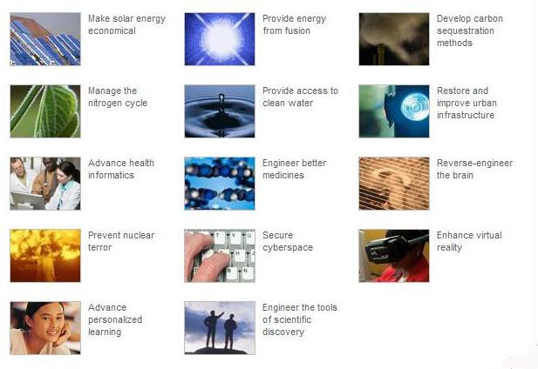
Grand Challenges for Engineers
These are the biggest challenges that face engineers of the future:
Notes:
The NAE has identified these 14 Grand Challenges for Engineering in the 21st Century. The Grand Challenges are a call to action and serve as a focal point for society's attention to opportunities and challenges affecting our quality of life.
Source: National Academy of Engineering via the University of Iowa at http://www.engineering.uiowa.edu/ess/14-grand-challenges and http://www.engineeringchallenges.org/Object.File/Master/11/574/Grand%20Challenges%20final%20book.pdf

Slide 6
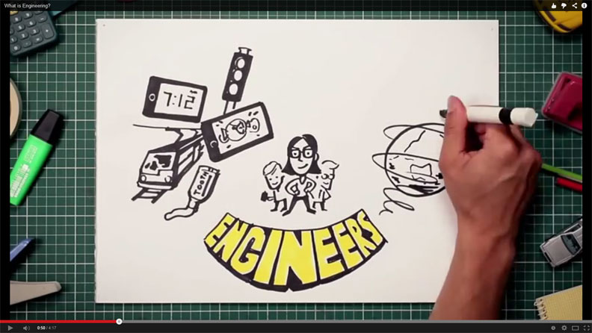
What Is Engineering?
Engineering is using science and mathematics to solve problems to improve the world around us. In the process, engineers also apply their economic, social and practical knowledge.
Many different fields of engineering exist…
➔ Watch this 5-minute “What Is Engineering?” video:
http://www.youtube.com/watch?v=bipTWWHya8A
Notes:
Show students the University of Newcastle’s 4:17-minute video, “What Is Engineering?” at https://www.youtube.com/watch?v=bipTWWHya8A.

Slide 7
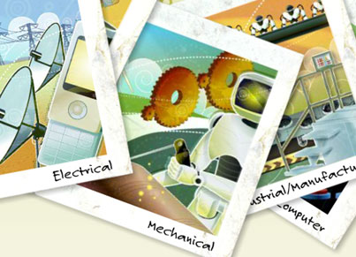
What Are Engineering Disciplines?
Let’s go through the different disciplines of engineering using a website for K-12 developed by the American Society for Engineering Education http://www.egfi-k12.org/#
Click on a flashcard ➔
for an engineering discipline
you want to explore, and it
provides you with details.
The website also has many
fascinating videos explaining
engineering.
The next three slides provide more
details about the various disciplines.➔
Notes:
If computers are available for each student or small student groups, let students explore the interactive engineering discipline flashcards on the ASEE website (http://www.egfi-k12.org/).Ask students to explain what they learned about at least one specific field of engineering.
Image source: ASEE/eGFI at http://www.egfi-k12.org/
eGFI = “Engineering—Go for It!”

Slide 8
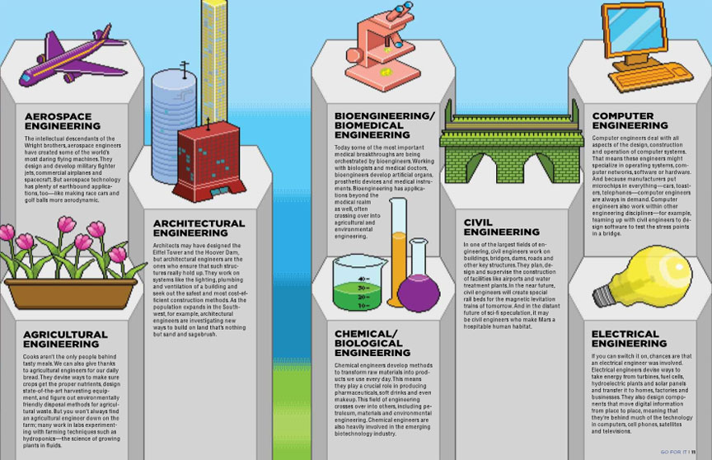
Example Engineering Disciplines
Notes:
Aerospace, architectural, agricultural, bioengineering/biomedical, chemical/biological, civil, computer, electrical
Source: ASEE’s eGFI website at http://students.egfi-k12.org/read-the-magazine.htm

Slide 9
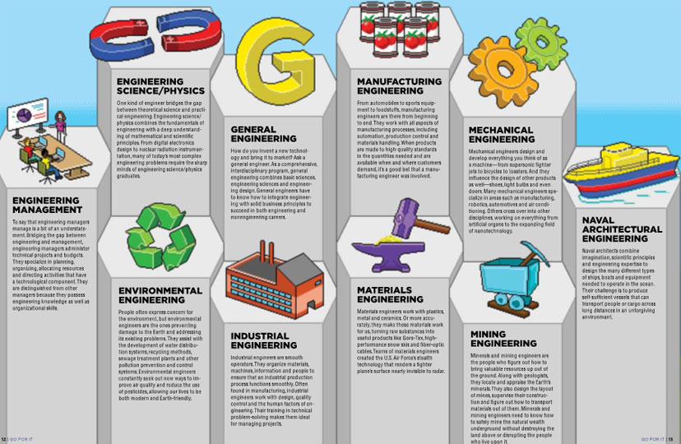
Example Engineering Disciplines
More
Notes:
Engineering management, engineering science/physics, environmental, general engineering, industrial, manufacturing, materials, mechanical, mining, naval architecture
Source: ASEE’s eGFI website at http://students.egfi-k12.org/read-the-magazine.htm

Slide 10
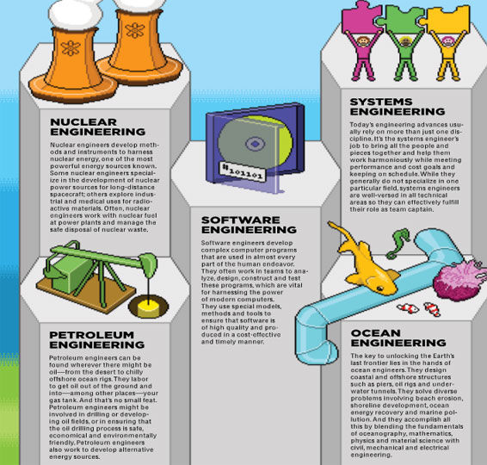

Example Engineering Disciplines
More
Notes:
Nuclear, petroleum, software, systems, ocean
Source: ASEE’s eGFI website at http://students.egfi-k12.org/read-the-magazine.htm
Light bulb and man image source: Microsoft clipart: http://officeimg.vo.msecnd.net/en-us/images/MH900442237.jpg

Slide 11
What Is Design?
Design challenges are not limited to engineering, but can also be found in other fields.
Artists, architects, interior designers, clothing designers, etc., are all “designing” products and solutions for us! So, they are also engaged in the design process!
So, what is design? Design can be loosely stated as the art of creating something that does not exist. Such a creation can be in the mind, too. For instance, you can “design a story” by thinking about the story plot, the characters you want to use in the tale, how long you want it to be, and who you want to be reading it.
Let’s first consider engineering design, and then you will perform a non-engineering design activity.

Slide 12
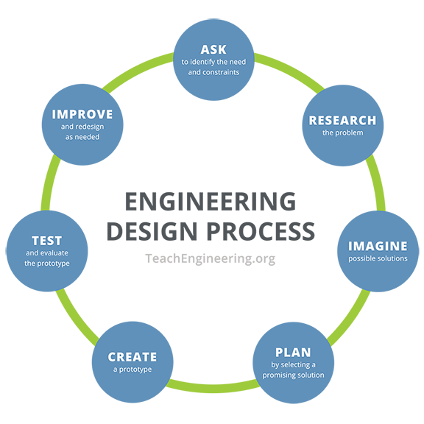
Engineering Design Process
ASEE website states:
“For engineers, the design process is a series of steps that helps teams frame and solve complex problems. Anyone can do it! To figure out how to build something, engineering teams gather information and conduct research to understand the needs and challenges to be addressed.”
⬅So, in a design cycle, the steps indicated in the diagram are done in sequence, and sometimes repeated, too, to improve the design!
See more details on the next slide. ➔
Notes:
Diagram source: NASA via ASEE at http://teachers.egfi-k12.org/design-process/

Slide 13
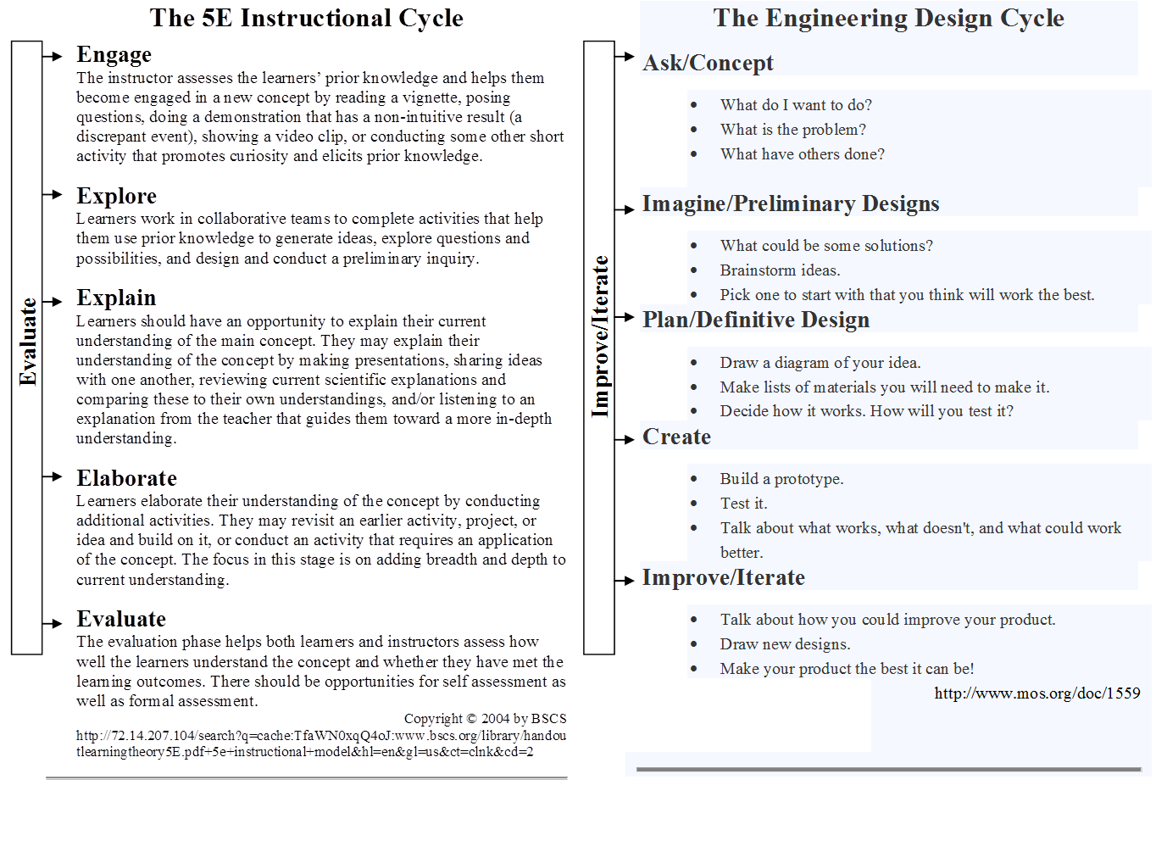
Engineering Design Process
Follow these steps...
Notes:
Source: Museum of Science, Boston, at http://www.mos.org/doc/1559 or http://legacy.mos.org/designchallenges/

Slide 14
Examples of Engineering Design
Main Subject | Design Challenge | Main Engineering Type
electricity | designing alarm circuits | electrical
astronomy | designing parachutes | aerospace
solids & liquids | improving a play dough process | chemical
insects | designing hand pollinators | agricultural
human body | designing knee braces | biomedical
landforms | evaluating a landscape | geotechnical
light | designing lighting systems | optical
energy & heat | designing solar ovens | renewable energy
water | designing water filters | environmental
Remember, the concept of design is not limited to engineering and can be applied to other life problems.
Let’s consider an example non-engineering design problem by challenging you to design a picnic! ➔
Source: Engineering is Elementary, http://www.eie.org/eie-curriculum/curriculum-units
Notes:
Optional: If time permits, download some of the 20 engineering design units created for elementary students; they are free of cost, and use them in class: Engineering is Elementary at http://www.eie.org/eie-curriculum/curriculum-units

Slide 15
Your 15-Minute Design Challenge:
To design a picnic for your friends.
Brainstorm how you would plan and organize a picnic for your friends. Consider each of the steps in the design cycle (slide 13) and address each one.
Assuming that you organized and held such a picnic, what might be some things you might have missed during planning the first time, and how can you use that to “improve” the picnic the second time?
How is this activity similar to designing a new house or designing spacecraft to take us to the moon?

Slide 16
Example Questions to Answer
Design Challenge: Design a Picnic for Your Friends
Where do you want to hold the picnic? At home, a park, a rented place?
How many friends to invite? Via Facebook, text, email?
What day/time? How much advance notice so you can make sure everyone might has that day open?
What foods and beverages to provide?
What games or activities to plan?
What is your budget? Total all estimated costs on a financial sheet. If costs too much, iterate and revise your plan.
Will the picnic plan be acceptable to your parents/guardians?

Slide 17
Post-Lesson Quiz
What is engineering?
List some example design challenges.

Slide 18
Post-Lesson Quiz Answers
What is engineering?
  Engineering is using science and mathematics to solve problems that improve the world around us. For example, engineers design toasters, robots, light bulbs, air conditioning, surgical tools, software, snowboards, shoes, ships, radar, oil rigs, and nanotechnology and pollution solutions.
List some example design challenges.
Possible answers are unlimited!
Examples: designing water treatment plants, highway bridges and tunnels, factory assembly lines, and even vacations and picnics!

Slide 19
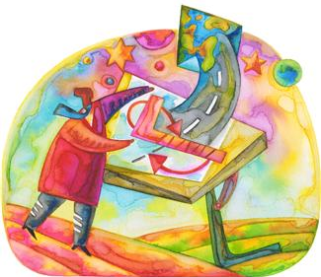
Vocabulary
design: Loosely stated, the art of creating something that does not exist.
engineering: The use of science and mathematics to solve problems to improve the world around us.
engineering design process: A series of steps used by engineering teams to guide them as they develop new solutions, products or systems.
The process is cyclical and may
begin at, and return to, any step.
Notes:
Image source: Microsoft clipart: http://office.microsoft.com/en-us/images/results.aspx?qu=design&ex=1#ai:MP900398793|mt:2|

