Slide 1


What is a Wave?

Slide 2

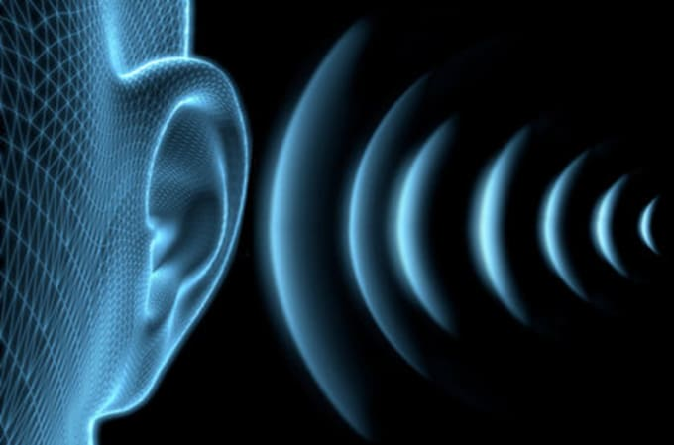

What kind of waves can you think of?
https://fiverr-res.cloudinary.com/images/t_main1,q_auto,f_auto/gigs/14292569/original/39cc66b3d877d2e39432753e221f227c920cc237/convert-your-audio-to-432-hz.png
http://2.bp.blogspot.com/-a8gILpXQLqM/TtisXg7cSmI/AAAAAAAAFy4/EeNDZUbl5-Y/s1600/forces_of_nature_landscape_nature_ocean_wave-other.jpg
https://stephybonillatok.files.wordpress.com/2015/03/visualizing-the-future-prism-decomposes-lightwaves.jpg

Slide 3
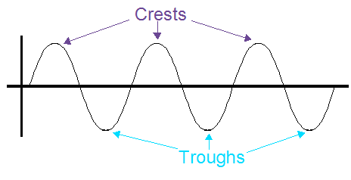
What is a wave?
A wave can be defined as a disturbance in a field that carries energy through space
Waves oscillate, or move back and forth between a minimum and maximum value, as they move through space
  We call the minimum value the trough of the wave, and the maximum value the crest of the wave
http://www.studyphysics.ca/newnotes/20/unit03_mechanicalwaves/chp141516_waves/images/crest_trough.png

Slide 4
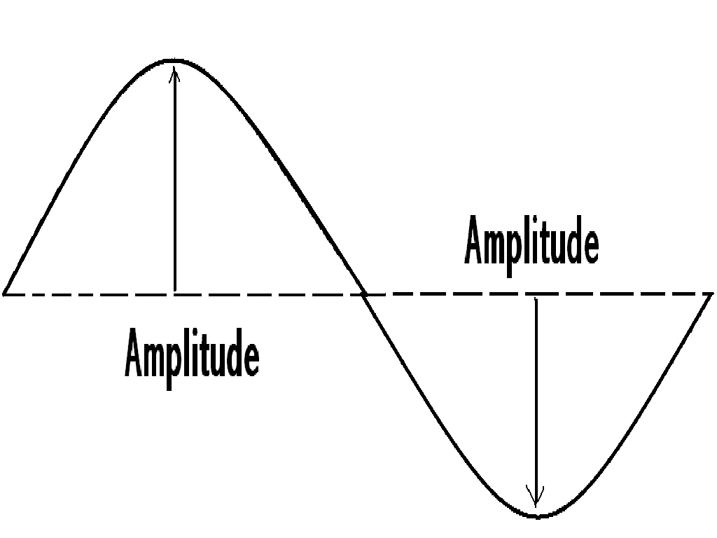
Wave Properties
The amplitude of a wave is the distance between the wave’s midpoint and the crest OR trough
  The midpoint of the wave is also called the inflection point
  The volume of a sound depends on amplitude (high = loud, low = soft)
http://4.bp.blogspot.com/-dETtLtPvR7A/TsOl875kCTI/AAAAAAAAABk/efHhzq272rE/s1600/waveamplitude.GIF

Slide 5
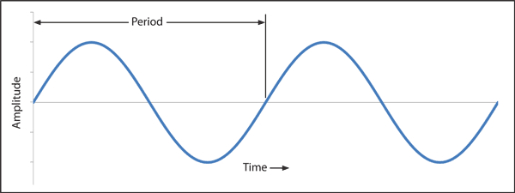
Wave Properties
The period of the wave is the time it takes for two consecutive crests (or troughs) to pass a specified point
https://www.minelab.com/__files/i/5890/Period.gif

Slide 6
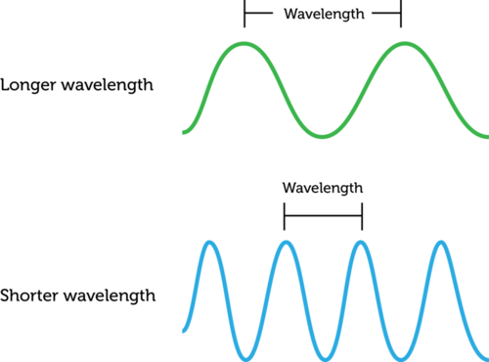
Wave Properties
The wavelength of a wave is the distance traveled by a wave in one period
https://dr282zn36sxxg.cloudfront.net/datastreams/f-d%3A9be4ba485ea614d0eb43f8491065be2f21035f07948ad356ed82cb15%2BIMAGE_THUMB_POSTCARD%2BIMAGE_THUMB_POSTCARD.1

Slide 7
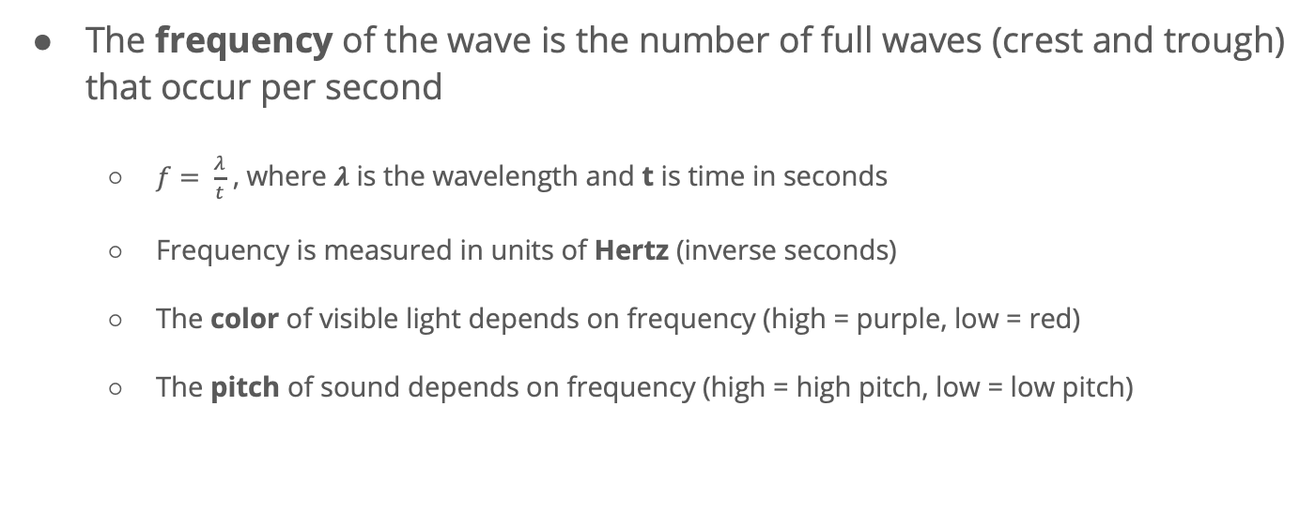
Wave Properties
The frequency of the wave is the number of full waves (crest and trough) that occur per second
  $f= \frac{λ}{t}$ , where $λ$ is the wavelength and t is time in seconds
  Frequency is measured in units of Hertz (inverse seconds)
  The color of visible light depends on frequency (high = purple, low = red)
  The pitch of sound depends on frequency (high = high pitch, low = low pitch)

Slide 8
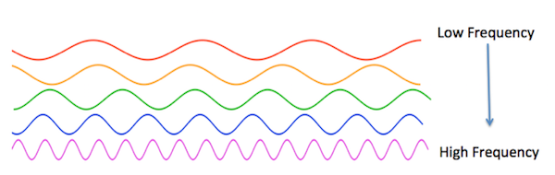
Wave Properties
https://study.com/cimages/multimages/16/wavefrequency.png

Slide 9
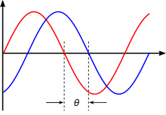
Wave Properties
The phase angle of the wave shifts the wave to the left or right on the x-axis
  A negative phase angle will shift the wave to the right
  A positive phase angle will shift the wave to the left
https://upload.wikimedia.org/wikipedia/commons/thumb/5/55/Phase_shift.svg/220px-Phase_shift.svg.png

Slide 10
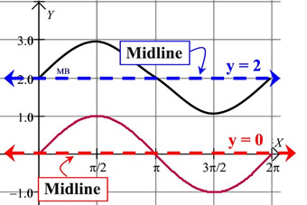
Wave Properties
A wave may be shifted up or down the y-axis by using a vertical shift
  A negative vertical shift will move the wave down the y-axis
  A positive vertical shift will move the wave up the y-axis
https://mathbitsnotebook.com/Algebra2/TrigGraphs/midline.jpg

Slide 11
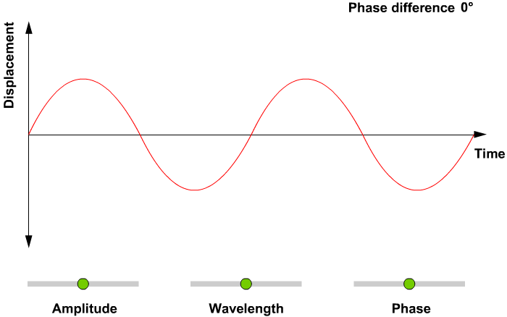
Notes:
This slide contains a GIF that shows the effect of changing the amplitude, wavelength, and phase of a sine wave

Slide 12
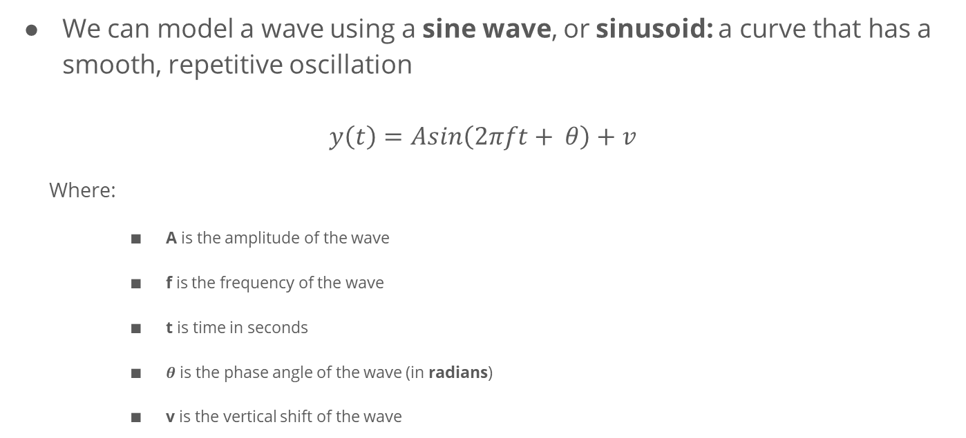
Mathematical Model of a Sine Wave
We can model a wave using a sine wave, or sinusoid: a curve that has a smooth, repetitive oscillation
$$y\left(t\right)=Asin\left(2πft+ θ\right)+v$$
  Where:
    A is the amplitude of the wave
    f is the frequency of the wave
    t is time in seconds
    $θ$ is the phase angle of the wave (in radians)
    v is the vertical shift of the wave

Slide 13
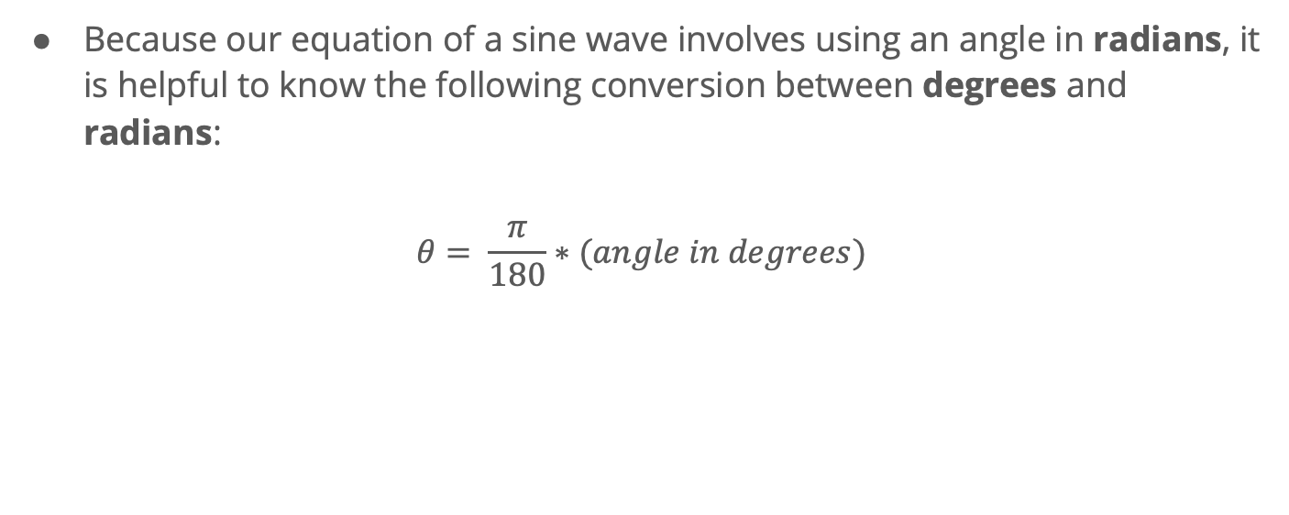
Note on Radians and Degrees
Because our equation of a sine wave involves using an angle in radians, it is helpful to know the following conversion between degrees and radians:
$$θ= \frac{π}{180}∗(angle in degrees)$$

