Slide 1


Oh Baby! Contractions and Calculations / Activity Part 2

Slide 2
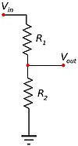
Voltage Dividers
In this activity, you will connect the force-sensitive resistor to an Arduino microcontroller to read the sensor values. The analog inputs of an Arduino microcontroller measure voltage and not resistance. A voltage divider is used to interface between the two. Based on the input voltage, the resistance of the FSR can be calculated.
The input of the analog pin is the voltage across the pull-down resistor. The pull-down resistor ensures a known state so when no input (no pressure) is applied, it is essentially an open circuit.
The FSR and the pull-up resistor are in series and their common node is connected to the analog pin. The source voltage Vin is distributed across both resistors which forms a voltage divider. The voltage divides in direct proportion to the resistance.
Photos should be a
square like this.
Voltage divider circuit

Slide 3
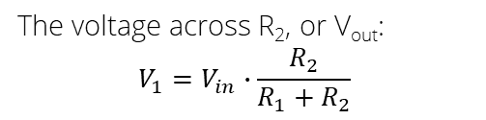
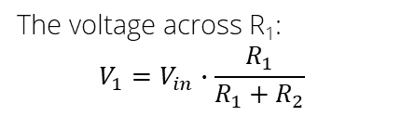
Voltage Dividers, cont.
For our circuit:
* Vin = 5 V
* R1 = FSR variable resistance
* R2 = 10 kΩ pull-up resistor
We are interested in V_{out}, which is the voltage across the pull-up resistor R2, but you can also calculate the voltage across the FSR R1.
Photos should be a
square like this.
The voltage across R₁:
$$V_{1}=V_{in}∙\frac{R_{1}}{R_{1}+R_{2}}$$
The voltage across R₂, or V_{out}:
$$V_{1}=V_{in}∙\frac{R_{2}}{R_{1}+R_{2}}$$
Voltage divider circuit
Voltage divider circuit

Slide 4
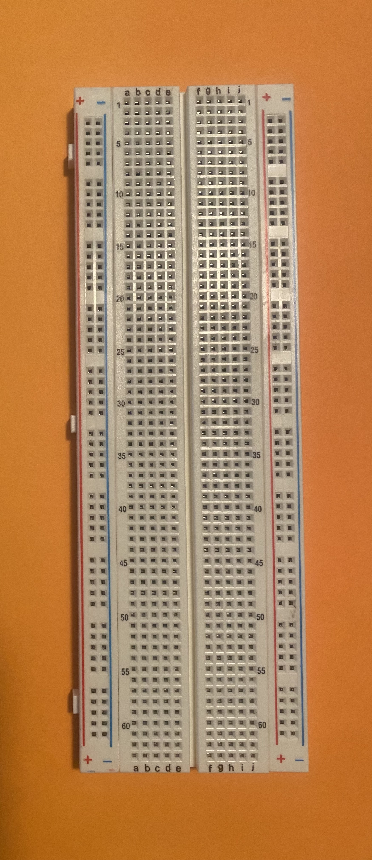
Breadboarding Basics
A breadboard is used to construct prototype (temporary) circuits for testing or simply to try out an idea. No soldering is needed so it is easy to change connections and replace components. Parts will not be damaged by soldering so they will be available for re-use afterwards.
Don’t be fooled! You can still damage components due to overload or short circuit resulting in blue smoke.
Power rail pins all connected
Photos should be a
square like this.
5–pin row connected
Ground rail pins all connected
Solderless breadboard

Slide 5
Conductive Layout
Power Rails: When you build a circuit you may need many components requiring power. The entire row of 30 holes is electrically connected together. There is another row on the opposite side providing another 30 holes. The two rows are not connected so if you want them to be, you can add a jumper wire between the rows.
Terminal Strips: Each group of 5 pins is also connected together. Note that the columns on either side of the middle divider are not connected together. This means a maximum of five components per column.
Power rail pins all connected
Photos should be a
square like this.
Photos should be a
square like this.
5–pin row connected
Ground rail pins all connected
Solderless breadboard

Slide 6
Resistor Bands Refresher
Color | Digit | Mulitplier | 0.5%
Black | 0 | x10⁰ | X
Brown | 1 | x10¹ | ±1%
Red | 2 | x10² | ±2%
Orange | 3 | x10³ | X
Yellow | 4 | x10⁴ | X
Green | 5 | x10⁵ | ±0.5%
Blue | 6 | x10⁶ | ±0.25%
Purple | 7 | x10⁷ | ±0.1%
Grey | 8 | x10⁸ | ±0.005%
White | 9 | x10⁹ | X
Silver | X | X | ±10%
Gold | X | X | ±5%
220 Ω Resistor
Red | Red | Brown | Gold
2 | 2 | x10 | 5%
220 Ω
3-Band Resistor | Digit | Digit | Multiplier | X | X
4-Band Resistor | Digit | Digit | Multiplier | Tolerance | X
5-Band Resistor | Digit | Digit | Digit | Multiplier | Tolerance
10,000 Ω Resistor
Brown | Black | Black | Red | Gold
1 | 0 | 0 | x100 | 5%
10,000 Ω

Slide 7
Digital Input/Output
You are probably familiar with circuits that use the digital input/output pins on an Arduino microcontroller to turn a switch or an LED on and off. The digital pins have only two values which you can look at in a variety of ways.
Photos should be a
square like this.
Digital Input/Output Pins
On | Off
Closed Circuit | Open Circuit
High | Low
+5 V | 0 V
Binary 1 | Binary 0

Slide 8
Analog Input/Output
The Arduino’s built-in analog-to-digital converter (ADC) accepts analog input (continuous signal) as voltages in the range 0‒~5 V and automatically converts them to a digital value (discrete values) 0‒1023. The ADC is a 10-bit converter which means it can handle 1024 distinct values.
ADC Converter
Analog Input | Digital Output
0 mV | 0
Anything in-between | Rounded digital value
5000 mV | 1023
Photos should be a
square like this.
The analogRead() line is the command that reads the digital value from the specified pin. The map() function proportionally converts one range of values to another: fsrVoltage = map(FSRval, 0, 1023, 0, 5000). The map value only works with integers and will round an output to the nearest integer. This is why we will work in mV rather than V.

