Slide 1


Tips for Translating Motor Motion

Slide 2
Table of contents
Crank and Slider
  How to build
  Tips
Cable-driven
Winch moving
  How to build
Cam
  How to build

Slide 3
Crank and Slider motion
Moving back and forth

Slide 4
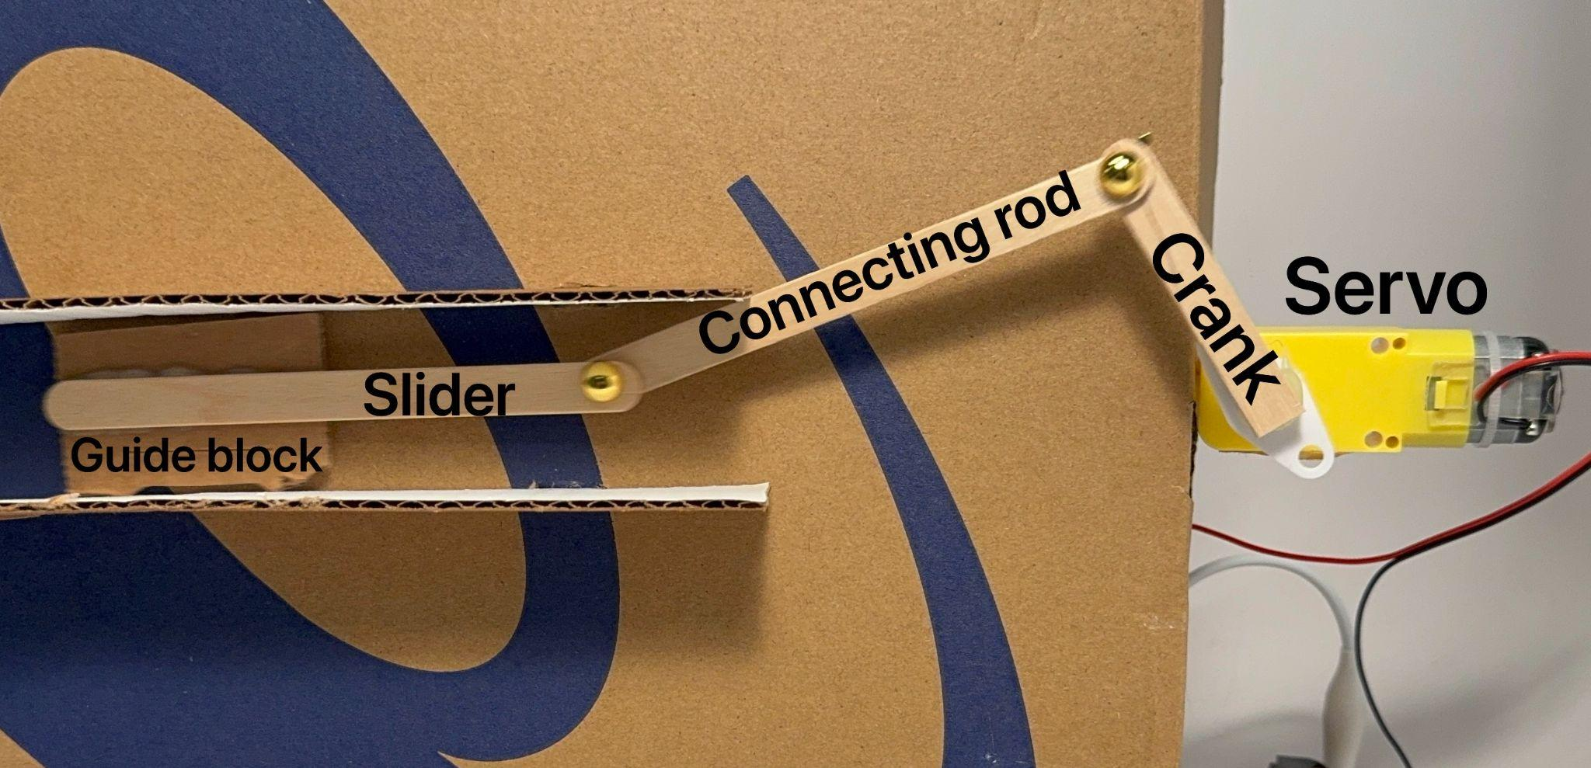
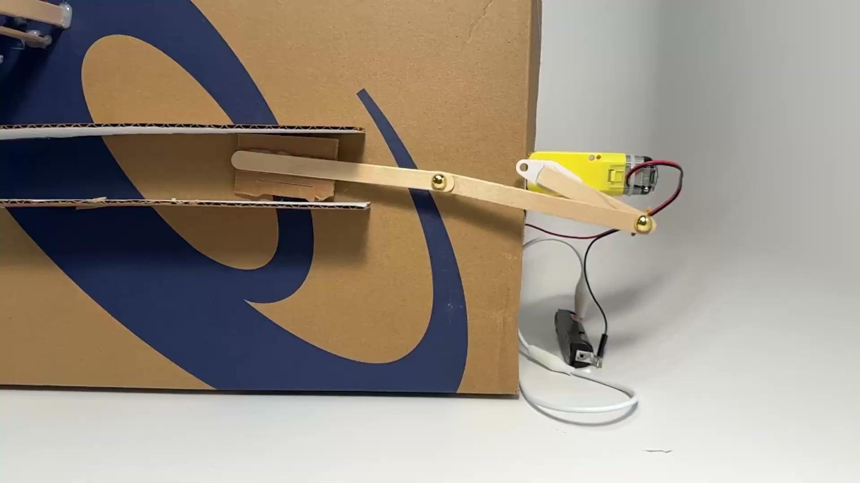
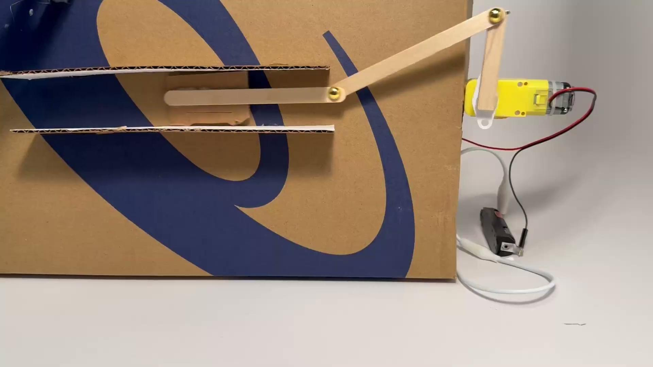


Crank and slider
It converts the circular movement to the moving back and forth motion by making the stick between the two blocks go back and forth.

Slide 5
Cable-driven motion
Open or close something

Slide 6
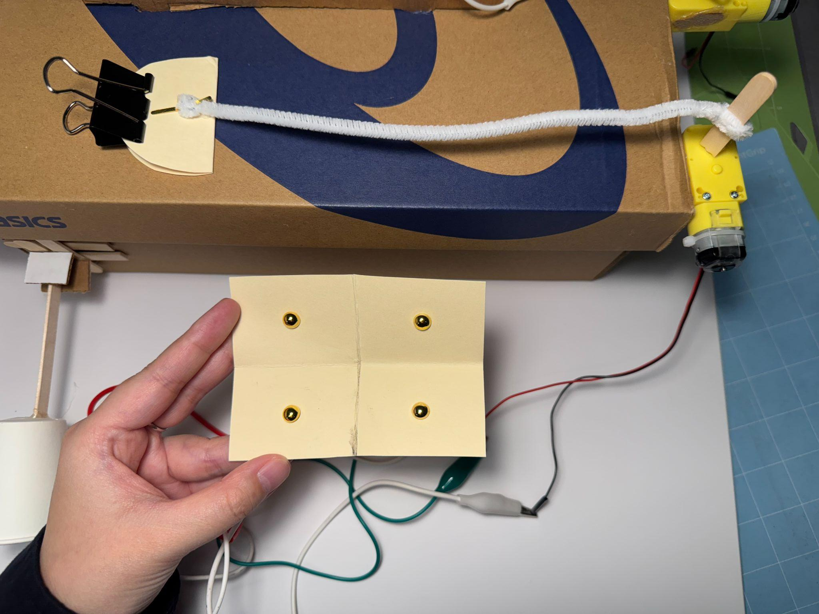
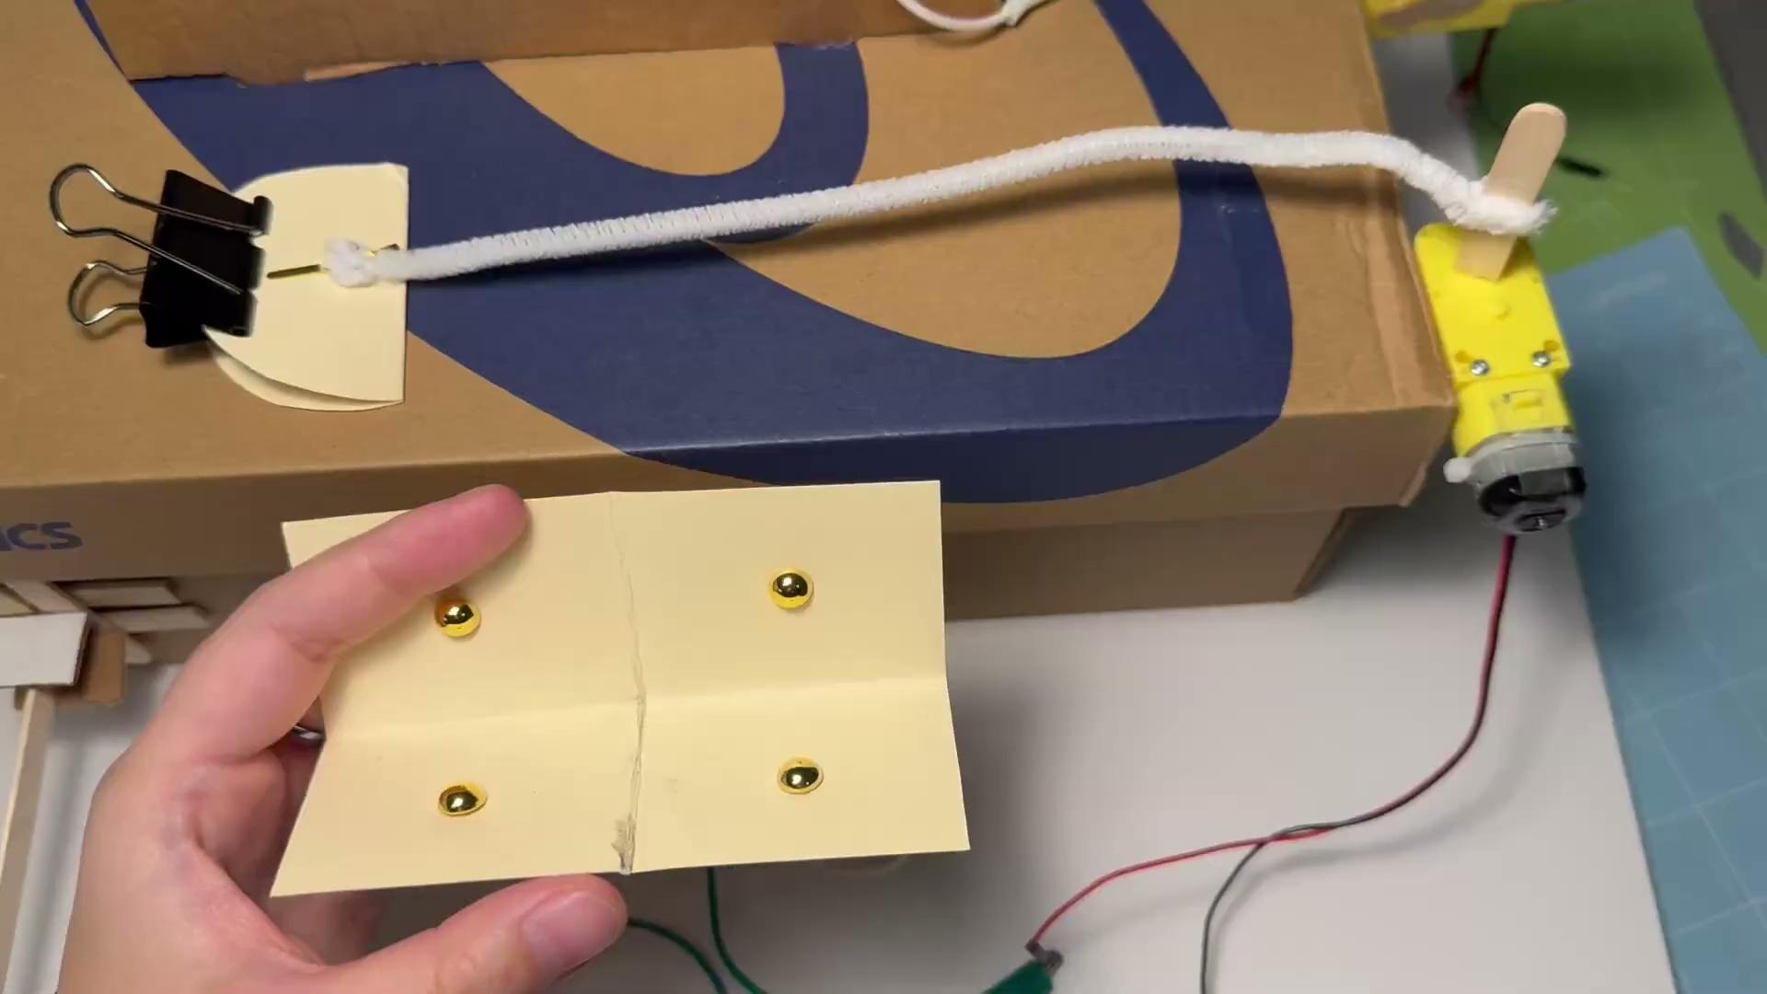
Cable-driven motion
Use a pipe cleaner to control something that opens and closes
(like the Venus Fly Trap)

Slide 7
Winch-moving motion
Lift up and down

Slide 8
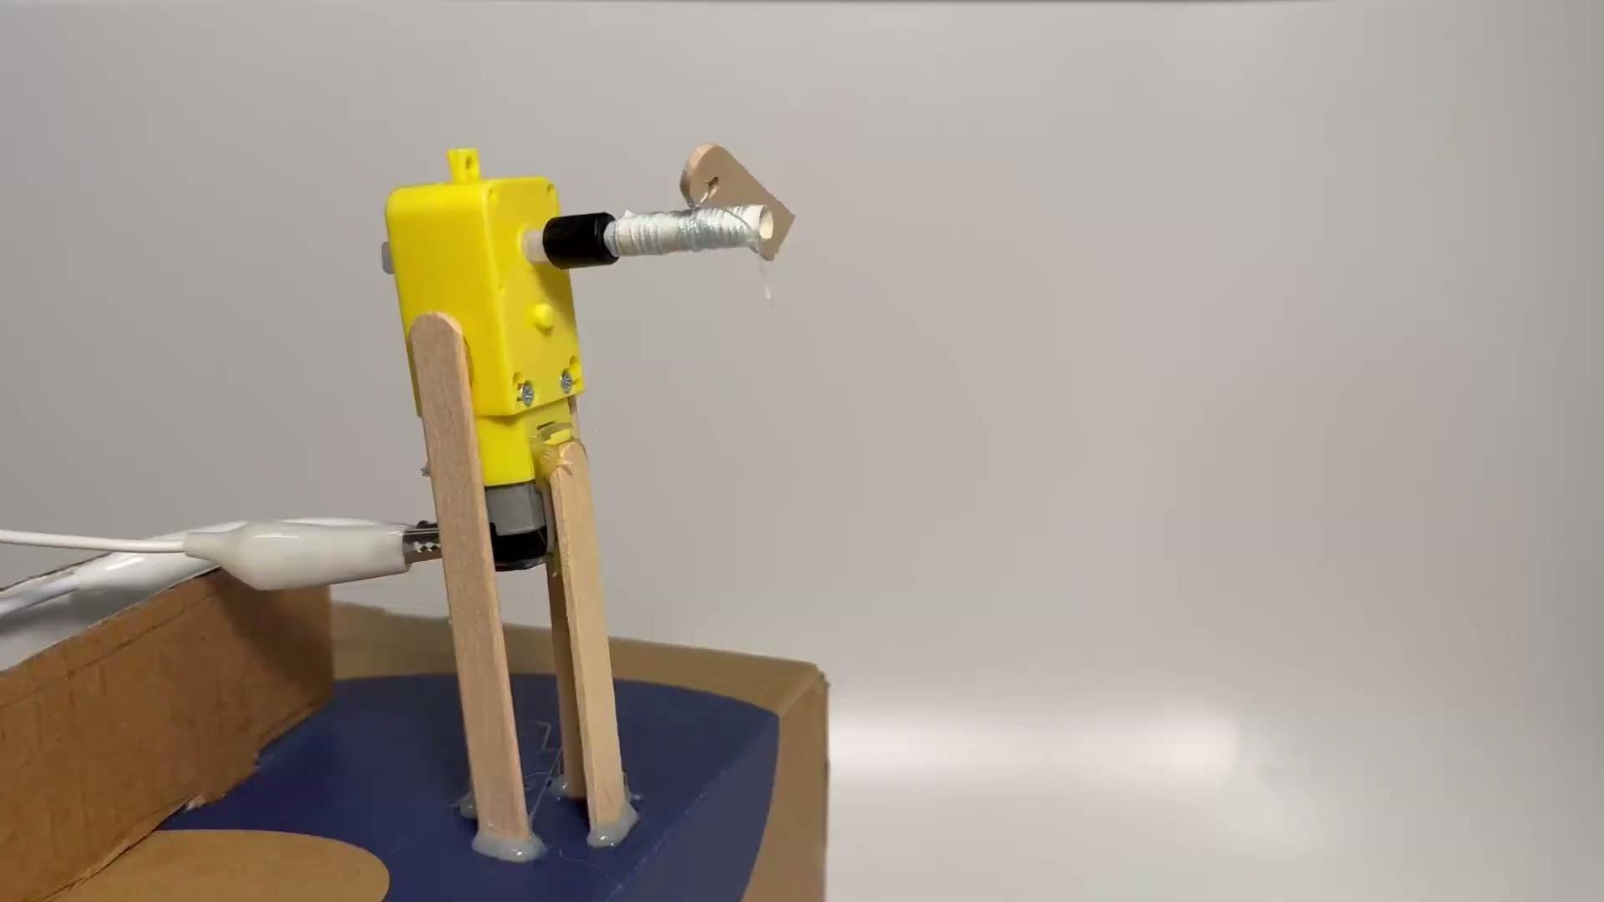
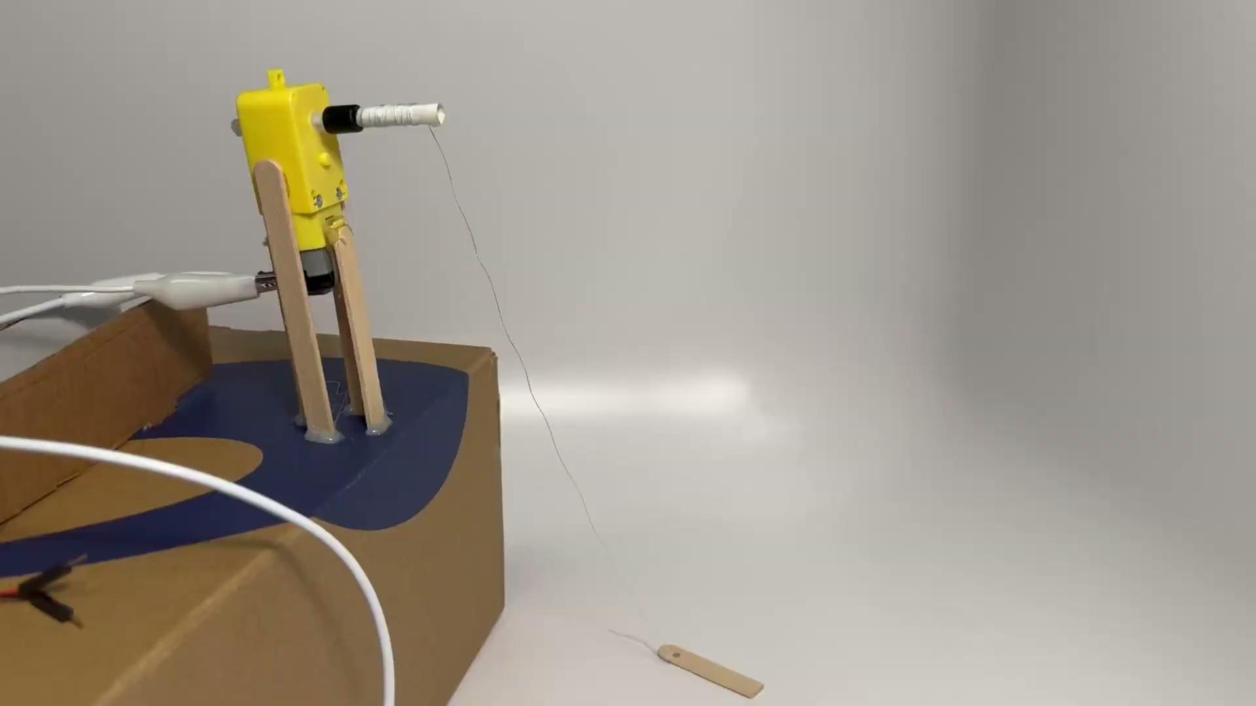
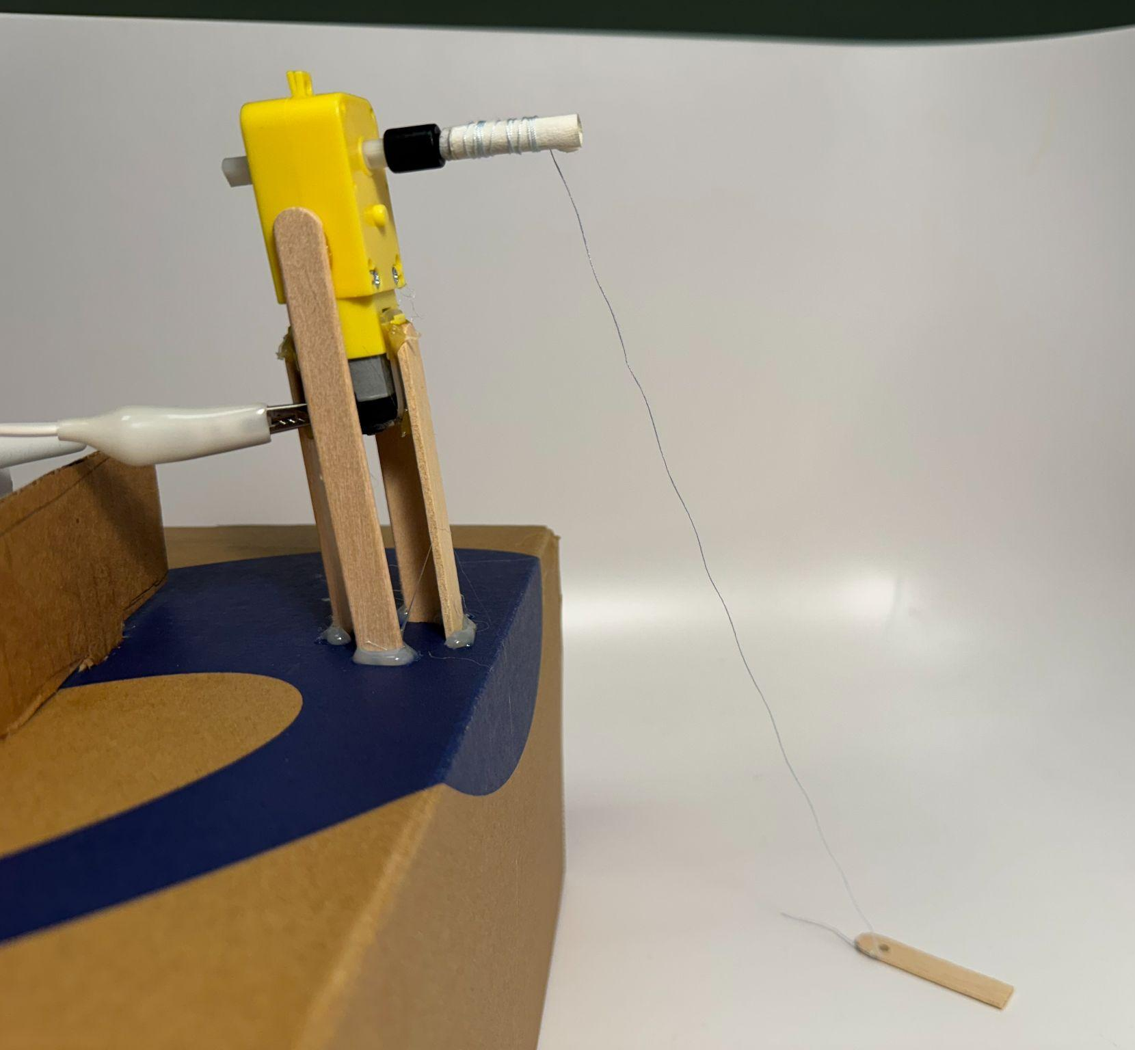
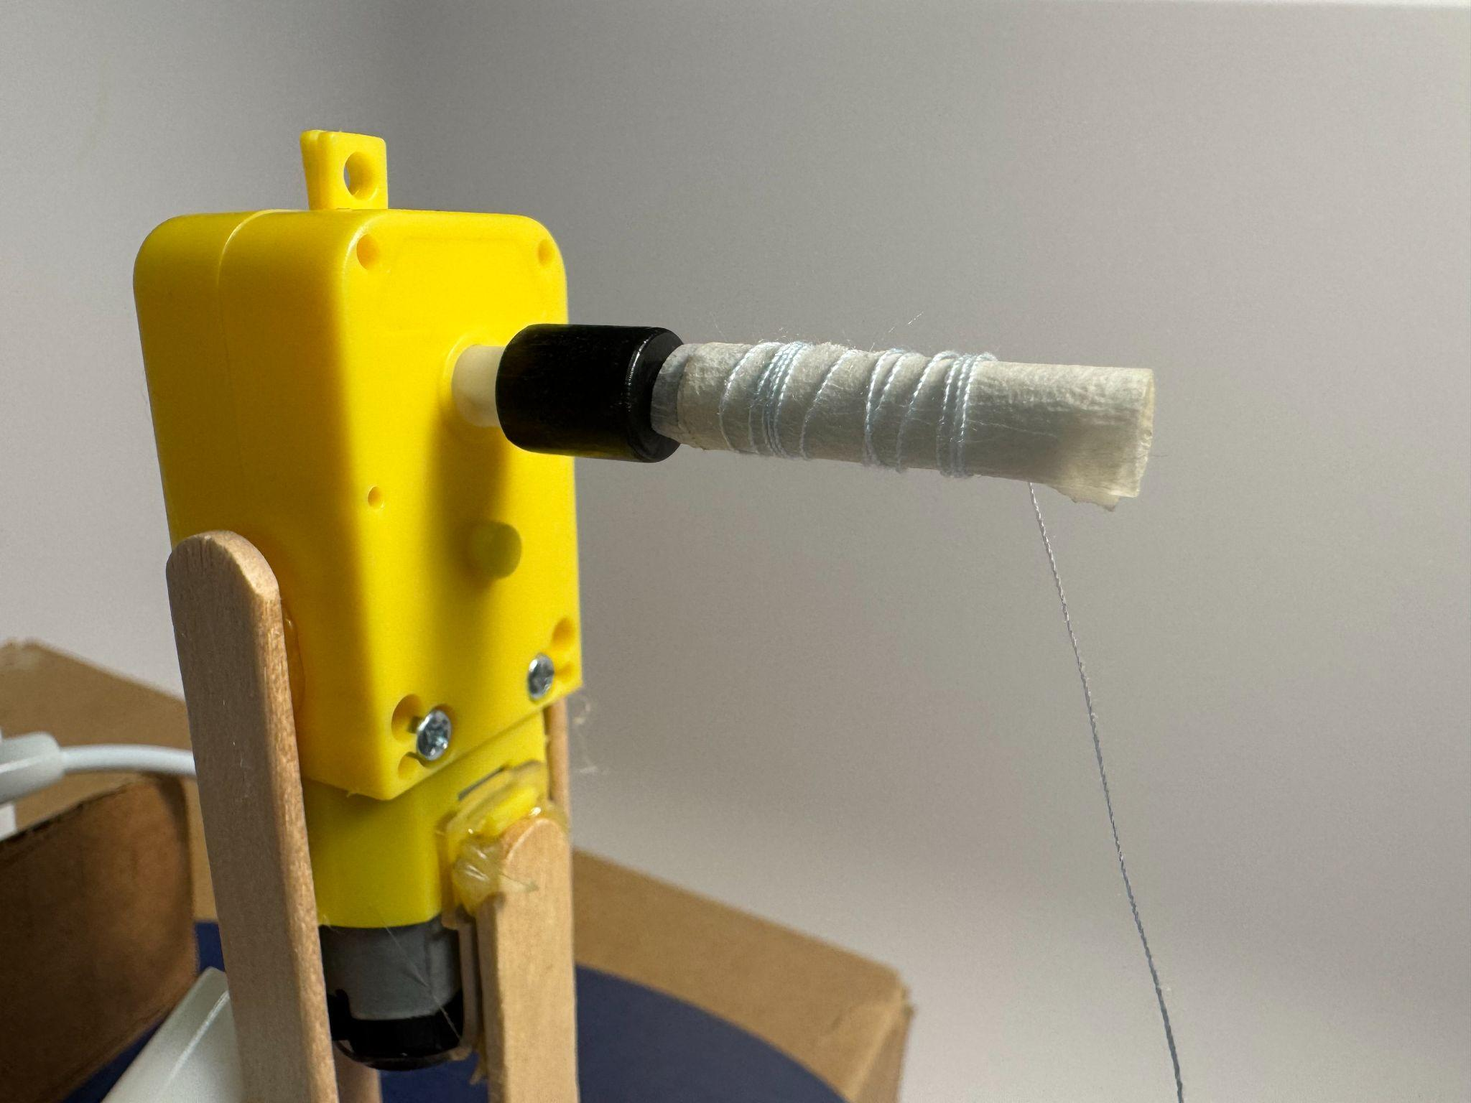
Winch-moving motion
Rotational movement rotates the yarn to lift things up or down.

Slide 9
Cam
Moving up and down

Slide 10
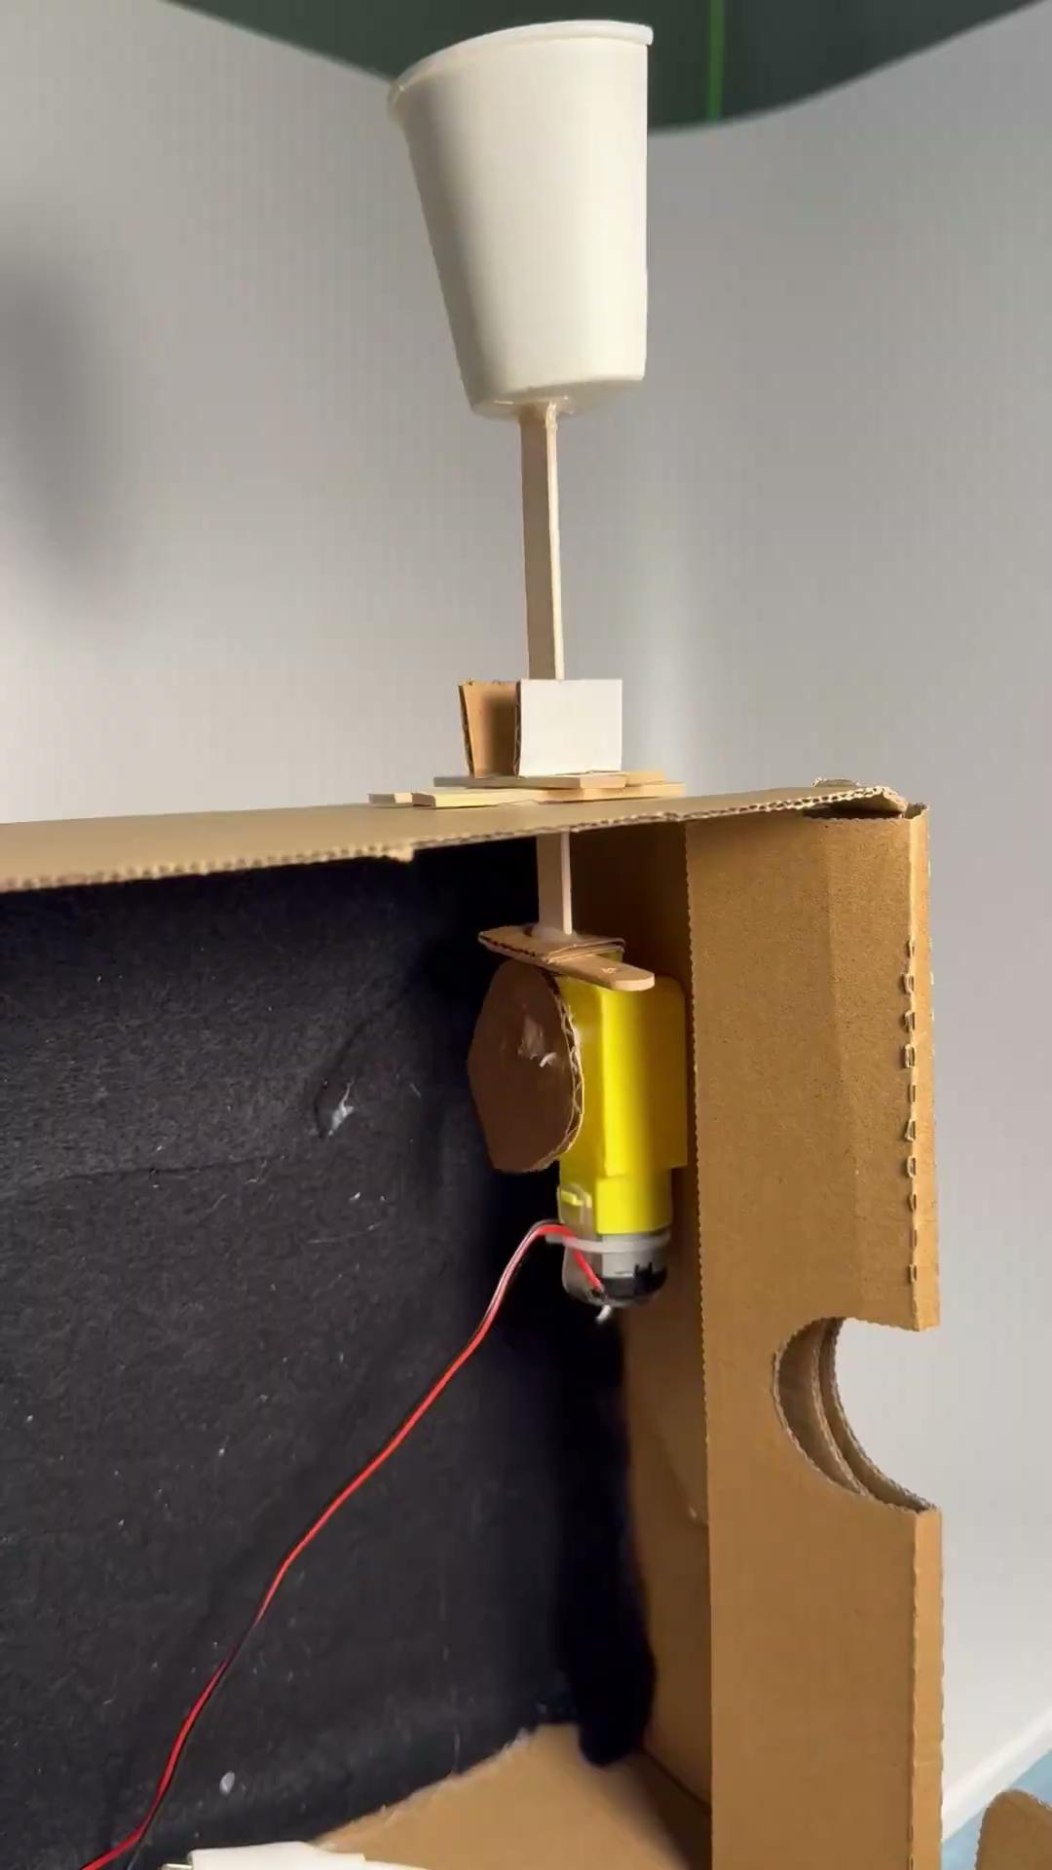
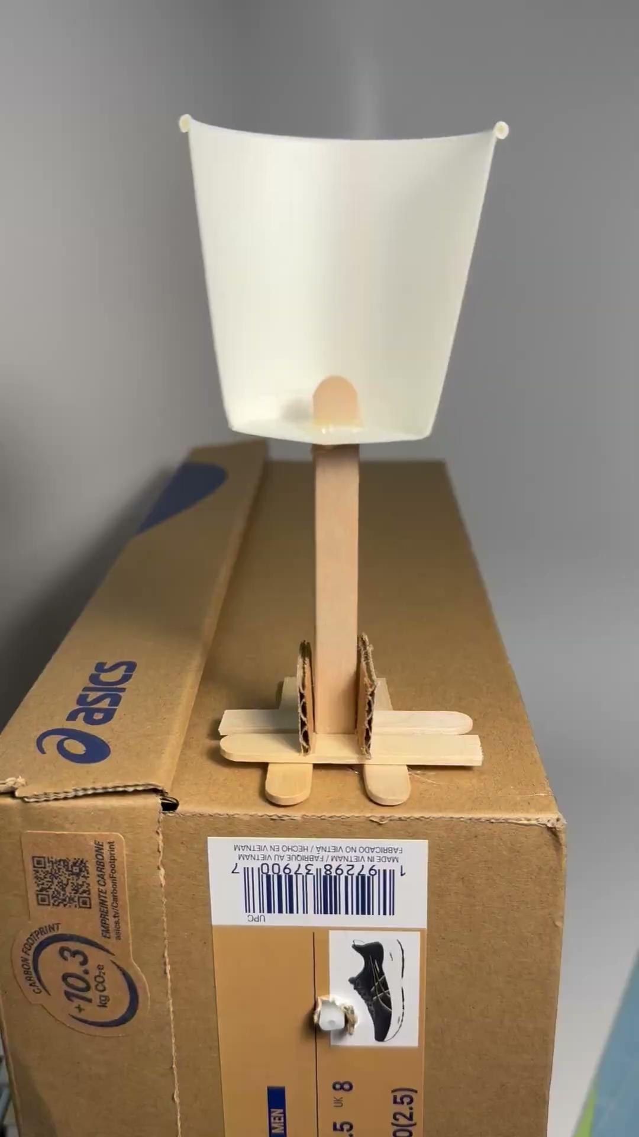
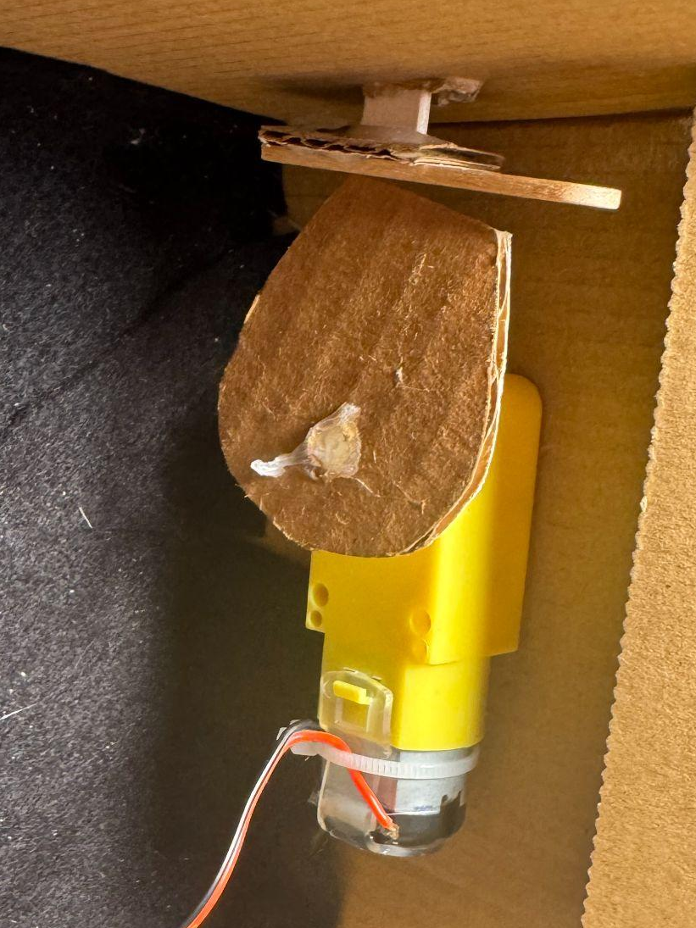

Slide 11
How to build?

Slide 12


How to build - Crank and Slider
Take three popsicle sticks, and cut one of the popsicle sticks in half.
Use a hole puncher to make two holes on both sides of the connecting rod (full-length one), one hole on the crank (half-length one), and one hole on the slider (full-length one).
Use the hot glue gun to connect the crank to the motor shaft; it should not move.
Use a hot glue gun to glue the guide block on the slider at the side without a hole.
Then, use metal brads to connect the connecting rod to the crank and slider; it should be movable on both sides.
Based on the guide block size and the moving distance/length to build a frame for the guide block; the moving distance/length depends on the length of crank.

Slide 13
Tips
Moving distance: 2 times the length of the crank
The connecting rod has to be at least 10% longer than the crank
The slider guide path should extend along a radius of the circle traced out by the crank. In other words, the slider guide path should be aligned with the crank and connecting rod when they are forming a straight line.

Slide 14
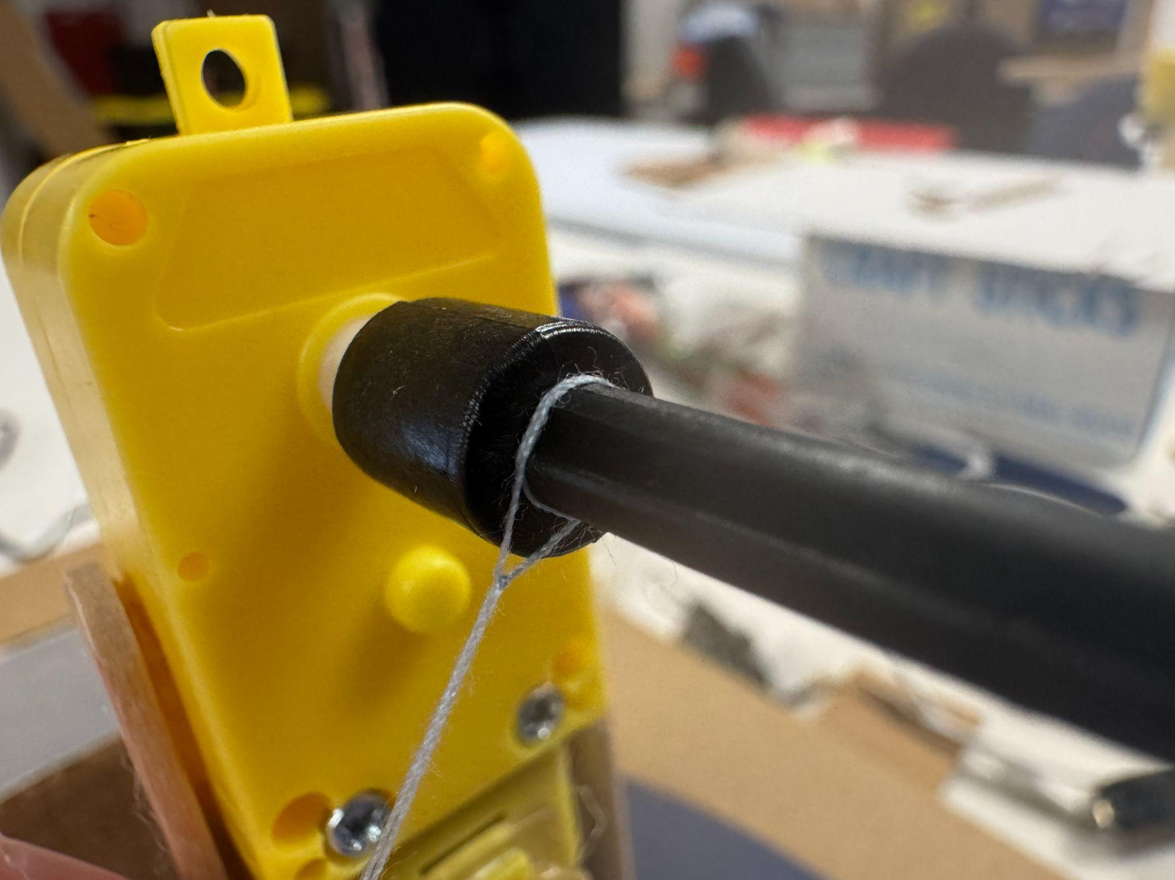
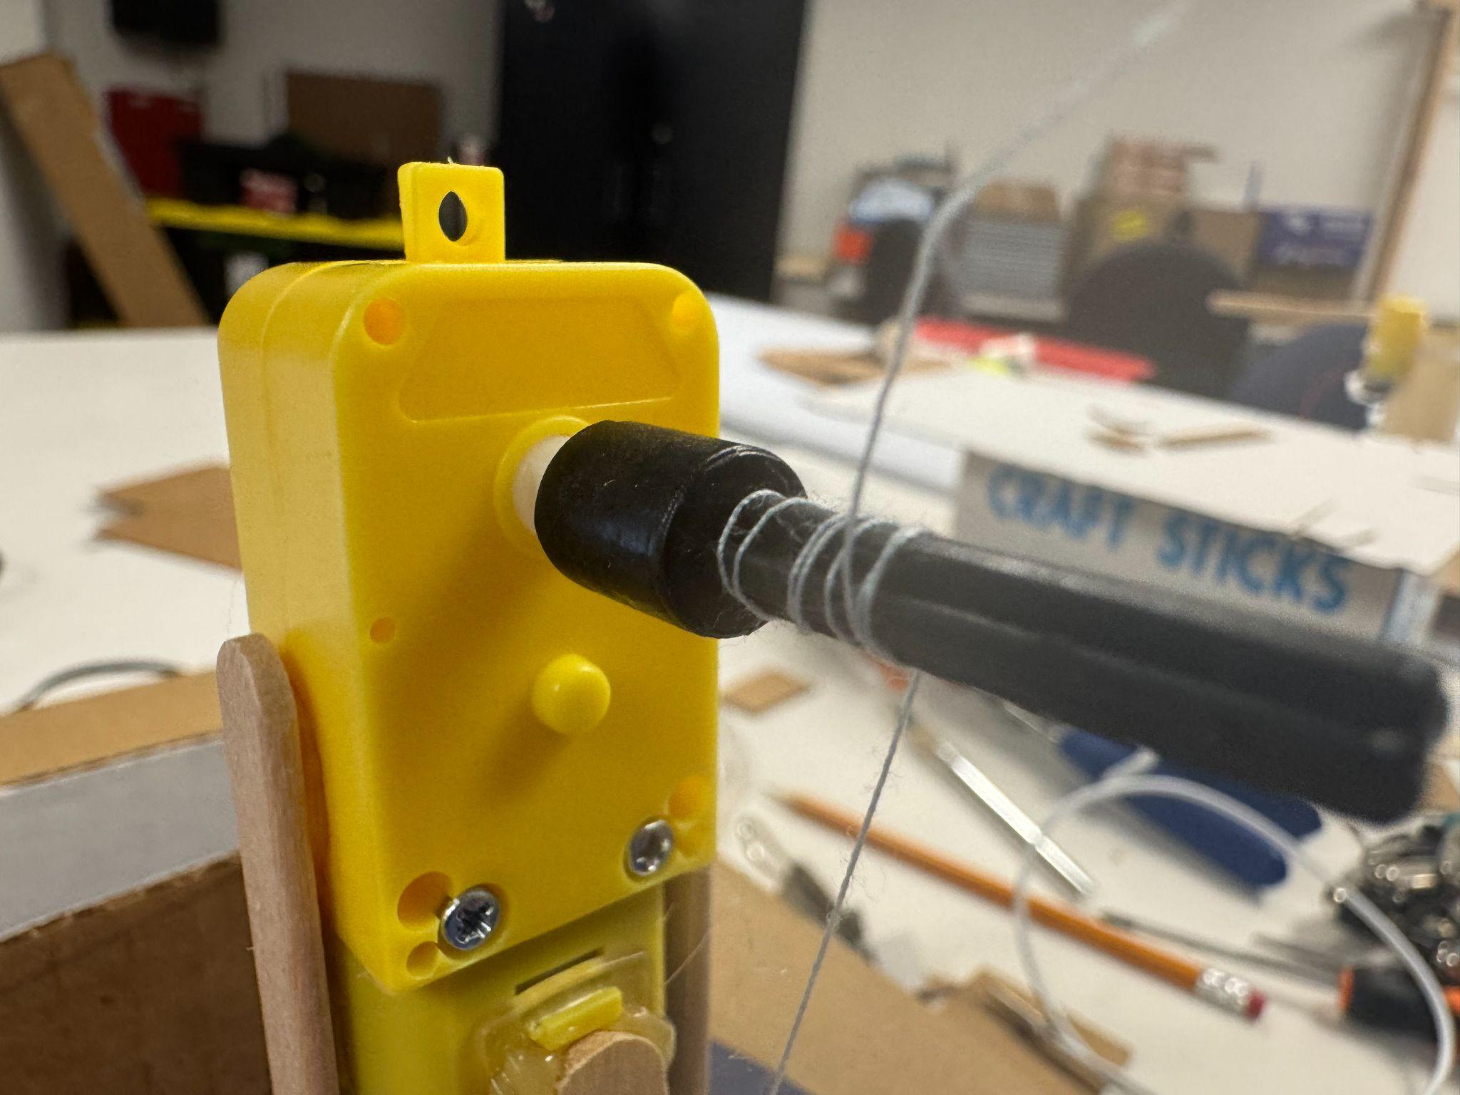
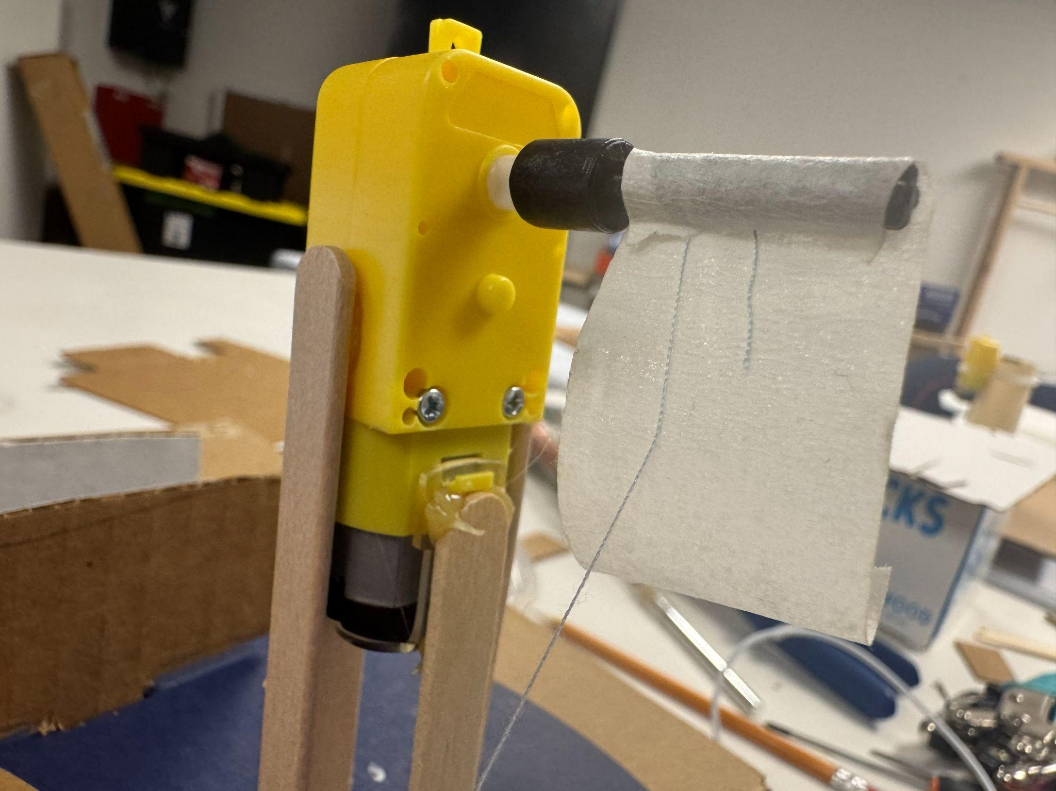
How to build - winch moving
Tie the yarn on the black adapter.
Twine some yarn on the black adapter.
Use tape to tape the yarn you already twined.
Keep twining more yarn out of the tape.
Tie whatever you want to lift to the end of the yarn.
Now you can lift up or down the stuff by changing the motor rotation direction.

Slide 15
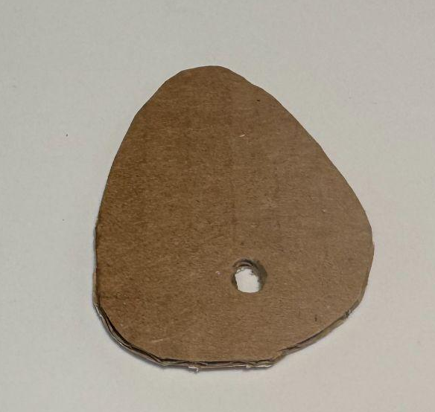
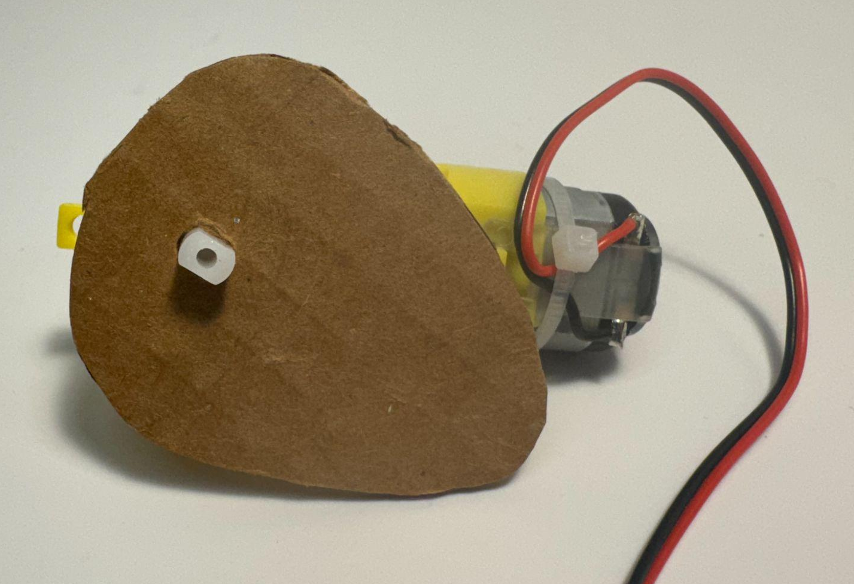
How to build - cam
Cut cardboard to a teardrop shape(?) (If you cut a round shape, it’s also ok, just make sure your hole is not in the center.)
Use a hole puncher to make a hole (any place if it’s a non-round shape, far away from the center if yours a round shape).
Attach the cardboard to the yellow motor adapter through the hole, and use a hot glue gun to glue it; make sure the cardboard rotates with the motor together.
Take a popsicle stick or a wooden stick (or whatever similar material you prefer to use), and cut a gap that has the same size as your stick in the frame/base/box (I use a shoe box here as an example) to make sure your stick can go through that gap and move up and down.
Cut a small rectangular cardboard, and use a hot glue gun to glue the rectangular cardboard to the end of your stick. Test it to make sure that when the motor rotates, the teardrop cardboard can touch the rectangular cardboard and can make your stick go up and down.
Glue/add anything on the other end of your stick.

