Slide 1


Motor Mounting Tips

Slide 2
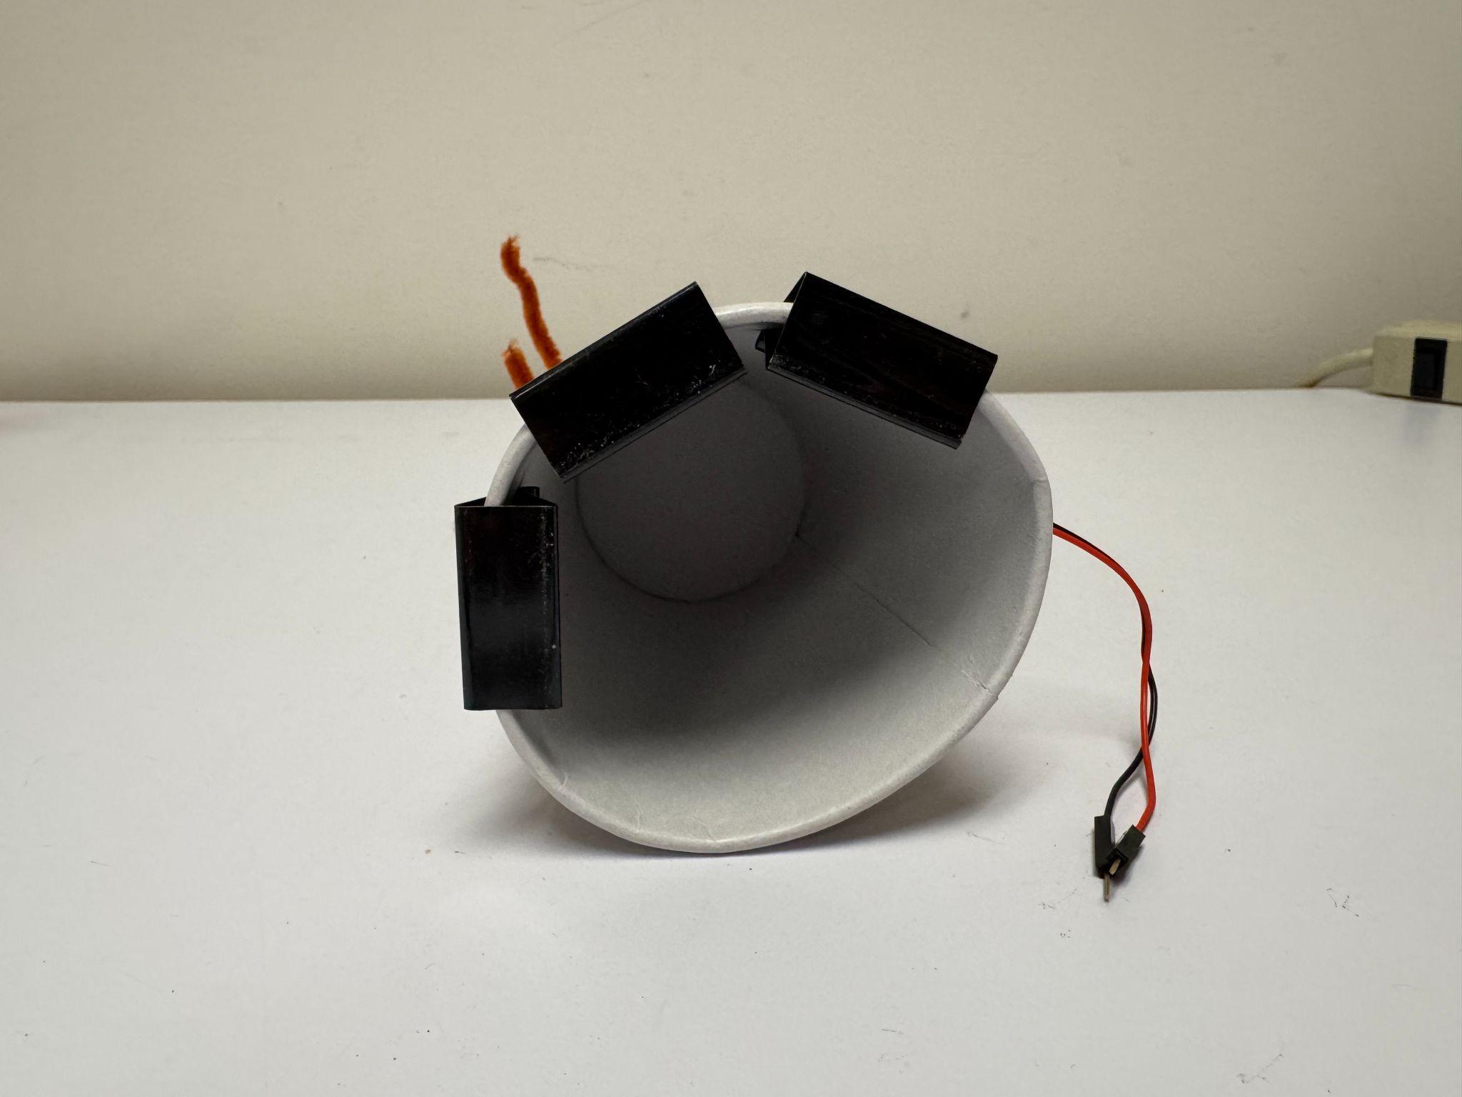
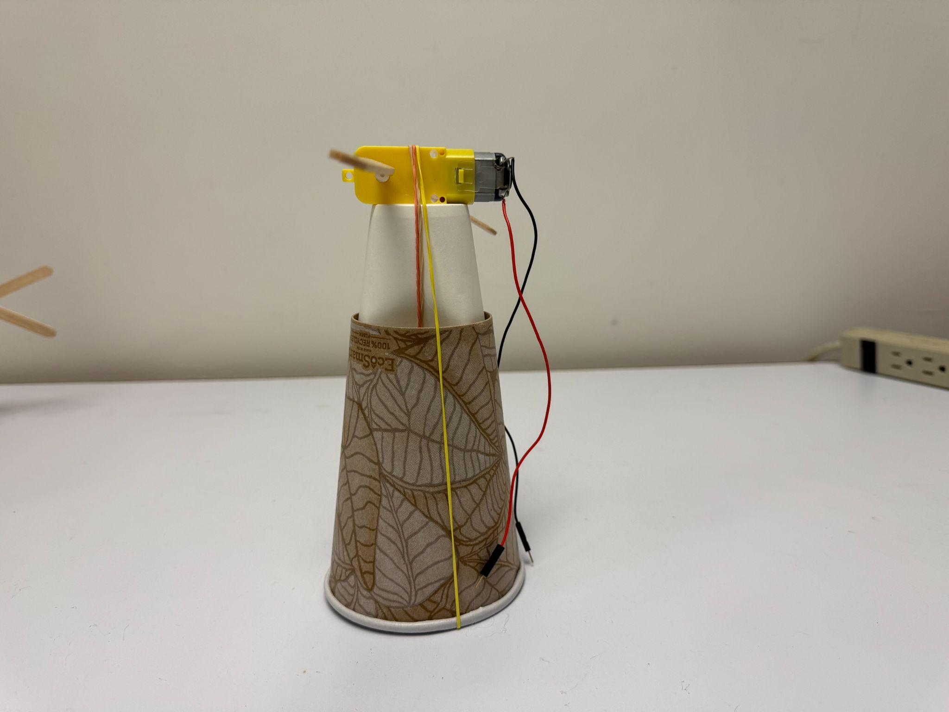
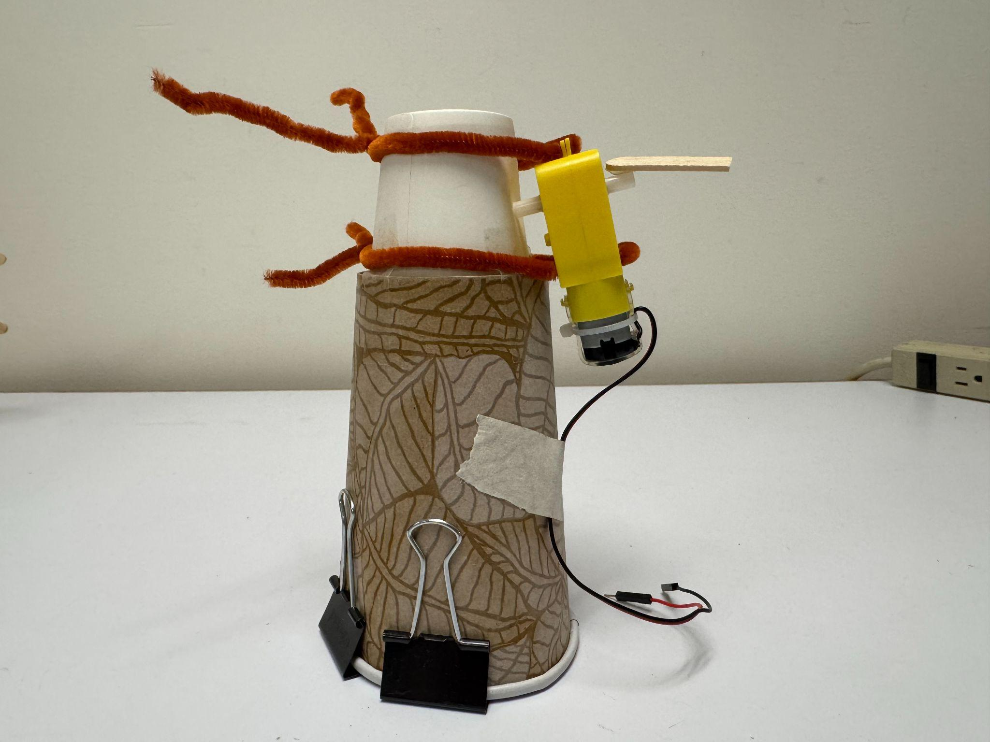
Cups
Use rubber bands or pipe cleaners to connect the motors to the cups.

Slide 3
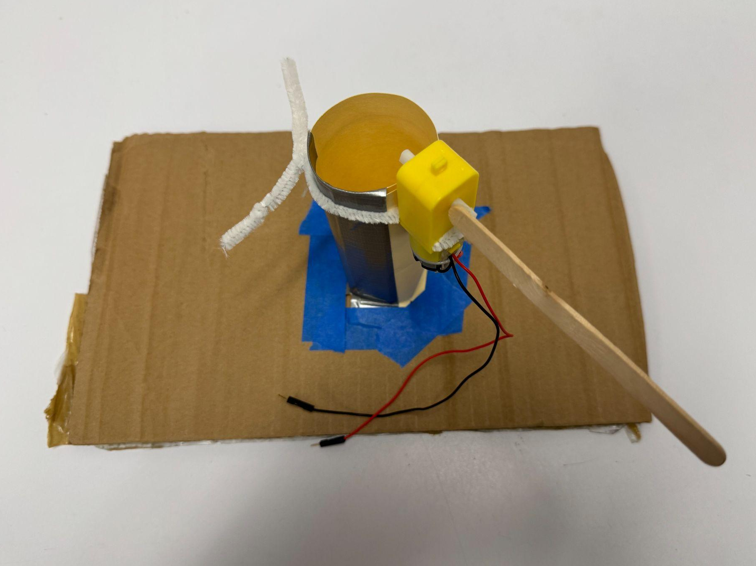
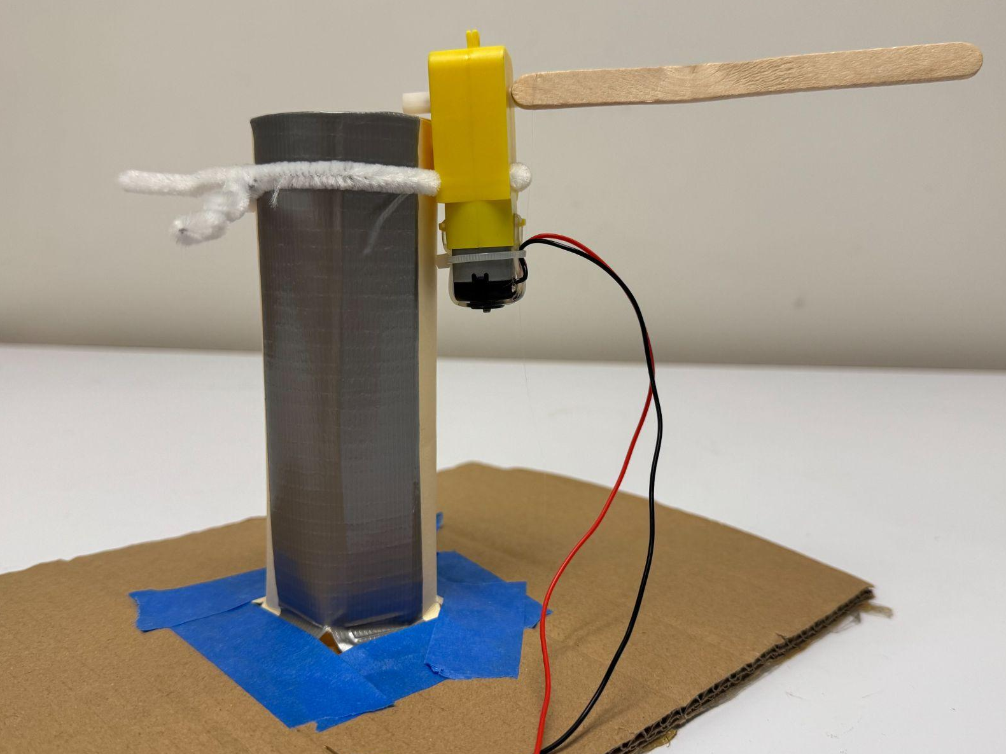
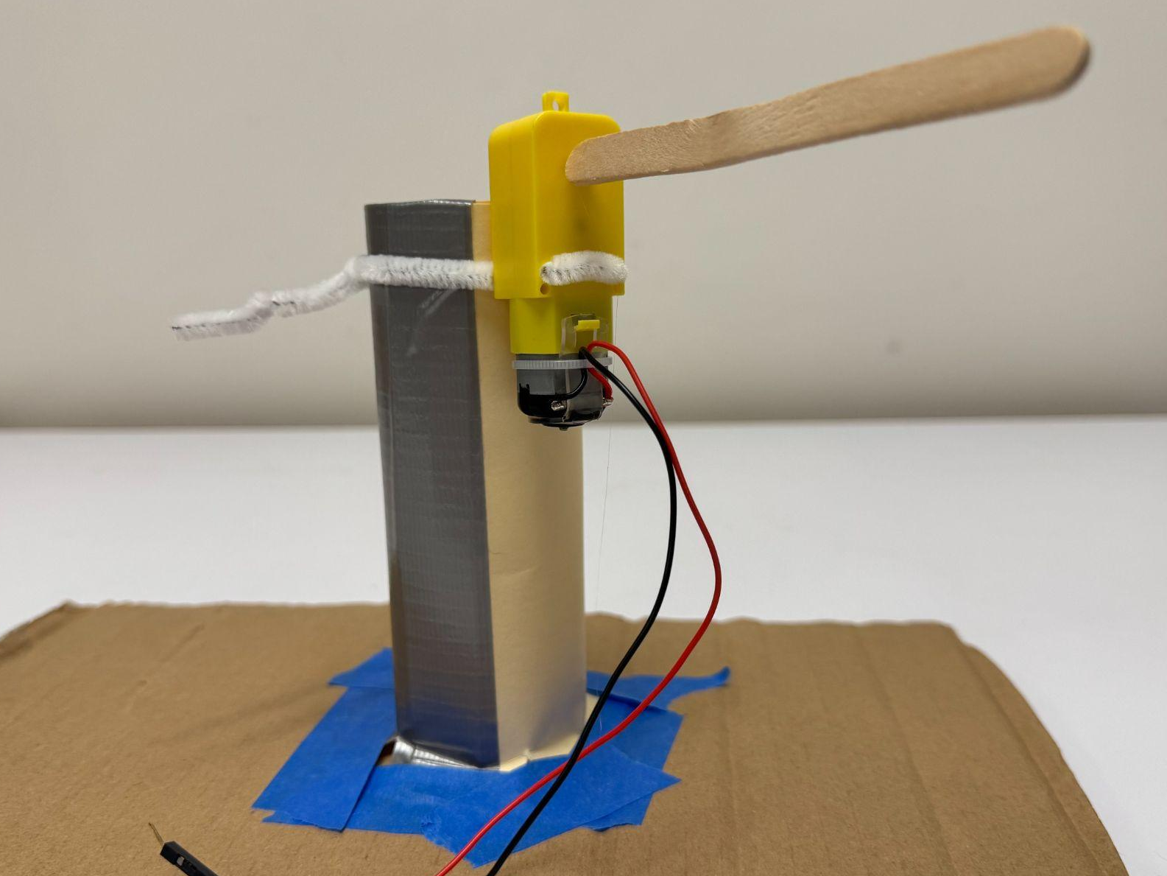
Toilet Paper Rolls/Cardstock
Use pipe cleaners to connect the motors to the toilet paper rolls/cardstock rolls.

Slide 4
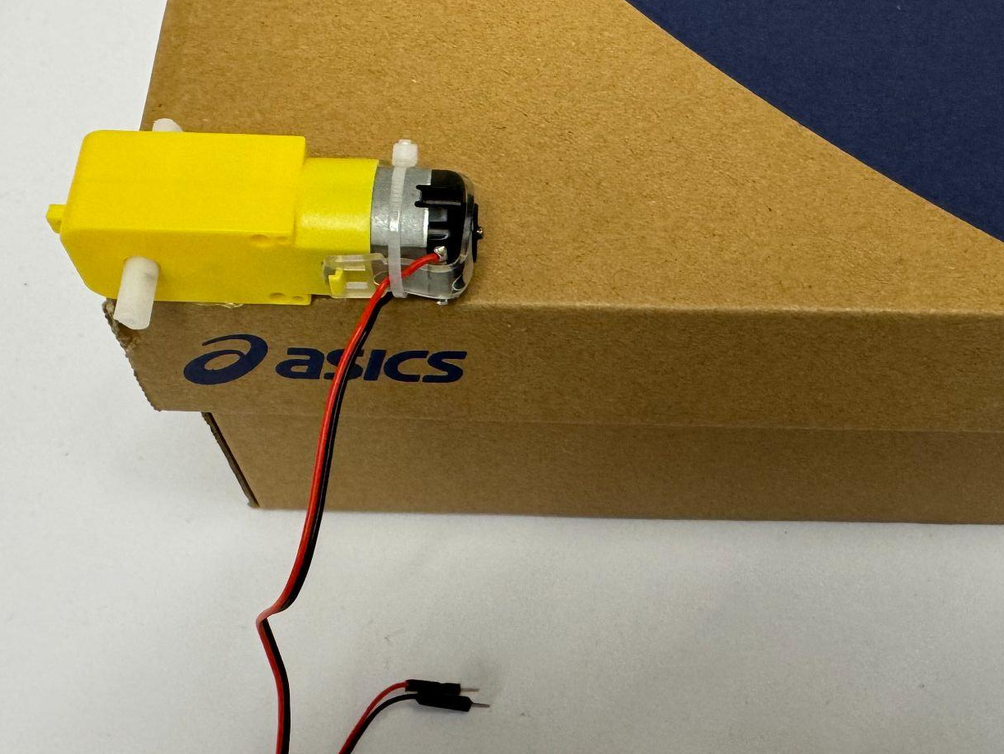
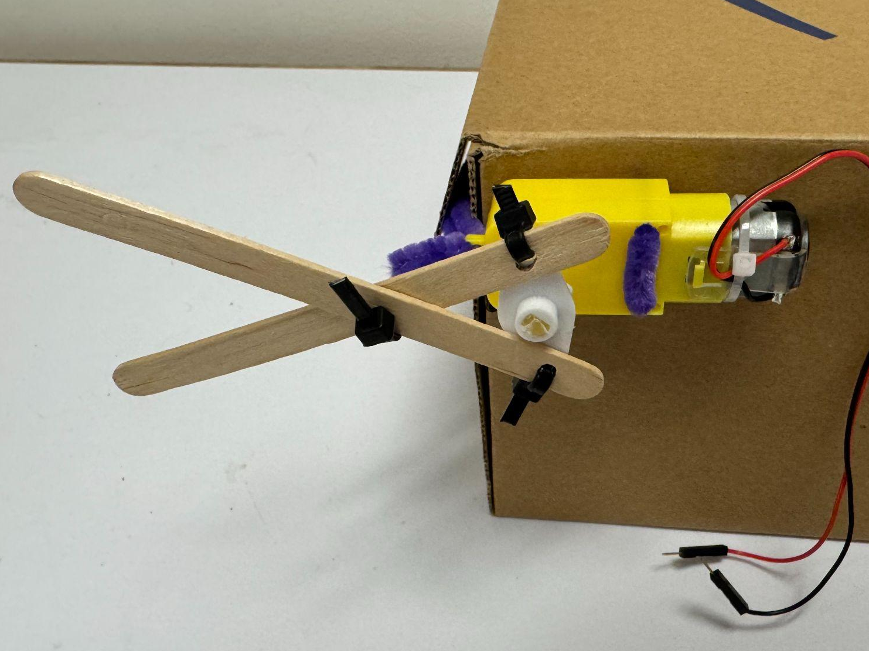
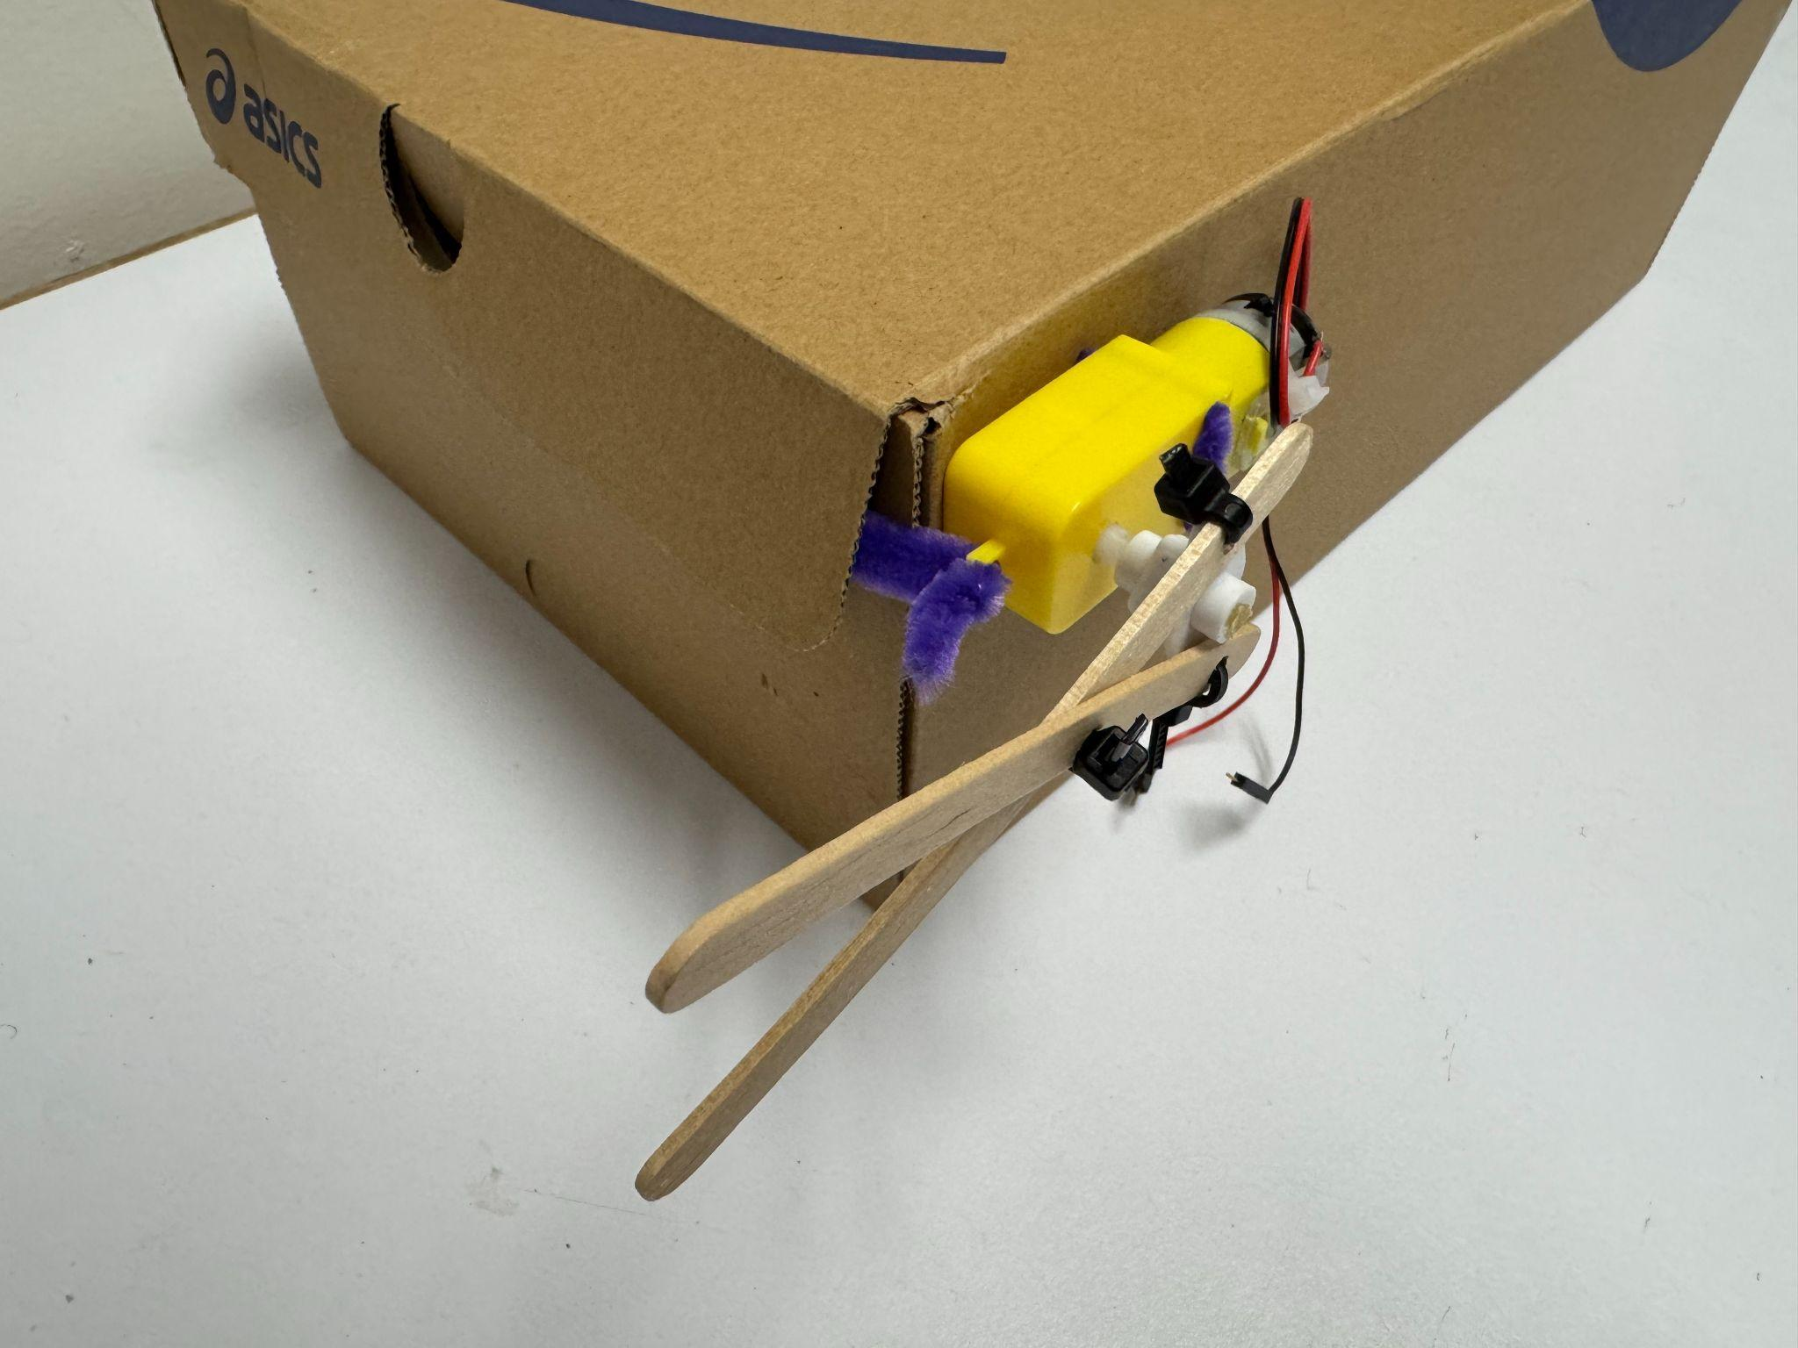
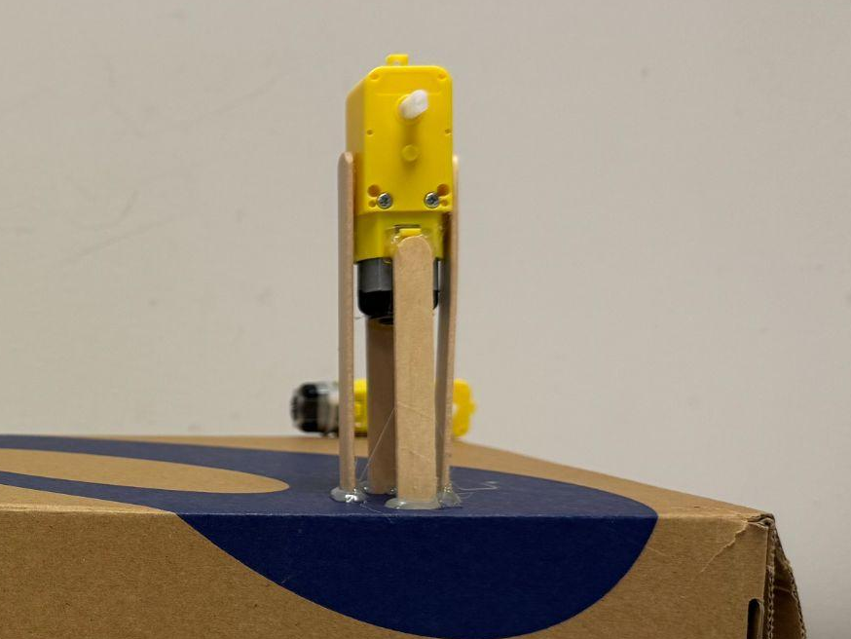
Shoe Boxes/Boxes
Use hot glue gun, pipe cleaner, or popsicle sticks to connect motors to the boxes.

Slide 5
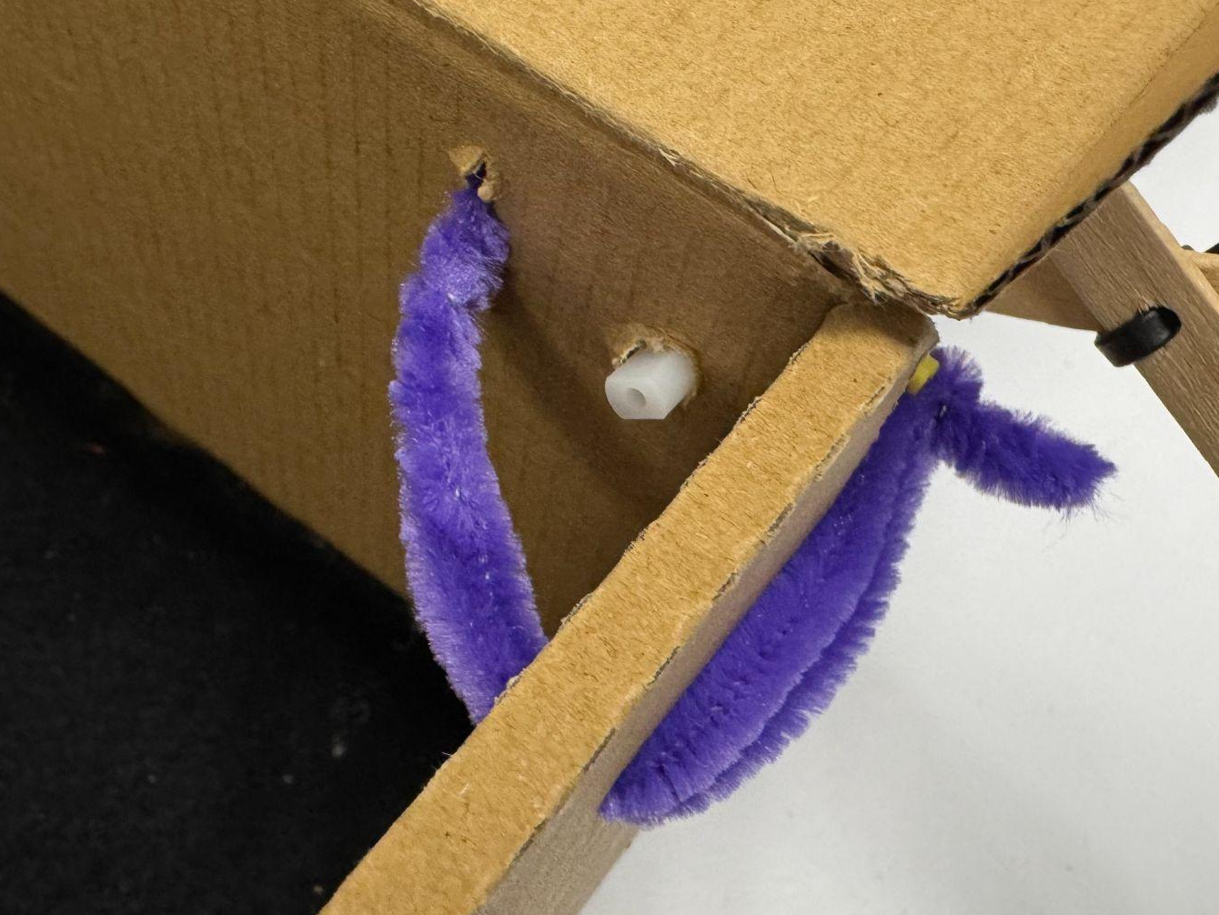
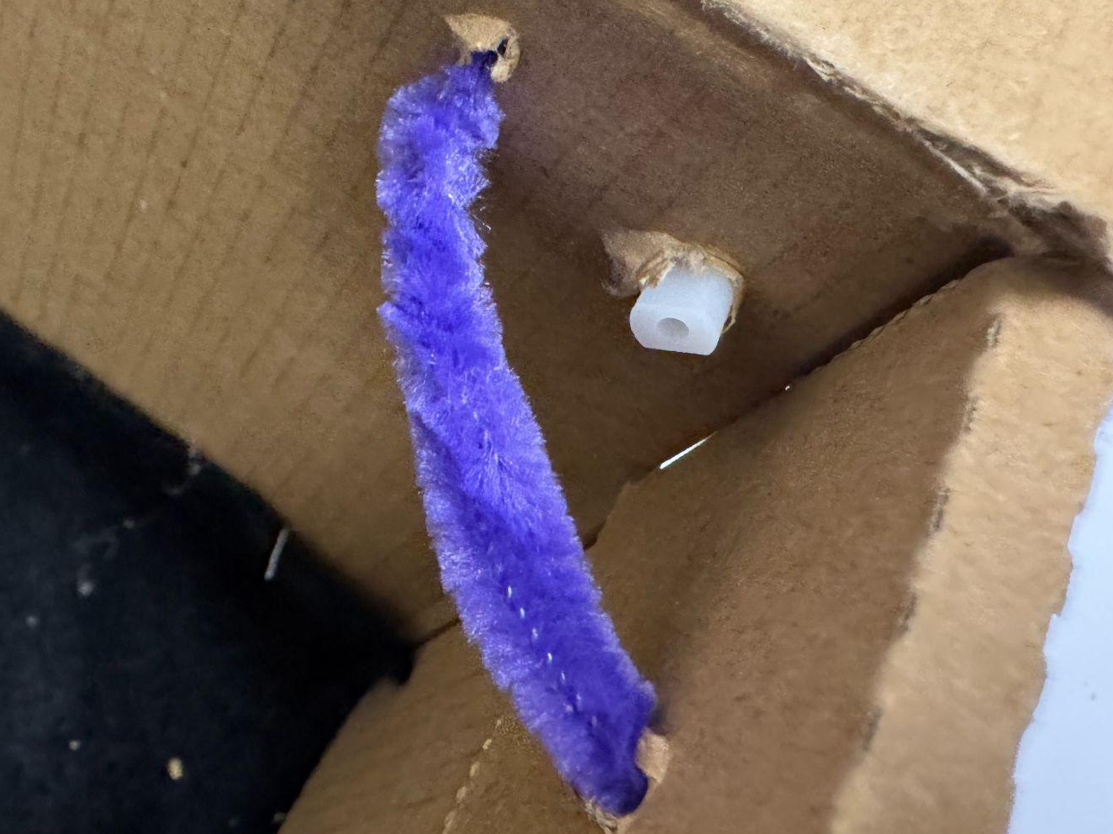
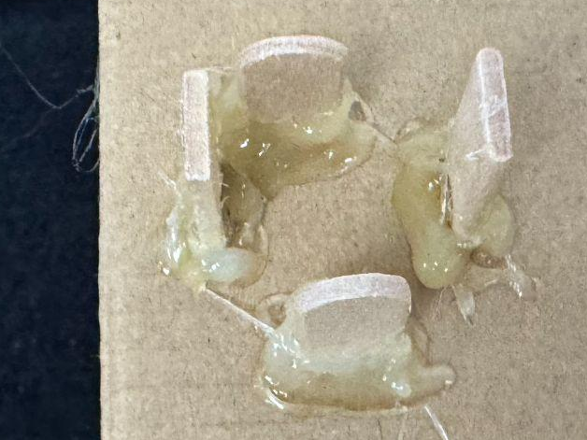
How to build
Make holes on the box, and use pipe cleaners go through both motor and box to connect the motor to the box.
Make small gaps on the box for popsicle sticks to go through, and use the hot glue gun to glue the popsicle sticks to the box.

