Slide 1


Motor Attachment Tips

Slide 2
With motor adapter

Slide 3
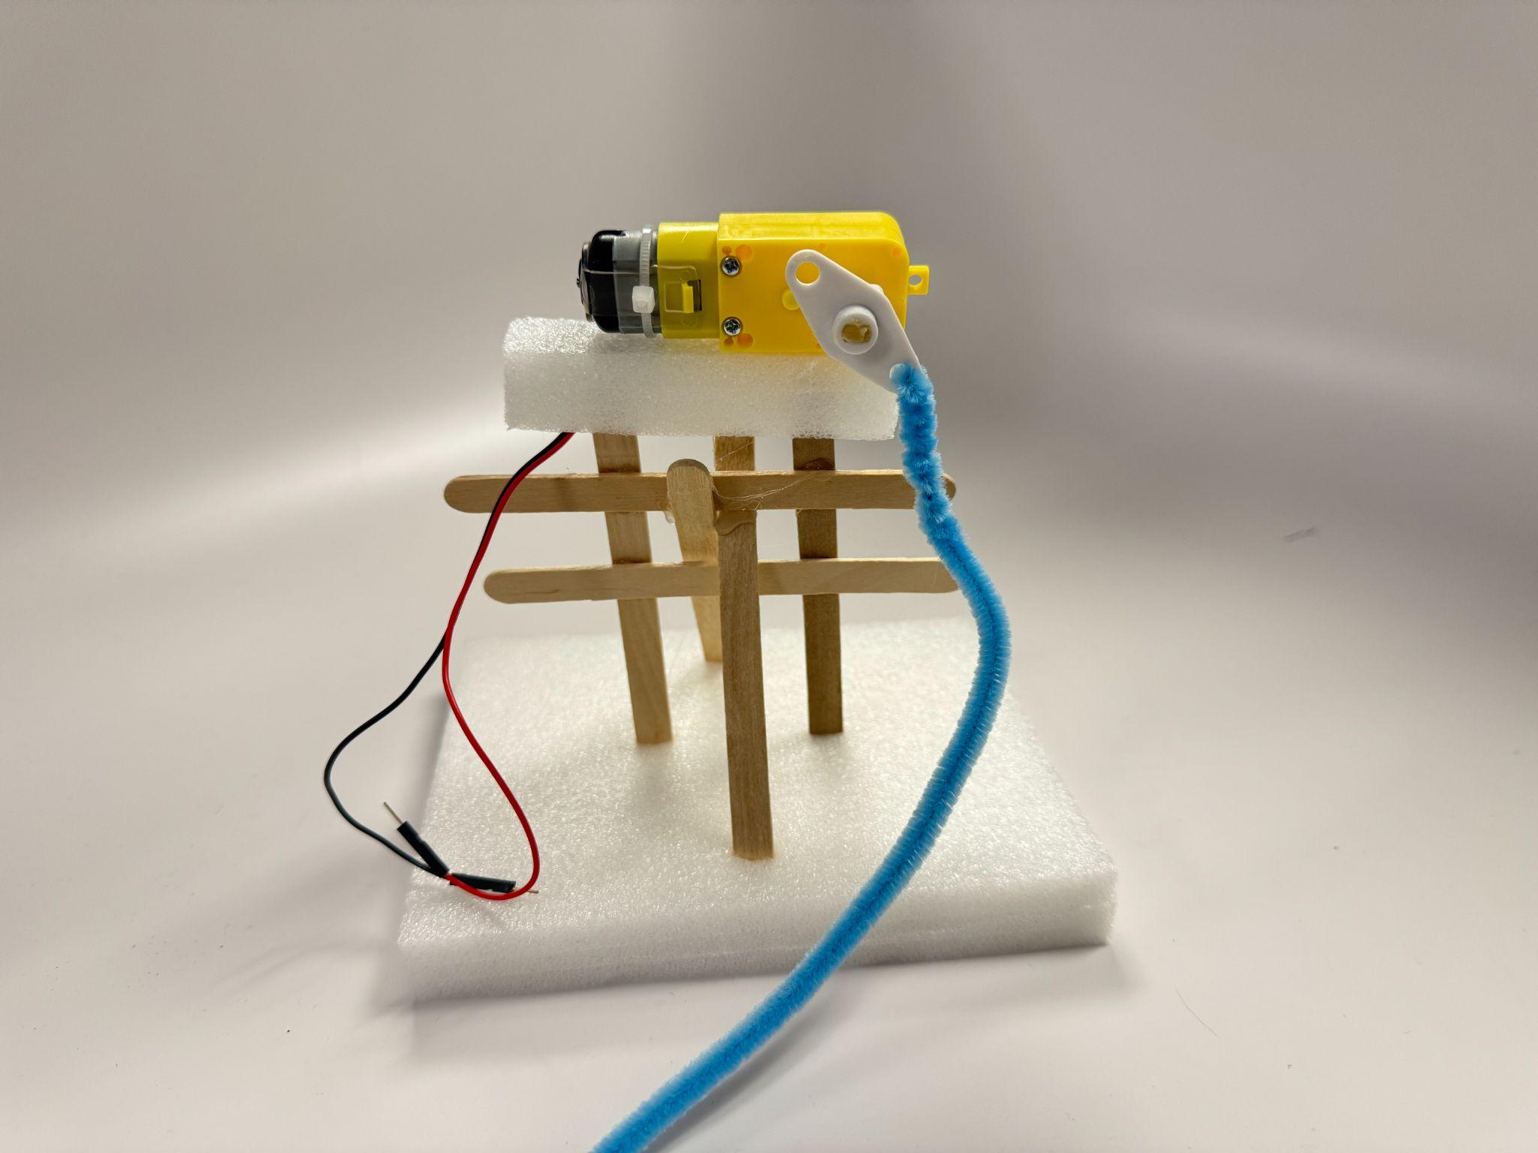
Pipe cleaner
Attach directly and twist it to be tight.

Slide 4
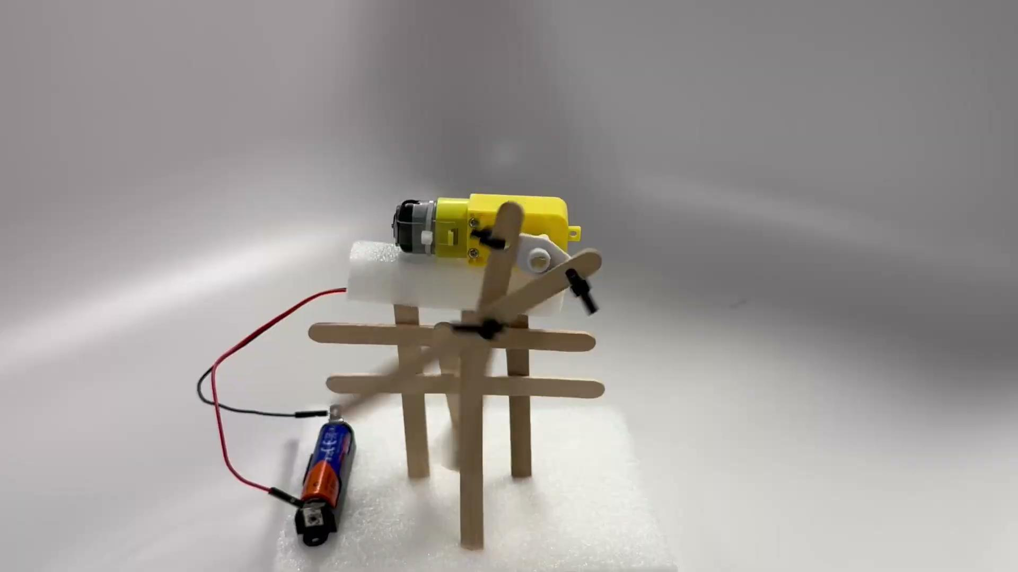
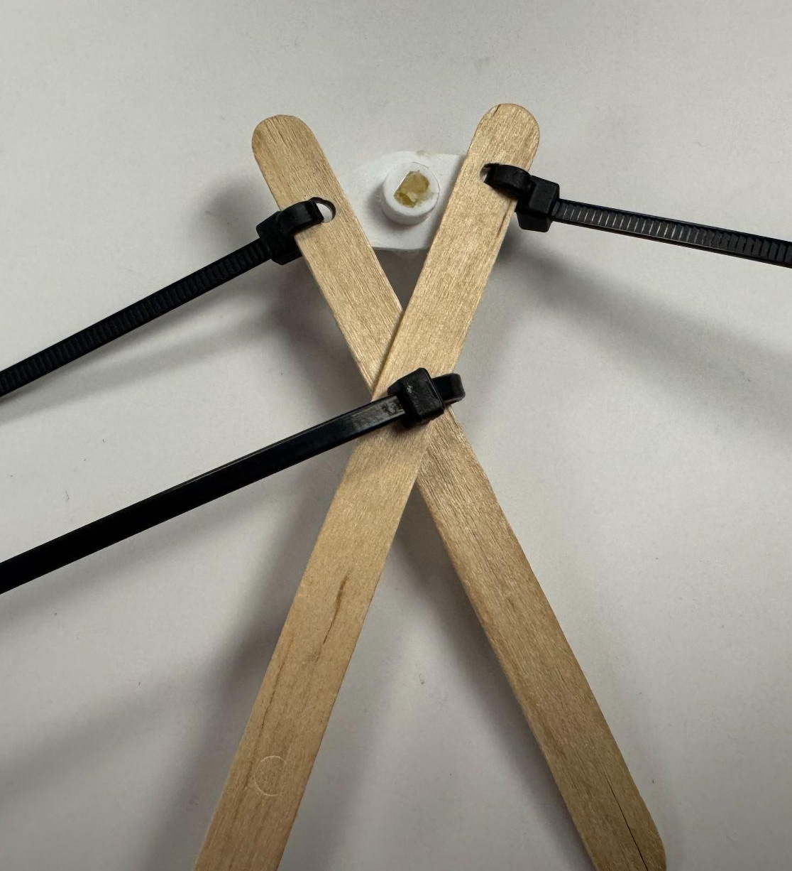
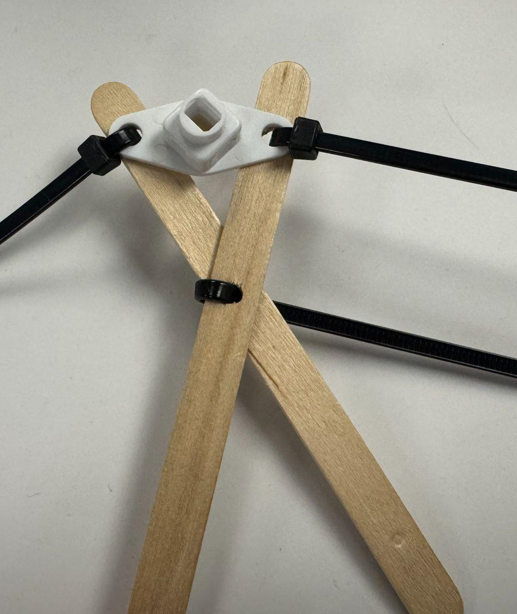
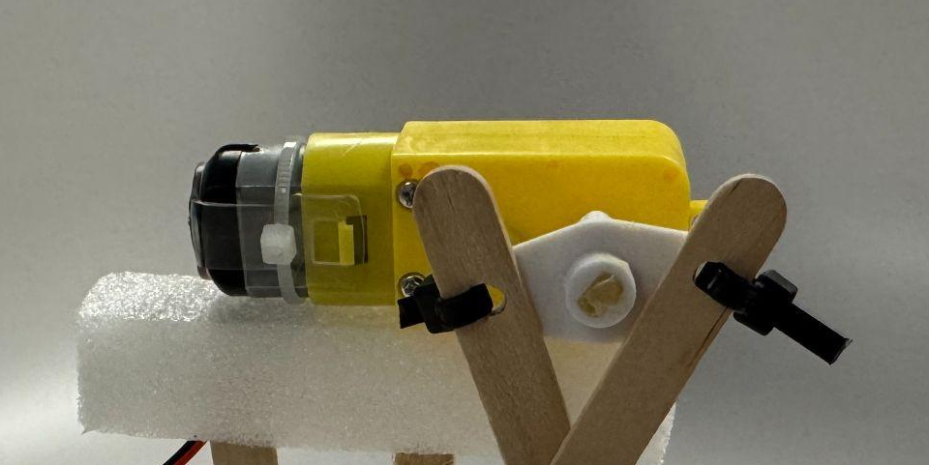


Popsicle stick and zip tie
Front
Back

Slide 5
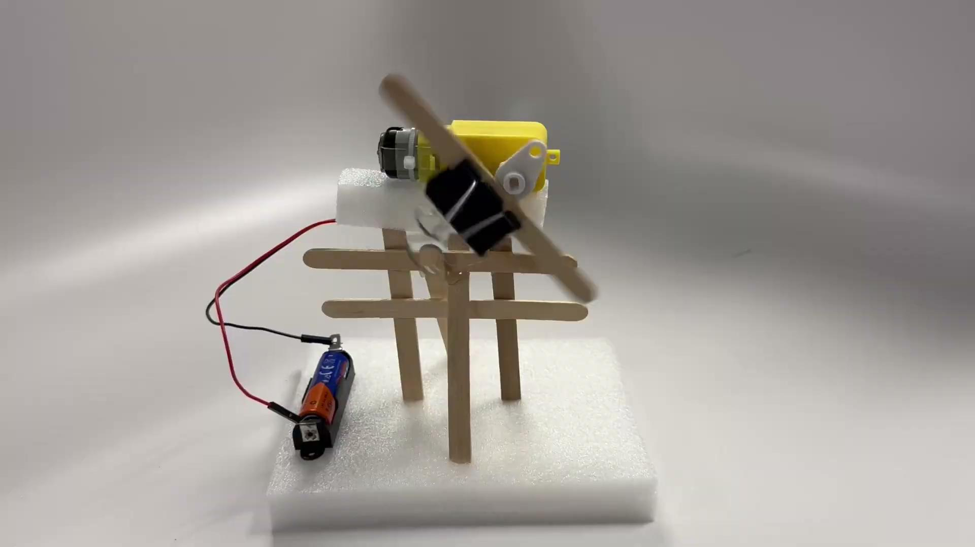
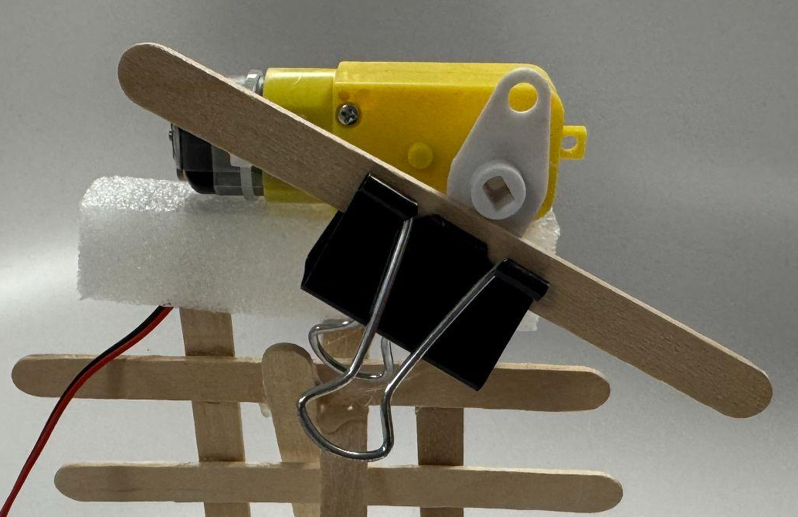
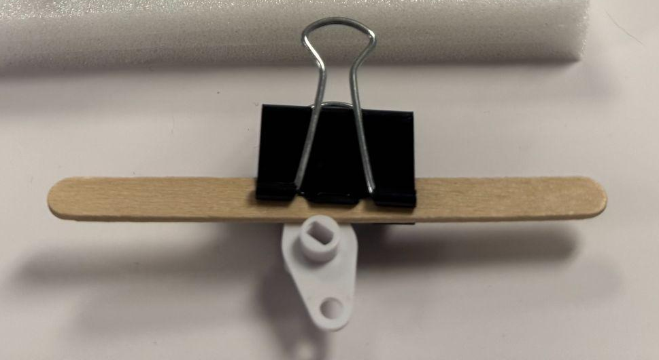
Clips

Slide 6
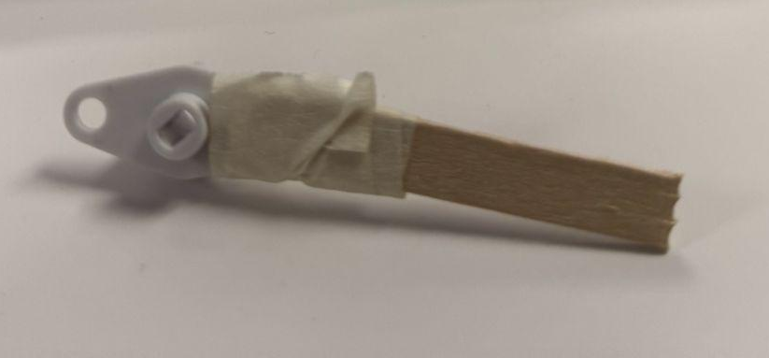
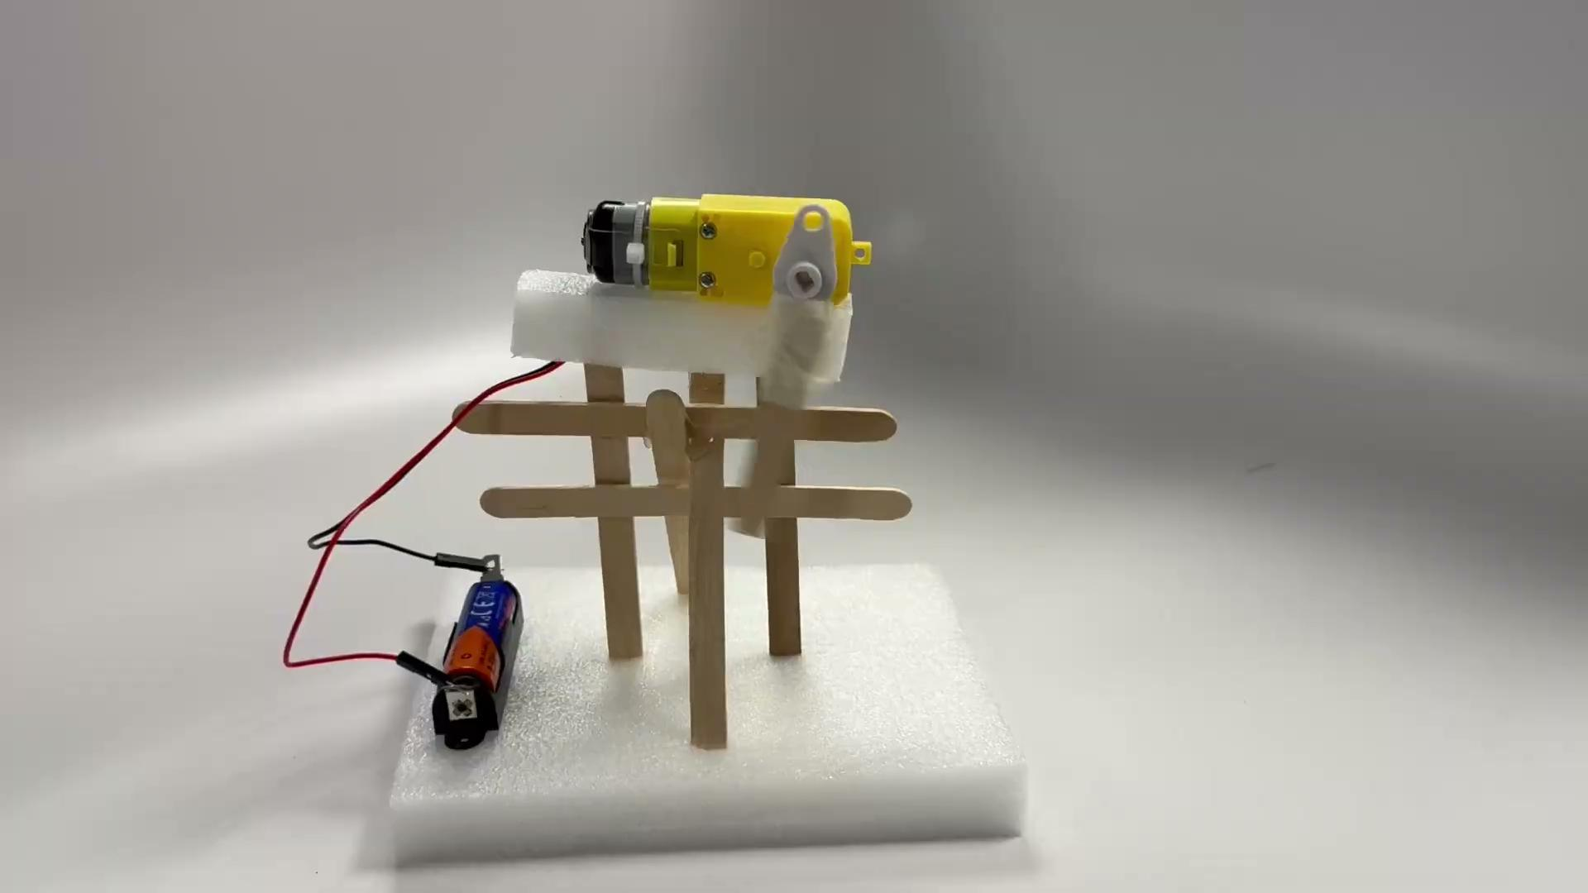
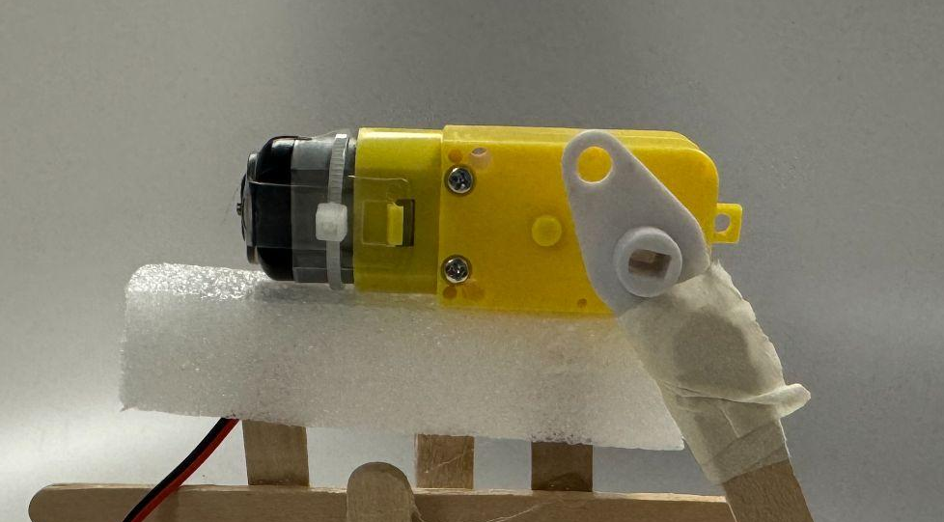
Tape

Slide 7
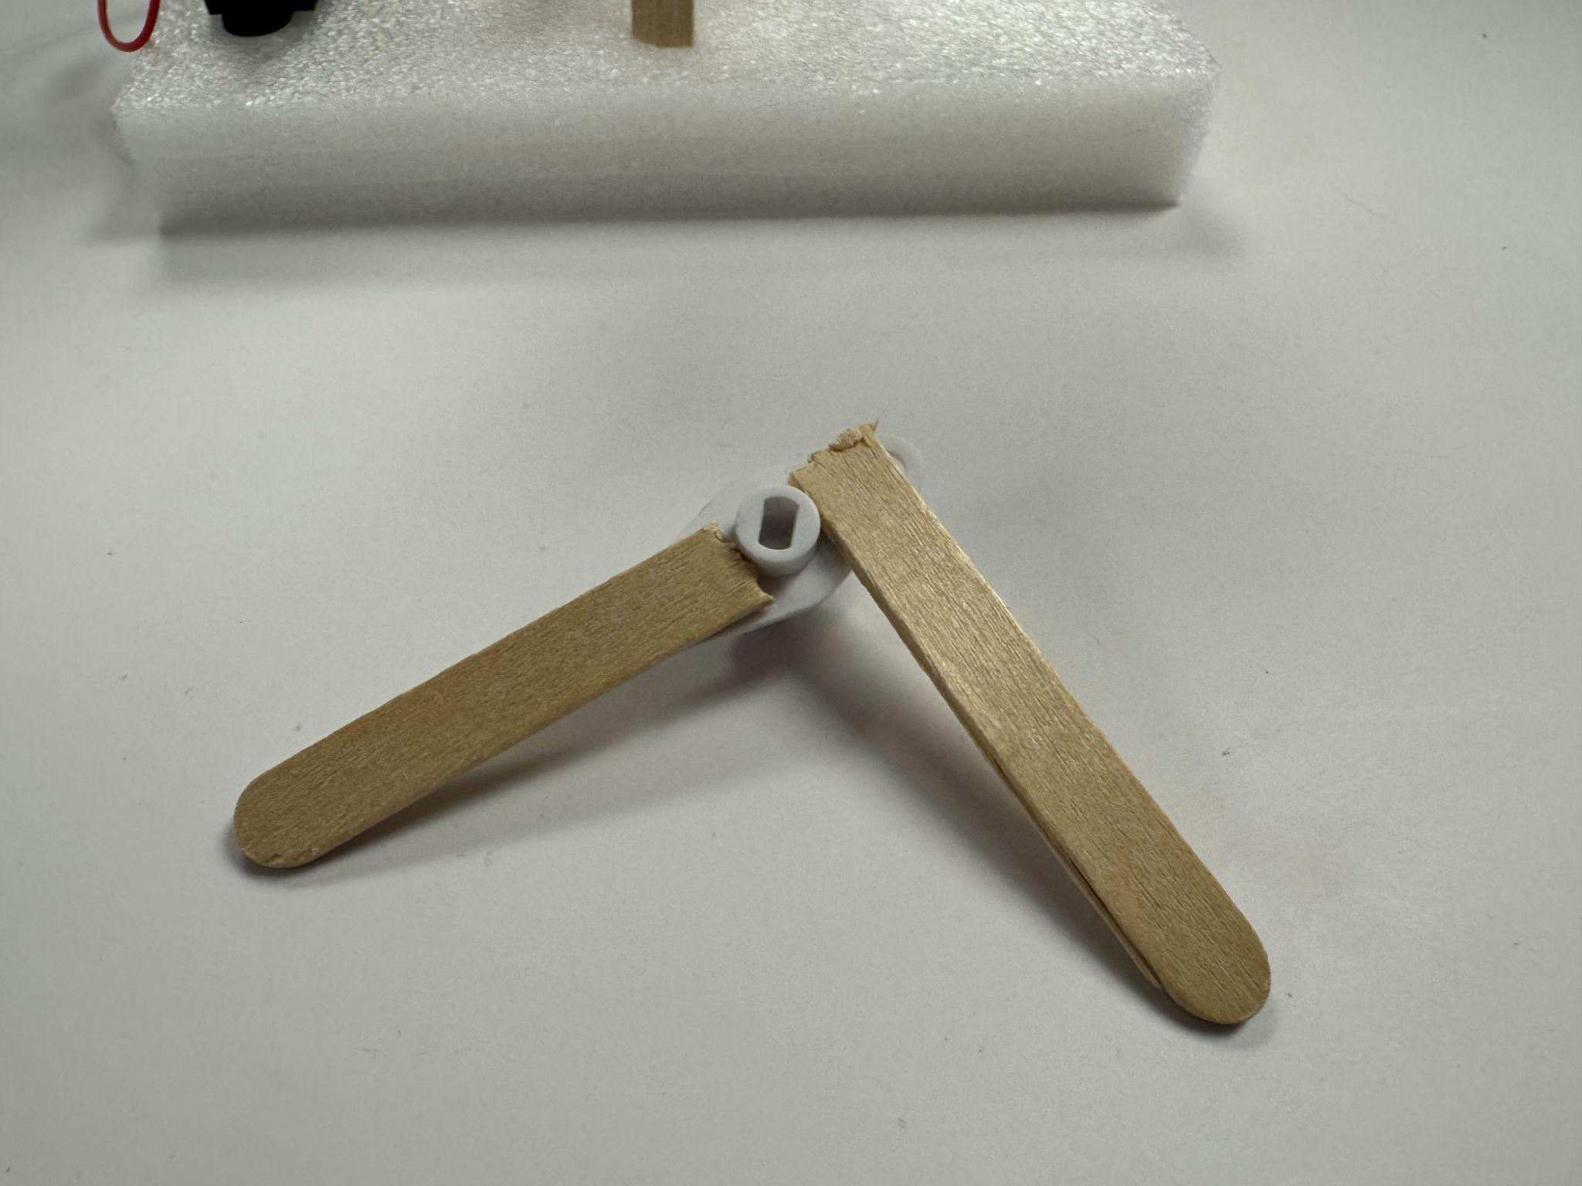
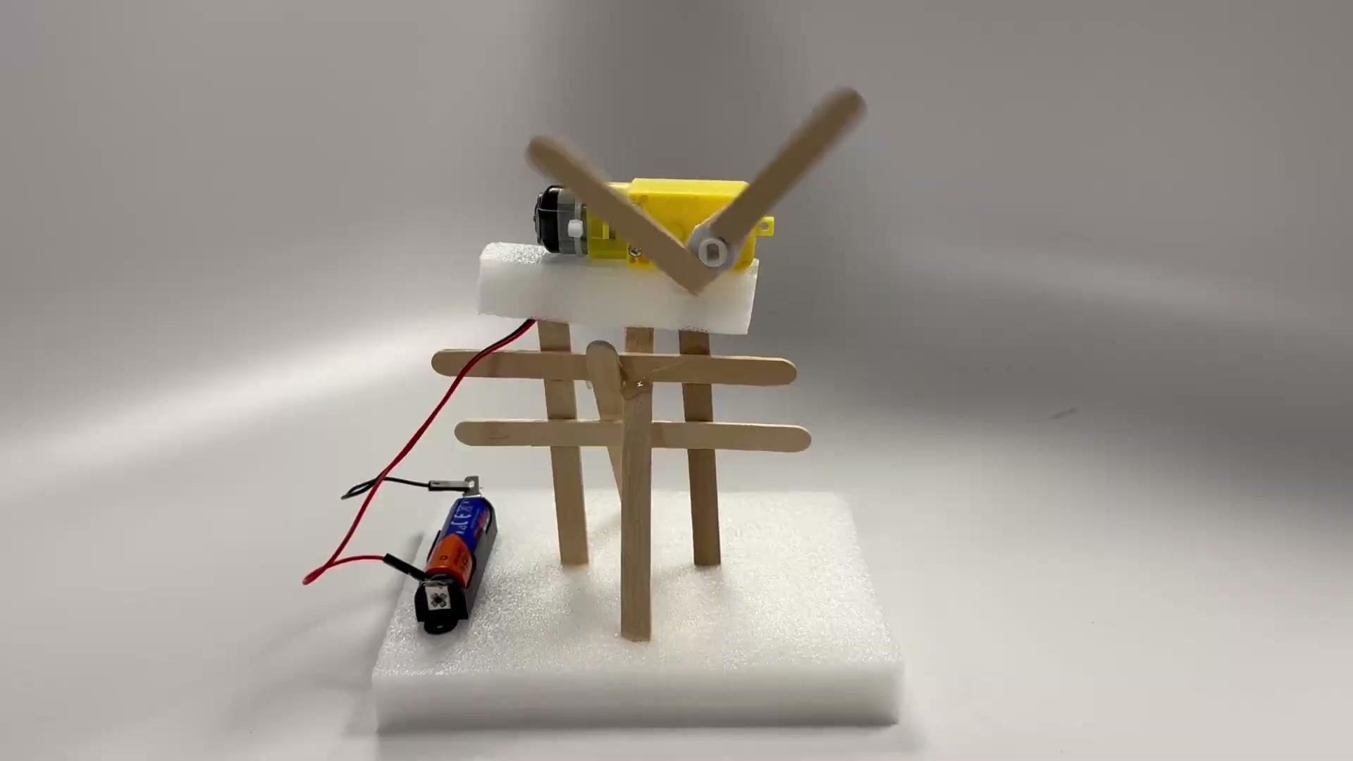
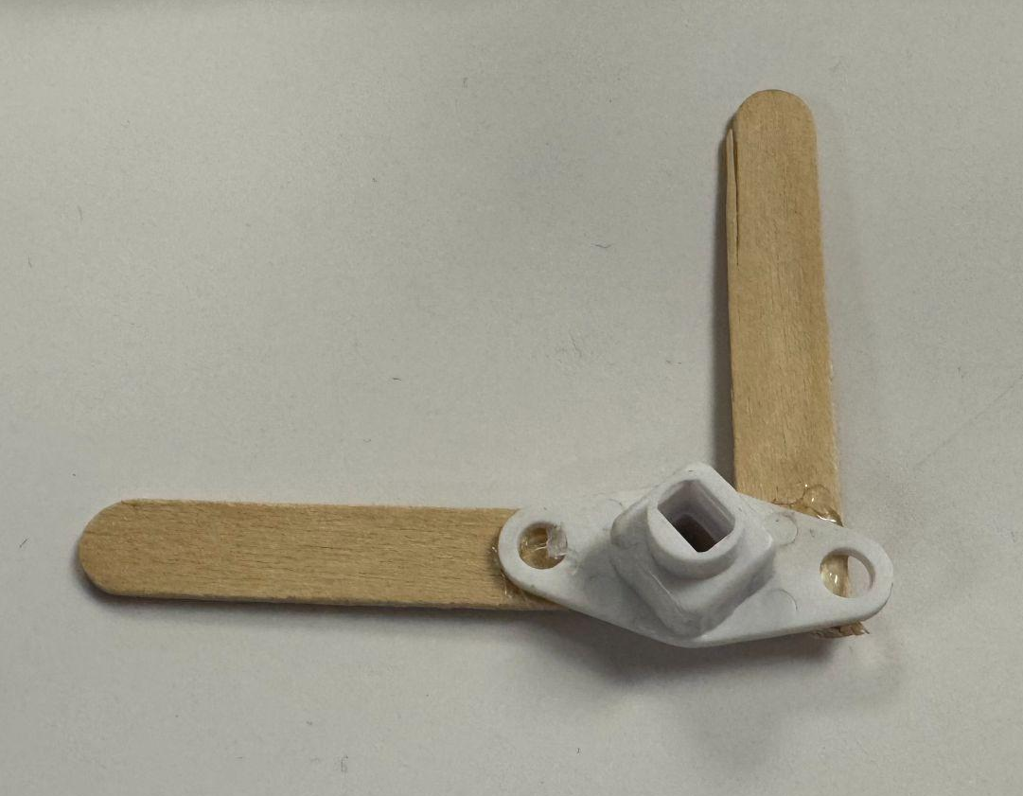
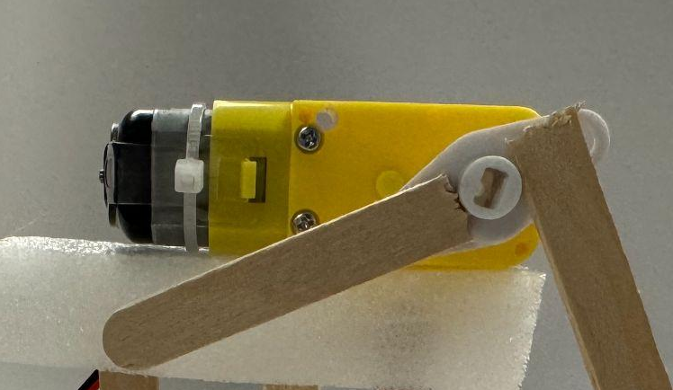
Hot glue gun
Front
Back

Slide 8
Without motor adapter

Slide 9
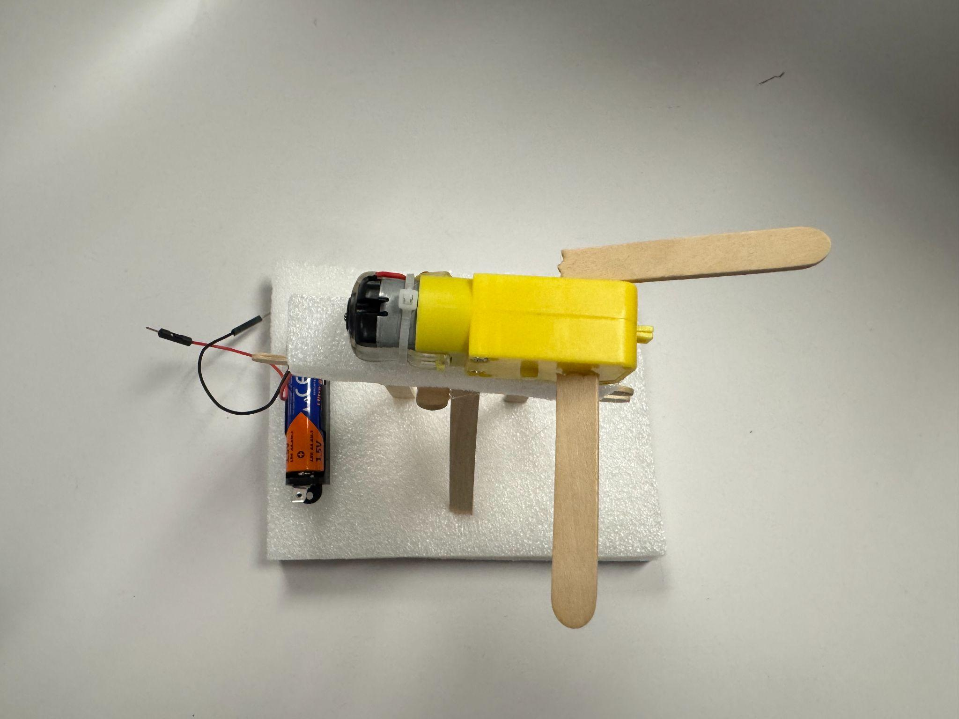
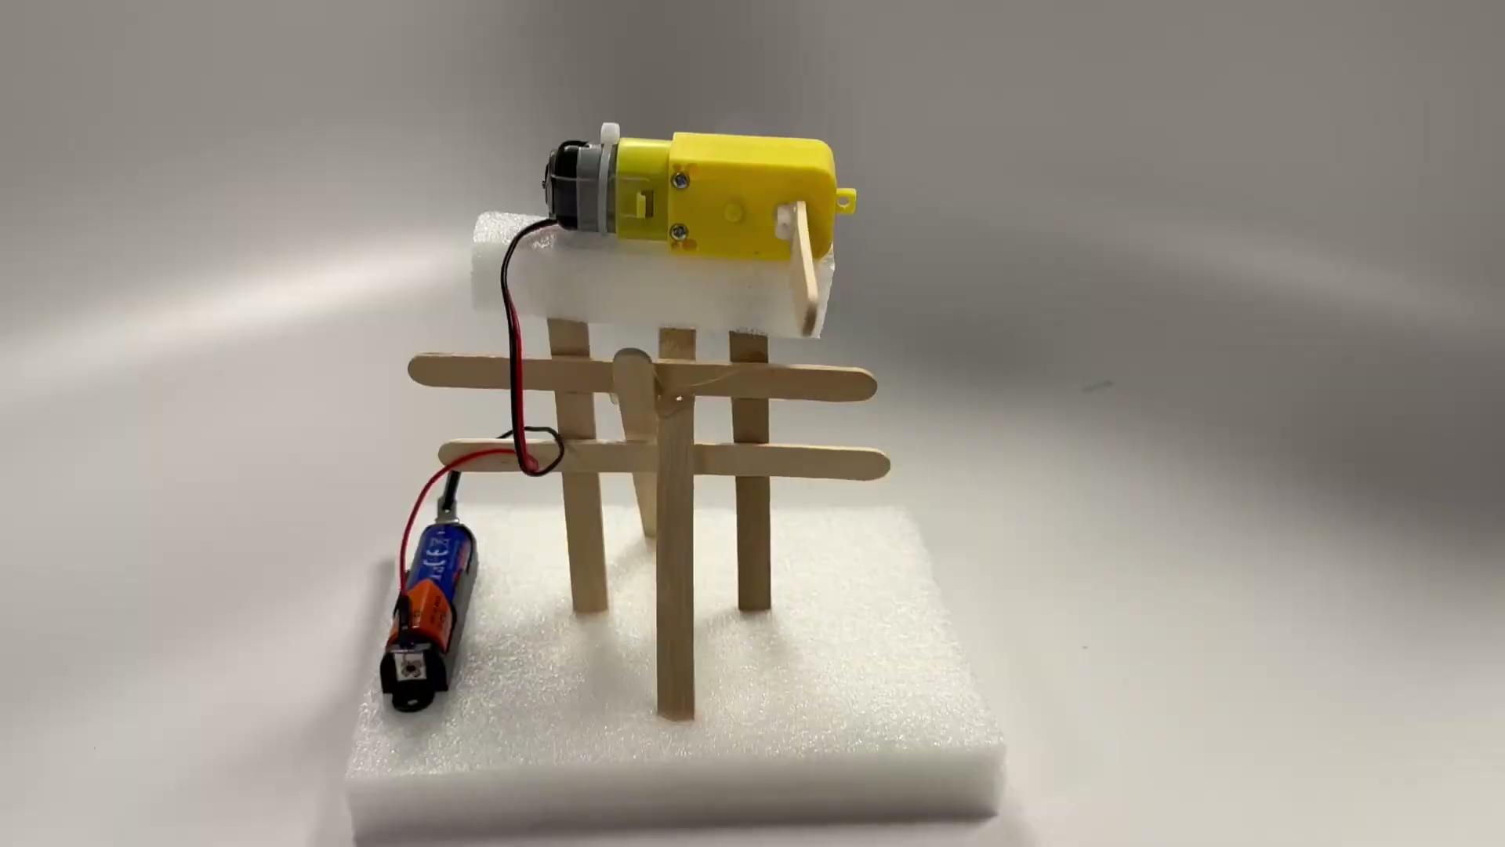
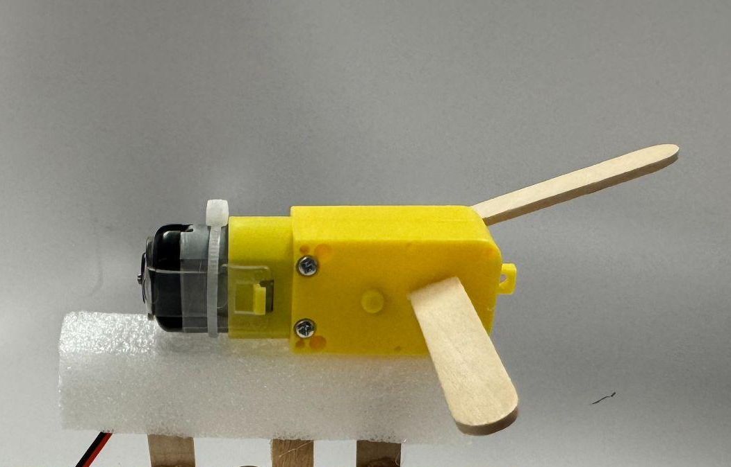
Hot glue gun
Attach the popsicle sticks to the flat side of the white shaft on the motor.

Slide 10
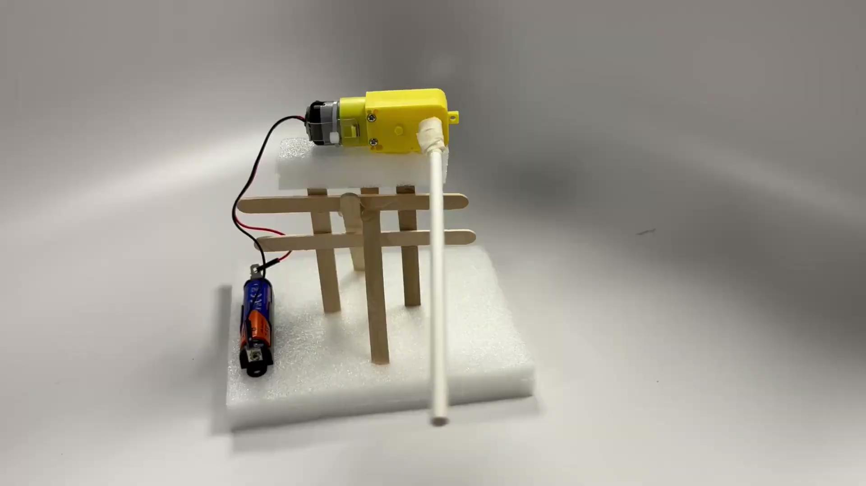
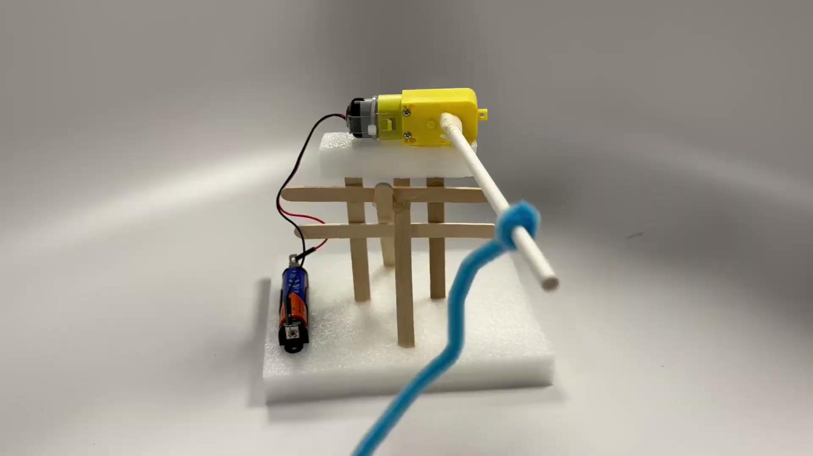
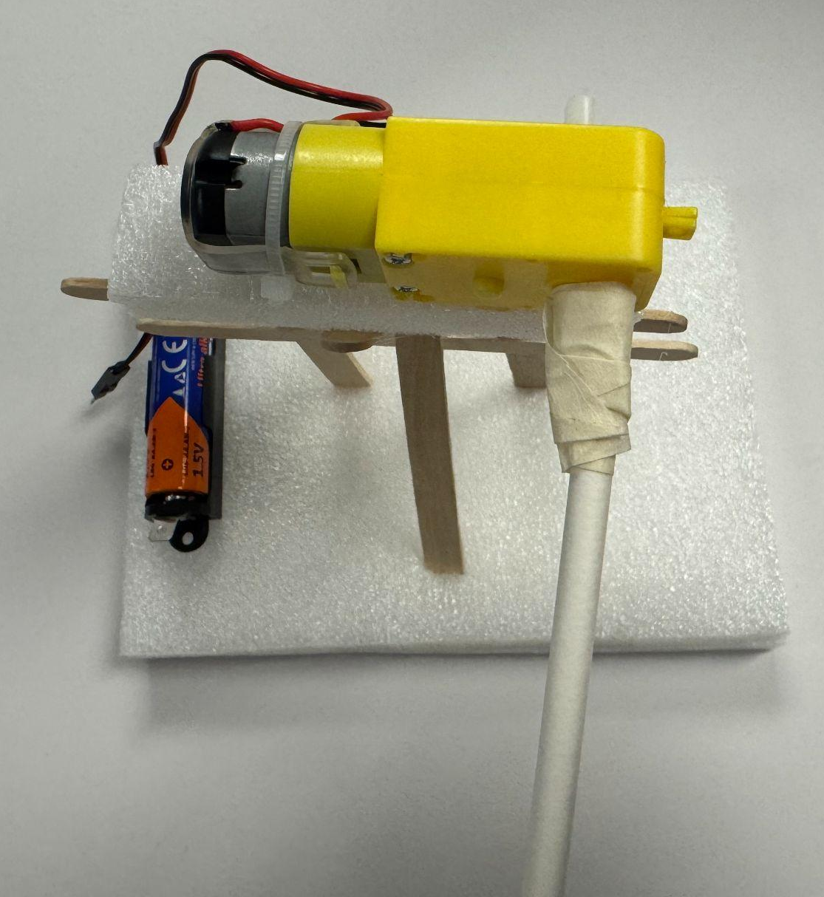
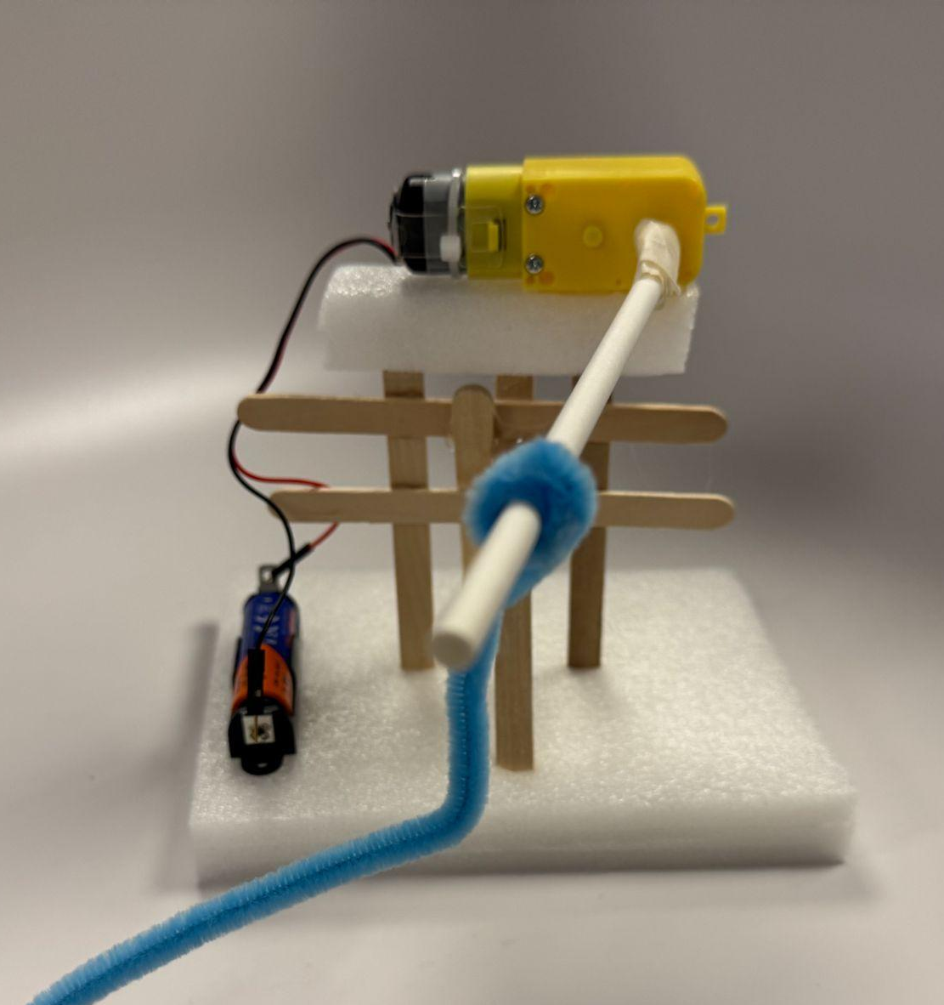
Tape
Tape your attachment tightly on the white shaft. Even a round shape works, such as a small wooden stick or straw. You can also attach other stuff to the attachment.

Slide 11
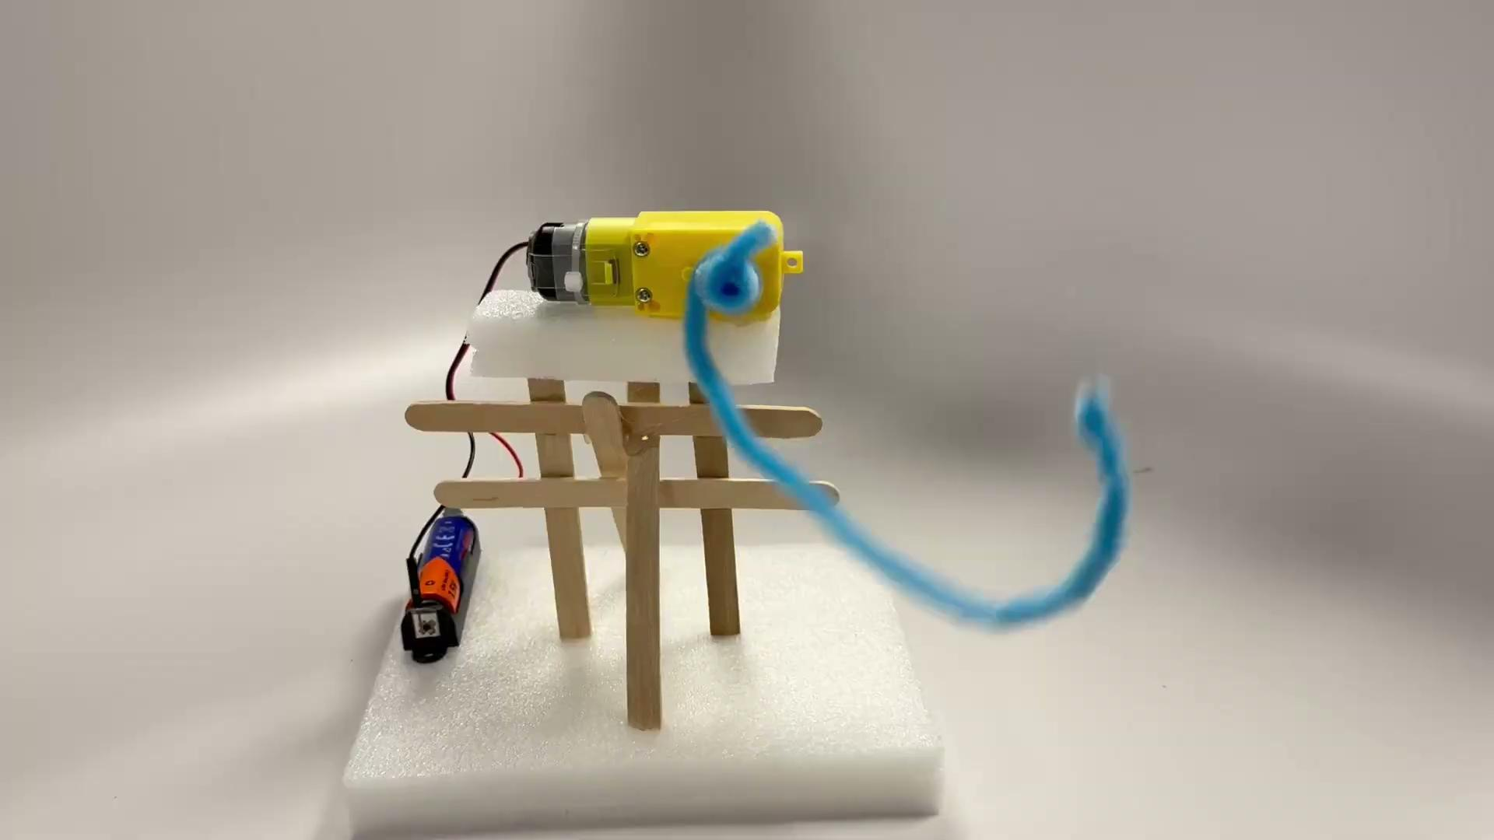
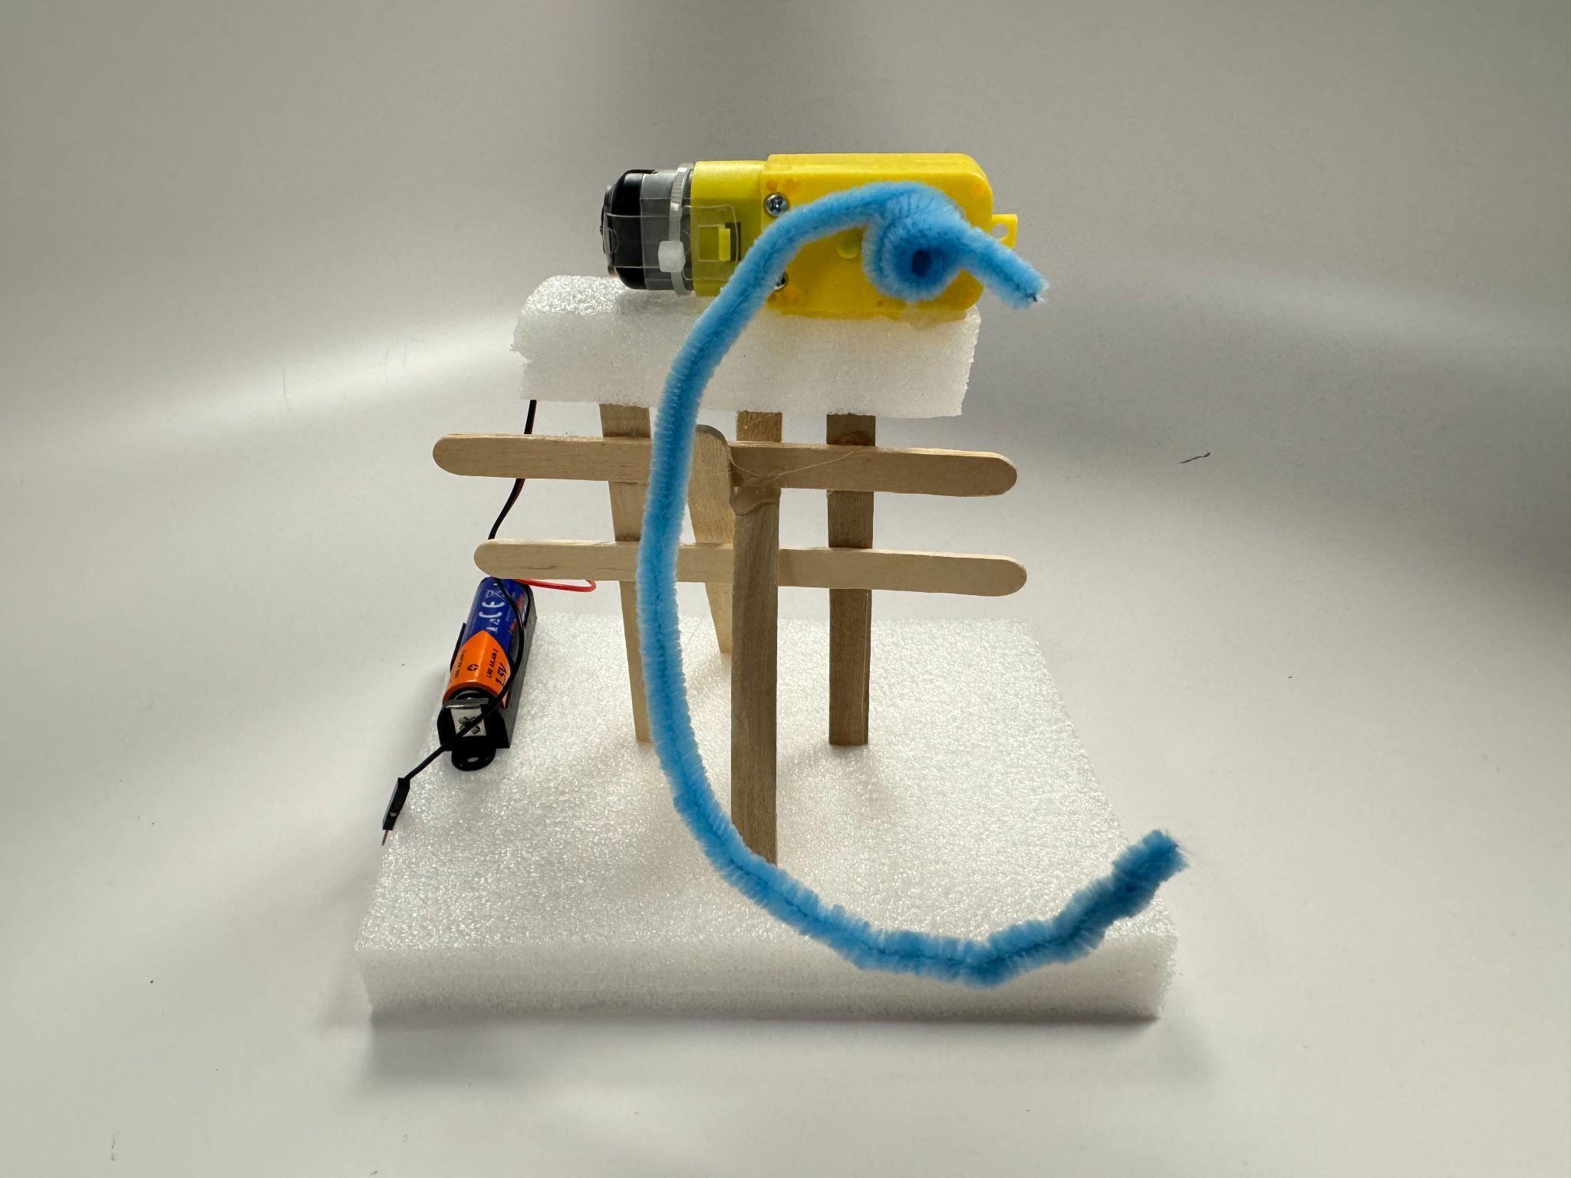
Pipe cleaners
Tie it directly to the white shaft on the motor.

Slide 12
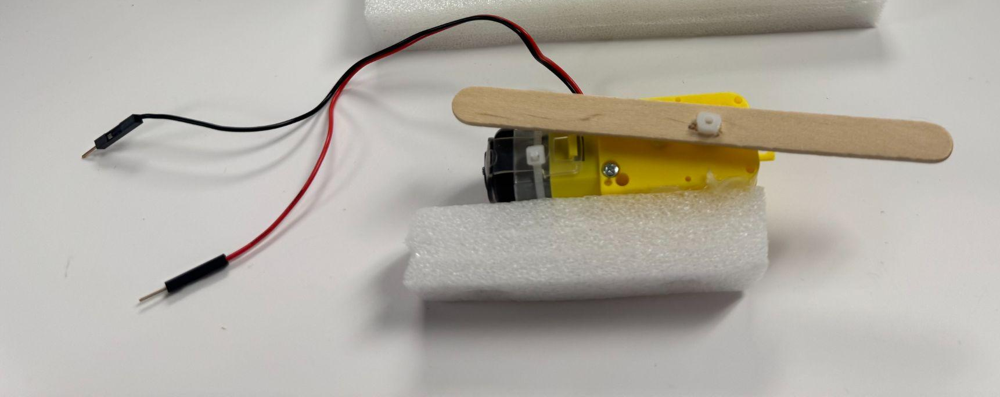
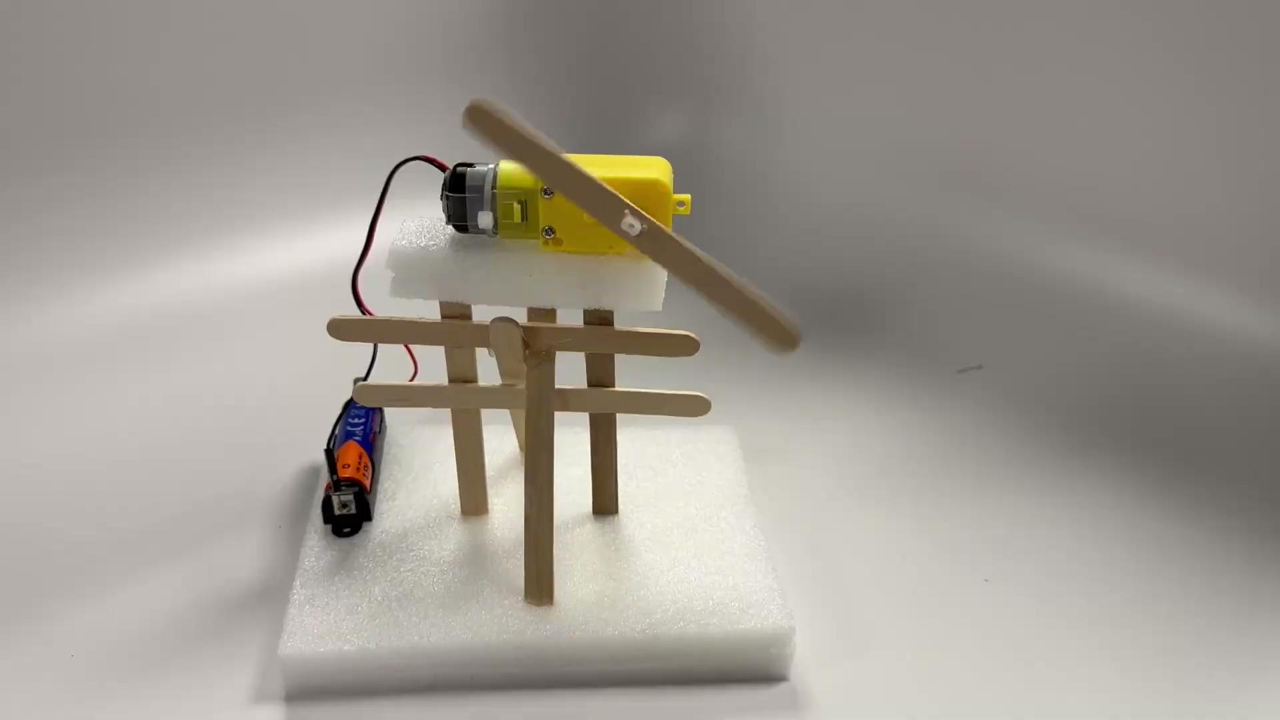
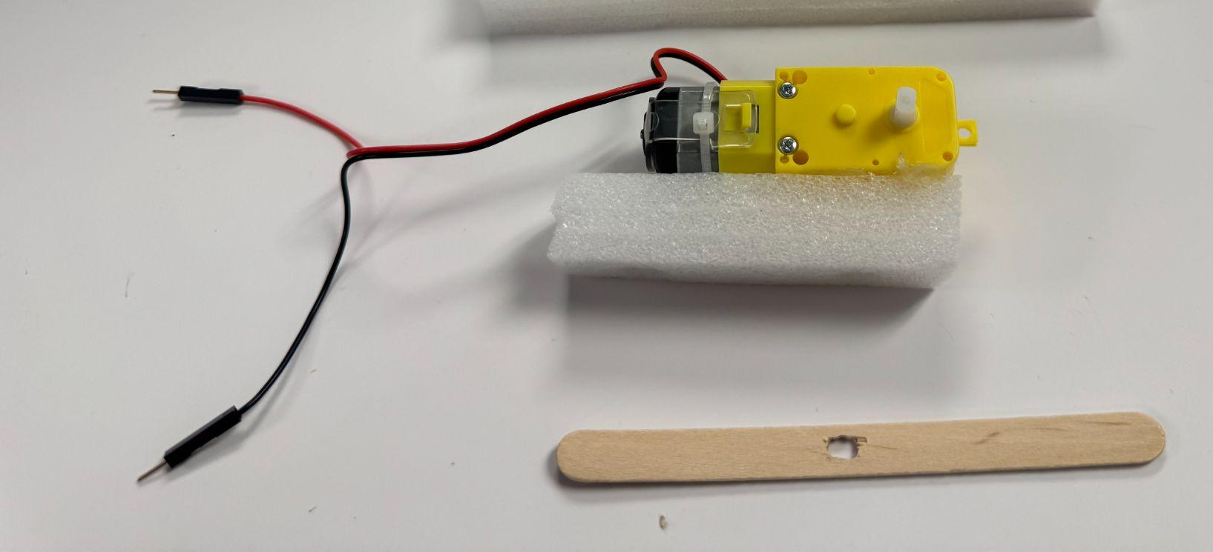
Popsicle sticks and a hole puncher
Use the hole puncher to make a hole that has the same shape and size as the white shaft of the motor.
Then push the white shaft of the motor into the hole you just made in the popsicle stick.

Slide 13

How to build - Popsicle stick and zip tie
Take two popsicle sticks.
Use a hole puncher to make a hole at the same position on both of the popsicle sticks. The hole should be a similar size to the hole on the adapter.
Use a zip tie to tie the popsicle stick and motor adapter together loosely.
Cross your two popsicle sticks, choose a point where you want them to cross, mark it, and make a hole in both of the popsicle sticks at the same position.
Use another zip tie to tie two popsicle sticks together at the cross point you made loosely.
Double-check whether the popsicle sticks on the position you want.
Tie all the zip ties tightly.
Cut the extra part of the zip ties.

Slide 14
How to change the spinning orientation?

Slide 15
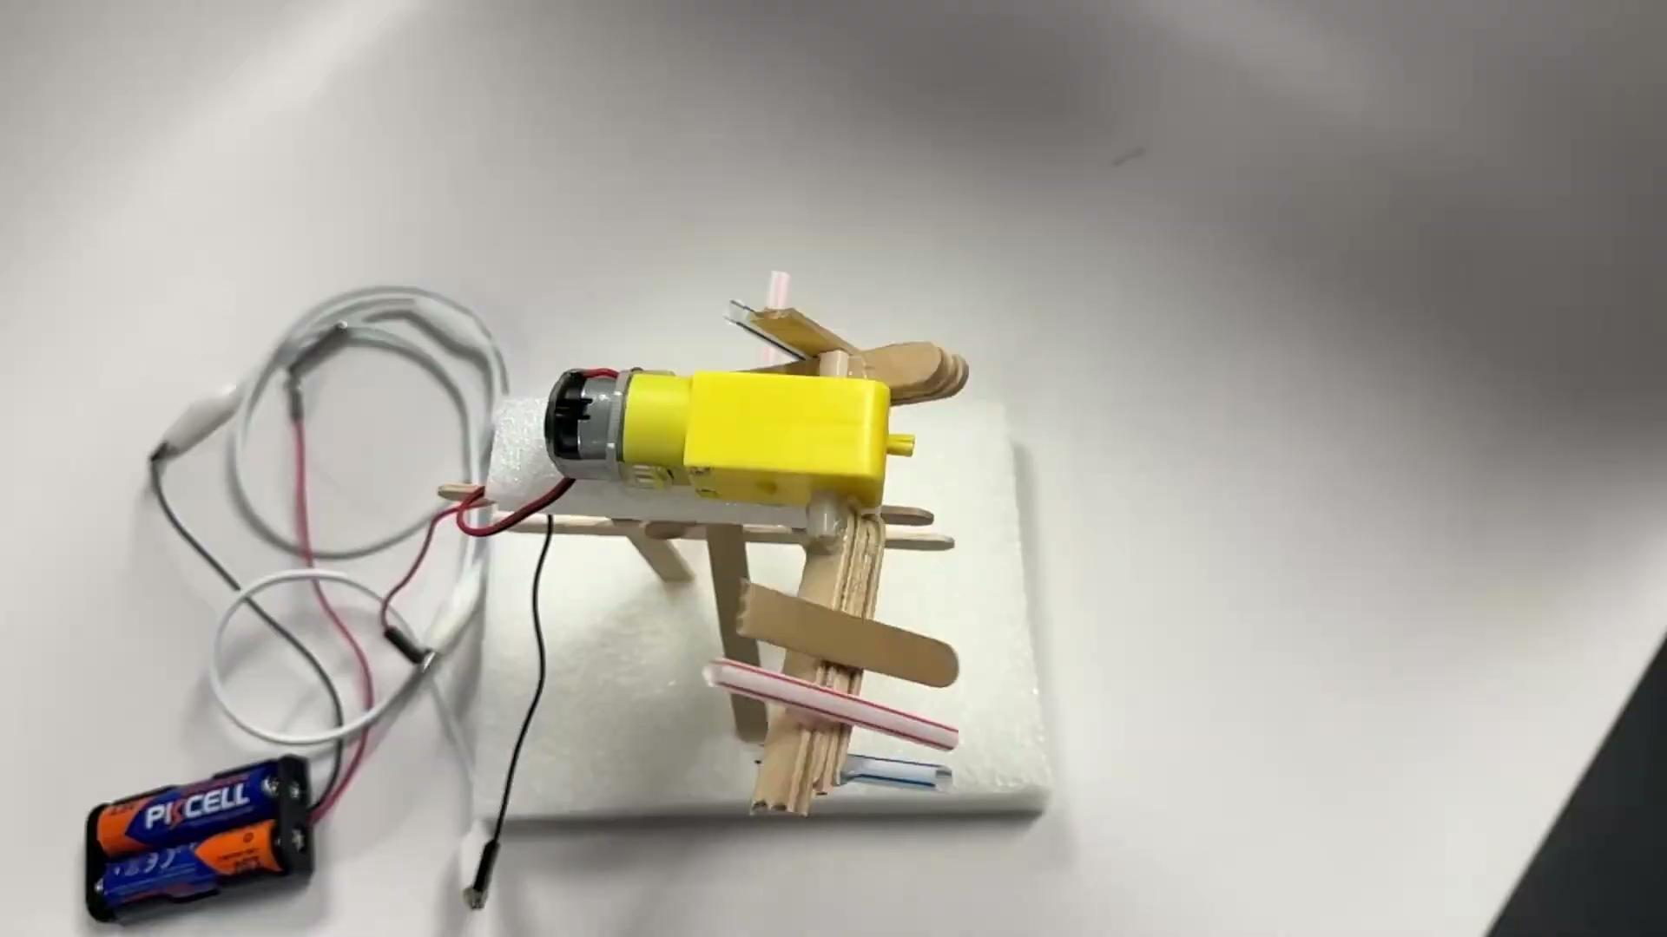
This video shows different orientations for craft sticks attached to the motor shaft.
Sometimes you need them to spin like a wheel, but sometimes you need them to spin like a lever arm.

Slide 16
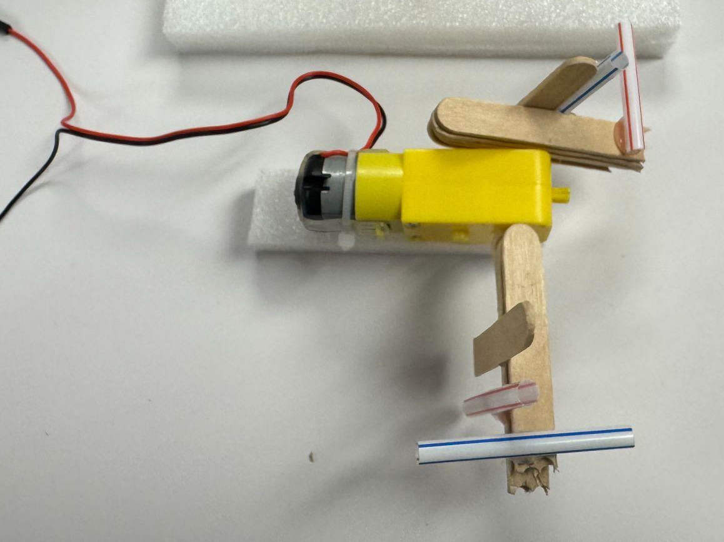
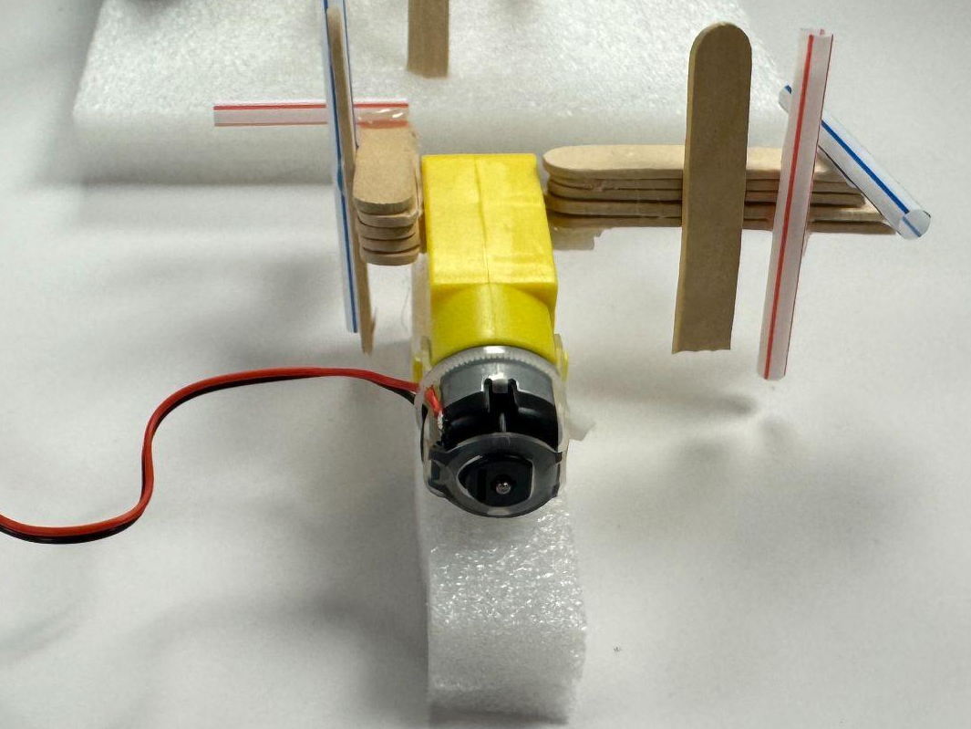
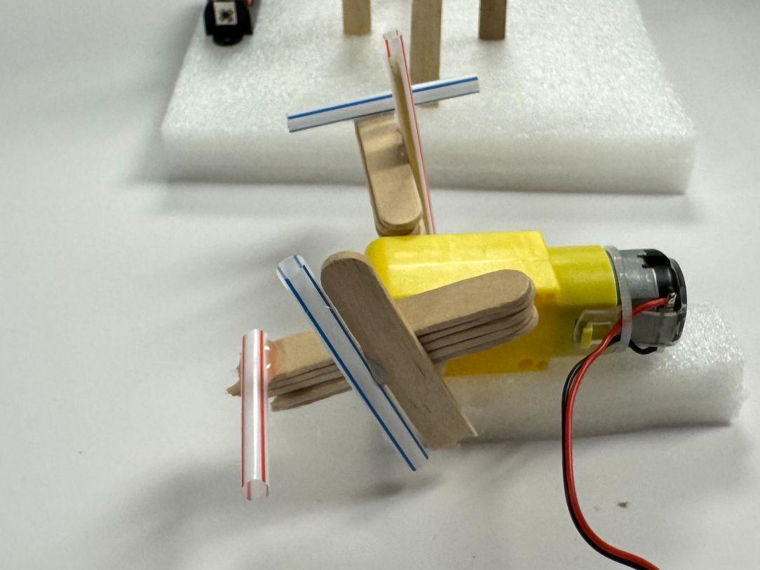
How to build
Grab several popsicle sticks.
Glue them together to make them thick.
Glue them onto the white shaft of the motor - there are two ways to attach them, horizontally or vertically. (See the photos.)
Now you can attach extra stuff to any side of your thick popsicle stick groups. (See the photos.)

