Slide 1


DIY Switches

Slide 2
Table of Contents
Basic switch (Cardstock)
  How to build
Basic switch (Popsicle sticks)
  How to build
The switch can change motor direction
  How to build

Slide 3
Basic Switch
Cardstock

Slide 4
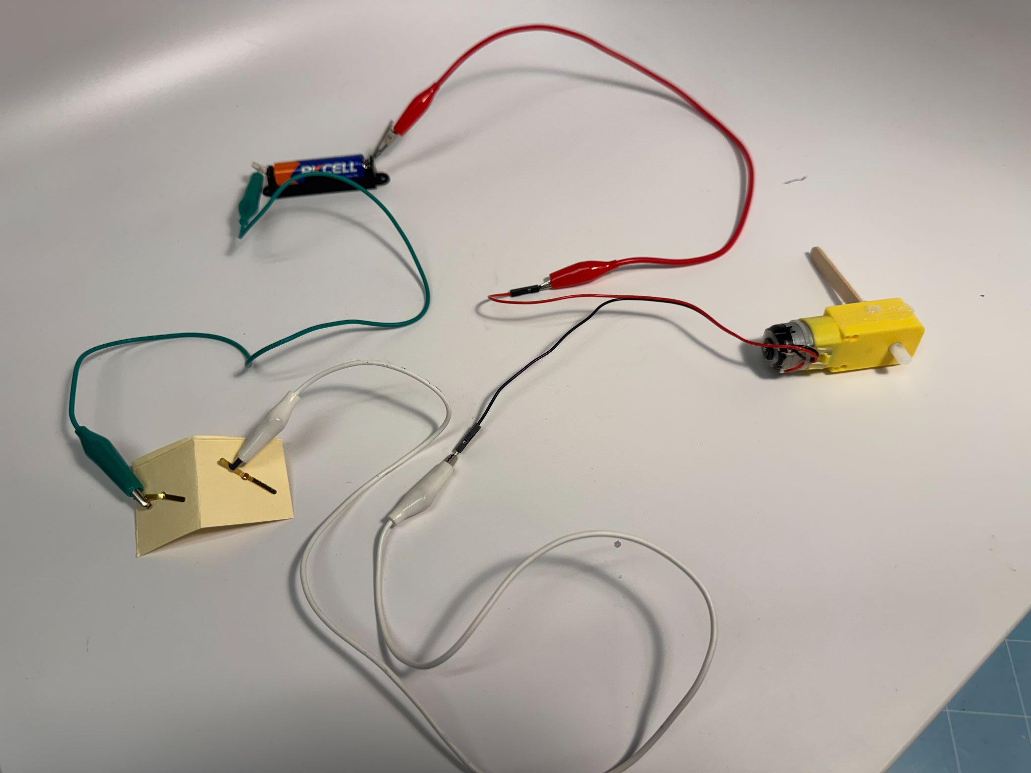
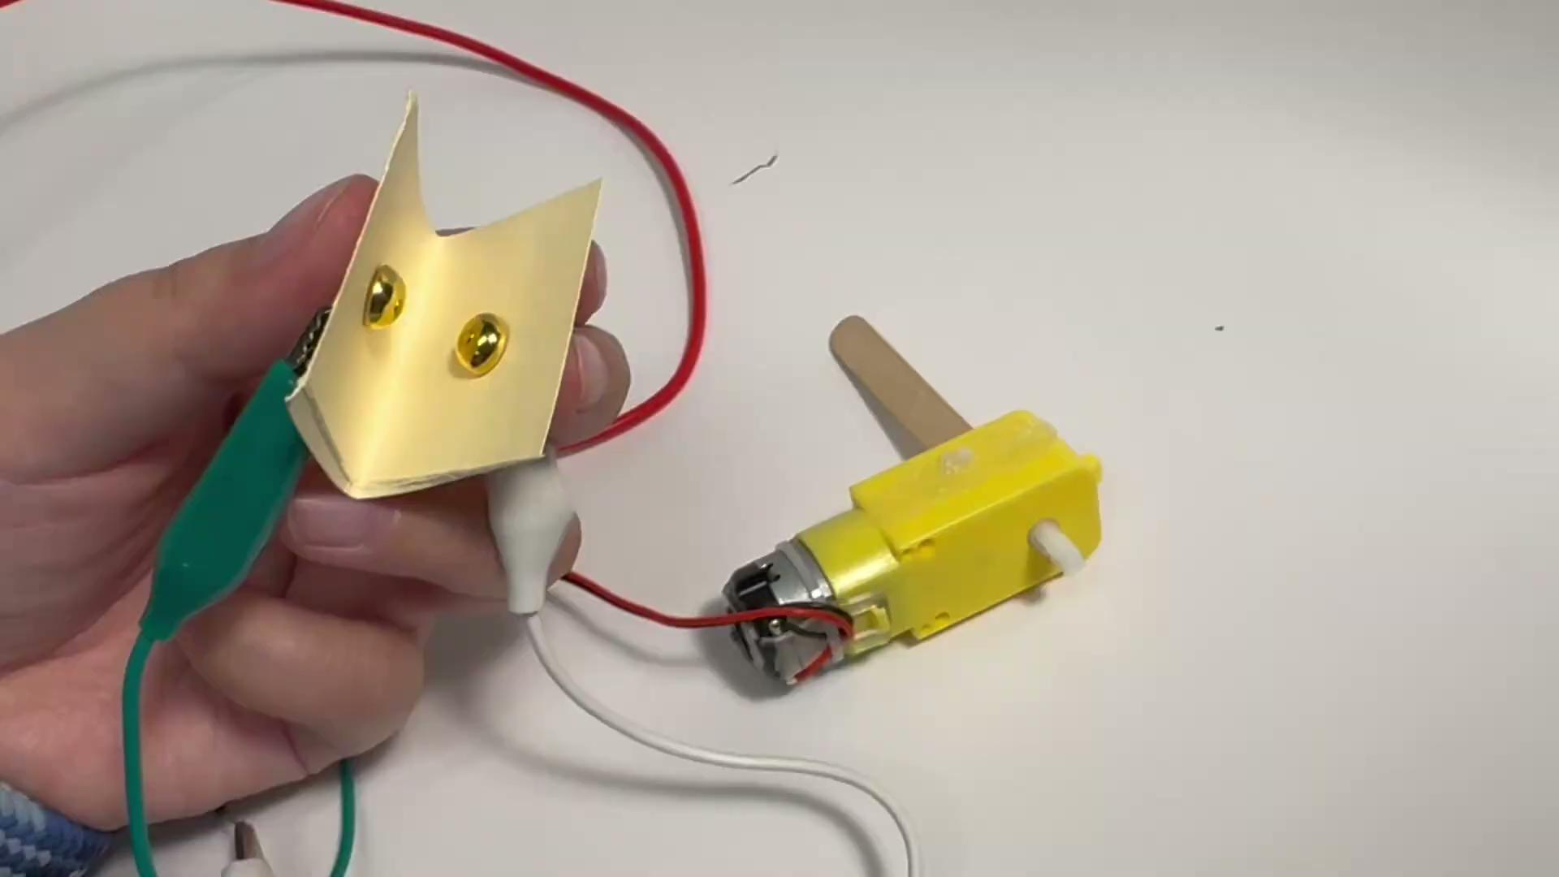
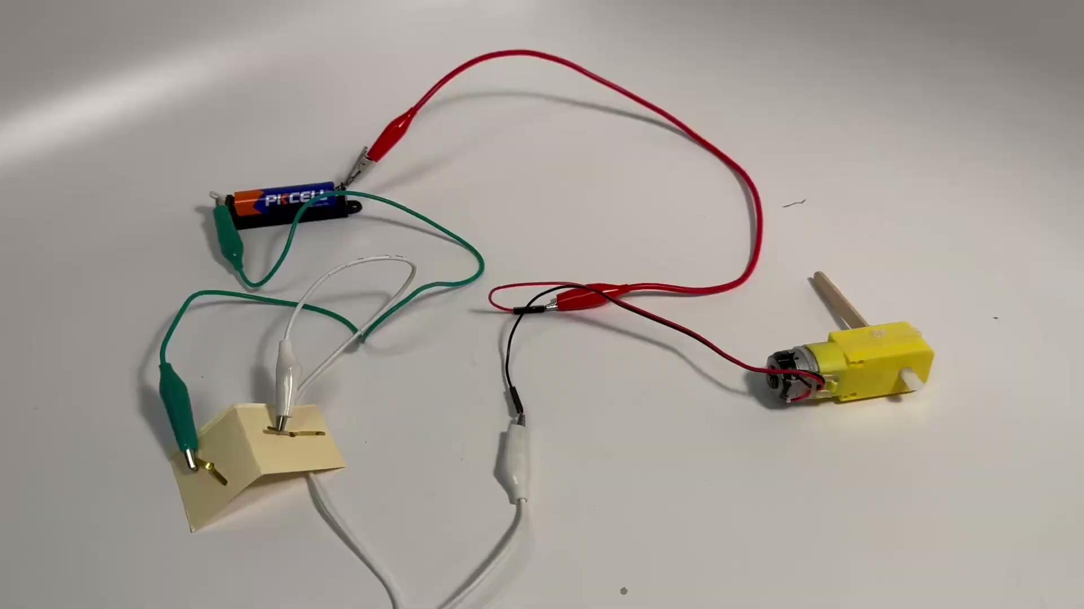



Slide 5
Basic Switch
Popsicle stick

Slide 6
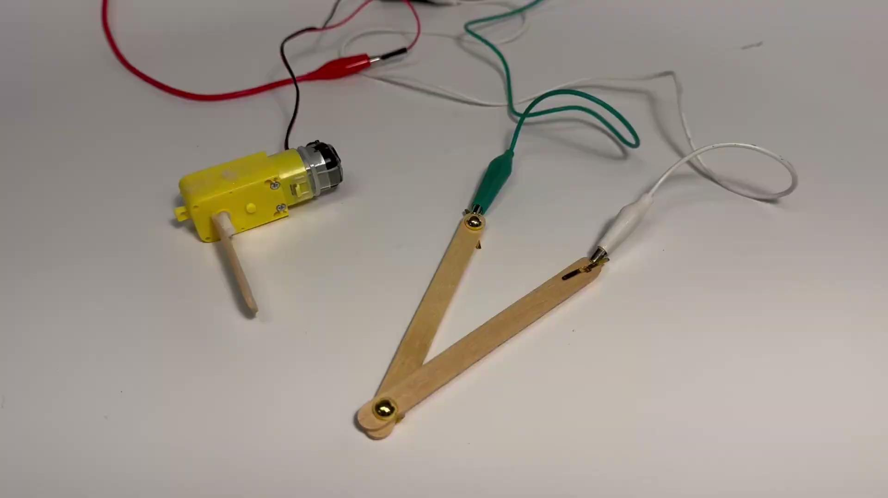
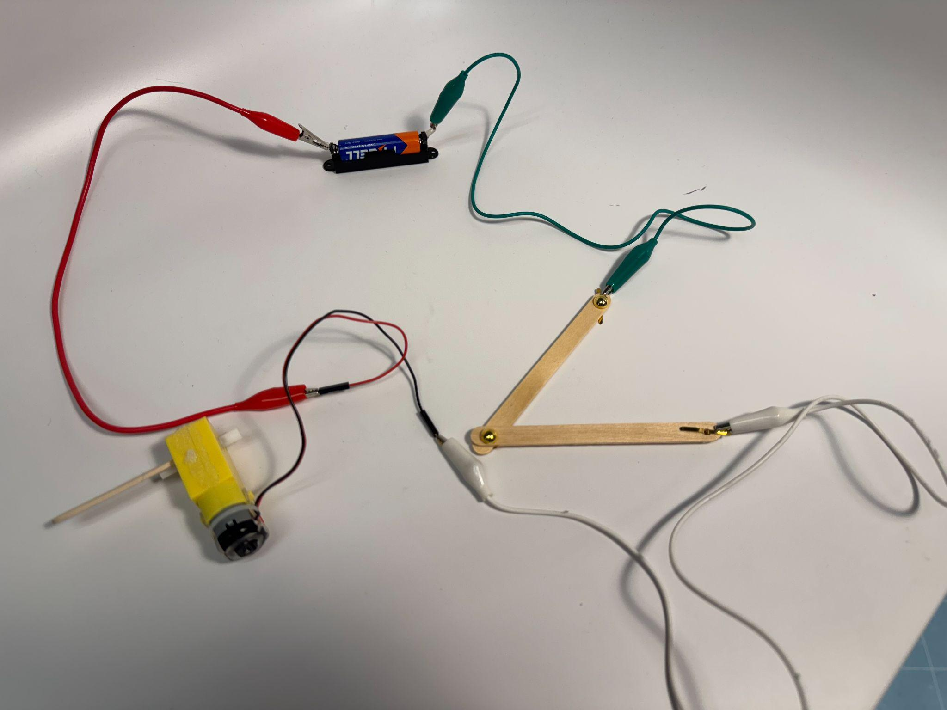
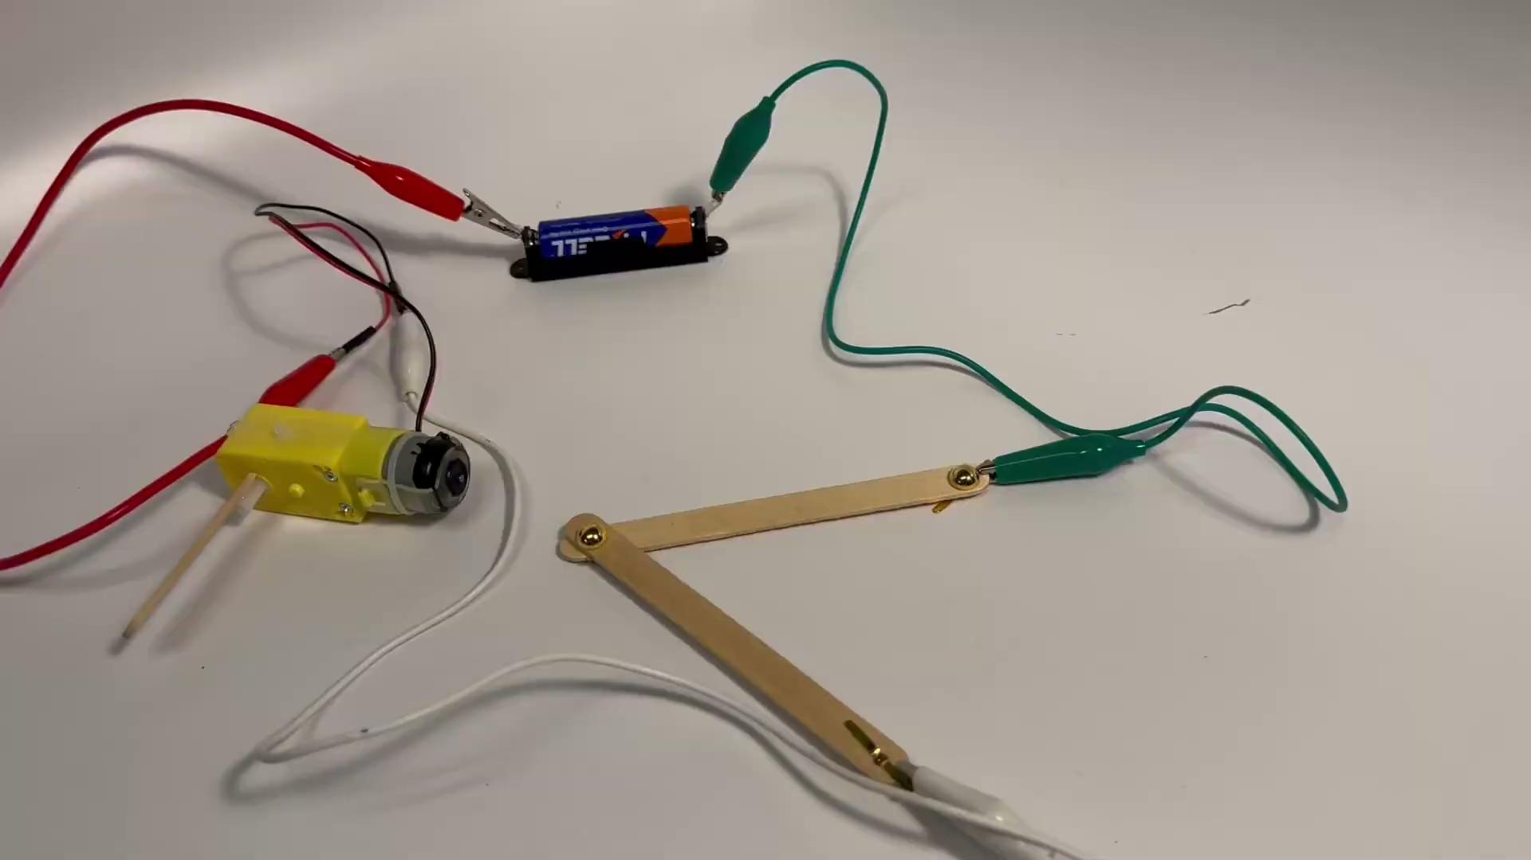
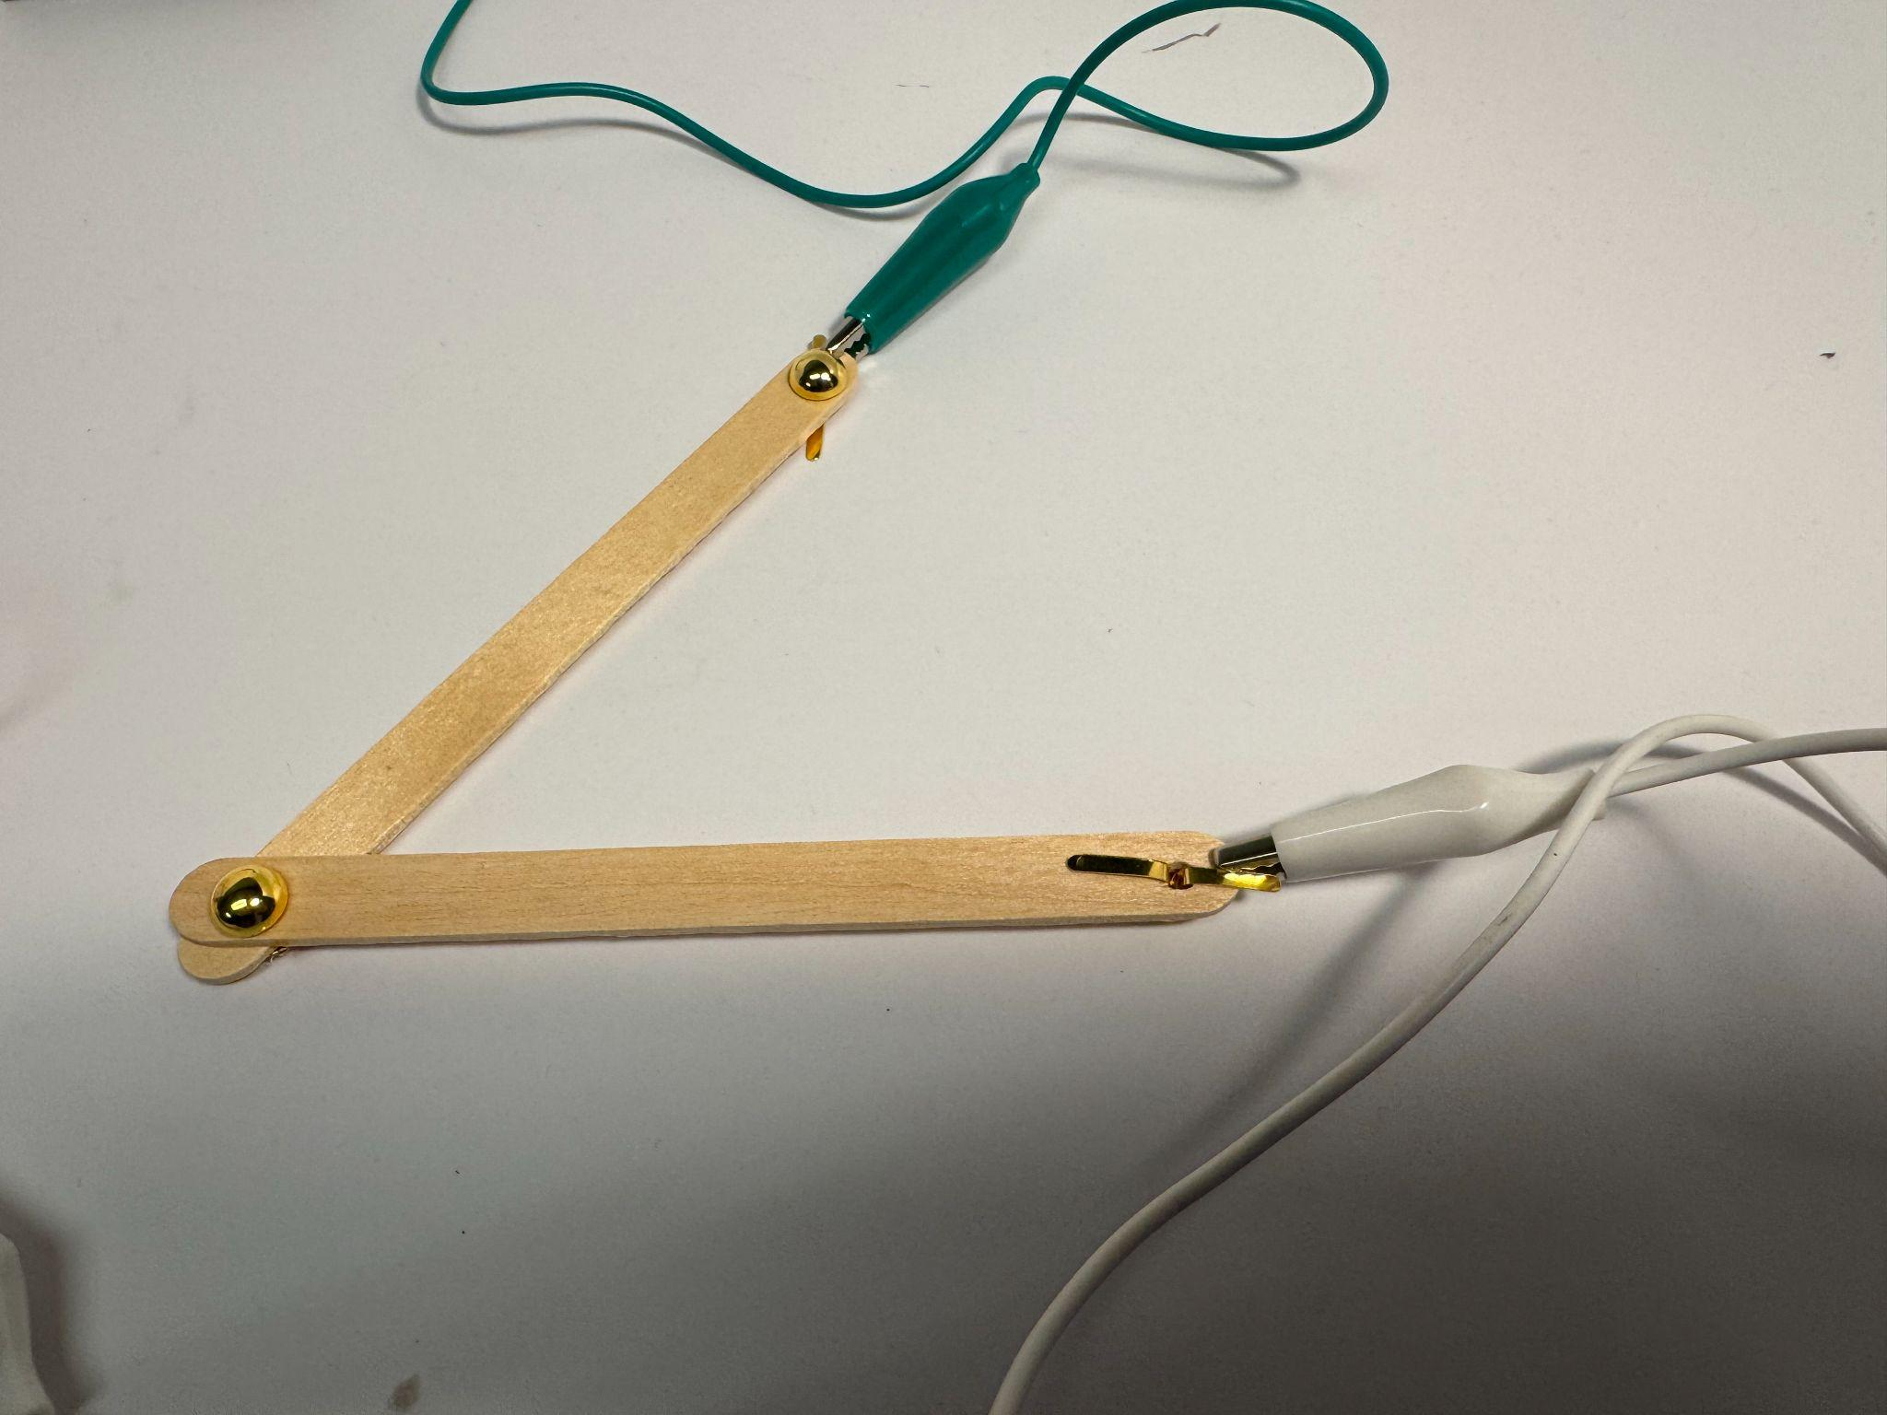
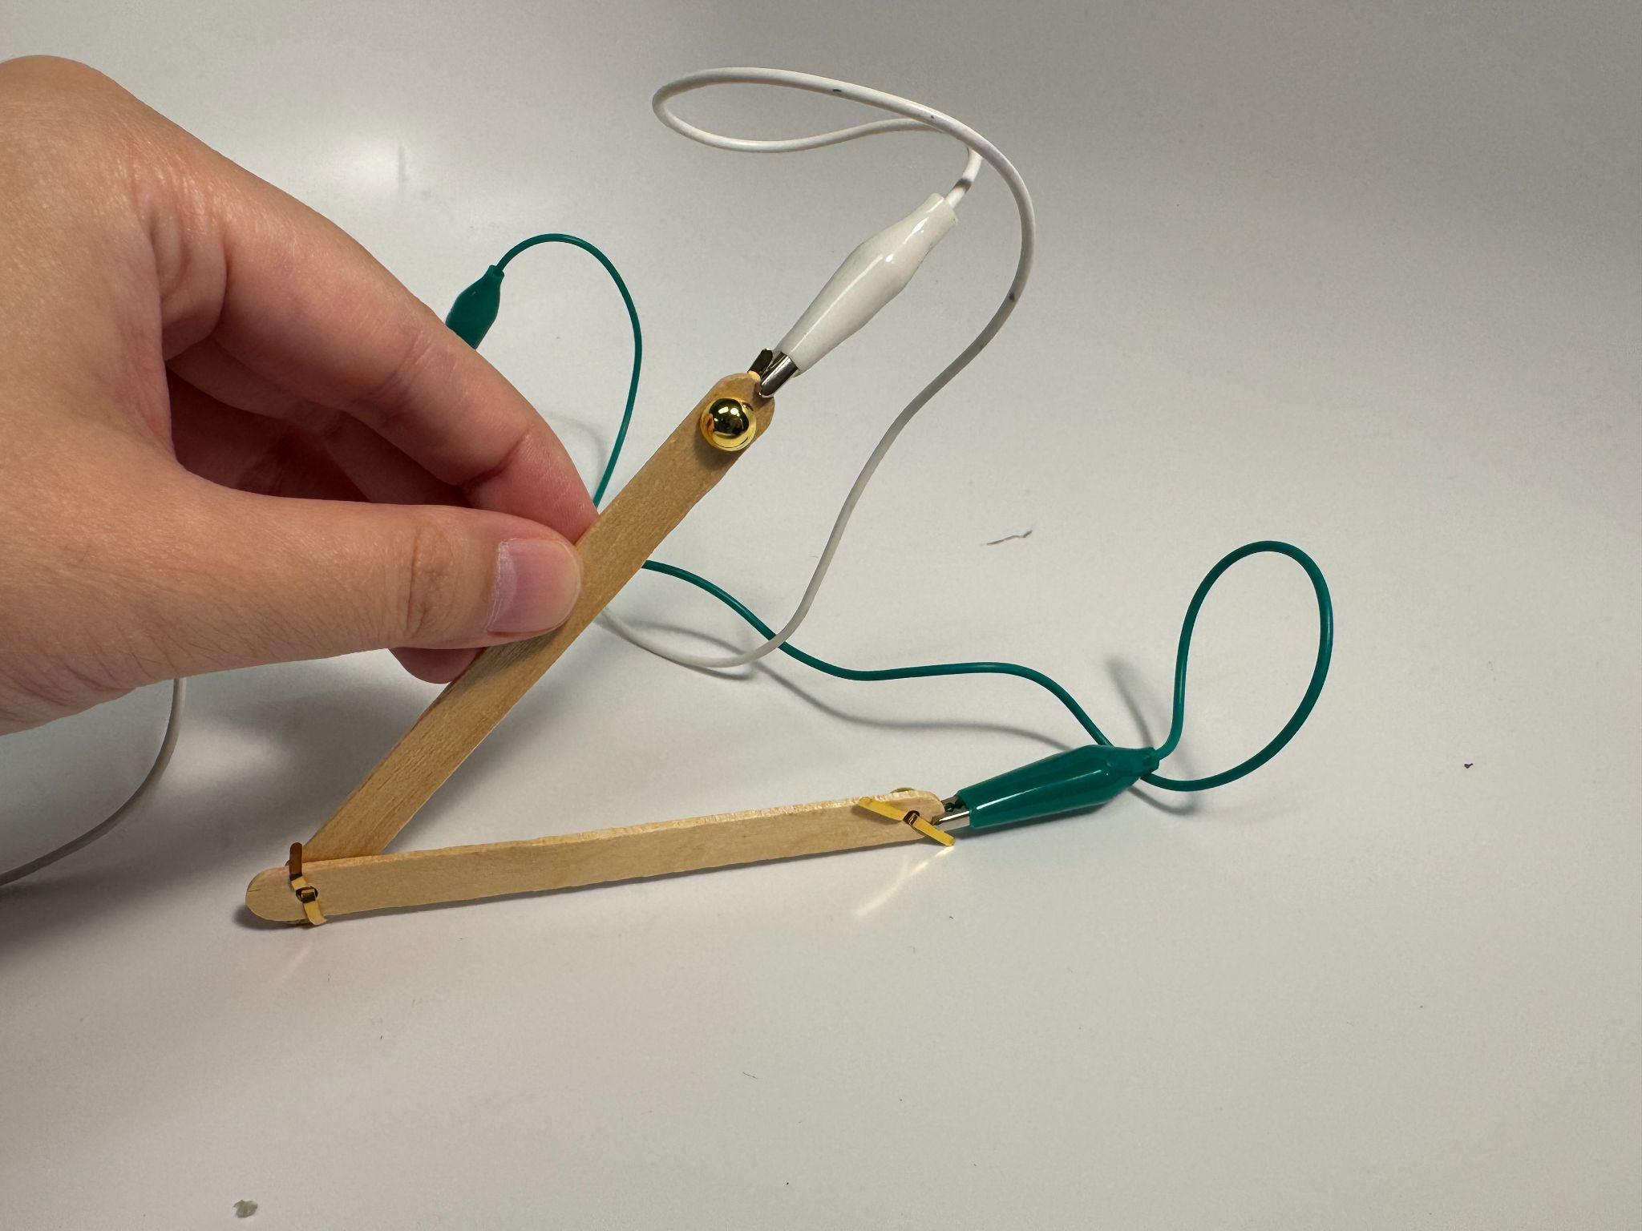

Slide 7
The switch can change motor direction.

Slide 8
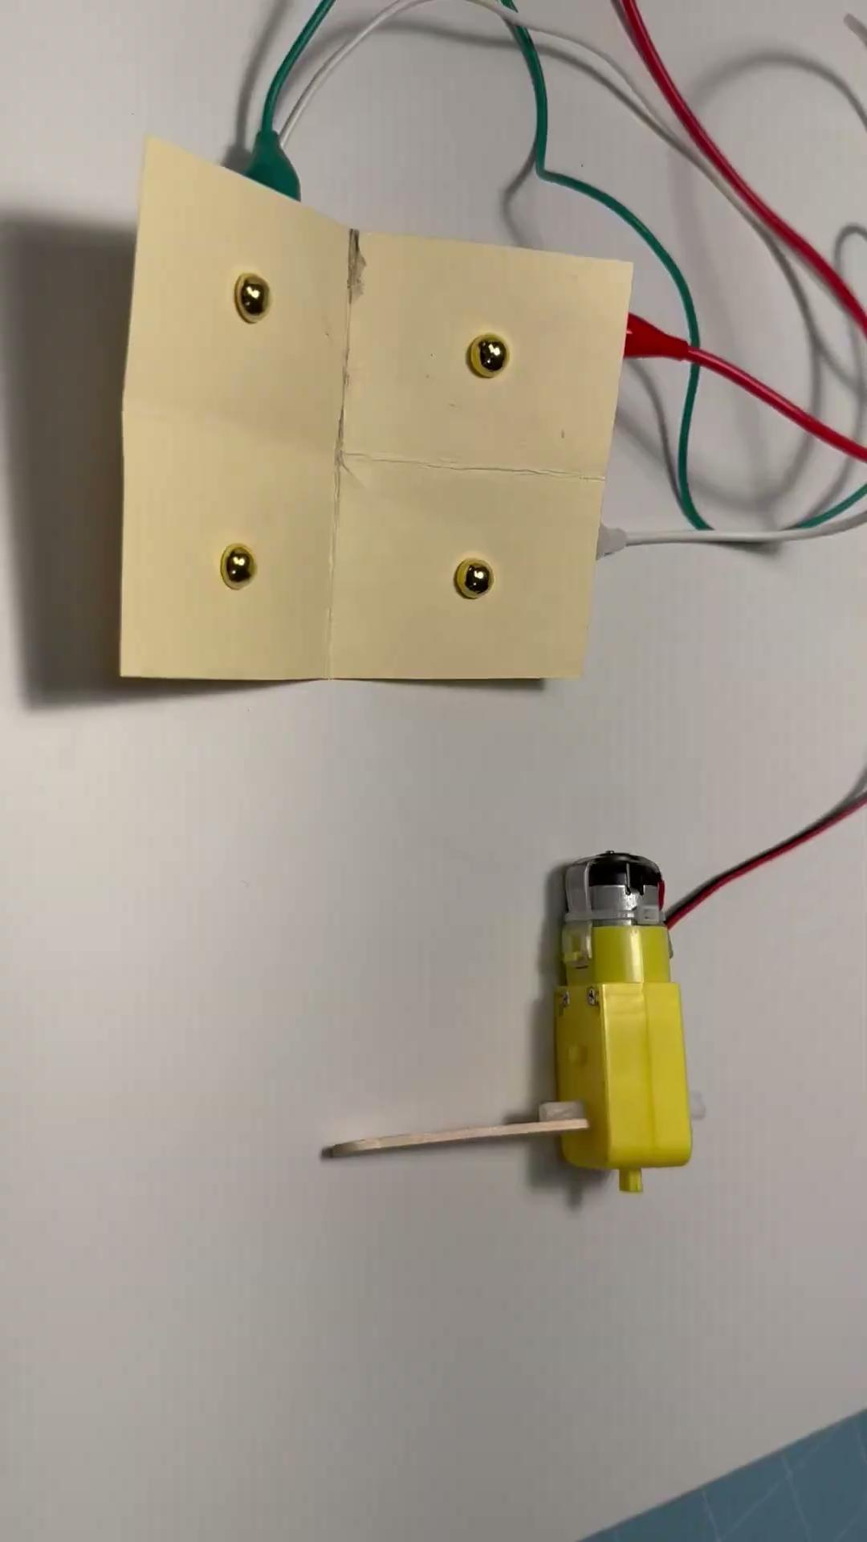
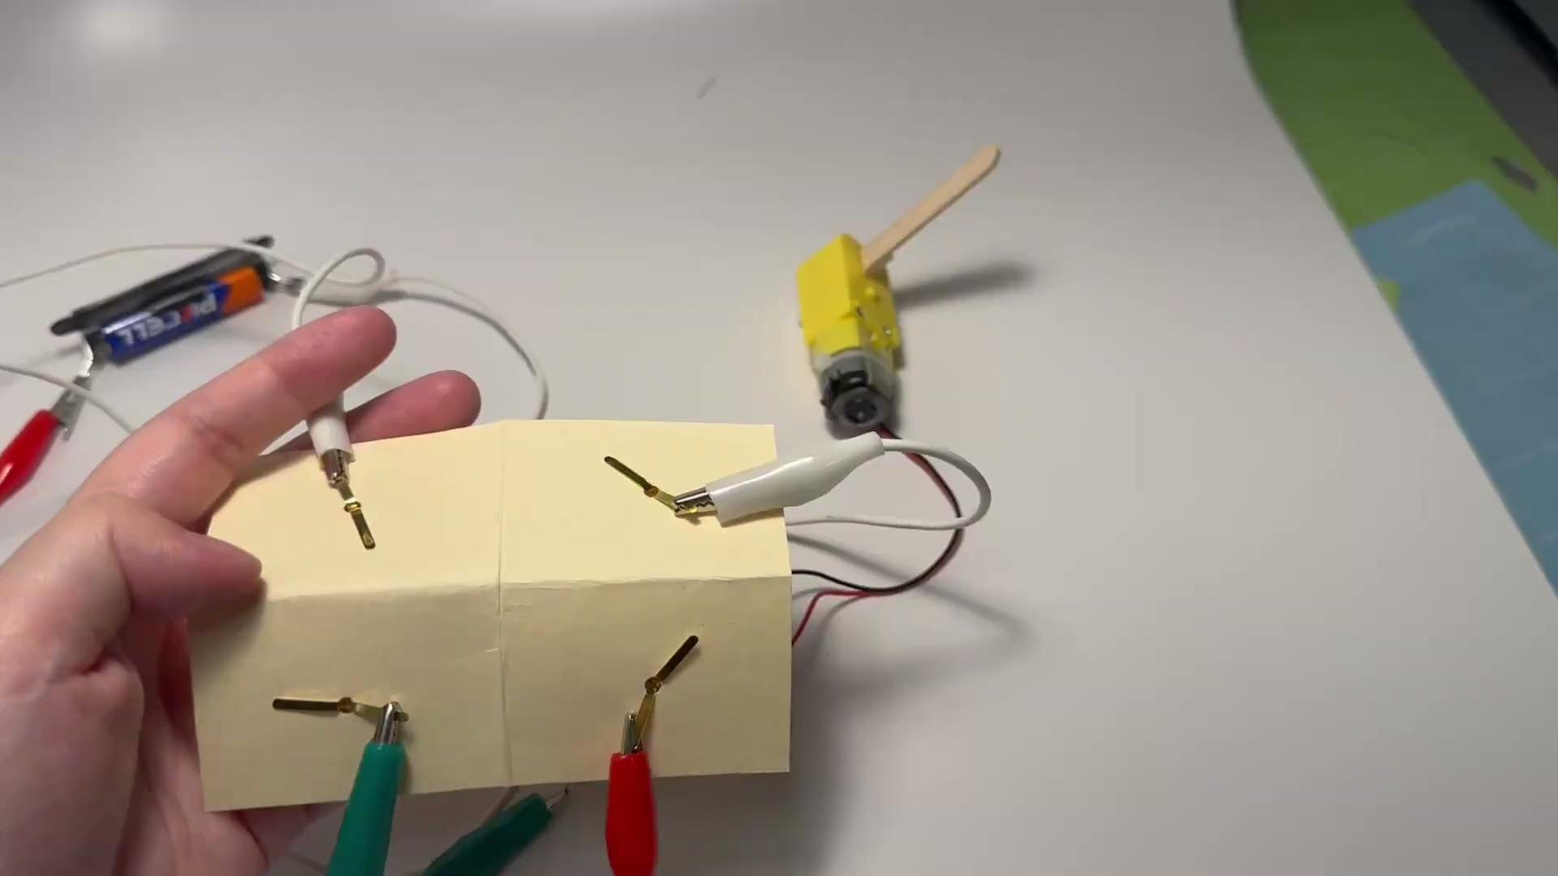
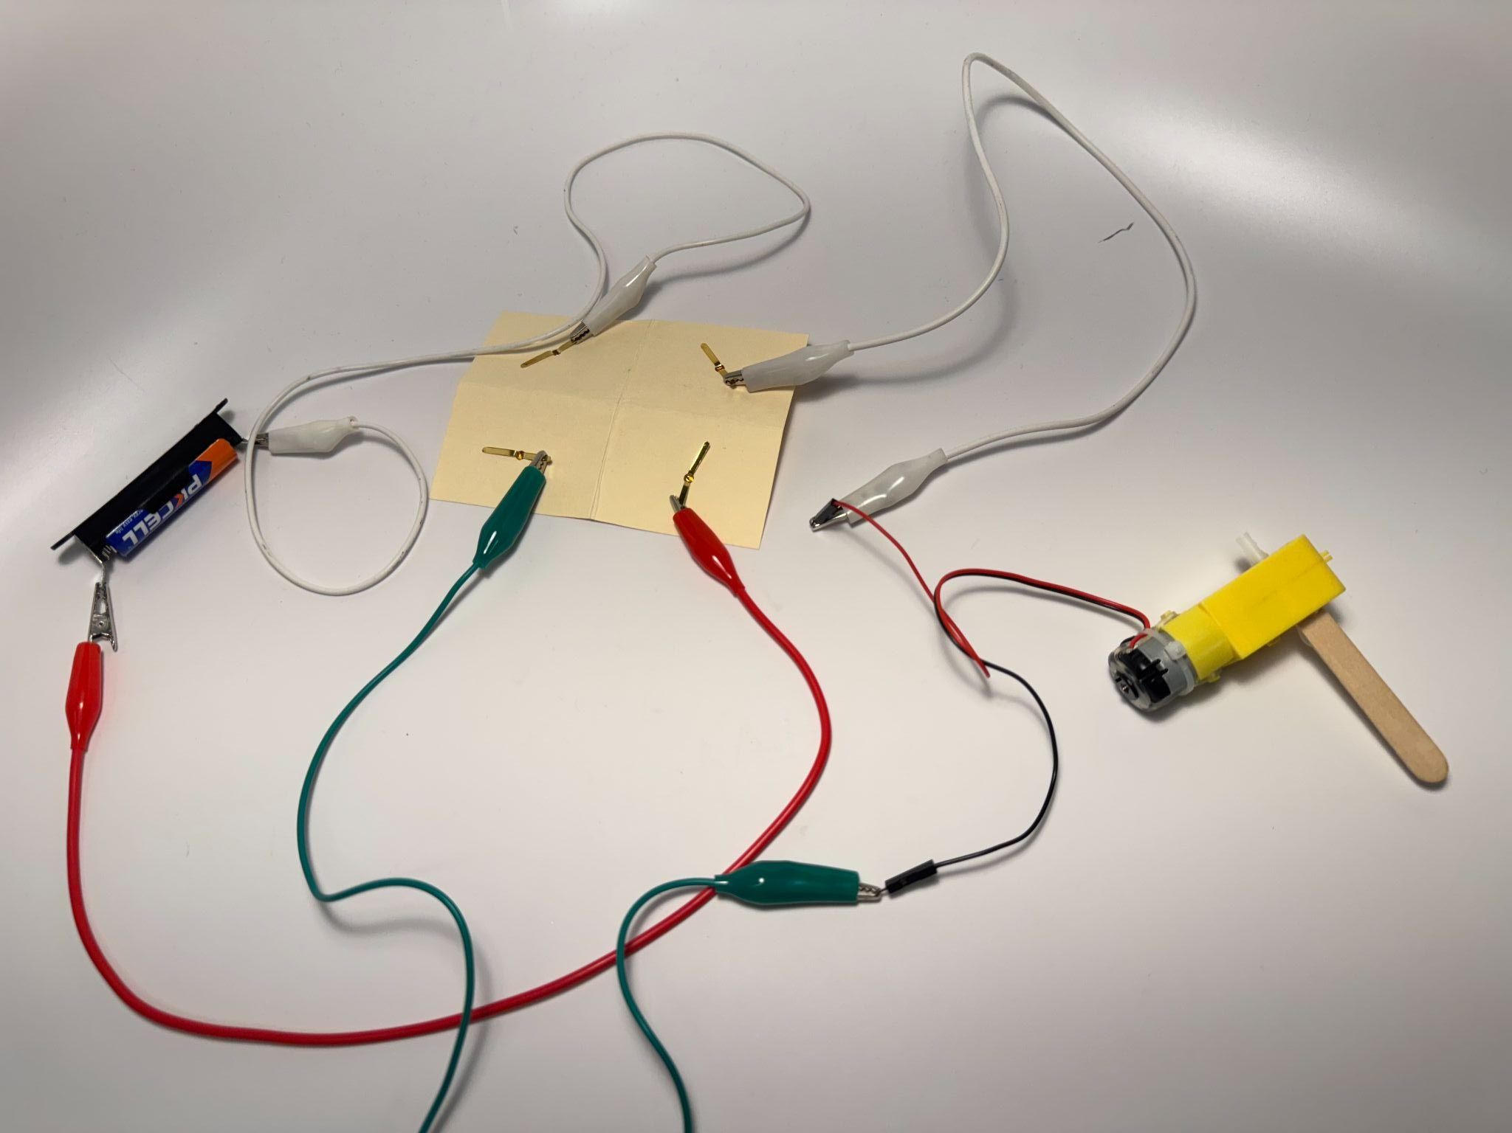

Slide 9
How to build?

Slide 10
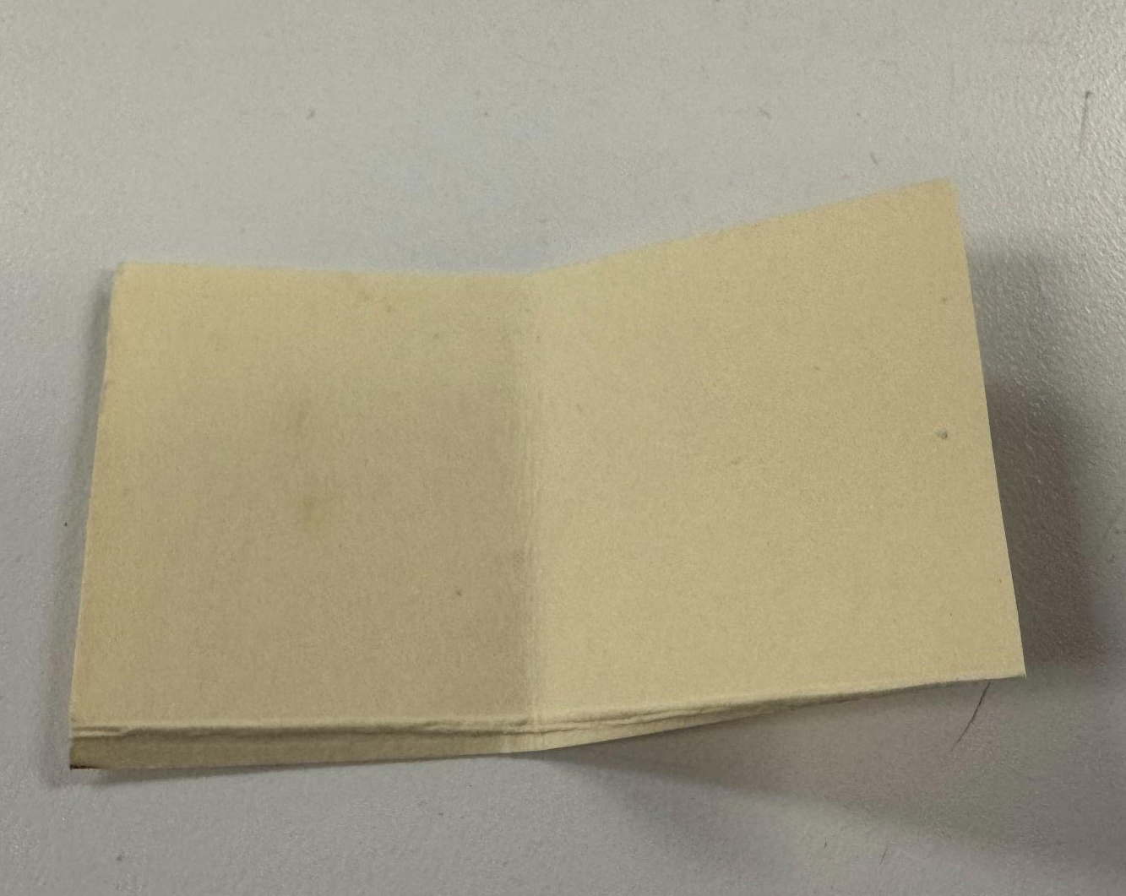
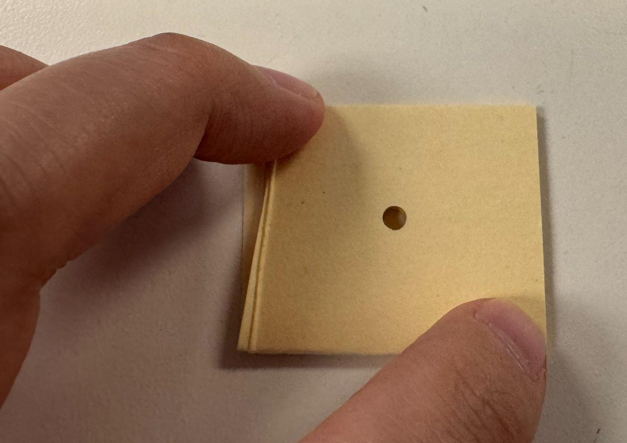
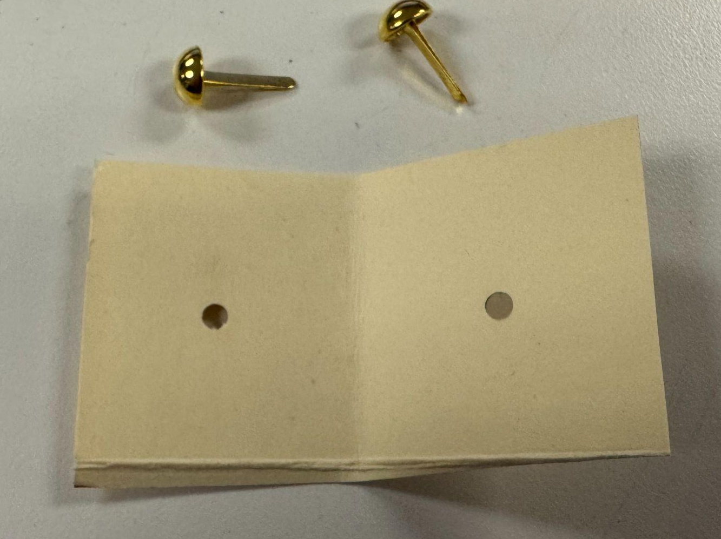
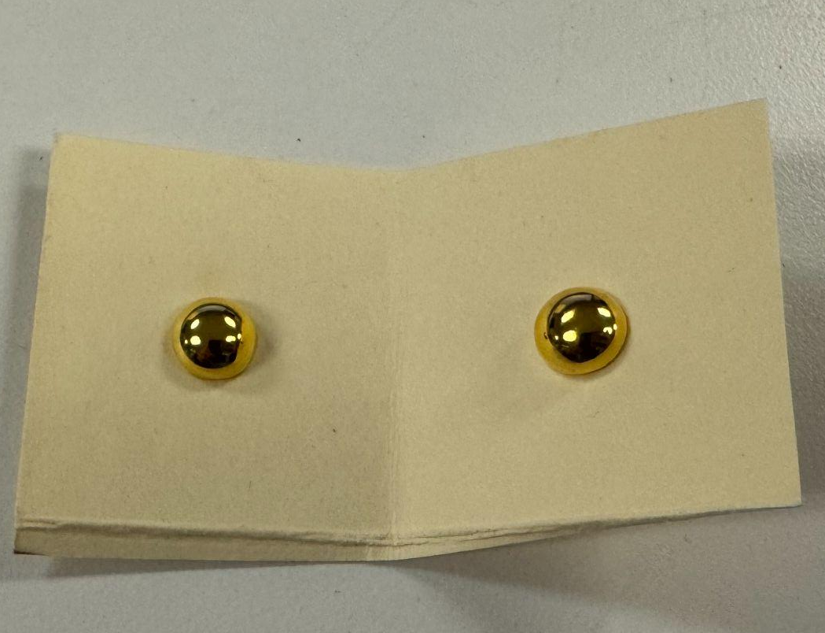
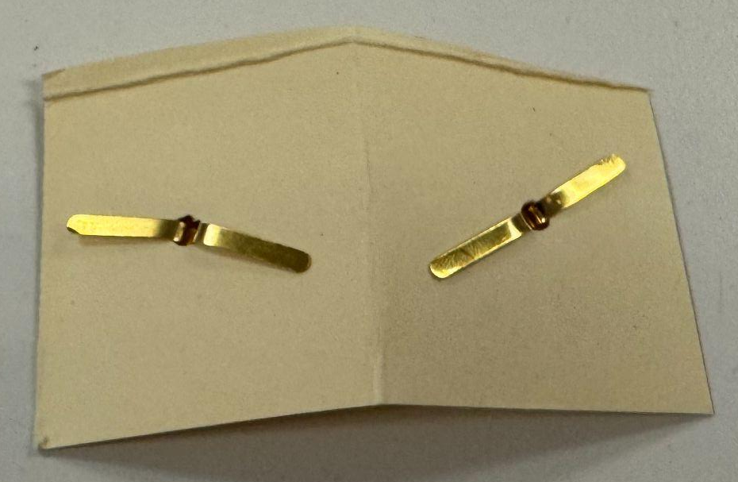
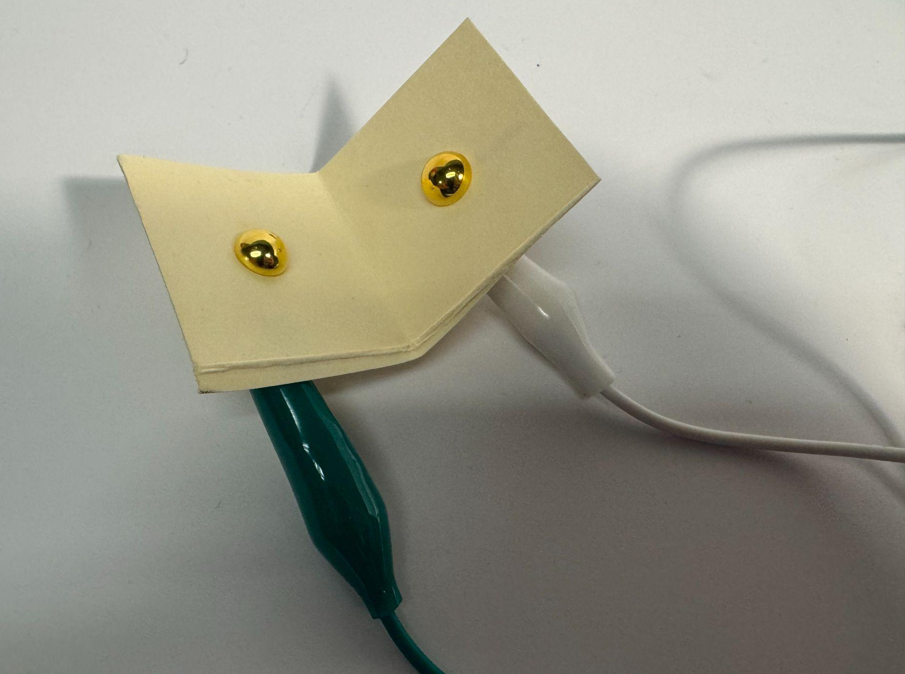
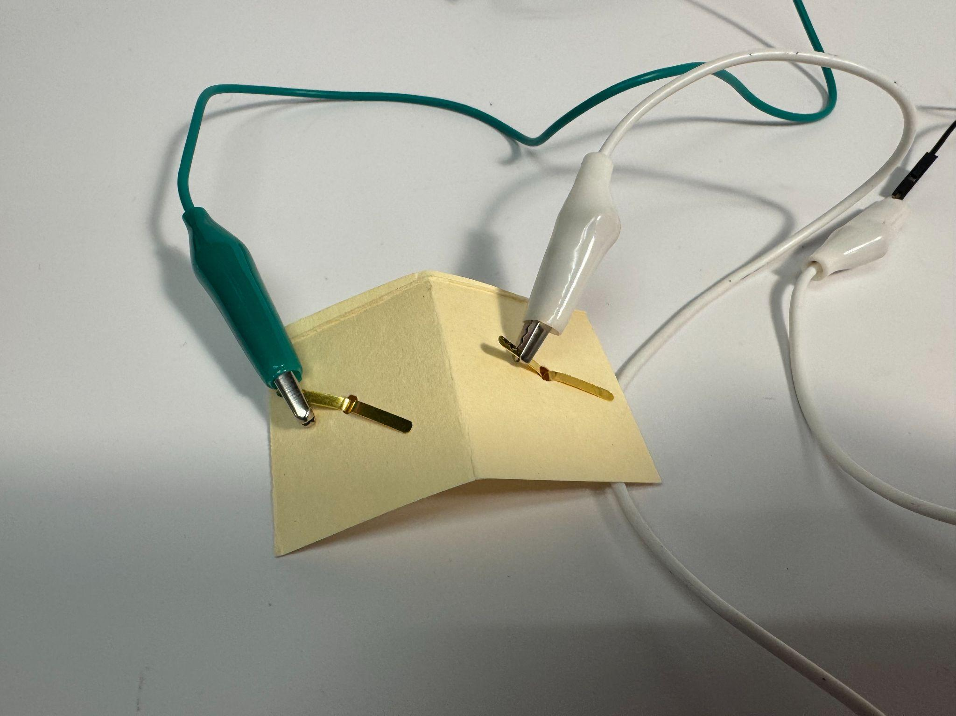

How to build - basic switch (cardstock)
Steps
(1) Take a piece of cardstock, cut it into a rectangular shape that can be held in one hand, and fold it in the middle.
(2) Use a hole puncher to make a hole in the center.
(3) Take two metal brads and put them into two holes.
(4) Unfold the brads as in the photo.
(5) Using two alligator clips, connect them separately to each brad. Now you get your switch.
(6) Connect one side of your switch (one of the alligator clips) to the battery, and the other side of your switch (the other alligator clip) to the motor. Connect the other side of your motor to the battery to make a closed working circuit.
(1)
(2)
(3)
(4)
(5)
(6)

Slide 11
How to build - basic switch (popsicle sticks)
Take two popsicle sticks.
Use a hole puncher to make two holes on both ends of each popsicle stick. Make sure you make the holes in exactly the same position on each popsicle stick.
Use one metal brad to connect two popsicle sticks at one end.
On the other end, put a metal brad in the hole on each popsicle stick. Make sure the top of the metal brads faces each other.
Unfold the metal brads, and connect an alligator clip to each metal brad.
Now you get your switch.
Connect one side of your switch (one of the alligator clips) to the battery, and the other side of your switch (the other alligator clip) to the motor. Connect the other side of your motor to the battery to make a closed working circuit.

Slide 12
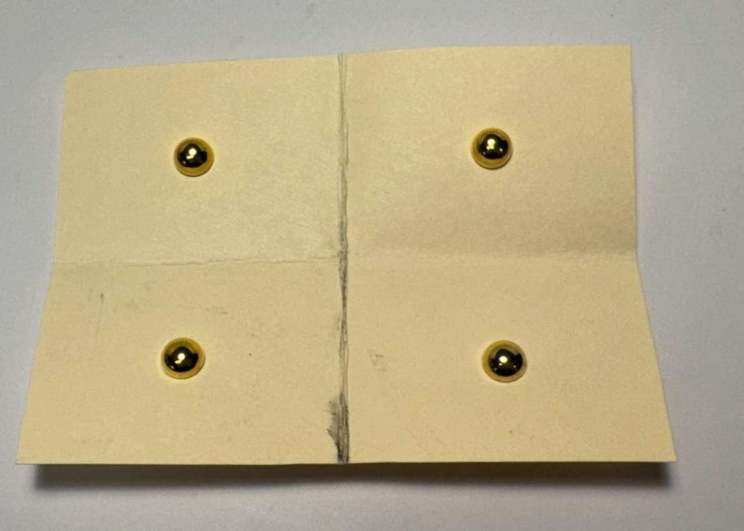
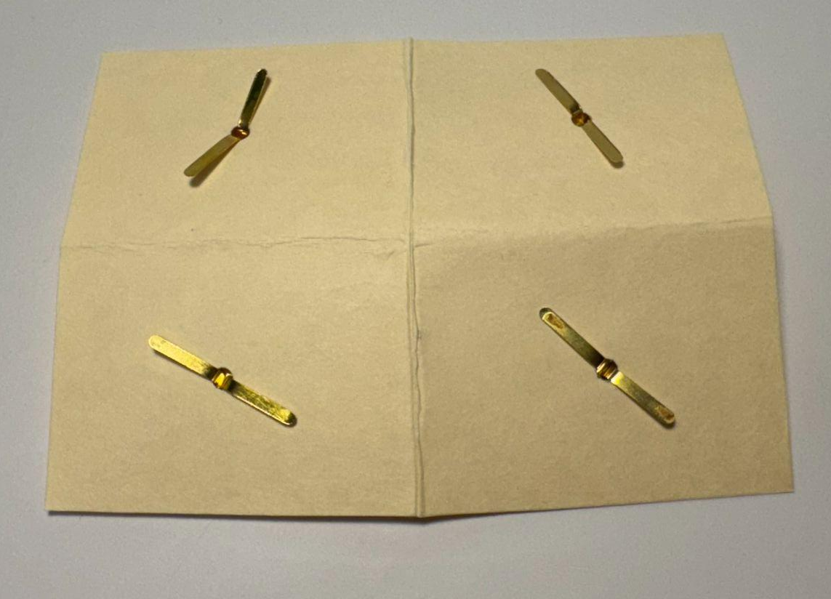
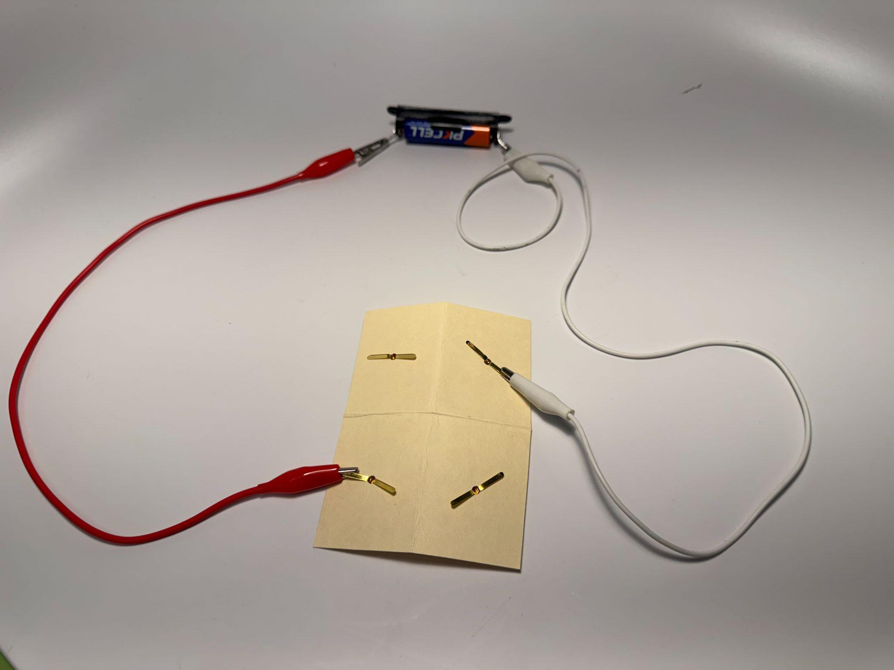
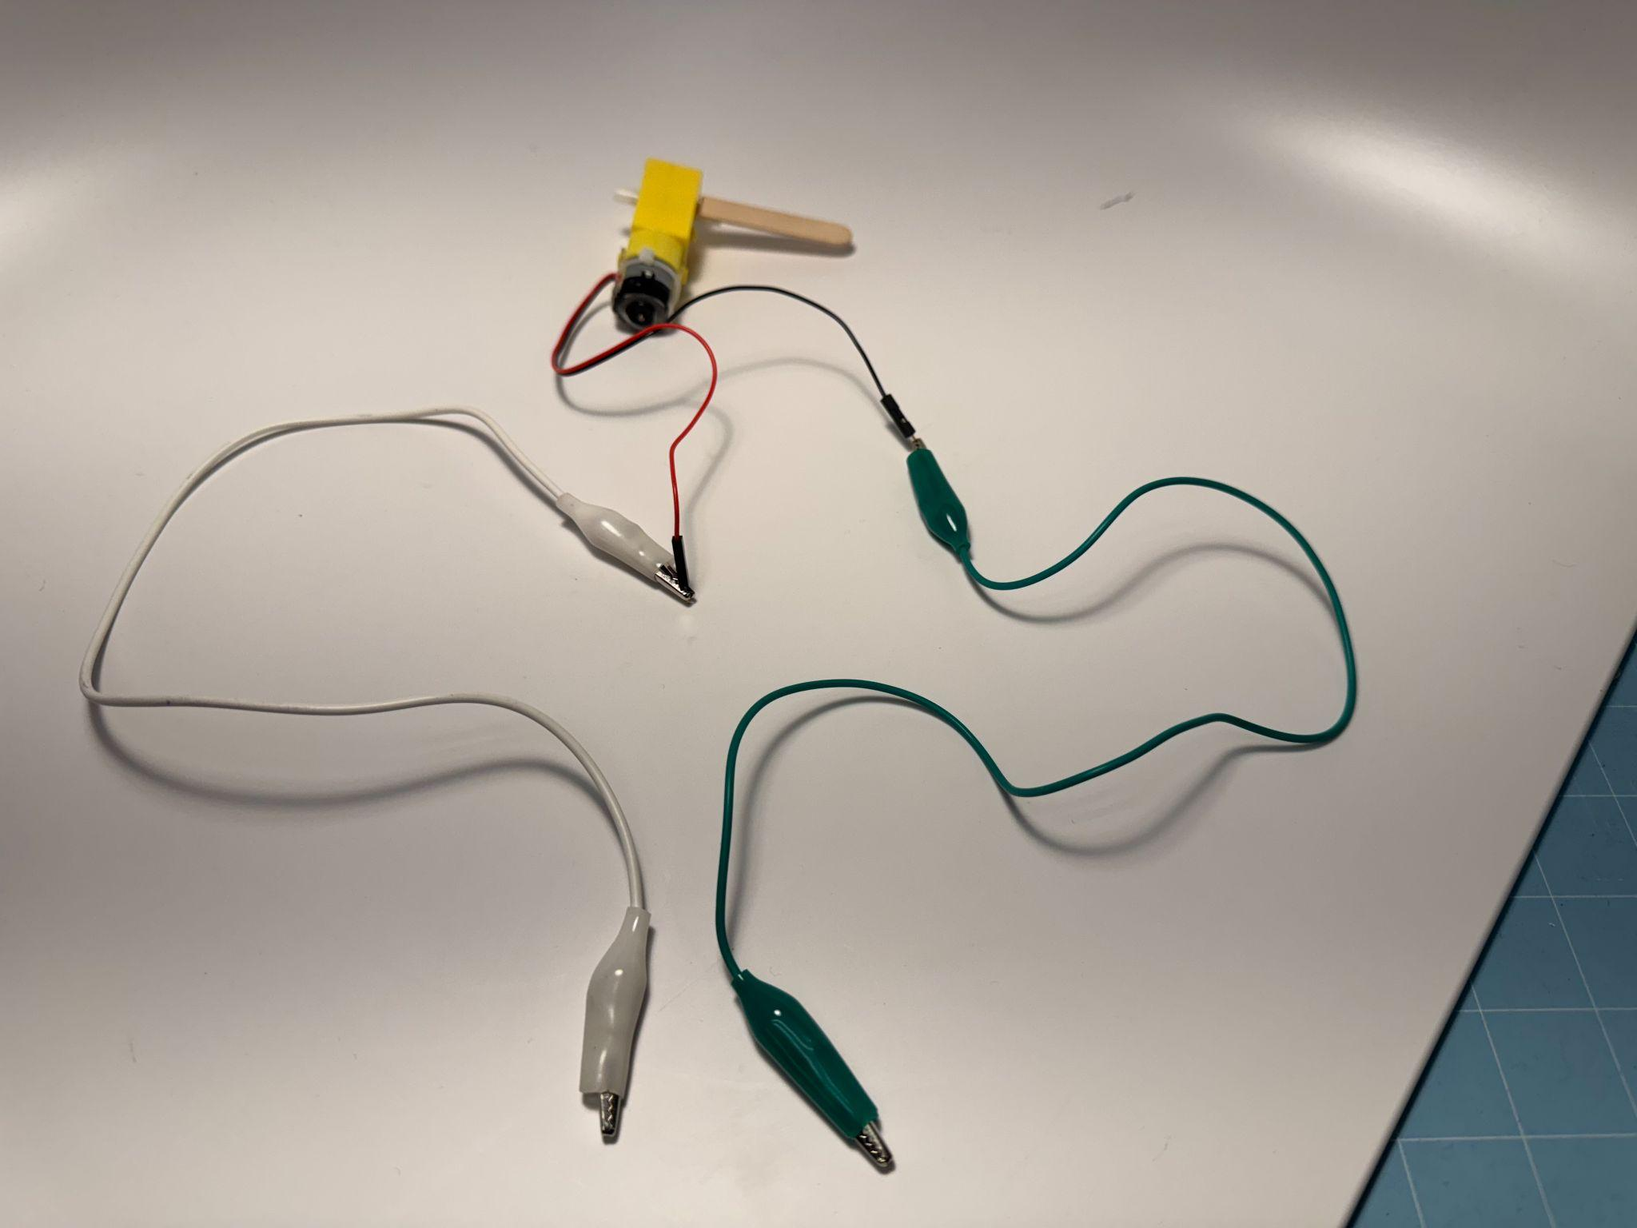
How to build - switch can change motor direction
Fold a piece of cardstock twice - separate it into four parts evenly.
Keeping the paper folded, use a hole puncher to make a hole in the center, then unfold the paper.
Add a brad to each hole, making sure the tops of the metal brads all face up.
Unfold the metal brads.
Connect the batteries to your switch with alligator clips, and make sure they are on the different corners, so whichever way you fold your switch, they won’t touch each other to cause a short circuit.
Then use the alligator clips to connect the other two brads to the motors.

