Slide 1



Energy Study Presentation

Slide 2
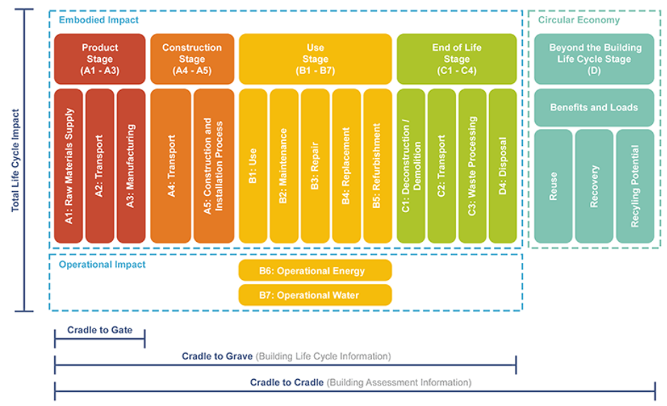
Life Cycle Analysis
Section
Page
12
The building sector is the largest contributor to global warming potential, accounting for 48% of energy consumption worldwide.
If I make informed design choices, I can improve that situation.
Image credit browningday.com

Slide 3
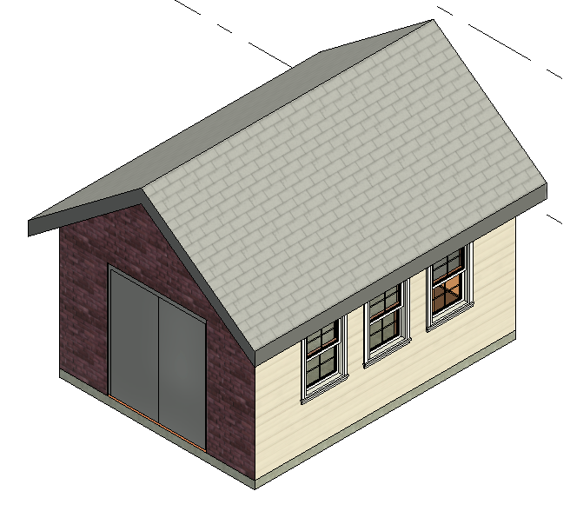
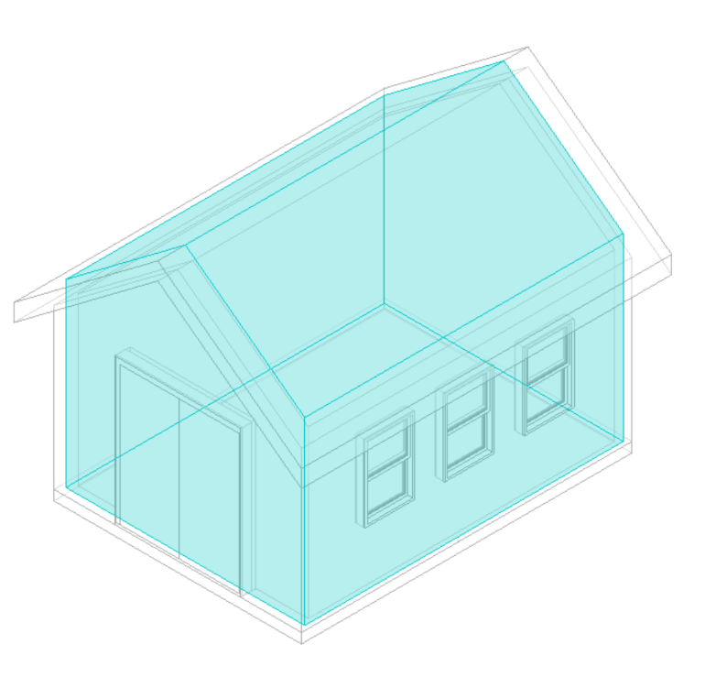

Images of Models
Section
Page
12
[insert your own screenshots]
My 192 ft² Workshop Model in Revit
My Building Envelope
[viewable in Revit browser
3D Views→Analytical Spaces ]
My Energy Model
[viewable on Autodesk Insight Panel from Energy Plus]

Slide 4

Analysis of Embodied Energy (EE)
Section
Page
12
Looking at the PDF Report I created by inputting material properties in Tally, I identified an estimate of the environmental impact potential of the embodied energy of my structure. Values are below. This is for a building life of 20 years.
Life Cycle Stage | Global Warming Potential (kg CO₂eq)
Product Stage [A1-A3] | [907.2 from Pg 3 of report you made last class]
Construction Stage [A4]
End-of-Life Stage [C2-C4]
Use Stage [B2-B5]
Module D [D]
TOTAL FOR THESE STAGES (EE)
[Leave the bracketed stage numbers in first column. Pull these numbers from the Report Summary on Page 3.]

Slide 5

Analysis of Operational Energy (OE)
Section
Page
12
Looking at the Autodesk Insight Report I created using Energy Plus, I identified an estimate of the environmental impact potential of the operational energy consumed by my structure over its life. Values are below. This is for a building life of 20 years.
Life Cycle Stage | Global Warming Potential (kg CO2eq)
Operational Energy [B6]
TOTAL FOR THIS STAGE (OE)
[Leave the bracketed stage numbers in first column. Pull these numbers from the Insight Report. The screen will default to one year, but use the pulldown menu to select 20 years.]

Slide 6
Questions
Section
Page
12
When you select 1 YEAR LIFESPAN, what is the Total Carbon for the building? How much of this is Operational Carbon? Units are kgCO2eq.
When you select 20 YEAR LIFESPAN, what is the Total Carbon for the building? How much of this is Operational Carbon? Units are kgCO2eq.
What does this tell you about the impact of Operational Carbon?

Slide 7
Life Cycle Global Warming Potential (GWP)
Section
Page
12
Combining these, I can estimate the environmental impact of my structure over a 20 year life cycle.
Life Cycle Stage | Global Warming Potential (kg CO2eq)
Product Stage [A1-A3] | [All but B6 are from slide 4. Convert to 20 yrs.]
Construction Stage [A4]
End-of-Life Stage [C2-C4]
Use Stage [B2-B5]
Use Stage [B6] | [This is OE from slide 5. Make sure it is 20 yrs.]
Module D [D]
TOTAL FOR THESE STAGES (EE+OE)

Slide 8
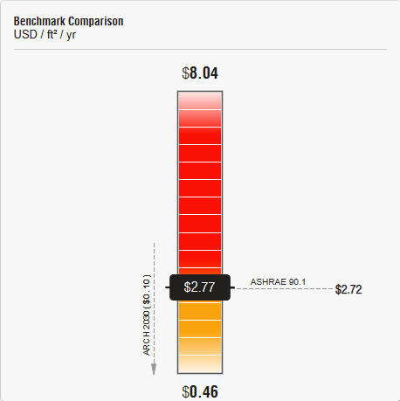
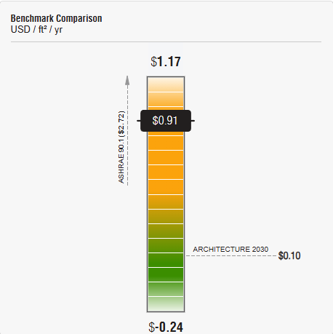
Energy Optimization
Section
Page
12
Energy Plus allows me to examine and manipulate several different factors to optimize the operational energy used by my structure each year. I can compare before and after values and the effects in terms of dollars per square foot per year.
Before optimization, my workshop requires [$2.77]/sf/year which is [this number x 192 $531.84 for this example] since my building is 192 sf.
Over 20 years, this amount is [$10,637 for this example].
After optimization, my workshop requires [$0.91]/sf/year which is [this number x 192 $174.72 for this example] since my building is 192 sf.
Over 20 years, this amount is [$3,494 for this example].
BEFORE Optimization
AFTER Optimization
[Replace screen snips with snips from your Insight Optimization]

Slide 9
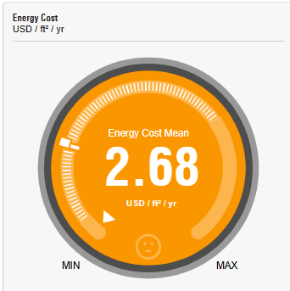
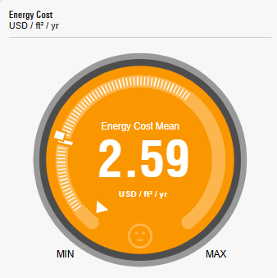
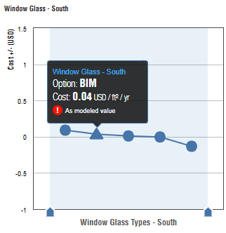
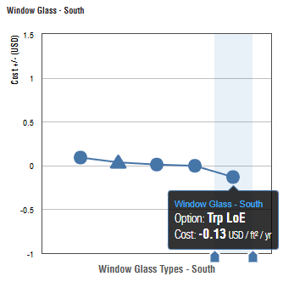
Optimization Factors
Section
Page
12
I can optimize factors like adding shades over windows, changing window-wall ratio, glass type in windows, wall construction, roof construction, infiltration, lighting, occupancy, plug loads, HVAC systems, operating schedule, and adding solar panels (PV).
Before optimization, my workshop energy used a composite of several different types of window systems.
By switching to a LoE glazing system, I am able to save $0.13/sf/yr, which is $499.20 over 20 years.
BEFORE Optimization
AFTER Optimization

Slide 10
Optimization Factors
Section
Page
12
Here are the optimization factors I integrated and their associated savings.
Factor | Reduction ($)
Rotate Building [180o] | [0.09]
WWR-N/S/E/W | [0.11]
Shades | [already optimized]
Wall Construction | [0.80]
Roof Construction | [0.09]
Infiltration | [0.01]
Factor | Reduction ($)
Lighting Efficiency | [0.25]
Occupancy Controls | [0.08]
Plug Load Efficiency | [0.26]
HVAC | [0.67]
Operating Schedule | [0.05]
Solar Panels [90%] | [0.16]
If I revised my design to incorporate all these factors, I could save up to [$2.57/sf/yr or $9,869] over 20 years.

