Slide 1


Side-Impact Crash Superheroes - Who Will Save the Day with a Better Safety Feature?

Slide 2
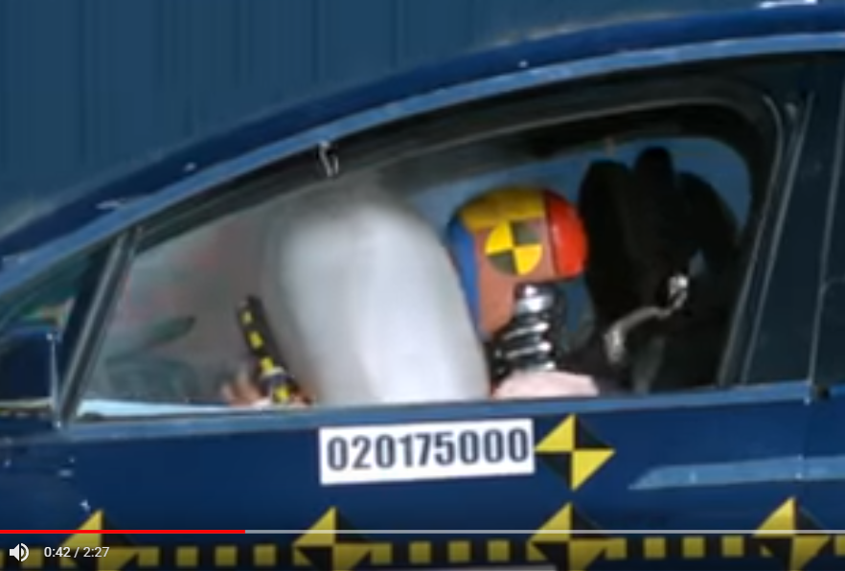
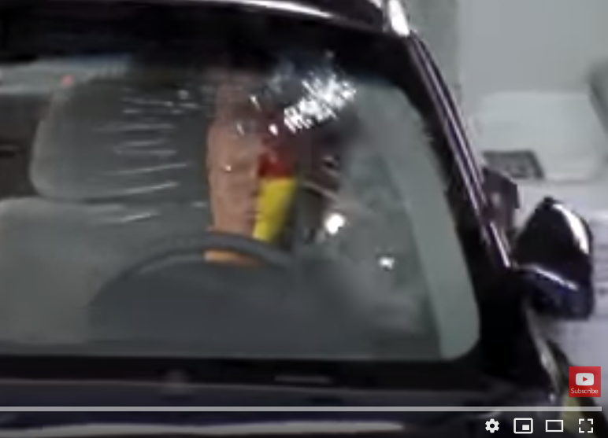
Side-Impacts are the most vulnerable…. Why?
Front-End
Compare a Front-End Crash with a Side-Impact Crash:
Watch the 2 video clips (focus on the 20 to 50 sec. of the Front-End).
Notice which crash has the most potential damage to the driver.
Why is there such a big difference?
Side-Impact
Notes:
The front-end crash has more time to stop (from the front crumple-zone of the hood) and more space to stop in.
The side-impact crash has no crumple zone and the crash force is very close to the driver. There is not much space between the head and the side window…impact is immediate.

Slide 3
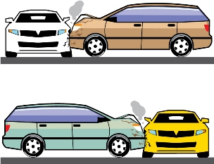
The facts…
Side impact auto accidents account for ~25% of fatalities in passenger vehicle crashes.
Serious injuries are also more likely to occur in side impact crashes since passengers can be extremely close to the impact site with no protective region of the car to crumple and absorb the impact.
It is difficult to provide protection where the car is normally thin and the door must be able to open.

Slide 4
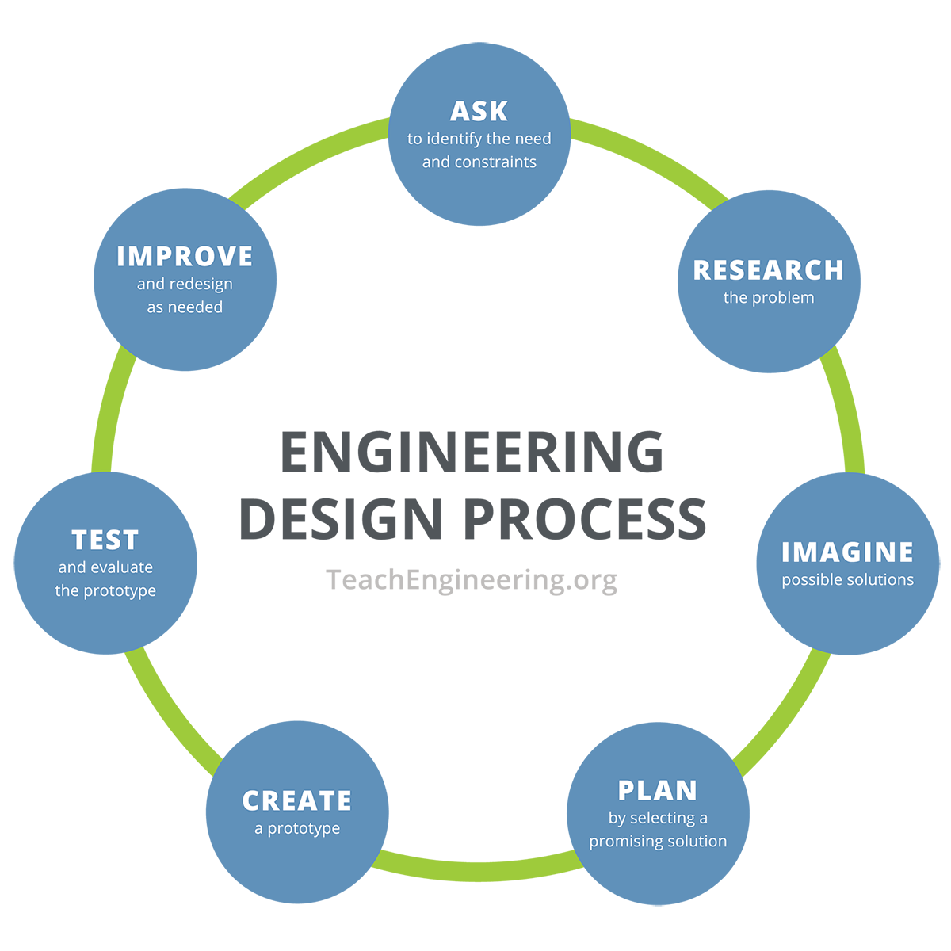
Engineering Design Process

Slide 5

1. ASK: Identify the problem
What is the problem and the constraints?
1

Slide 6

2. RESEARCH: Research the problem
What information will help you find a solution?
1

Slide 7
Research…
What do we know so far about how to protect people in car accidents?
What type of car material protects you more…
soft, flexible metal or strong, rigid metal?

Slide 8
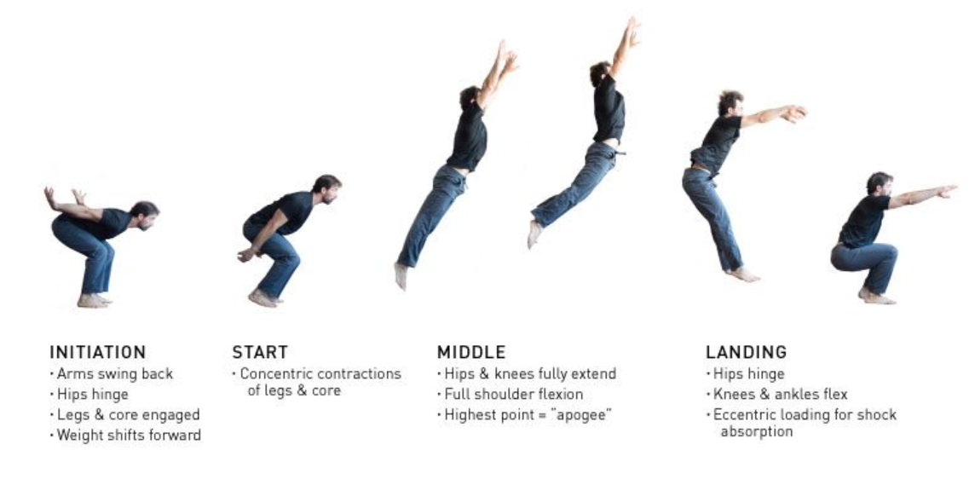
Quick activity…
What do we know about jumping and landing safely?
What is the best way to land?
1
Was it soft and flexible or hard and rigid?

Slide 9
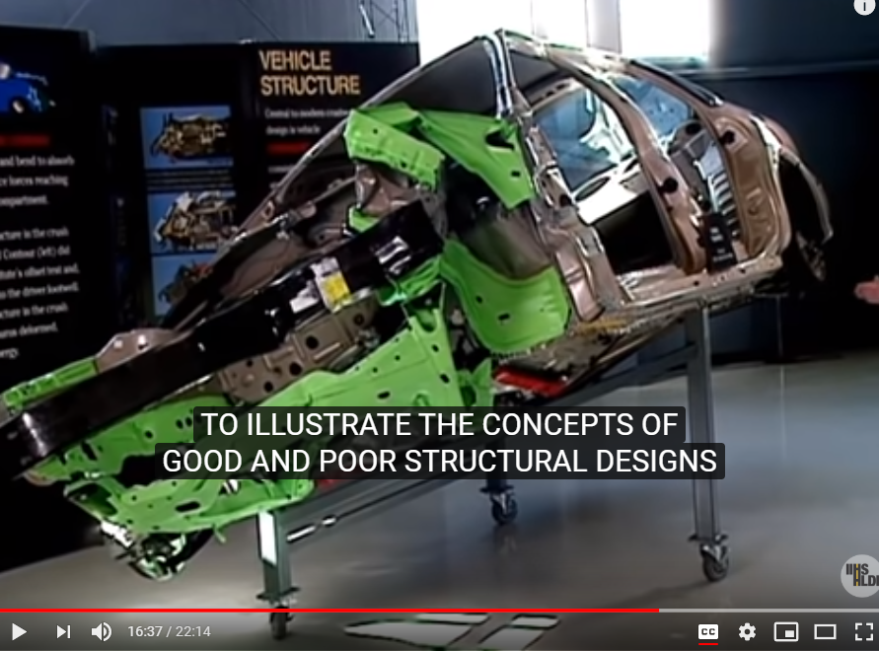
Research…
What do we know so far about how to protect people in car accidents?
What type of car material protects you more…
soft, flexible metal or strong, rigid metal?

Slide 10
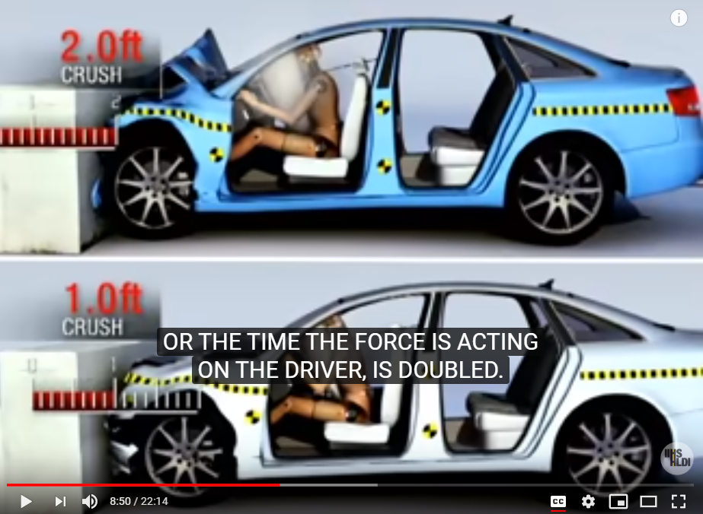
Research…
Now let’s look at the math behind decreasing the damage caused by stopping car momentum in a crash.
…How do we decrease the FORCE (F)?

Slide 11
Research…
The Ft is the impulse that stops the momentum (mv) before the car crash. How fast the car stops (time; t) is the all-important difference between regular stopping and the crash stopping force (F) that we feel.
…How do we decrease the Force (F)?

Slide 12

Engineering challenge
How can we design a car to make side-impact crashes a little safer?
1

Slide 13

3. IMAGINE: Develop possible solutions
Brainstorm as many design ideas as you can.
1

Slide 14

4. PLAN: Select the most promising solution
Which is the best idea?
1

Slide 15
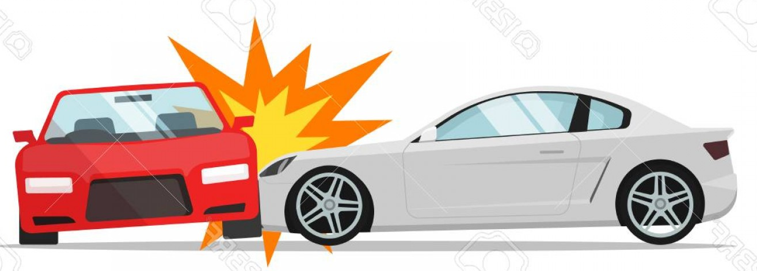
5. CREATE: Create a prototype
1

Slide 16
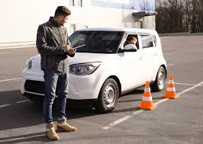
6. TEST: Test and evaluate the prototype
How did it go?
What were the problems?

Slide 17
7. IMPROVE: Redesign and try again!!
How well did your redesign work?

Slide 18

Communicate the Design
Explain what you did so far, what happened, and what you would like to try next.

