Slide 1


The New and Improved Nanotube- Fighting Breast Cancer

Slide 2
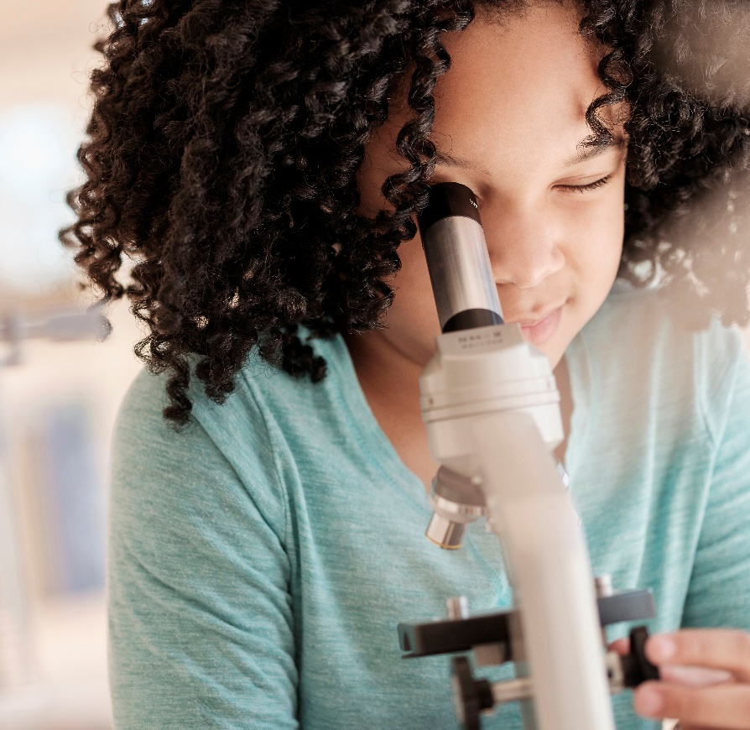

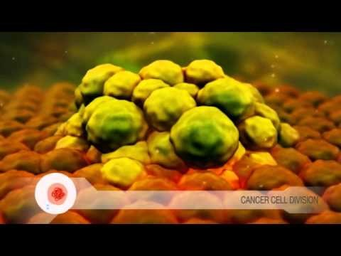

Raise your Hand!!
*If you know someone with breast cancer
*Know what breast cancer is
*Why cancer develops in the body

Slide 3
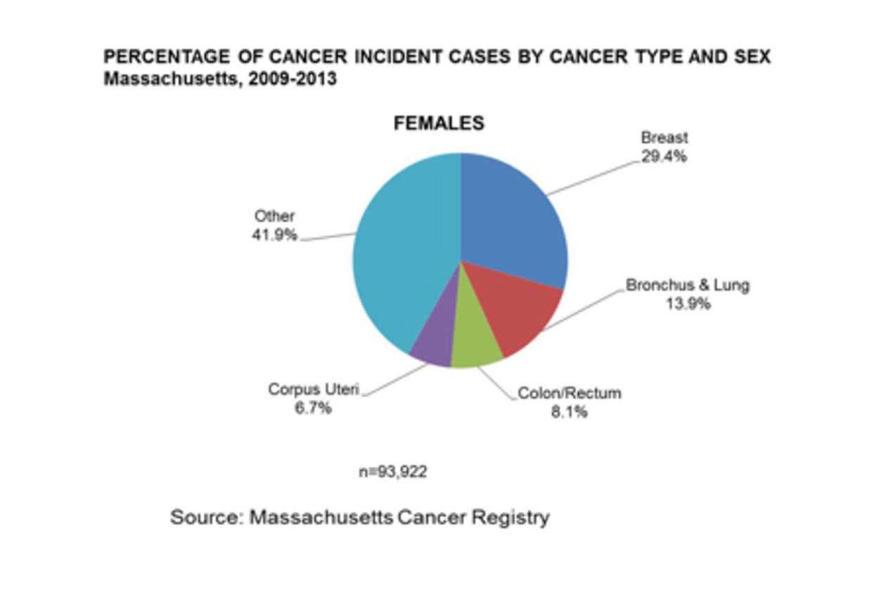
Breast cancer is known as the uncontrolled growth of breast cells.
What is Breast Cancer?

Slide 4

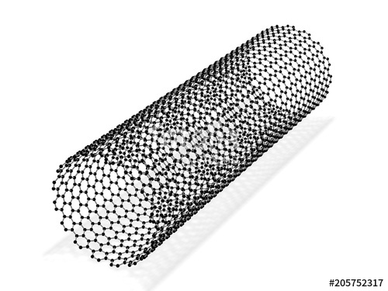
Thumbs up or Thumbs!!
Have ever heard of a carbon nanotube? Do you know how they are used?

Slide 5
What are Carbon Nanotubes?
Carbon nanotubes are cylindrical molecules that consist of rolled-up sheets of graphene
Used in biomedical engineering in a variety of applications

Slide 6
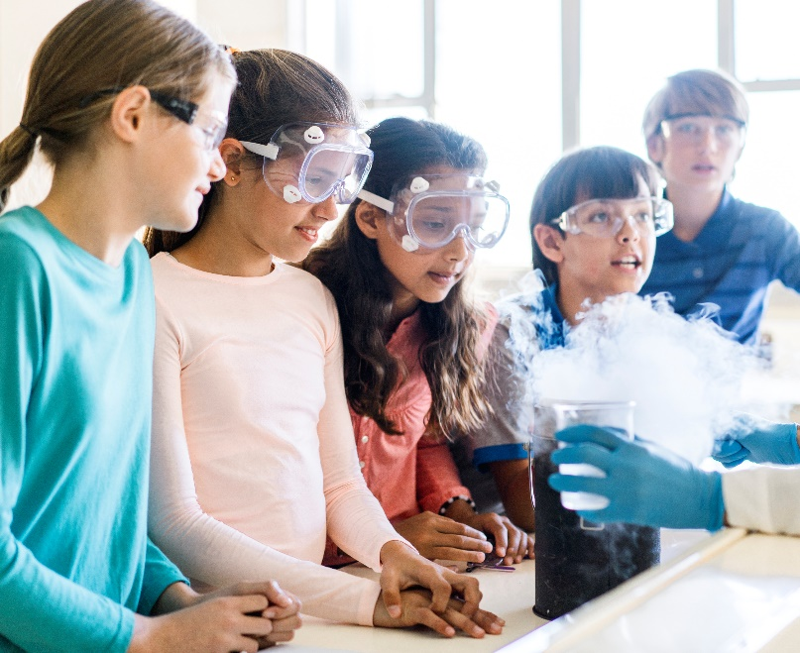
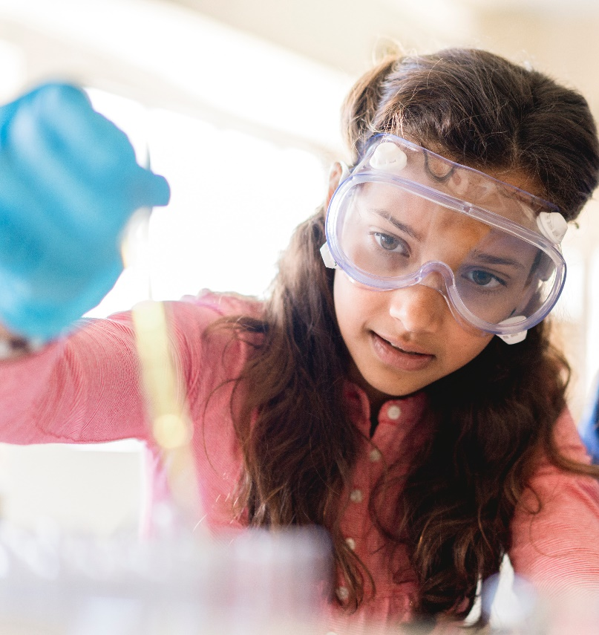
So What’s the Big Connection?
Carbon nanotubes hold outstanding properties such as electrical and thermal conductivity
Doctors are able to detect breast cancer in patients due to carbon nanotubes optical properties
The connection of the two may lead to a promising future in curing breast cancer!

Slide 7
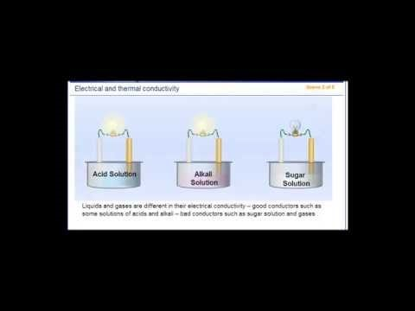
What can you recall about conductivity?

Slide 8

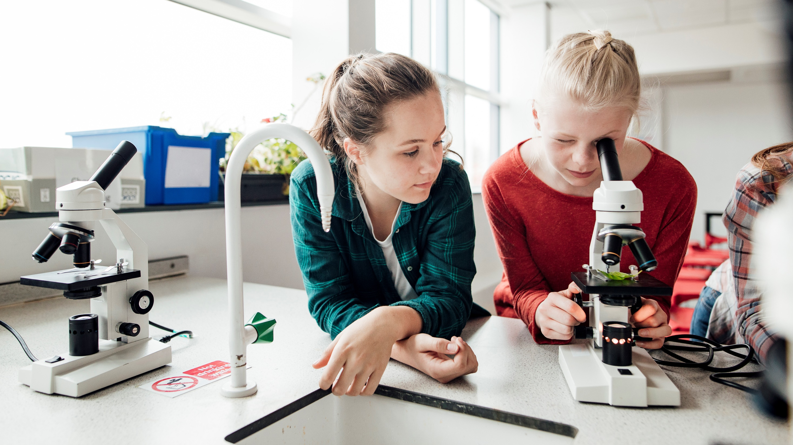
Let's Get Started!!

