Slide 1
The Glow Show:
Fun With Engineering!
(Or, Practicing the Engineering Design Process)

Slide 2
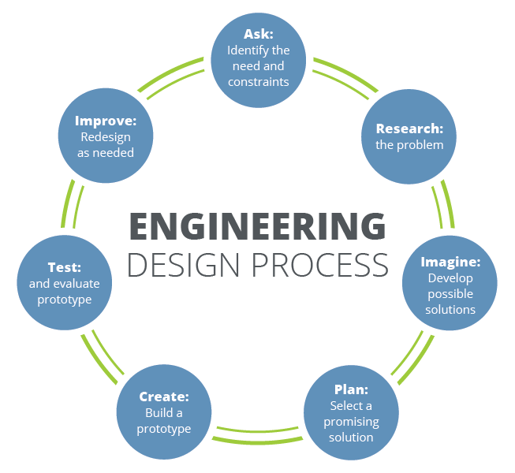

Slide 3
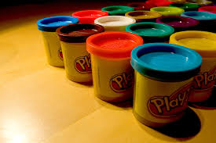
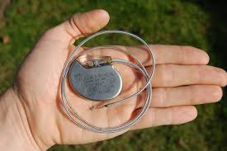
What if you HAD An idea for a product first?
Play-Doh was Meant To Be a Wallpaper Cleaner
The Pacemaker Started As a Heart-Recording Device

Slide 4


Choose Your Product!

Slide 5
Now Find a Use For It!
Your product must fill a need in industry:
  What industry will you choose?
  How will your product impact the industry?
Keep an electronic journal of the engineering process:
  Include prototypes, pictures, iterations, and thoughts along the way.
  Collect as much data as possible.

Slide 6


Promote Your Invention!
Advertise your product!
How you advertise is up to you, but it must include:
  The industry for which your invention is designed
  A working demonstration

