Slide 1

Nanotechnology

Slide 2
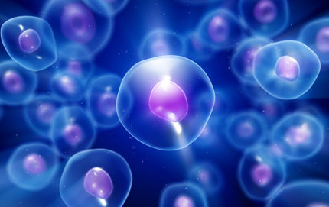
Nanotechnology
Nanotechnology is the manipulation of matter at the near-atomic and molecular (or nanoscale) level through engineering and scientific design. Nanotechnology is essential in the production of new materials, structures, systems and devices and seeks to improve functions and reactions of products.

Slide 3

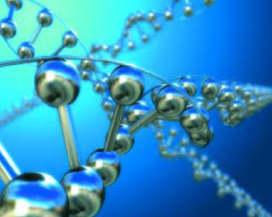
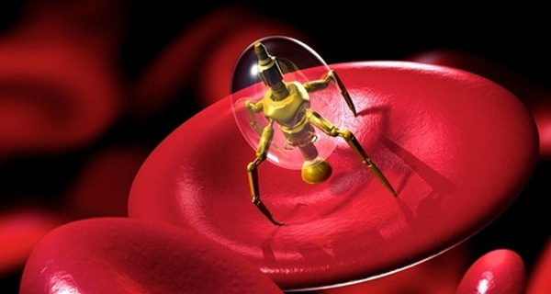
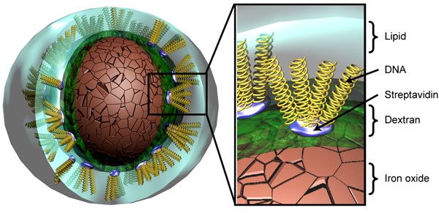
Nanotechnology
… has potential in a variety of industrial applications such as:
advanced engineering materials
drug and gene delivery
nanomedicine

Slide 4
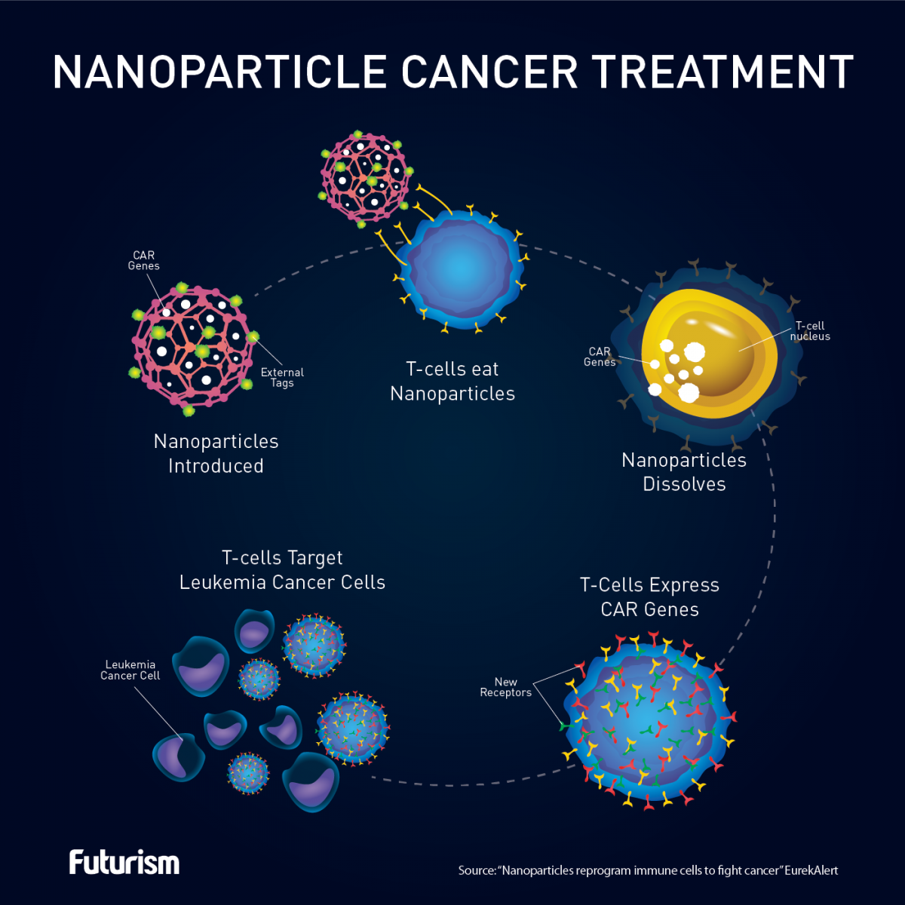
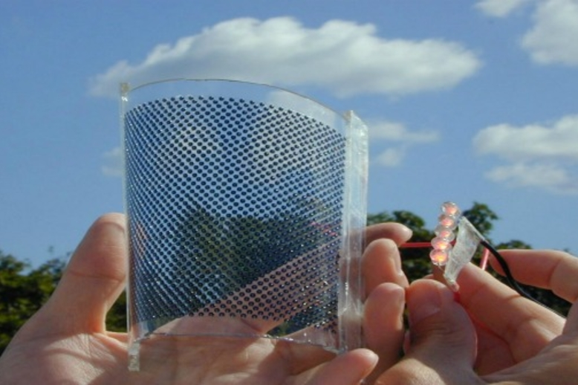
imaging and sensors
energy generation and storage materials

Slide 5
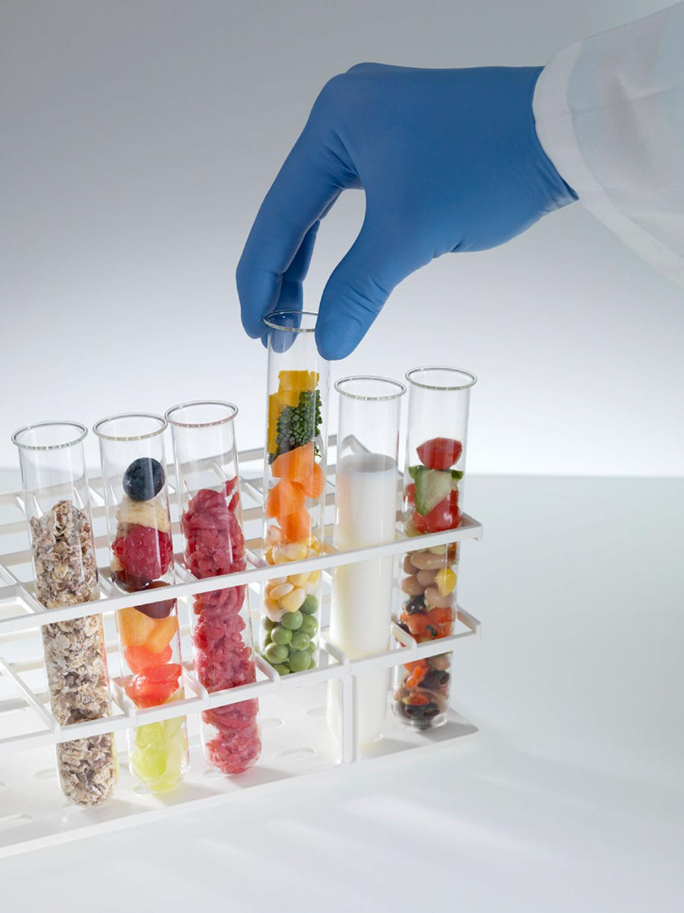
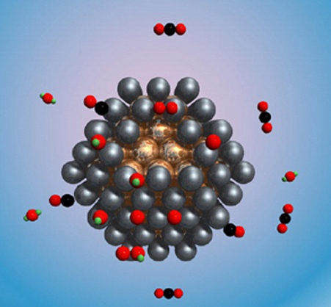
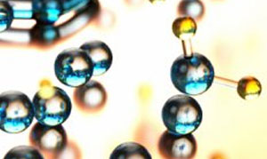

catalysts, foods and personal care products

Slide 6
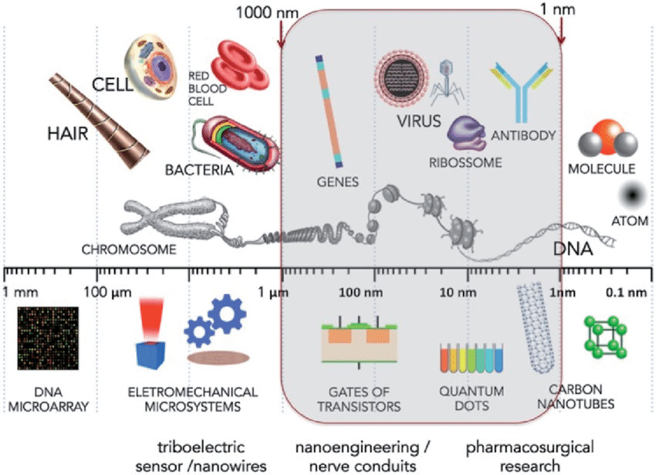
Nanoscale
Nanomaterials typically measure between 1nm and 1000 nm

Slide 7
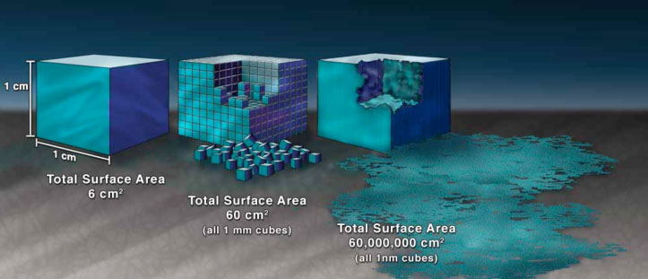
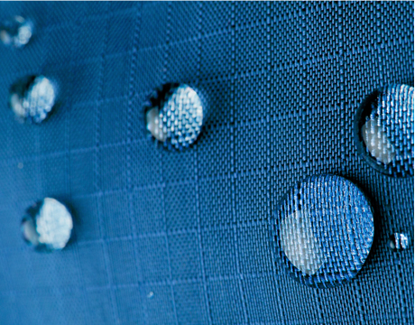
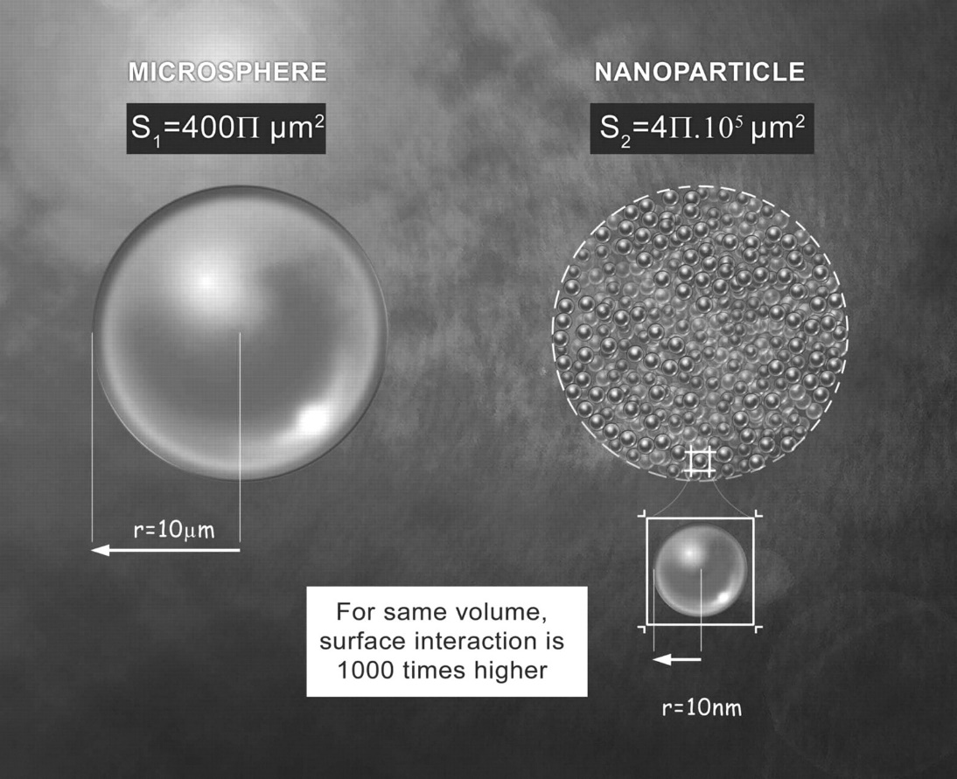
At this size, materials begin to exhibit unique properties that affect physical, chemical, and biological behavior
Nanoscale

Slide 8
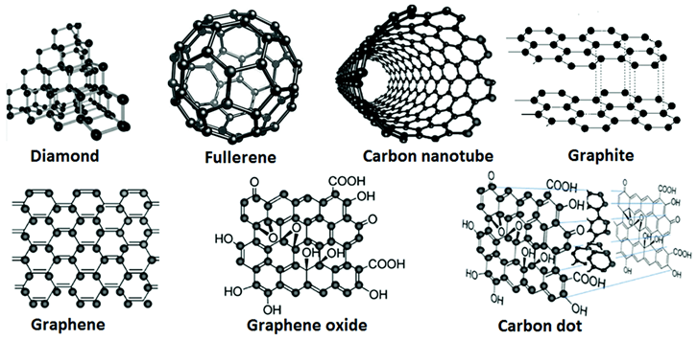
Types of Nanoparticles
Nanomaterials can be categorized in 4 major types:
CARBON-BASED

Slide 9
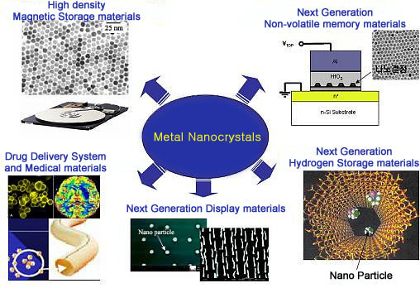
METAL-BASED

Slide 10
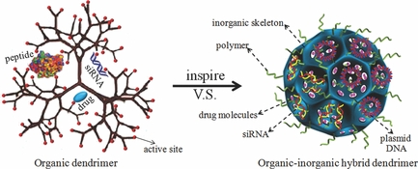
DENDRIMER
(a synthetic polymer with a branching, treelike structure)

Slide 11
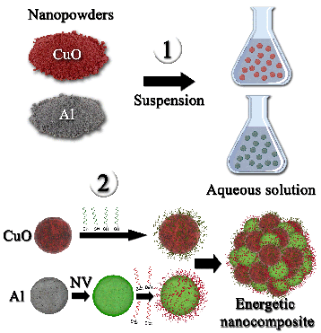
COMPOSITE

Slide 12
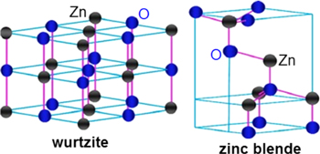
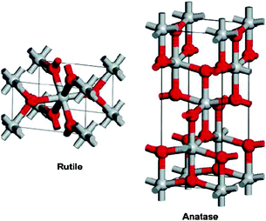
Photocatalytic Nanoparticles
Some nanoparticles have photocatalytic properties that scientists can engineer to speed up reactions using a light source. Photocatalytic nanoparticles are organic, may have antimicrobial properties, and are considered cost-effective.

Slide 13
Photocatalysis photo = light catalysis = using a catalyst catalyst = decreases activation energy to speed up a reaction

Slide 14
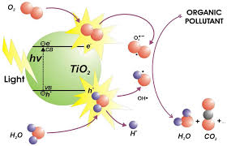
Photocatalytic Nanoparticles
These specific nanoparticles have the unique property of acting as a catalyst and speeding up a reaction using a light source (usually UV light).

Slide 15
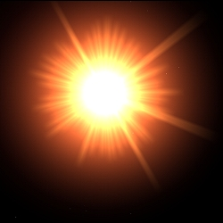
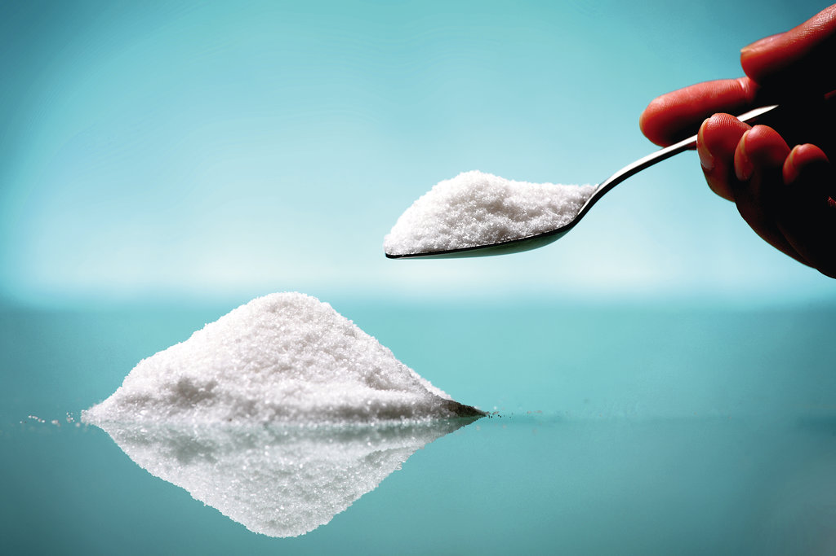
Photocatalytic
Nanoparticles
Through this process, nanoparticles such as titanium dioxide, act as organic destroyers and degrade organic toxins in the process of hydroxylation. (A chemical process that introduces a oxygen bonded to hydrogen—or a hydroxyl group—
into an organic compound.)

Slide 16
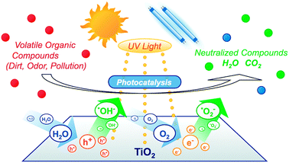
Titanium Dioxide Nanoparticle
Photocatalytic Activity
Organic Compounds→ photocatalyzed by TiO₂ with UV light→ to produce H₂0 and CO₂
Organic Compounds→degraded/destroyed in the process through hydroxylation

Slide 17
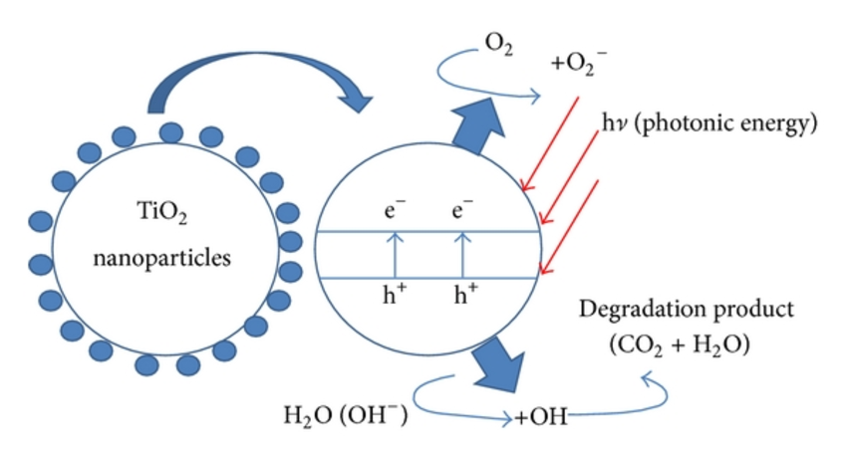
Photocatalytic Process
Photocatalysts create a strong oxidation agent and electronic holes to break down the organic matter into carbon dioxide and water when in the presence of photocatalysts such as light and water

Slide 18
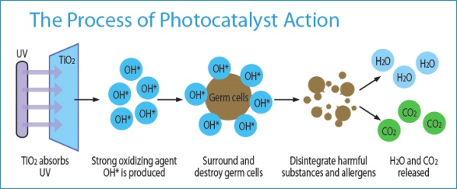
HYDROXYLATION TO DESTROY ORGANIC COMPOUNDS

Slide 19
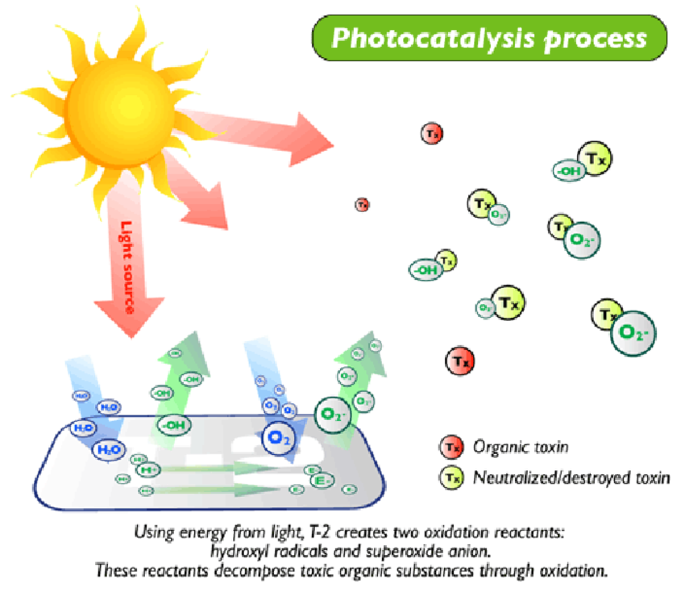
OF TITANIUM DIOXIDE

Slide 20


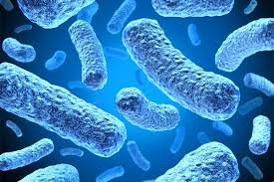

Uses of Photocatalytic Nanoparticles
Nanoparticles are essential in industries such as such as water sanitation and purification. They are also used in products from antimicrobial agents, cosmetics, and sunscreens to semiconductor systems.

Slide 21
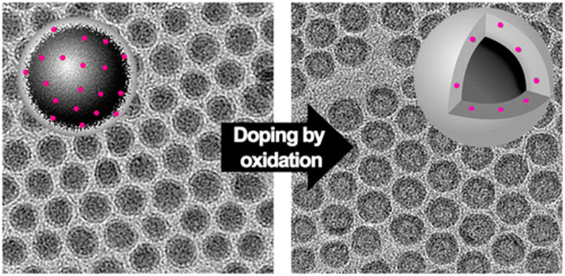
Future Research
Photocatalytic nanoparticles are currently being doped (an approach to modulate the electronic and optical properties of nanoparticles) and manipulated to trigger specific properties for nanoparticles in order to build an effective material.
Researching, developing, and utilizing these properties is at the heart of engineering nanoscale technologies.

Slide 22
Image links for each slide (from left to right on the page)
®PowerPoint slides and images are for classroom use only
Slide # | Image 1 | Image 2 | Image 3 | Image 4
1 | http://nanodome.info
2 | https://dornsife.usc.edu/news/stories/1111/analyzing-life-on-a-molecular-level/
3 | http://www.drrnlahotipolytechnic.com/course/computer-technology | http://www.european-coatings.com/Raw-materials-technologies/Technologies/Nanotechnology/Layer-by-layer-deposition-of-nano-patterned-thin-films-optimised | https://www.quora.com/What-invention-if-it-were-invented-today-would-quantum-leap-human-technology-by-several-decades-if-not-centuries-overnight | https://www.hopkinsmedicine.org/wilmer/research/retina/lutty/nano.html
4 | https://futurism.com/in-the-future-cells-reprogrammed-inside-our-bodies-will-fight-cancer-for-us/ | http://www.energydigital.com/sustainability/no-limits-total-abundance-transparent-solar-windows
5 | https://news.wisc.edu/new-nanoparticle-catalyst-brings-fuel-cell-cars-closer-to-showroom/ | https://nanofixit.wordpress.com/2015/04/28/nanotech-foods-will-nanotechnology-change-what-you-eat/ | http://www.european-coatings.com/Raw-materials-technologies/Technologies/Nanotechnology/What-do-people-know-about-nanotechnology | https://www.101newsmedia.com/news/16693
6 | http://blogs.iu.edu/sciu/2017/03/28/nanomaterials-bacteria/
7 | https://www.nano.gov/nanotech-101/special | https://www.asme.org/engineering-topics/articles/nanotechnology/nano-advancement-repels-liquids | https://www.acast.com/pulseoftheplanet/nanoparticles-awholelotofsurface15may17
8 | https://www.cd-bioparticles.com/t/Properties-and-Applications-of-Carbon-Nanoparticles_61.html

Slide 23
Slide # | Image 1 | Image 2 | Image 3 | Image 4
9 | http://composite.kaist.ac.kr/cgi-bin/reseng2.pl?metalnano
10 | https://chemeng.adelaide.edu.au/qiao/publications/previous/
11 | https://www.laas.fr/public/en/dna-nano-engineered-reactive-materials
12 | http://iopscience.iop.org/article/10.1088/2043-6262/6/3/033002 | http://pubs.rsc.org/en/content/articlelanding/2013/cp/c3cp43938k/unauth#!divAbstract
13
14 | http://www.mdpi.com/2073-4344/3/1/189
15 | https://www.birminghammail.co.uk/news/midlands-news/live-why-sun-red-today-13767276 | https://www.popularwoodworking.com/woodworking-blogs/flexner-on-finishing-woodworking-blogs/titanium-dioxide-a-carcinogen
16 | http://pubs.rsc.org/en/content/articlelanding/2011/cs/c1cs15065k/unauth#!divAbstract
17 | https://www.researchgate.net/profile/Chin_Wei_Lai2
18 | https://sciencedatacloud.wordpress.com/2013/11/22/photocatalyst-technology/
19 | https://www.researchgate.net/figure/Mechanism-of-titanium-dioxide-photocatalytic-degradation-process_fig3_215721240
20 | https://www.cdc.gov/healthywater/global/index.html | https://www.medexpressrx.com/blog/kids-shouldnt-avoid-using-sunscreen.aspx | https://csl.illinois.edu/news/metagenomic-research-studies-effects-microbial-populations | http://www.voicendata.com/worldwide-semiconductor-revenue-grew-2-6-percent-in-2016-gartner-results/
21 | http://www.lnls.cnpem.br/successful-oxidation-induced-doping-of-nanoparticles-revealed-by-in-situ-xas/

