Slide 1


Maze Craze: Pick the Healthy Path!

Slide 2
Index
DAYS 1 & 2
DAY 3
DAY 4

Slide 3
DAYS 1 & 2
Introduction
Brainstorm
Draft prototype

Slide 4



We have a problem!
Type 2 diabetes can happen at any age.
Come up with healthy and unhealthy choices.
Think like a robotics or biomedical engineer.
Problem solve.
Design.
Code smart machines.

Slide 5
Based on the information provided
What questions do you have?
What do you need to know?
What information is missing?

Slide 6
Pre-assessment!
Answer the questions to the best of your ability.
  Complete in 5 minutes.
Put pencil down when you are ready to share.
Sit silently until teacher direction.

Slide 7

Story
(link)

Slide 8

What is diabetes?
(link)

Slide 9
Good News!
Studies show that if you don’t have diabetes, you can make healthy lifestyle choices to help prevent getting this disease and others!
Let’s Think
  What are some healthy choices people can make?
  What are some unhealthy choices people can make?

Slide 10
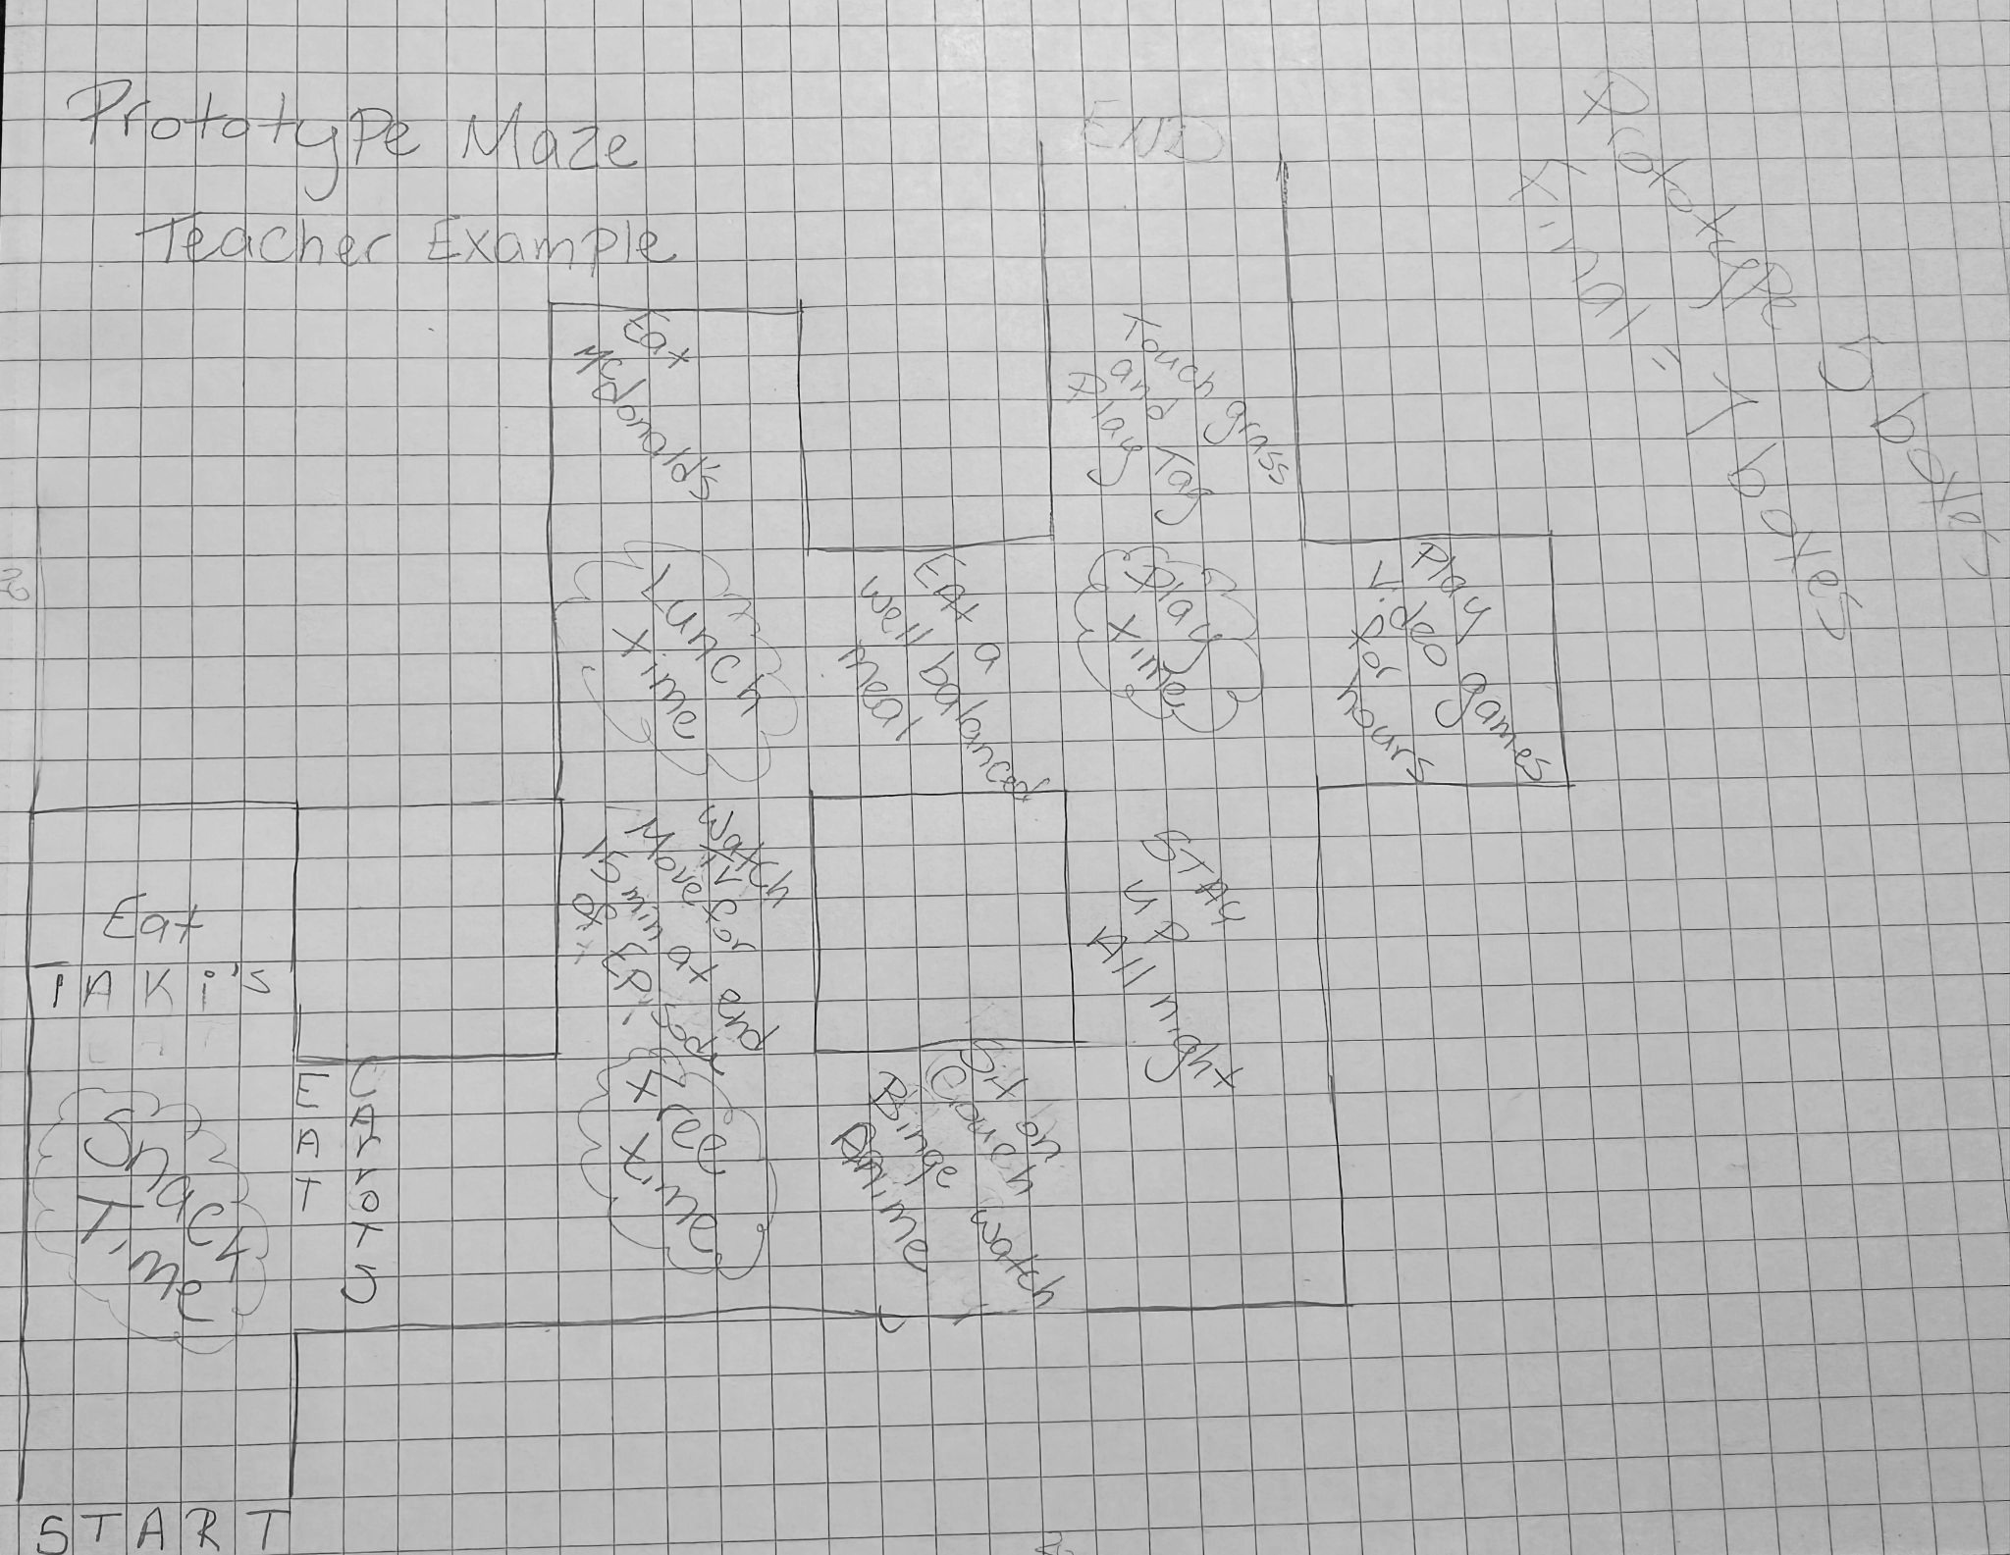
Expectations
Prototype Maze
  Must have a start and an end.
  For every healthy choice there needs to be an unhealthy choice.
  Minimum 3 healthy choices and 3 unhealthy choices.
  Maximum 5 healthy choices and 5 unhealthy choices.
  The choices do not need to be drawn on the prototype but would be required on the final. This is a good time to decide what they would look like; tracing from a computer will not be an option.
  Must be approved by teacher before moving to final copy.
Image above: prototype maze, made entirely in pencil, no pictures, 5x5 grid used

Slide 11
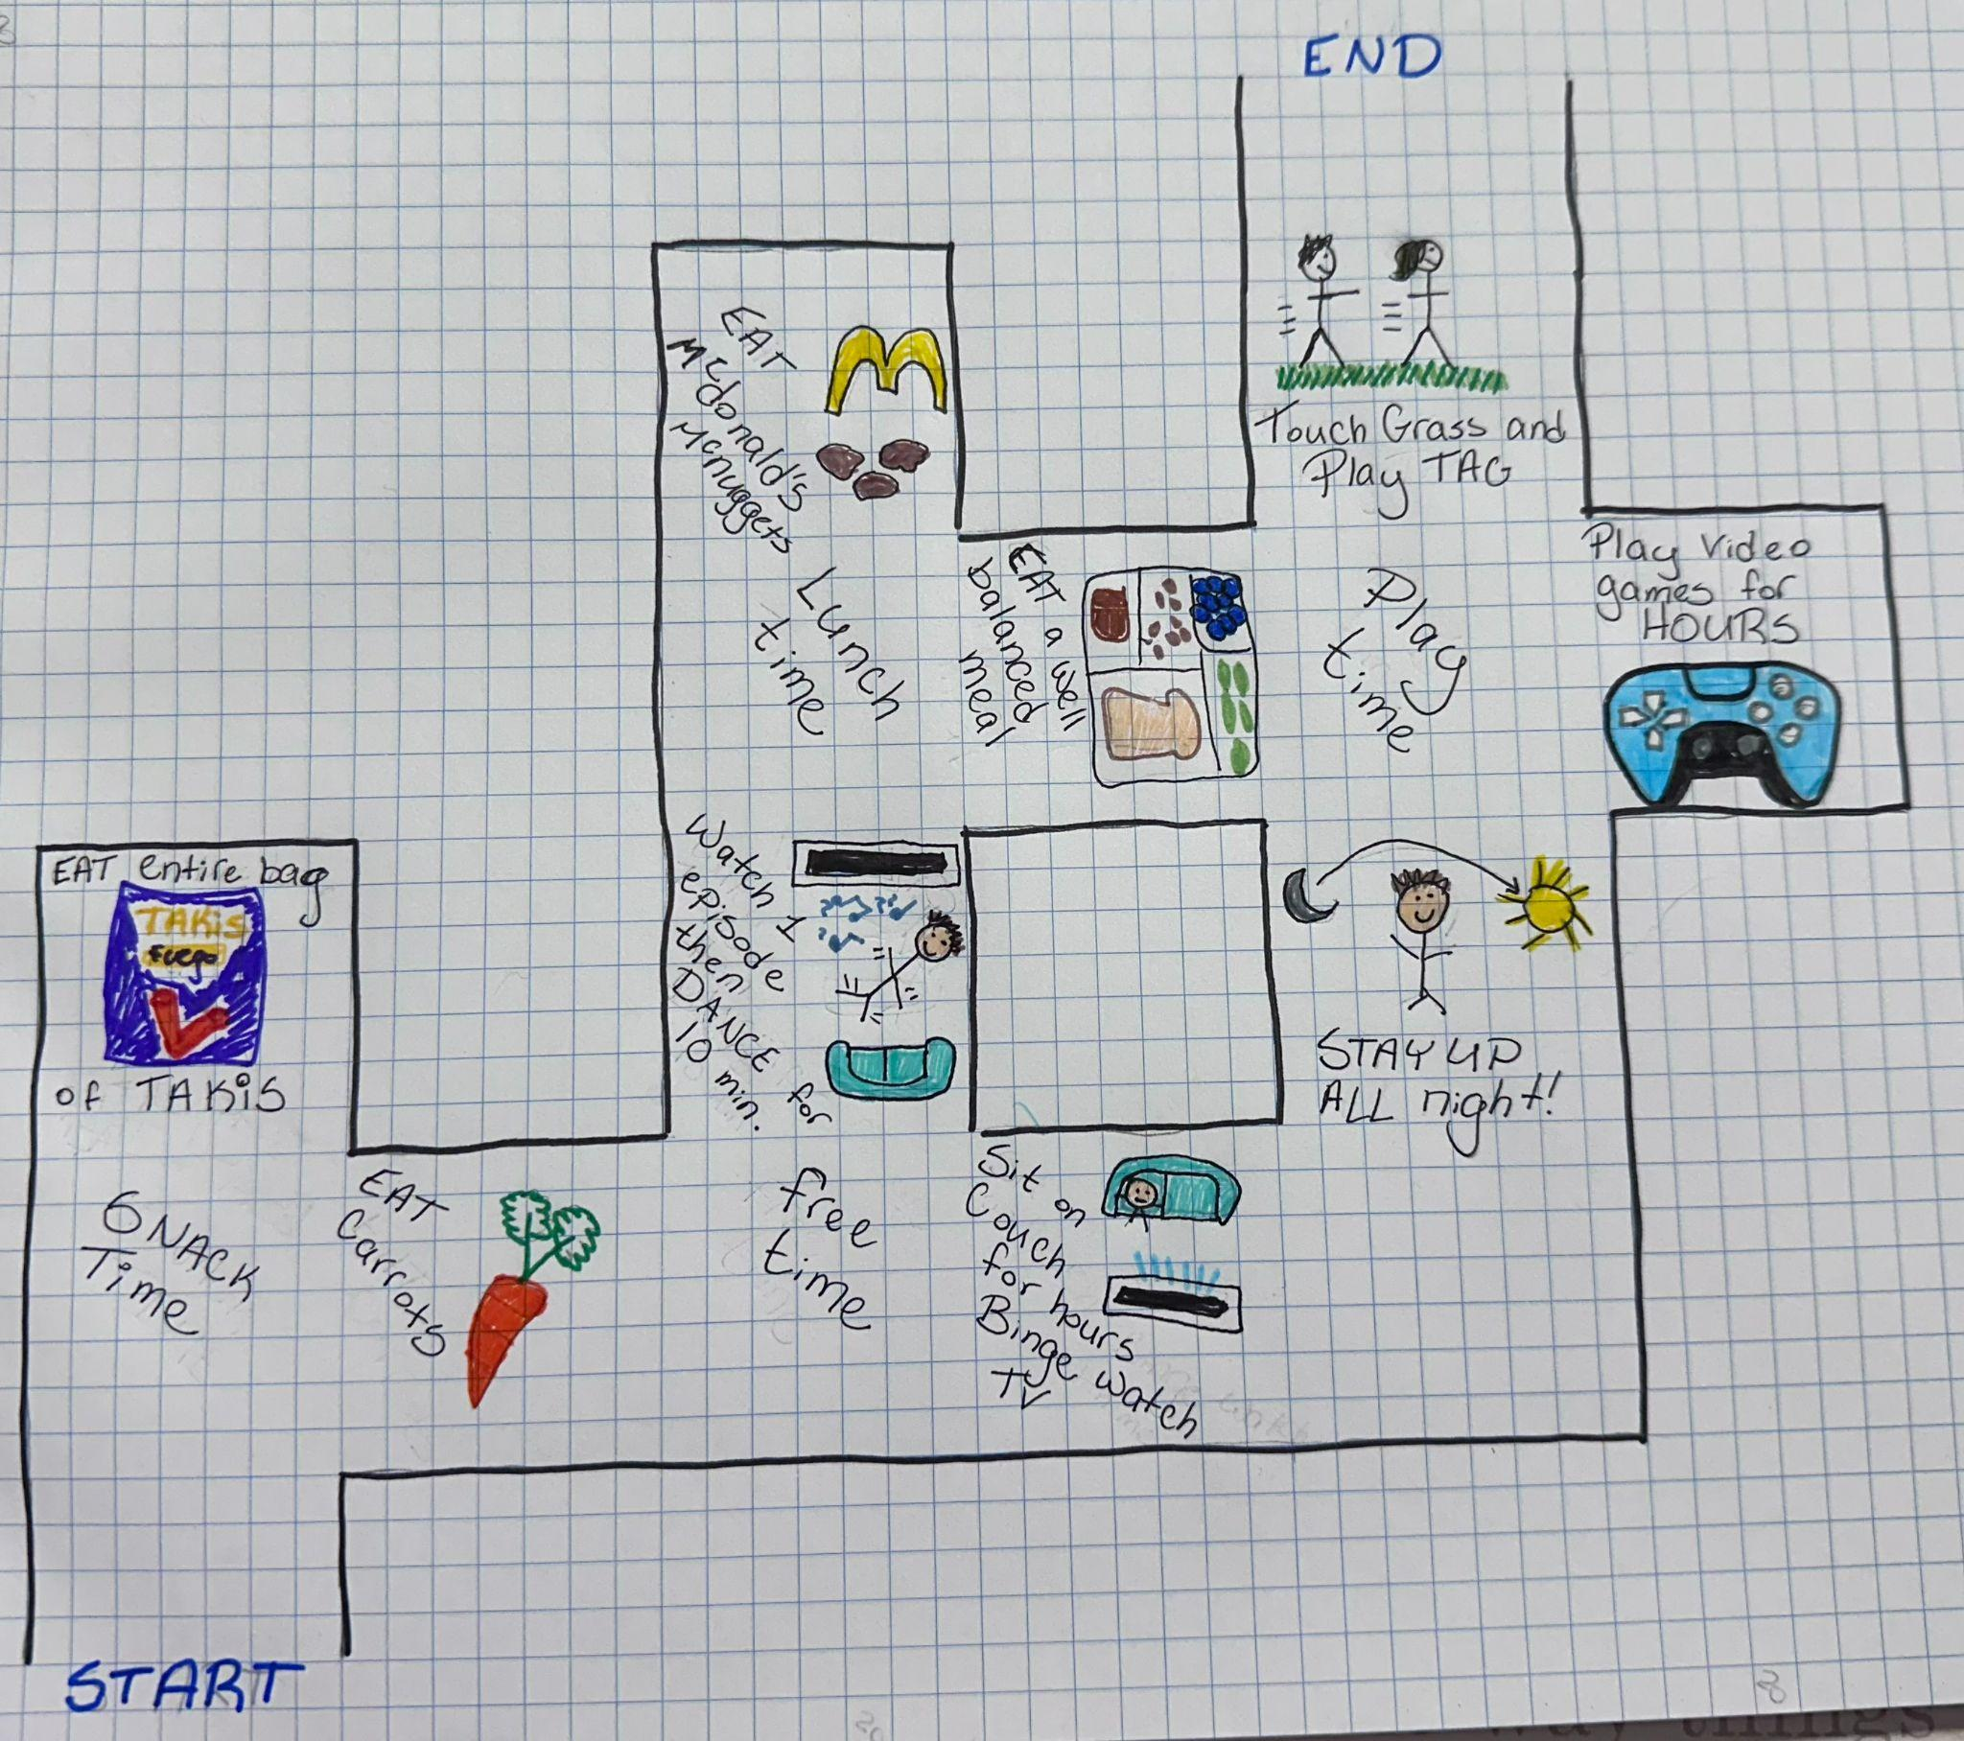
Expectations
Final Maze
  Only one paper will be provided – all mistakes must be incorporated into design – problem solve.
  Recreate the APPROVED maze.
  Illustrations with labels must be drawn.
Image above: final maze, created in pencil, traced in marker, pictures added, 7x7 grid

Slide 12
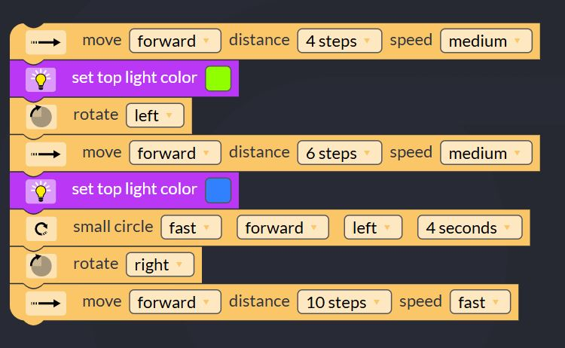
Expectations
Test Code
  Create a code you think the robot will follow to make it through your maze.
  Must start at your start.
  Must go through the healthy choices.
  Must end at your end.
Final code
  Robot starts at “start,” correctly goes through the healthy choices, and ends at “end.”
  If there is time, you may see what features your robot has that could advance the experience as it travels through your maze.
Image above: sample of code to get through maze

Slide 13
Start Prototype Maze
Prototype Maze
  Must have a start and an end.
  For every healthy choice there needs to be an unhealthy choice.
  Minimum 3 healthy choices and 3 unhealthy choices.
  Maximum 5 healthy choices and 5 unhealthy choices.
  The choices do not need to be drawn on the prototype but would be required on the final. This is a good time to decide what they would look like; tracing from a computer will not be an option.
  Must be approved by teacher before moving to final copy.

Slide 14
DAY 3
Draft prototype
Create final copy
Test code

Slide 15
Expectations
Prototype Maze
  Must have a start and an end.
  For every healthy choice there needs to be an unhealthy choice.
  Minimum 3 healthy choices and 3 unhealthy choices.
  Maximum 5 healthy choices and 5 unhealthy choices.
  The choices do not need to be drawn on the prototype but would be required on the final. This is a good time to decide what they would look like; tracing from a computer will not be an option.
  Must be approved by teacher before moving to final copy.
2. Final Maze
  Only one paper will be provided – all mistakes must be incorporated into design – problem solve.
  Recreate the APPROVED maze.
  Illustrations with labels must be drawn.

Slide 16
Expectations
Test Code
  Create a code you think the robot will follow to make it through your maze.
  Must start at your start.
  Must go through the healthy choices.
  Must end at your end.
Final code
  Robot starts at “start,” correctly goes through the healthy choices, and ends at “end.”
  If there is time, you may see what features your robot has that could advance the experience as it travels through your maze.

Slide 17
DAY 4

Slide 18
Troubleshooting Code
Run your code.
Make adjustments for incorrect movements the robots make.
Final code
  Robot starts at “start,” correctly goes through the healthy choices, and ends at “end.”
  If there is time, you may see what features your robot has that could advance the experience.
Record observations throughout troubleshooting.
Keep in mind how far the robot travels based on the code provided, including:
  Whether it traveled the correct direction.
  Whether there are any changes you need to make.
  Whether there are any measurements you might need to take.

Slide 19
Post Assessment
Complete post assessment in workbook.
  Answer in complete sentences.
  Turn in workbook.

Slide 20
Discussion
What did we learn?
What was the best part?
What was the worst part?

