Slide 1


Clean the Dirty Water

Slide 2
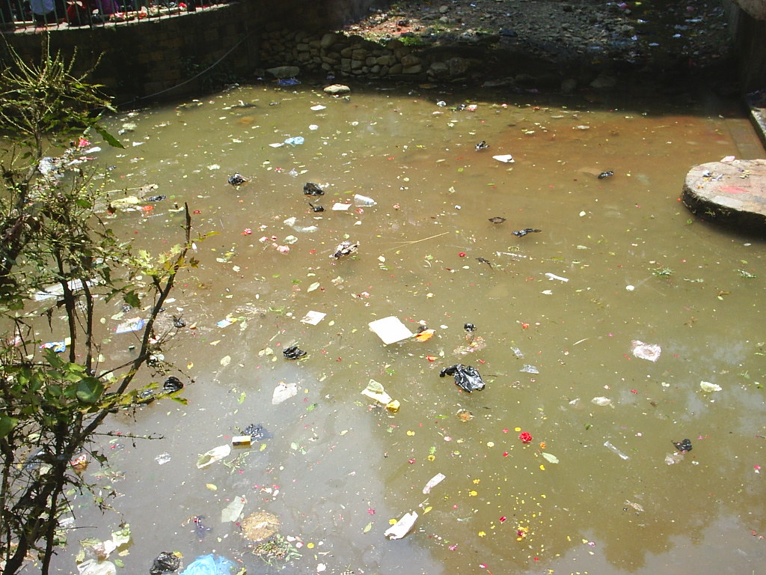
The Problem…
Many people around the world do not have access to clean drinking water.
Water from rivers, lakes, or wells is often dirty and contains…
- Dirt and sand.
- Oils and grease.
- Other household or environmental contaminants.
→ Contaminated drinking water can cause illness and disease.

Slide 3
The Challenge Questions...
How can we clean dirty water using simple everyday materials to make it safe to drink?
How do we test the clean water to determine whether it is safe to drink?

Slide 4
🧪You are the Engineers!
⚙️ Think Like a Pro! Define → Plan → Test → Improve
🌊 Use Your Science Skills — Matter • Mixtures • Materials that clean water
🏭 Real-World Connection — Real engineers build water filters for communities.
💡 Big Idea — Science + Engineering = Cleaner Water & a Healthier Planet!
Design Challenge…
You are a team of chemical and environmental engineers. Your mission is to design a filtration system to clean dirty water from a local water source in your city using inexpensive materials. The goal is to obtain approximately 10 mL of clean water.

Slide 5
Phase 1: Qualitative and Quantitative Observations
Use your senses (except taste!!) to describe your dirty water sample.
•👀 Sight
•👂 Sound
•👃 Smell
•✋ Touch

Slide 6
Phase 2: Imagine and Plan Your Filtration System
Choose up to THREE layers from the materials.
☐ | Coffee filter | ☐ | Gauze
☐ | Cotton fabric | ☐ | Baking soda
☐ | Cotton balls | ☐ | Untreated sawdust
☐ | Paper towels | ☐ | Grass clippings
☐ | Felt
Which materials will you pick for each layer?

Slide 7
Phase 2: Imagine and Plan Your Filtration System
Choose up to THREE layers from the materials.
☐ | Coffee filter | ☐ | Gauze
☐ | Cotton fabric | ☐ | Baking soda
☐ | Cotton balls | ☐ | Untreated sawdust
☐ | Paper towels | ☐ | Grass clippings
☐ | Felt
Which materials will you pick for each layer?
After you brainstorm your team’s filtration system, draw and label your planned system in your worksheet to show how you and your partner will layer the materials.

Slide 8
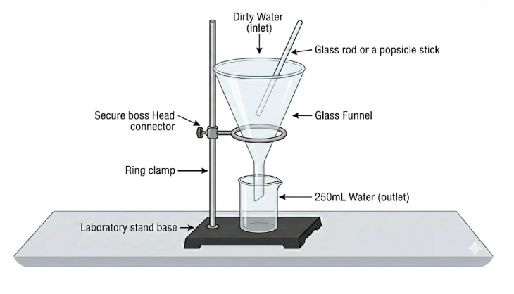
Phase 3: Create Your Filtration System
Materials
1 large plastic funnel
1 large 250 mL beaker
1 50 mL graduated cylinder
1 lab stand
1 ring support for the large plastic funnel up to three chosen filter materials
Instructions to set up filter and testing apparatus.
Place your filtration system into the large plastic funnel.
Set up your lab stand with the ring stand attached to it.
Place your fully functional filtration system in the ring stand with the 250 mL beaker underneath it.
Adjust the ring to place the funnel into the beaker.

Slide 9
Phase 4: Test Your Filtration System
Set up your system using a funnel, beaker, and lab stand.
Test the pH of the dirty water.
Slowly pour the water through your filter.
Observe changes in sight, smell, and sound.
Test the pH again when clean water collects.
Record in your data table:
  pH before filtering.
  pH after filtering.
  Amount of clean water collected.
  Observations of sight, smell, touch, and sound.

Slide 10
Phase 5: Reflect and Improve Like an Engineer
Think about your results.
What did each material do?
Why did you choose them?
Was your water cleaner?
What could you improve next time?
Why are chemical engineers important?

