Slide 1


How Sweet Are You? Engineering Smarter Solutions Using Data-Driven AI

Slide 2
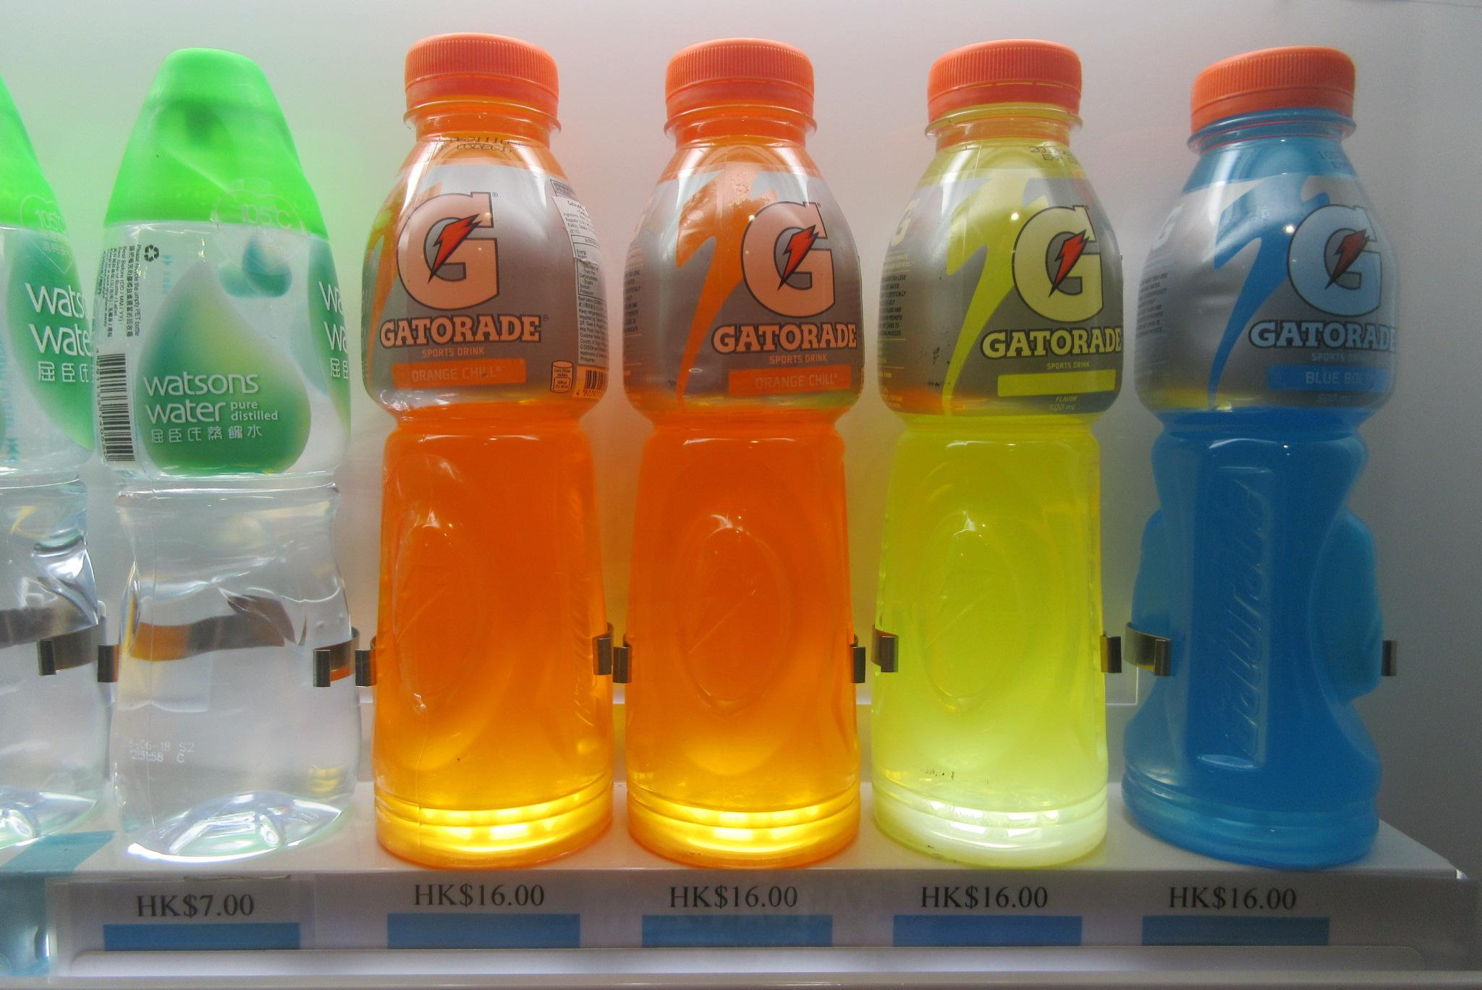
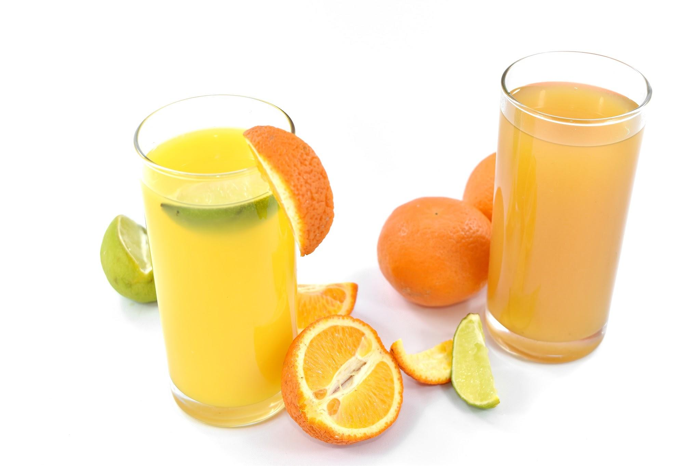


Thirsty? Which One Would You Choose? Why?
#6091ba
#9fcc3b
#8d64aa
#f8a81b
Notes:
pre-assessment

Slide 3
Did You Know?
When there is too much sugar in the blood, the kidneys remove the extra sugar.
When doctors look at your blood sugar, they are concerned with the sugar dissolved in your plasma.
Plasma is water with dissolved molecules. Plasma is a solution.
#6091ba
#9fcc3b
#8d64aa
#f8a81b

Slide 4
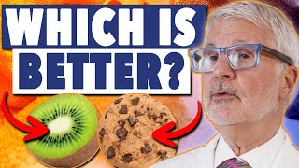
What Is Sugar?
#6091ba
#9fcc3b
#8d64aa
#f8a81b

Slide 5
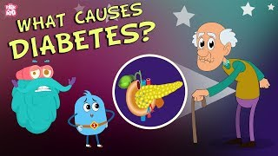
What Is Diabetes?
#6091ba
#9fcc3b
#8d64aa
#f8a81b
Notes:
Students watch the video. They may start taking notes in their STEM/Science journal and complete the graphic organizer on Page 1.

Slide 6
Think and Talk With a Partner
What do you already know about diabetes? Have you heard of it before?
How do you think food affects our bodies, especially when it comes to sugar?
Can you think of any foods or drinks that might have a lot of sugar in them?
Why do you think it's important for doctors and scientists to understand how different foods affect our bodies?
#6091ba
#9fcc3b
#8d64aa
#f8a81b
Notes:
Students watch the video. They may start taking notes in their STEM/Science journal and complete the graphic organizer on Page 1.

Slide 7
How Sweet Are You?
Challenge: Your task is to help doctors predict how certain foods affect a person's blood sugar levels.
#6091ba
#9fcc3b
#8d64aa
#f8a81b

Slide 8
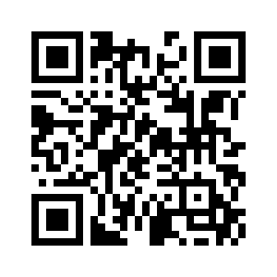
Activity 1
Read the article and make notes in your STEM/Science journal.
https://kidshealth.org/en/kids/carbs-diabetes.html
#6091ba
#9fcc3b
#8d64aa
#f8a81b
Notes:
Students read the article.

Slide 9
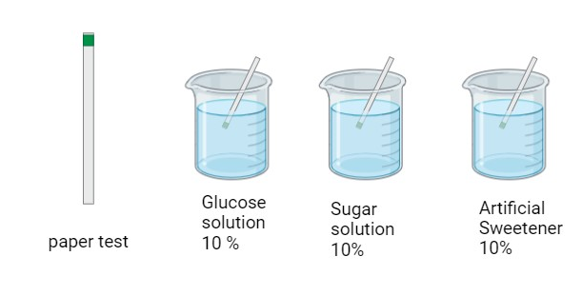
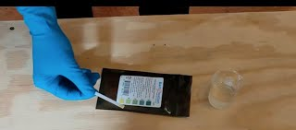
Activity 1 - Glucose Paper Test
Dip a glucose test strip into the 10% glucose solution (use gloves or a clothes pin).
Wait for the time specified by the test strip manufacturer.
Observe and record the color change or digital reading on the your group’s data sheet.
Repeat the process with the other solutions.
#6091ba
#9fcc3b
#8d64aa
#f8a81b

Slide 10
Activity 1 - Gathering Data
In teams, use chart paper and markers to create a graph to represent the data gathered in your datasheet.
Once done, have a gallery walk and make observations about the other graphs. What things are similar? What things are different?
#6091ba
#9fcc3b
#8d64aa
#f8a81b

Slide 11

Activity 2 - What Is Machine Learning?
#6091ba
#9fcc3b
#8d64aa
#f8a81b
Notes:
Students watch the video. They may start taking notes in their STEM/Science journal and complete the graphic organizer on Page 1.

Slide 12

Activity 2 - Machine Learning Tutorial
#6091ba
#9fcc3b
#8d64aa
#f8a81b
Notes:
Students watch the video. They may start taking notes in their STEM/Science journal and complete the graphic organizer on Page 1.

Slide 13
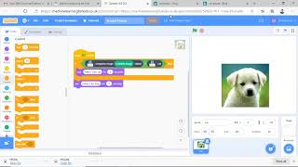
Activity 2 - Now It's Your Turn!
Adapt the tutorial in image recognition to have a machine learning system recognize foods that have high levels of glucose.
Double-check your food choices by using the Glycemic Food Guide
#6091ba
#9fcc3b
#8d64aa
#f8a81b
Notes:
Students will take pictures or browse pictures of foods online to create the database. Students can refer to the Glycemic Index Food Guide table HERE.

