Slide 1


Forms of Energy and Electrical Circuits

Slide 2
Forms of Energy

Slide 3
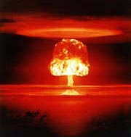
Energy
Energy is the ability to do work.
Energy exists in various forms: kinetic (mechanical), potential, thermal, chemical, electrical, light, sound, and nuclear. Energy cannot be created or destroyed – only converted from one form to another.

Slide 4
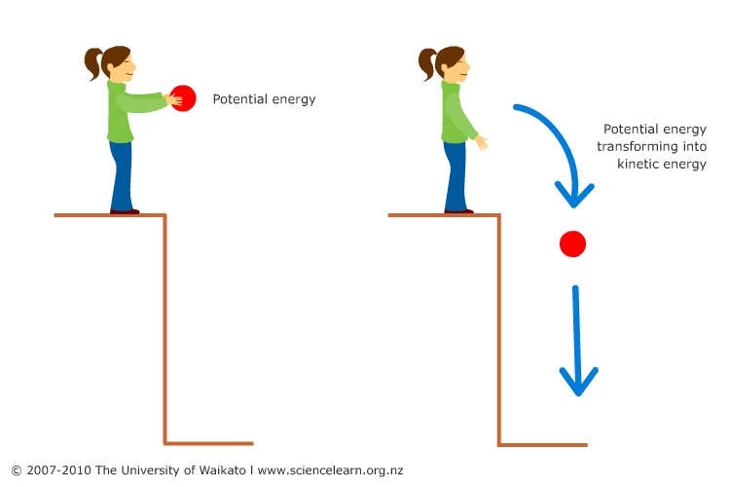
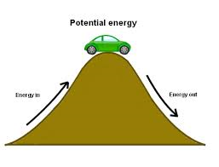
Potential energy
→ the energy an object has because of its position or condition.
→ It is STORED energy

Slide 5
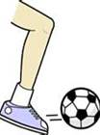
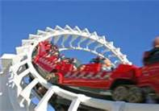

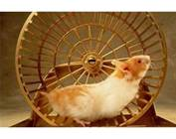
Kinetic energy
→ the energy an object has due to its motion, position, or condition.
It is energy in MOTION.
Anything moving has kinetic energy.

Slide 6
Mechanical energy
→ the total energy of an object due to its motion PLUS its position
→ Energy that does work.
Energy that is moving.

Slide 7
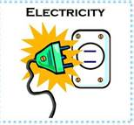
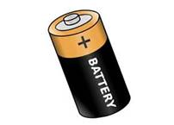
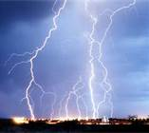
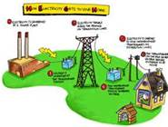
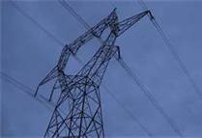
Electrical energy
→ energy that comes from the flow of electricity through a conductor.
Use electricity by:
plugging a cord into an outlet
using a battery
lightning

Slide 8
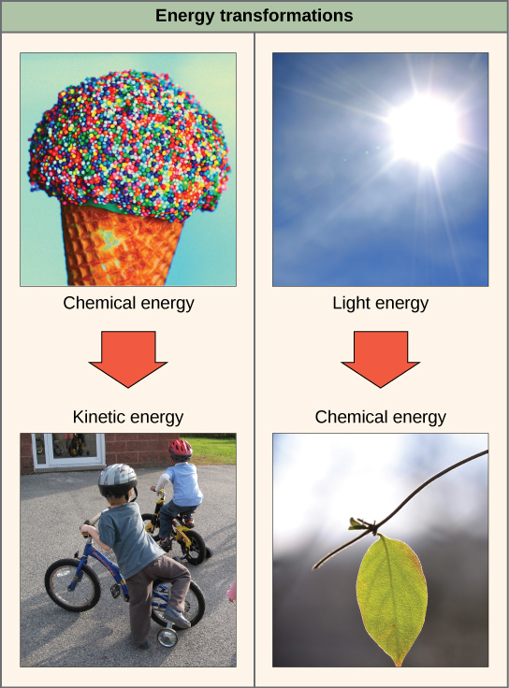
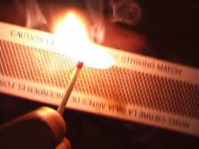
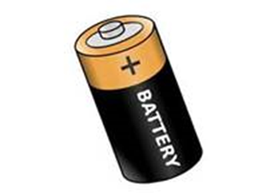
Chemical energy
→ energy stored in matter that can be released by chemical reactions

Slide 9
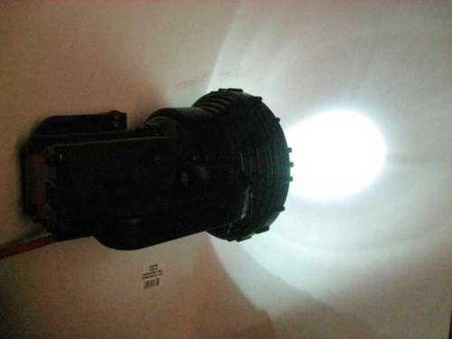
Light energy
→ energy that
can be seen
travels in a straight line
move through empty space where there is no air.

Slide 10
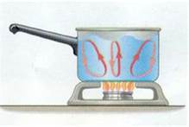


Thermal energy
→ the energy from heat
→ The energy created by the movement of molecules causing an object to get hot and release heat.
Also known as heat energy

Slide 11
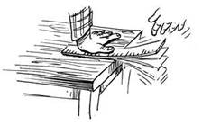

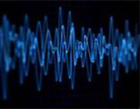

Sound energy
→ the energy of vibrations carried in waves by air, water, or other matter.
→ energy you can hear caused by vibrations (rapid back and forth movement).

Slide 12
Electrical Circuits

Slide 13
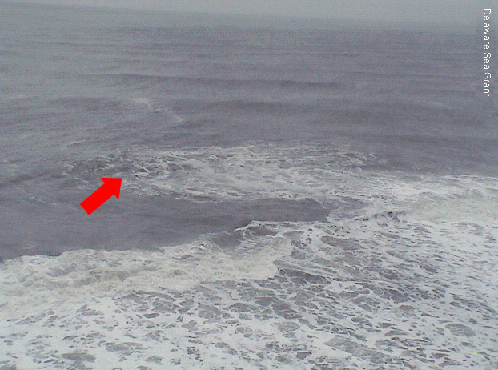
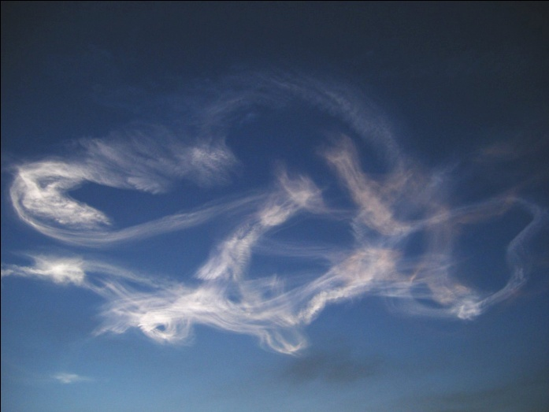
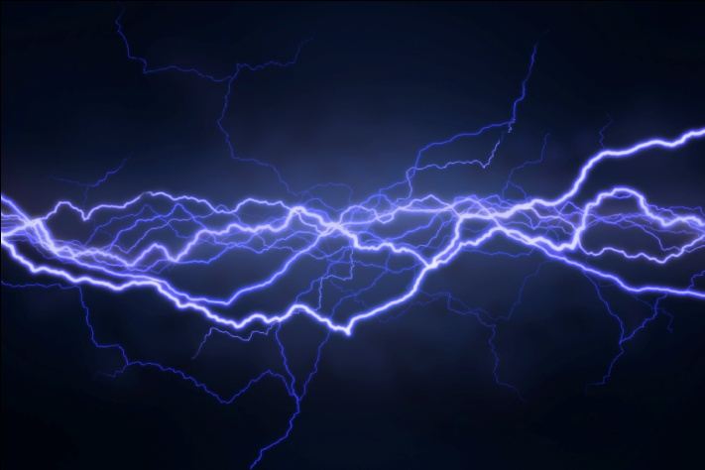
Current
A flow of water, air, or electricity.
Water current
Lightning
Air current

Slide 14
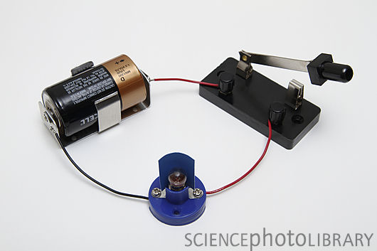
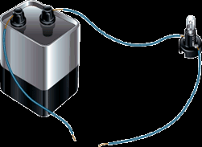
Open circuit
(incomplete or broken)
An open circuit has a gap in the loop.
→ When a circuit is open, the device will not work.

Slide 15
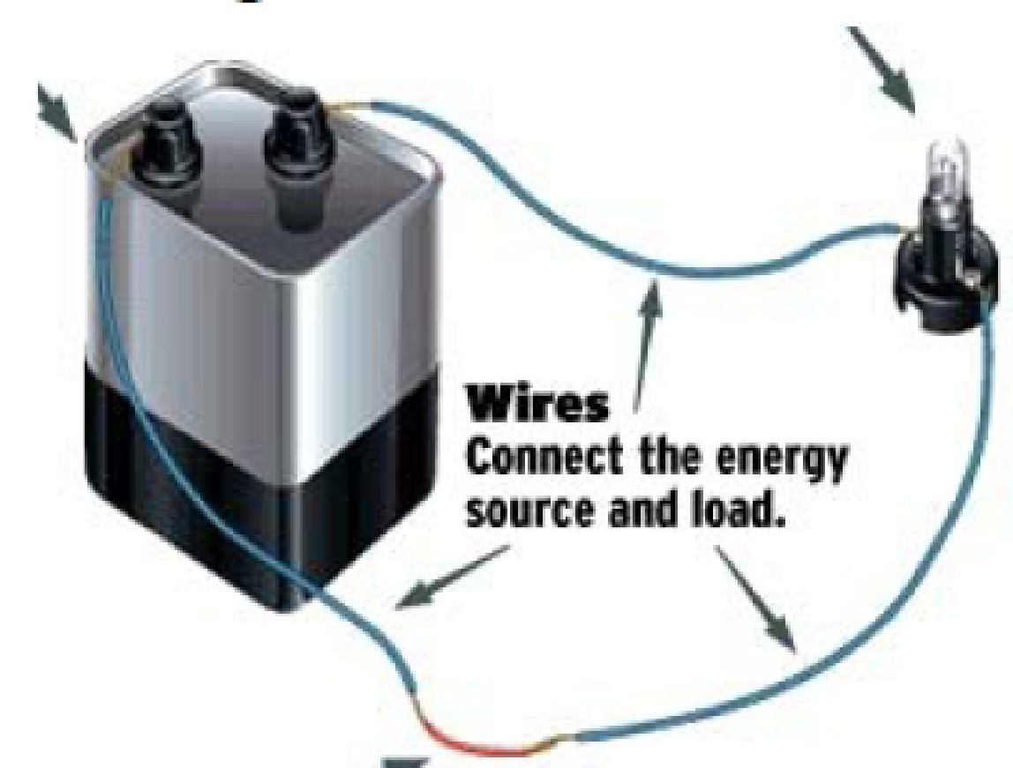
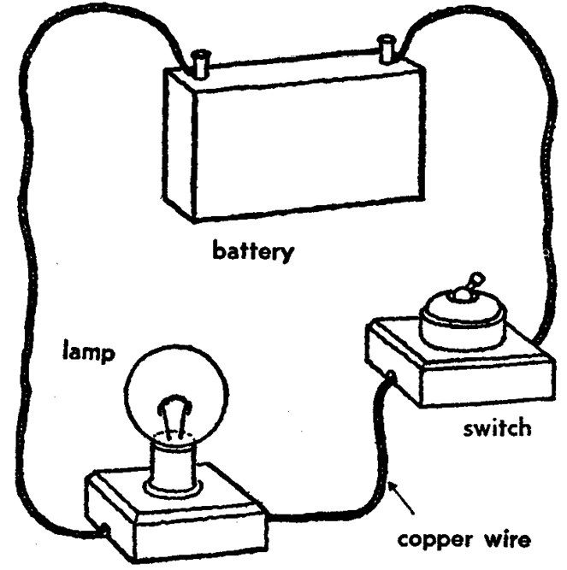
Closed circuit
(complete or working)
A closed circuit is a path that allows an uninterrupted, endless path for flow of electricity.
A closed circuit is a continuous loop.
When a circuit is closed, the device works.

Slide 16
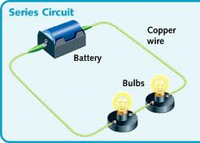
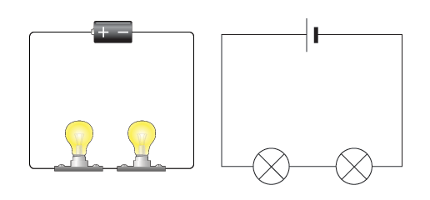
Series circuit
All parts of a circuit in a single continuous path
Only ONE path for electric current.
If one part breaks, the circuit is broken.

Slide 17
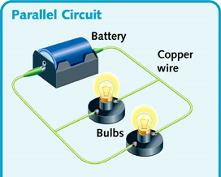
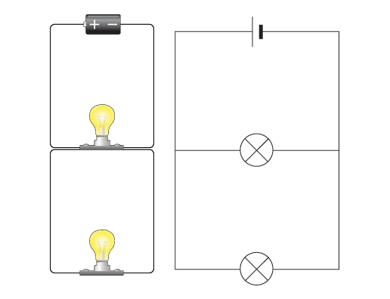
Parallel circuit
All parts of a circuit in multiple paths
Two or more paths for electric current
If one part breaks, the circuit still works.

Slide 18
Light Energy

Slide 19
Light energy
A form of energy that
can be seen
travels in a straight line
move through empty space where there is no air.

Slide 20
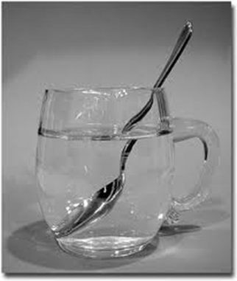
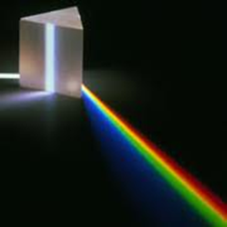
Medium
→ a substance/material that a force acts on or energy is carried (passed) through
3 light mediums:
Transparent: all light passes
Translucent: some light passes
Opaque: no light passes (absorbed)

Slide 21
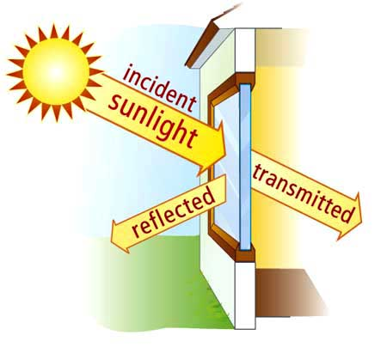
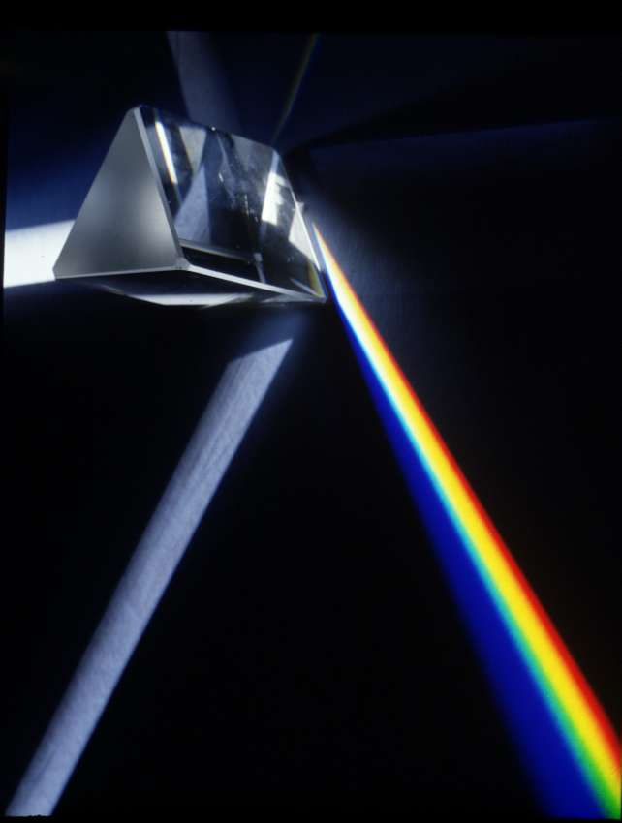
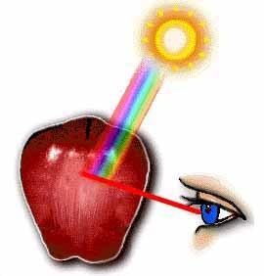
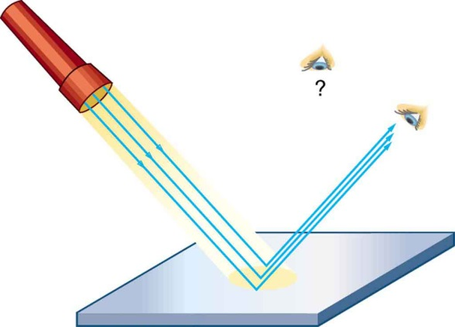
Interaction
What happens to light when it interacts with a medium?
Light can:
Transmit
Reflect
Refract
Absorb

Slide 22
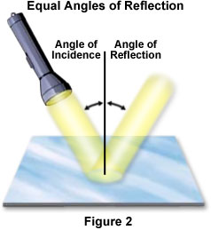
Reflect
Light energy that bounces off a surface.
Example: mirror, water surface, tinted windows/glass

Slide 23
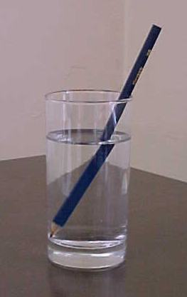
Refract
The bending or breaking of light rays as they pass from one substance to another.
Light slows down and changes direction when it enters a medium.
Example: lens

Slide 24

Transmit
All light passes through
Light interaction
When light comes inyo contact with a transparent medium
Example: window

Slide 25

Absorb
Stops or blocks light from passing
Turns energy into heat
Happens with opaque mediums
Example: the color black

