Slide 1
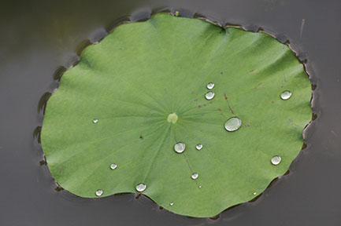
Engineering Self-Cleaning Hydrophobic Surfaces

Slide 2
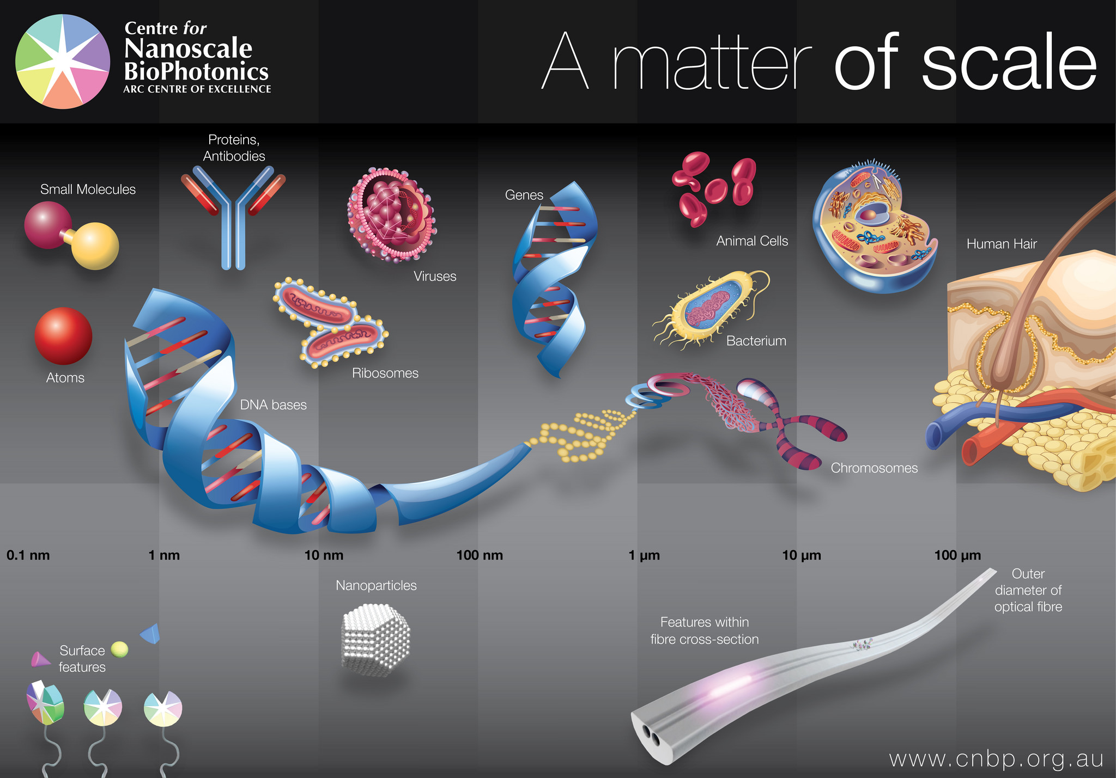
Nanoscale
Nanoscale: nanomaterials that typically measure between 1 nm and 1000 nm
Nanomaterials typically measure between 1nm and 1000 nm
Notes:
https://www.flickr.com/photos/cnbp/15375472773

Slide 3
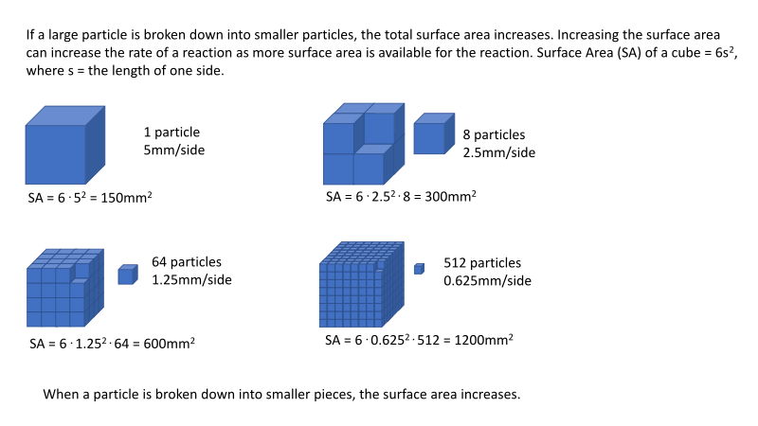
Nanoscale
At this size, materials begin to exhibit unique properties that affect physical, chemical, and biological behavior
At this size, materials begin to exhibit unique properties that affect physical, chemical, and biological behavior
Notes:
https://commons.wikimedia.org/wiki/File:Surface_area.svg

Slide 4
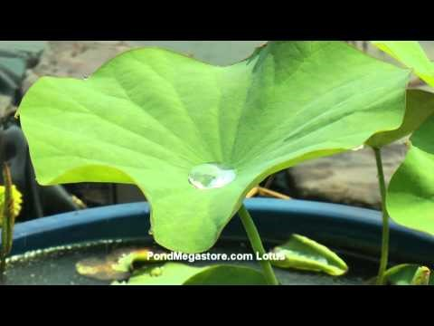
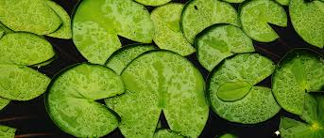
Biomimicry
Have you ever noticed how water rolls off a leaf, or how a lily pad floats on water? These plants parts are said to be “superhydrophobic” and their leaves never get dirty. Why is this?
Notes:
https://www.google.com/imgres?imgurl=http%3A%2F%2Falekhyahomes.in%2Fwp-content%2Fuploads%2F2015%2F08%2Flotusleaf_930x400.jpg&imgrefurl=http%3A%2F%2Falekhyahomes.in%2Fprojects%2Flotus-leaf%2F&docid=L2EcfkT7npDodM&tbnid=PQE5c6PJvNkaYM%3A&vet=10ahUKEwjVwIT-kundAhUKP60KHaFxBZUQMwh_KAYwBg..i&w=930&h=400&safe=strict&bih=657&biw=1366&q=lotus%20leaf&ved=0ahUKEwjVwIT-kundAhUKP60KHaFxBZUQMwh_KAYwBg&iact=mrc&uact=8

Slide 5
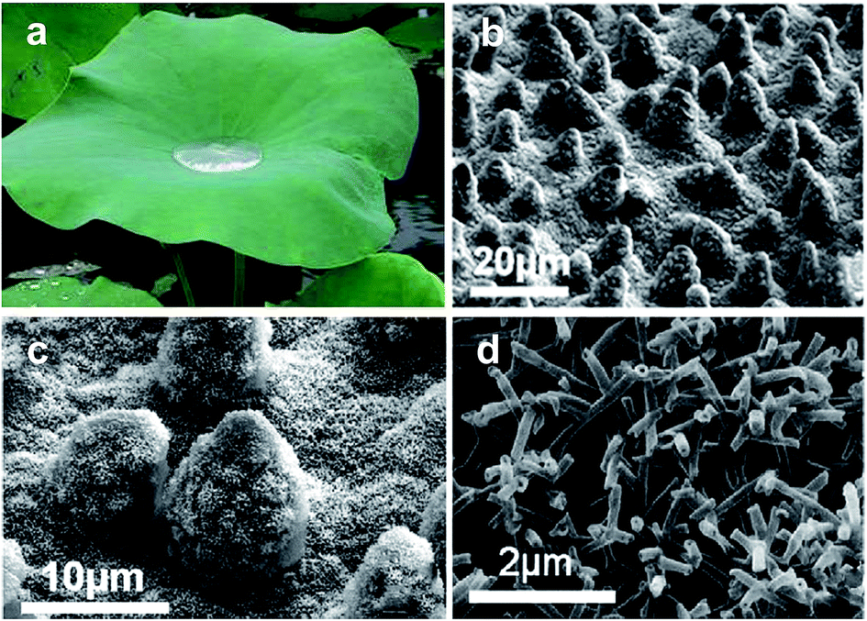
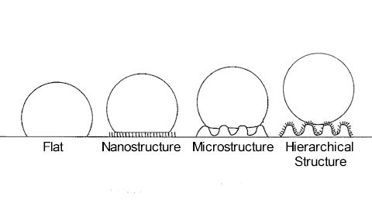
What is the hydrophobic effect?
Hydrophobic comes from the word hydro (water) and phobos (fear). It can be demonstrated by trying to mix oil and water.

Slide 6
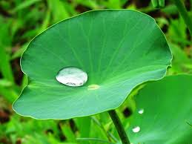
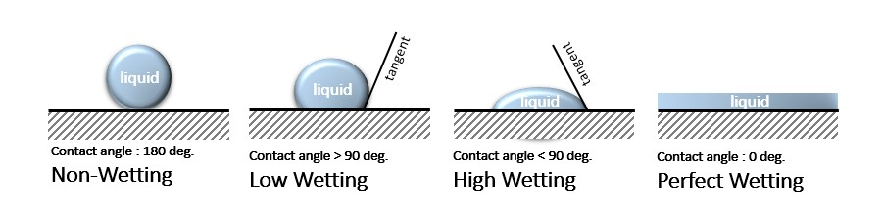
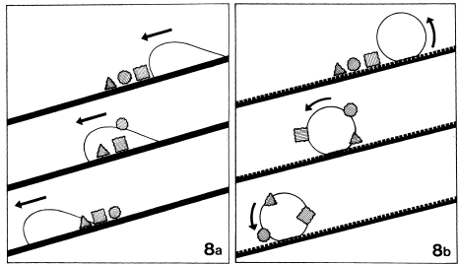
Superhydrophobic Surfaces
High Contact Angle and Low Roll Off Angle Aids in Cleaning
Diagram of water on tilted surface

Slide 7
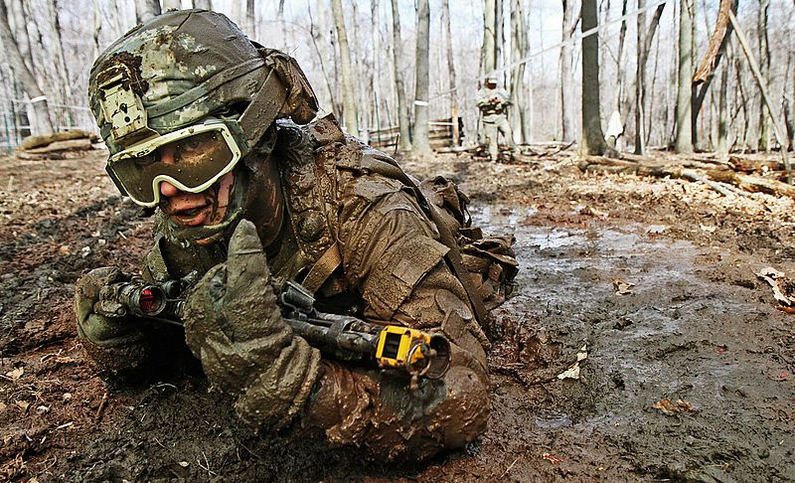
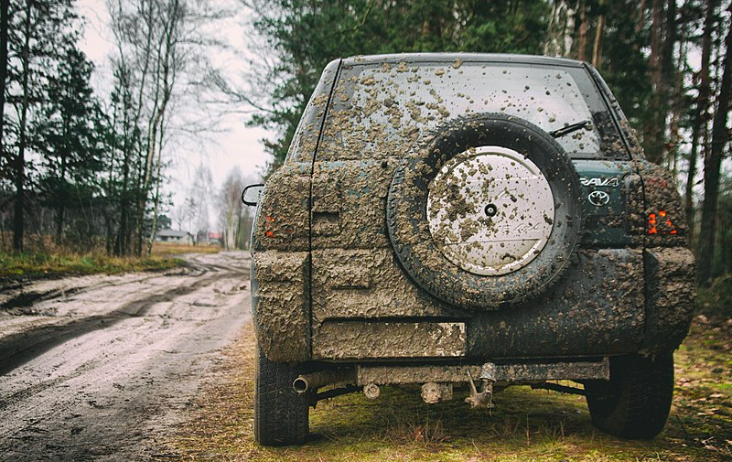
Using self-cleaning products, you may be able to avoid stained clothing and dirty cars.
Notes:
https://commons.wikimedia.org/wiki/File:Mud_low_crawl_Individual_Movement_Techniques_training.jpg
https://commons.wikimedia.org/wiki/File:Muddy_Toyota_RAV4.jpg

Slide 8

Ultra Ever Dry (Video)
Notes:
https://www.youtube.com/watch?v=IPM8OR6W6WE&t=148s

Slide 9


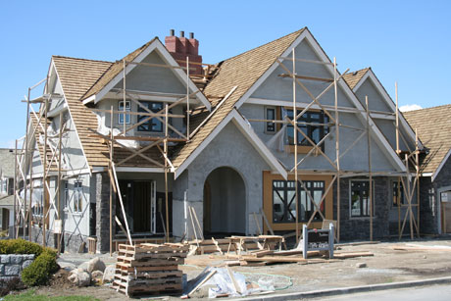
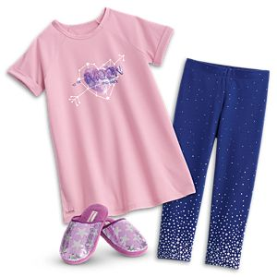
Your Challenge
You are a part of a team of materials engineers at a company that specializes in waterproofing materials.
Your team has been asked to create a product that can make any surface dirt and stain resistant.
Notes:
https://www.hydrotechusa.com/
https://nhg.secure.footprint.net/-/media/Articles/shutterstock_1170325_construction01.jpg?h=307&la=en&w=460&t=20170612T055408Z
https://images.mattel.com/scene7//wcsstore/MattelCAS/05BUN14_Comfy_Space_PJs_and_Slippers_Girls_FMD28_FMD29_1?$ossmallindex$&storeId=10651&SKU=05BUN14

Slide 10
Make Observations – Define your Problem
Choose Materials
Surfaces to Modify
10 cm x 10 cm wood
10 cm x 10 cm cotton fabric
Water Proofing Materials
wax
crayons
flax seed oil
lanolin
clay
glue
Tools to Modify
sandpaper
wax paper
sand

Slide 11
Plan & Design
Must have a written plan for chosen surface.
  What material will you modify.
  What industry is this for?
How will you modify?
  What tools and materials will you use to modify your surface?
  Explain how and why you are using each material.
Sketch your design.

Slide 12
Create/Modify
Modify your surfaces.
Make sure to adjust and make note of any changes to your original plan as you create.

Slide 13
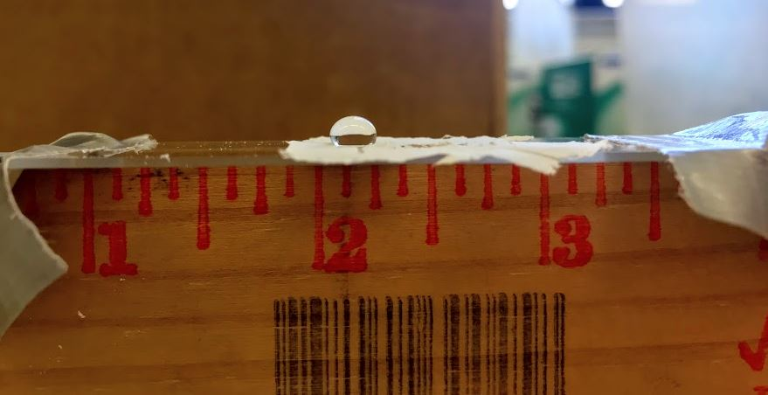
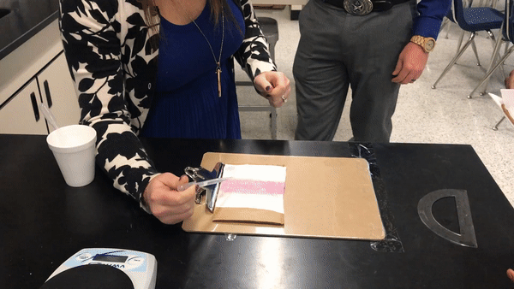
Investigate and Test
Step 1: Observe surface and record.
Step 2: Drop profile / Contact angle
Step 3: Tilt / Roll off angle
Notes:
Drop Profile Credit (Krystle Dunn)
Tilt Roll Off Angle Credit (Krystle Dunn)

Slide 14
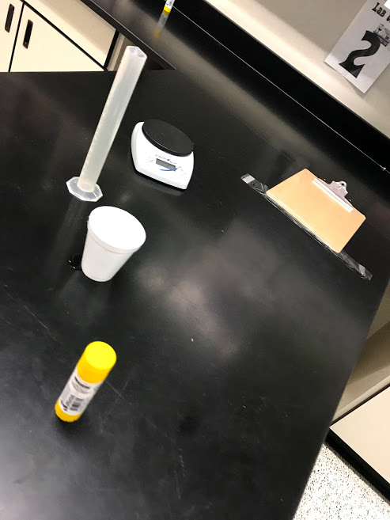
Testing Self Cleaning Ability
You will be provided with “dirt” to make your surfaces dirty.
Sprinkle the “dirt” on your surface.
Measure the initial mass. Record in data table below.
Over a sink pour water over your material until all water is gone.
Measure final mass of material after cleaning. Record in data table below.
Repeat steps 2-5 for material 2.

Slide 15
Reflections/Improvements
Discuss and answer reflections questions the with group.
  Remember properties of a superhydrophobic surface!
    Water contact angle above 150º
    Water roll off below 10º
Create a poster with following information:
  Your groups specific problem, chosen material, proposed solutions, results (surface observations, tilt angle, and drop profile), and conclusion that includes future work.
Choose a spokesperson to communicate results.

