Slide 1


Measurements with Biochar:
The Sponge For Your Soil

Slide 2
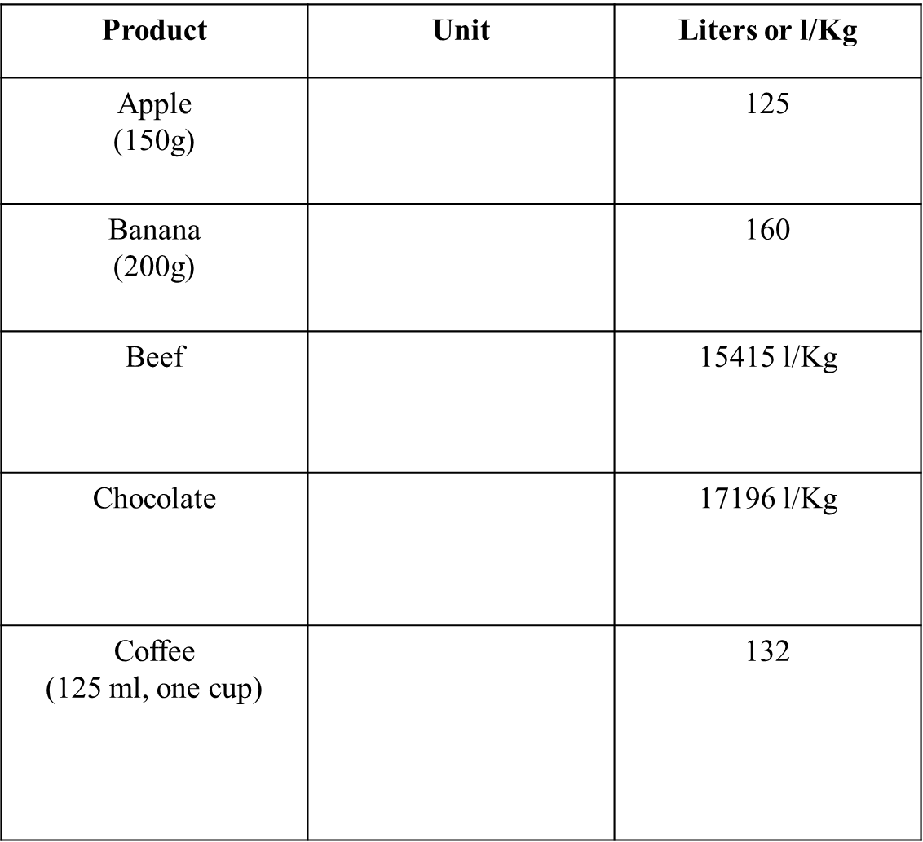



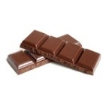

Introduction
Agricultural costs in terms of water (H20)
  Is it possible to manipulate the behavior of one of the most vital molecules on our planet?
  Three staples remain globally consistent—water, soil and agriculture.
Notes:
Engage using questions:
Ask students basic question on how many liters of water does it take to produce an apple?
Callout other items as needed.
What is one of the most vital molecules on planet Earth?
How can we manipulate the behavior of water so less is needed?

Slide 3
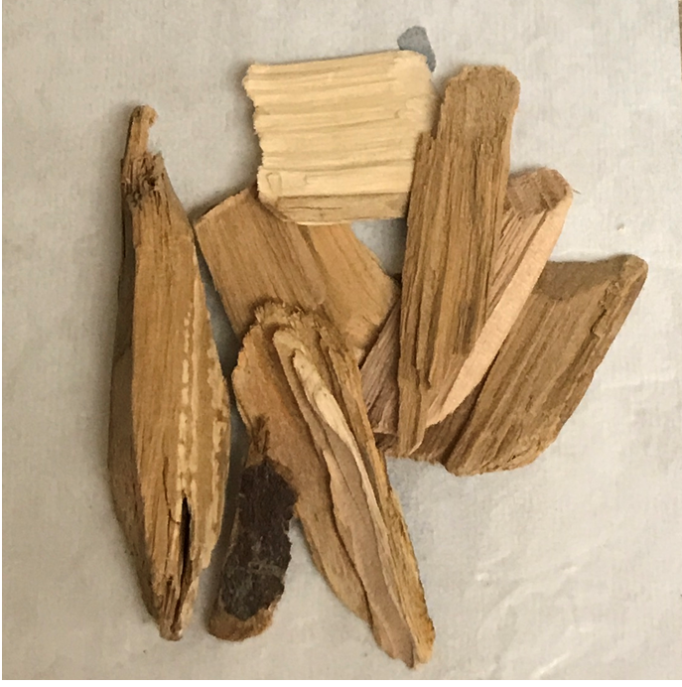
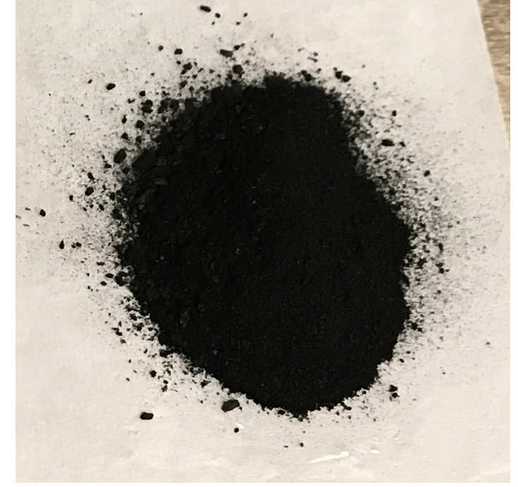
Explore
This experiment explores how biochar impacts hydraulic conductivity in soil.
Biochar is a solid material obtained from the “carbonization” of biomass.
  Carbonization involves removing oxygen from the charring process and heating biomass at 500°C (932°F)
In each experiment, we will:
  Add biochar to several soil types, which will attribute to 4% of total mass.
  Saturate each soil type, with and without biochar, from bottom-up and then drain until no standing water remains.
  Add 20 ml of water from top-up to measure the rate of water flow.
wood chips
wood chips after “carbonization”
Notes:
Explore with providing basic overview:
What is biochar?
-- How will biochar be used in this experiment?
-- Cover safety, to include use of gloves, if needed, as biochar may temporarily stain the hands.
Image Source/Rights: Chetan Sawhney, RET Program, Department of Earth, Environmental, and Planetary Sciences, Rice University.

Slide 4
Procedure
  Select two soil types: sand & clay.
  Measure 50 grams of each soil type: 50 g of sand and 50 g of clay.
  Hollow out the bottom of four plastic graduated cylinders:
    Either cut the entire bottom using a pair of scissors or poke several holes on the bottom using a push-pin.
    Cover the hollowed out bottom with either organza fabric, mesh cloth or a simple dryer sheet. Affix the organza fabric, mesh cloth, or the dryer sheet with a rubber band.
  Mark and fill two graduated cylinders with only soil: (50 g sand, and 50 g clay).
  Mark and fill the other two graduated cylinders with soils + biochar:
  (48 g sand + 2 g biochar) and (48 g clay + 2 g biochar).
Notes:
Continue with covering the experiment procedures.
-- Provide students with two types of soil, sand and clay.
-- Using only two types of soil to fit the experiment in 90-minutes.
Cover all the procedures, ratio of biomass to soil, graduated cylinder use, and amount of water needed.

Slide 5
Procedure
  Place the plastic graduated cylinder on the support stand.
    Fill the plastic graduated cylinders with 200 ml of water.
    Measure the flow rate; the amount of water that drips through the soil.
  Reference the following slides for visual images.
Notes:
Continue with covering the experiment procedures.
-- Provide students with two (2) types of soil, sand and clay.
-- Using only two types of soil to fit the experiment in 90-minutes.
Cover all the procedures, ratio of biomass to soil, graduated cylinder use, and amount of water needed.

Slide 6
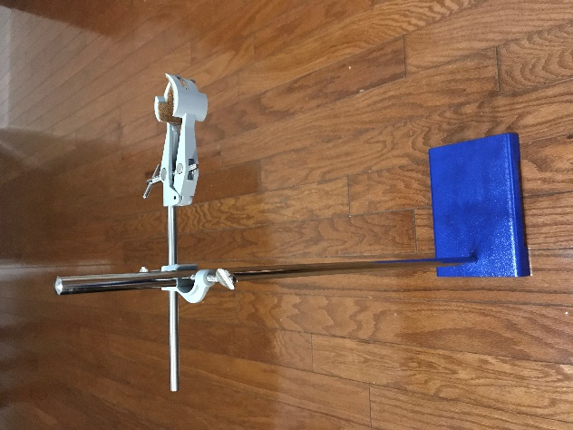
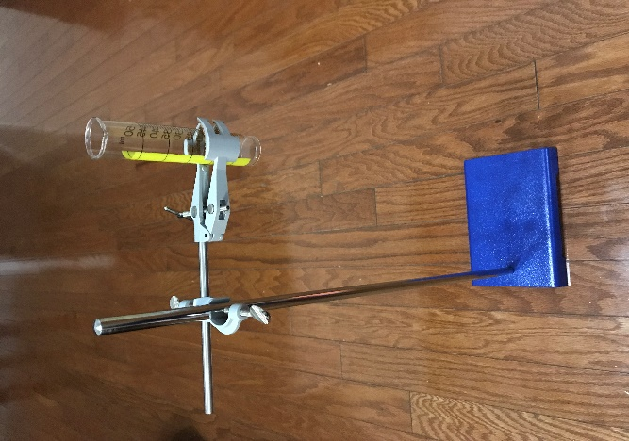
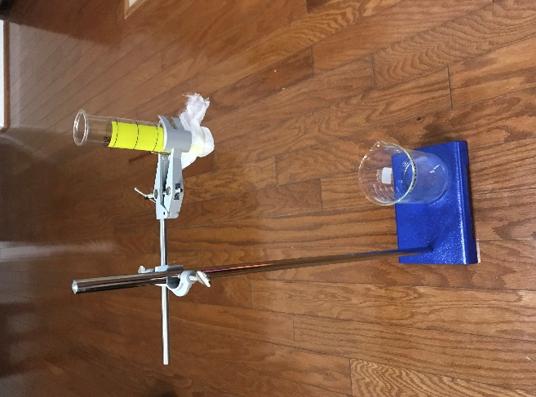
Explore Designs
Notes:
Image Source/Rights: Chetan Sawhney, RET Program, Department of Earth, Environmental, and Planetary Sciences Joint: Bio and Chemistry, Rice University.

Slide 7
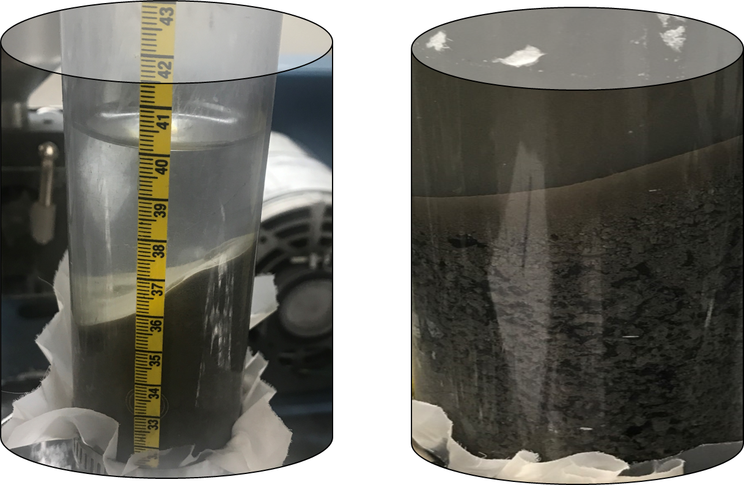
Explain
This experiment explored how biochar impacted hydraulic conductivity in soil.
Biochar allows for faster absorption of standing water.
  A primary effect of using biochar includes aiding in flood prevention or drought mitigation.
  Further effects could be minimizing the spread of mosquito-borne diseases by using biochar to absorb standing water.
Notes:
Explain how biochar effects hydraulic conductivity.
-- Hydraulic conductivity is the amount of water that makes it through the soil.
-- Biochar acts as a ‘sponge’ and allows for faster and more absorption of water when present in soil.
Image Source/Rights: Chetan Sawhney, RET Program, Department of Earth, Environmental, and Planetary Sciences Joint: Bio and Chemistry, Rice University.

Slide 8
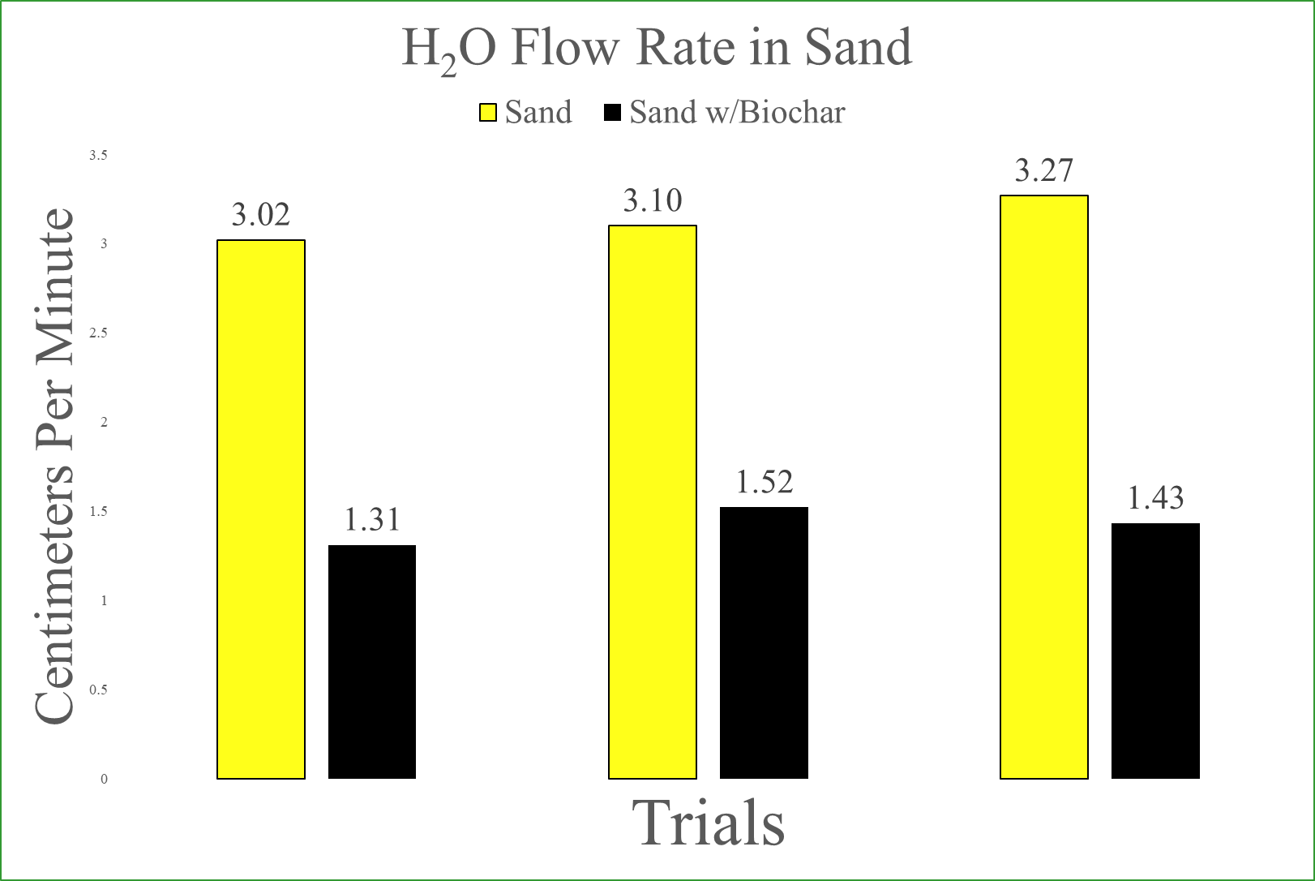
Explain
Biochar decreased the water flow rate in fine sand by 110%.
Water flow rate changed from an average of 4 minutes to an average of 9 minutes.
Notes:
Image Source/Rights: Chetan Sawhney, RET Program, Department of Earth, Environmental, and Planetary Sciences Joint: Bio and Chemistry, Rice University.

Slide 9
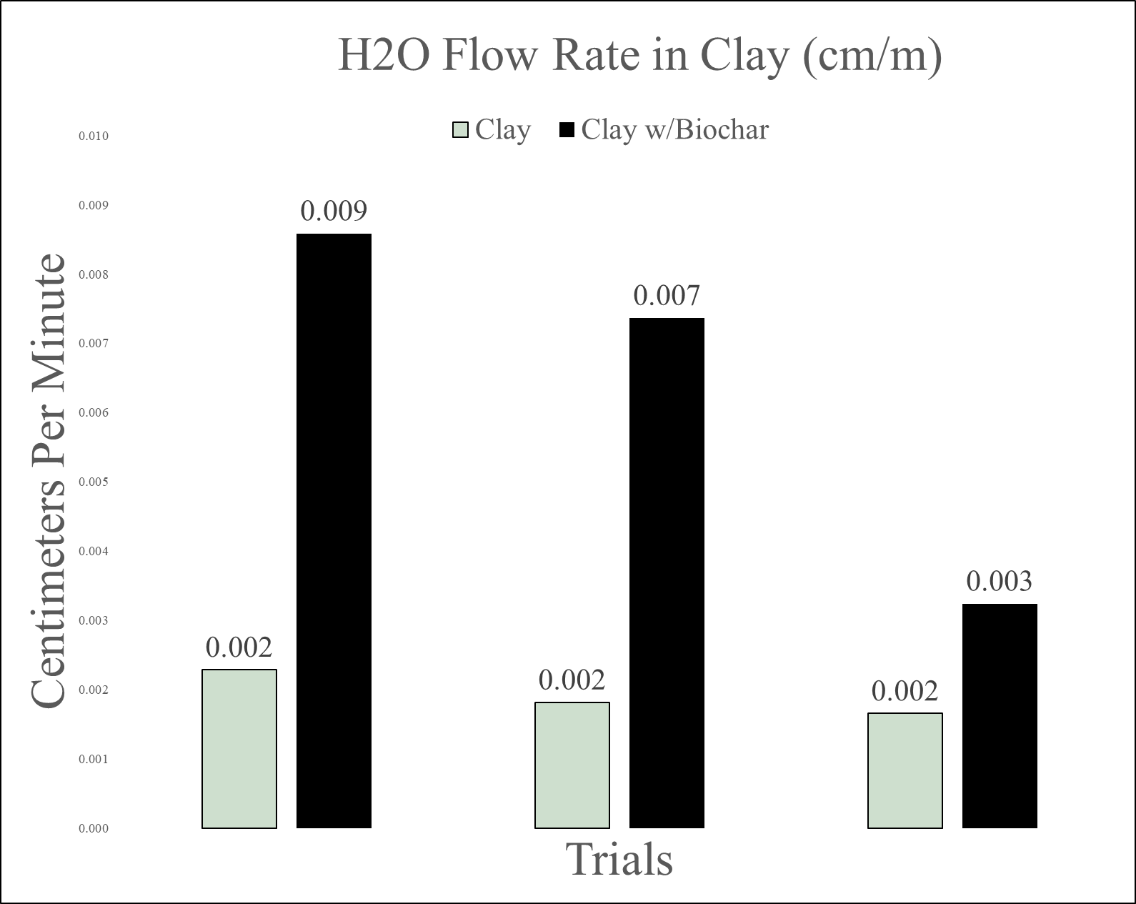
Explain
Biochar increased the hydraulic conductivity by 207% in clay.
Water passed through the pores of clay faster, from an average of 4 days to just 1 day.
Notes:
Source/Rights: Chetan Sawhney, RET Program, Department of Earth, Environmental, and Planetary Sciences Joint: Bio and Chemistry, Rice University.

Slide 10
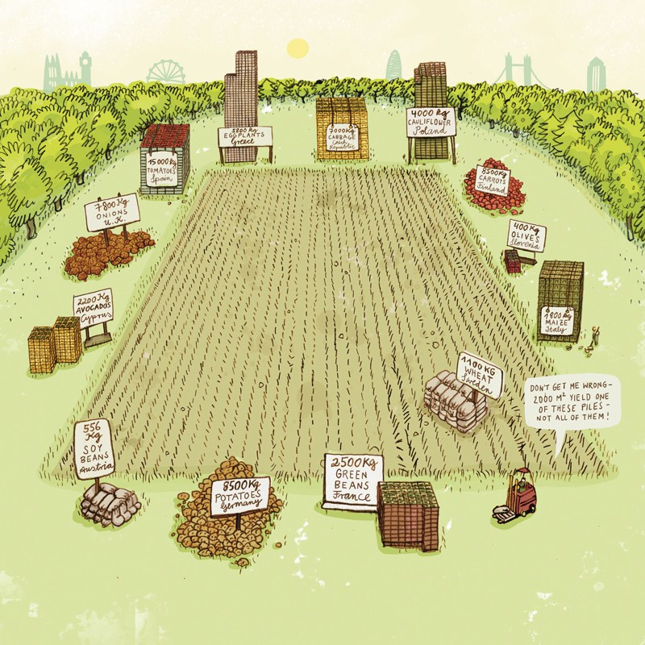
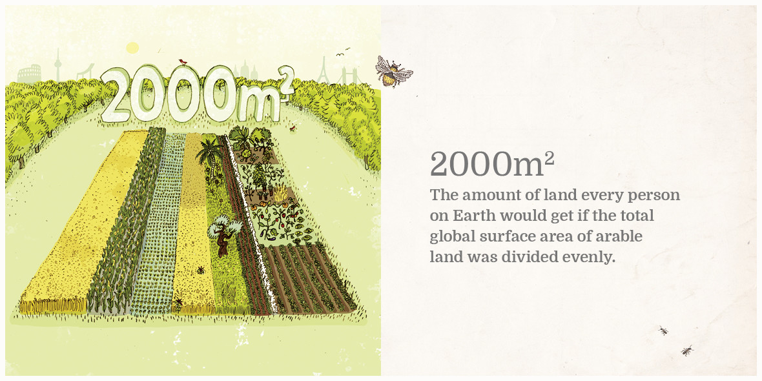
Understand
Dividing the total global surface area of arable land by number of people provides each person 2000m² or the size of one (1) supermarket.
  1,700,000,000 / 7,300,000,000 (1.7 B / 7.3 B).
Notes:
Elaborate with scenarios:
-- Use the 2000m² as the area given to each person if total land mass is divided by total population.
What would students wish to produce, types of crops?
-- Would they use biochar in their agriculture?
-- Why or why not?
- Illustration Source/Rights: von Annika Huskamp. (2016). Reference list: Electronic sources. Retrieved from https://www.2000m2.eu/.

Slide 11
Evaluate
Using bar graphs or other visual representation, present your data and findings.
List the different variables (independent, dependent, and control).
Explain how biochar can be used to manipulate the behavior of water?
How could biochar aid in mitigating climate change?
Notes:
Evaluate based on the findings from the experiment.
-- Request students to present data using graphs, bar, line or scatter.
-- Have student list the variables, constant, dependent, and independent.
-- How can biochar be used to mitigate climate change, can we reverse the negative effects?

