Slide 1
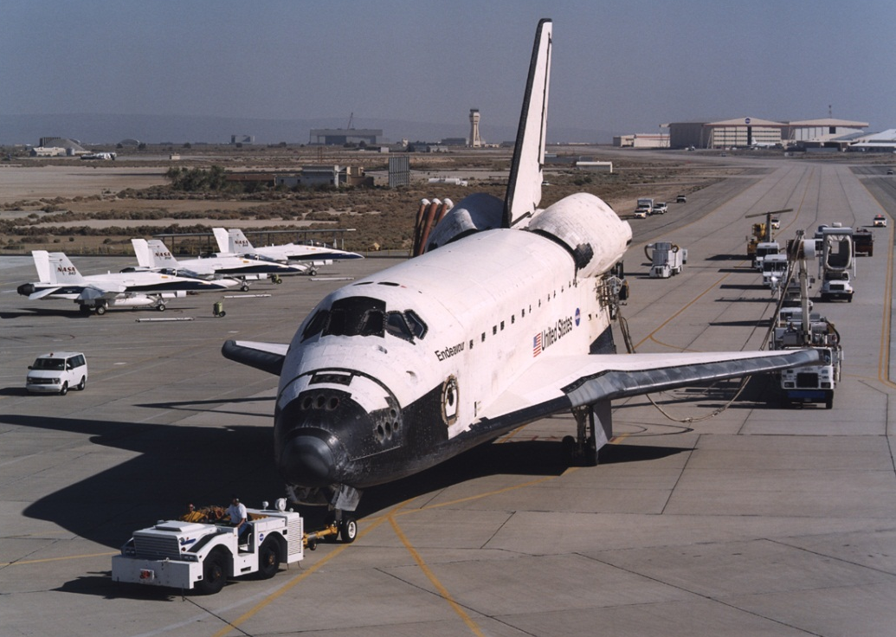
How to Pull
Something Heavy
Notes:
Image source (space shuttle Endeavor being towed): NASA http://www.dfrc.nasa.gov/gallery/photo/STS-111/Medium/EC02-0131-6.jpg and http://www.dfrc.nasa.gov/gallery/photo/STS-111/HTML/EC02-0131-6.html

Slide 2
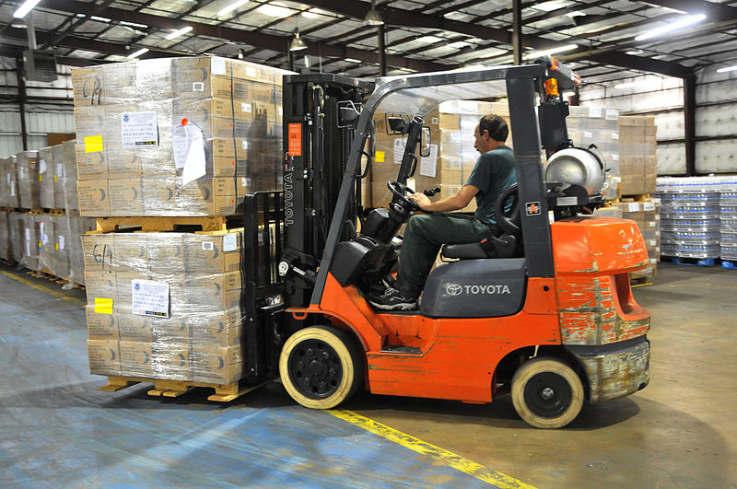
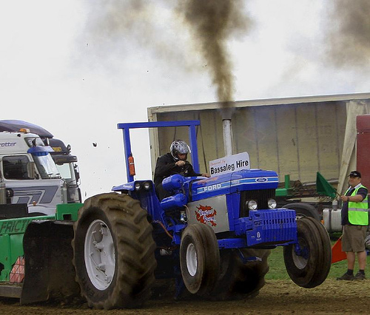
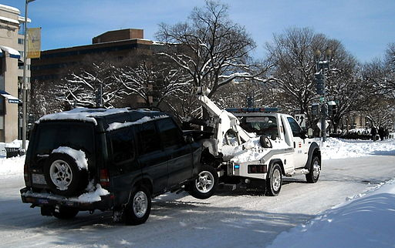
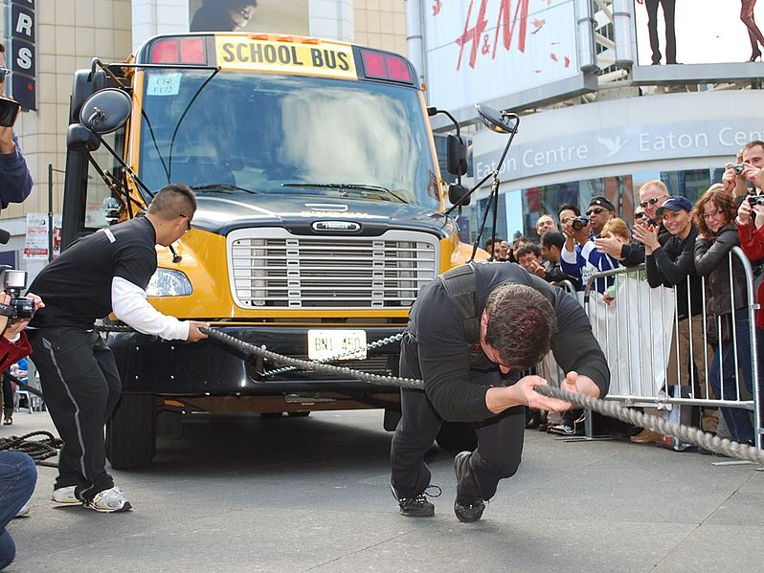
fork Lift
tractor
tow truck
strong man
Notes:
Discuss with students the many vehicles that are designed to pull heavy objects.
Images sources:
fork lift: Wikimedia Commons (public domain) http://commons.wikimedia.org/wiki/File:FEMA_-_37931_-_Meals_Ready_to_Eat_being_moved_by_fork_lift_in_a_Texas_warehouse.jpg
tractor: Mark Robinson, Wikimedia Commons (Creative Commons license) http://commons.wikimedia.org/wiki/File:Ford_Pulling_Tractor.jpg
tow truck: AgnosticPreachersKid, Wikimedia Commons (Creative Commons license) http://commons.wikimedia.org/wiki/File:Tow_truck_-_Blizzard_of_2010.JPG
strong man: Tsar Kasim, Wikimedia Commons (Creative Commons license) http://commons.wikimedia.org/wiki/File:Bus_Pull.JPG

Slide 3
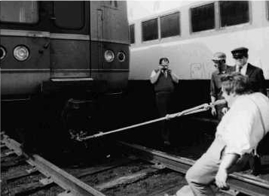
On April 4, 1974, John Massis of Belgium managed to move two train passenger cars belonging to New York’s Long Island Railroad.
He did so by clamping his teeth down on a bit that was attached to the cars with a rope and then leaning backward while pressing his feet against the railway ties.
The cars together weighed ~80 tons.
Did Massis have to pull with superhuman force
to accelerate them?
Notes:
Image source: AP/Wide World Photos, Library of Congress in Halliday, Resnick and Walker, Fundamentals of Physics. 6th edition, John Wiley & Sons, 2001
Text source: 2001 Halliday, Resnick and Walker, Fundamentals of Physics. 6th edition, John Wiley & Sons

Slide 4
Do now:
The car is pulling the green block to the right. Assume that the system is in equilibrium (that is that the block is so heavy that the car cannot move it from its stationary position).
Draw a diagram showing and labeling all the forces acting on the car and a block!
Direction of
car’s pull
Notes:
This slide goes with the “Do now” section on the first page of the worksheet for this activity.

Slide 5
Free Body Diagram
normal force
normal force
force generated by motor
tension in the string
force of static friction
force of kinetic friction
weight of the block
weight of the car
Notes:
Review physics concepts necessary for the activity, that is, Newton’s second and third laws, and force of friction. Mention that this problem is similar to Massis’ train pulling problem, hence the free body diagram will be similar.

Slide 6
y
Nblock
Ncar
x
T
T
Fmotor
FblockFriction
FwheelFriction
Wblock
Wcar
In y direction:
In x direction:
Adding both equations:
Notes:
Derivation of the pulling force of the car.

Slide 7
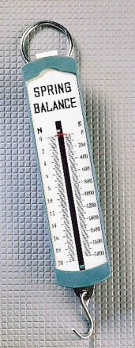
Now we know that
FYI: if you want the car to pull over a heavy object, just let
Notes:
Derivation of the pulling force of the car and the condition for a car to pull over a heavy block from rest.

Slide 8
Nblock
Ncar
T
T
Fmotor
FblockFriction
FwheelFriction
Wblock
Wcar
We just found out that:
The pulling force of the car measured using a spring scale can be expressed as
To move a block from rest, the pulling force must be greater than the force of static friction on the block
Notes:
Keep this slide for students to refer to during the activity.

