Slide 1


Flood: Causes and Mitigation Strategies for Civil Engineers

Slide 2
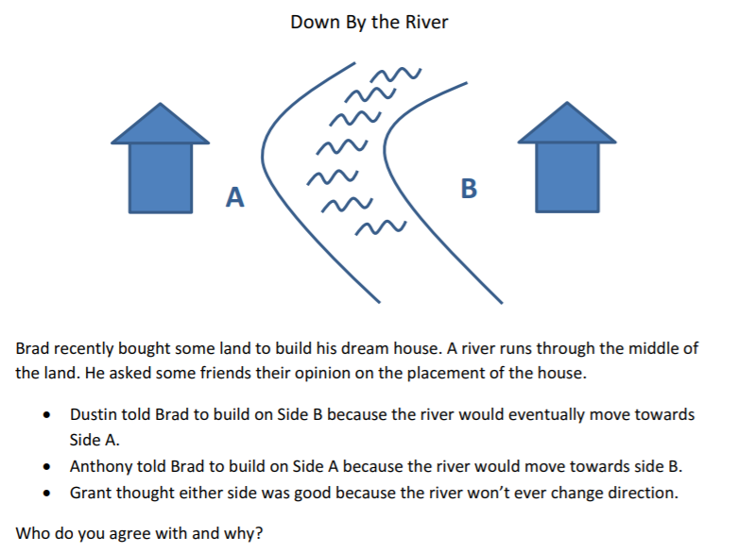
Introduction
Read through the following scenario.
Discuss the question with a partner and determine who you agree with and why.
Be ready to share with the class.
Notes:
Answer: The correct side to build on is Side B. This is because the rivers path will continue to shift towards Side A (a cutbank) and shift away from Side B (a point bar).

Slide 3
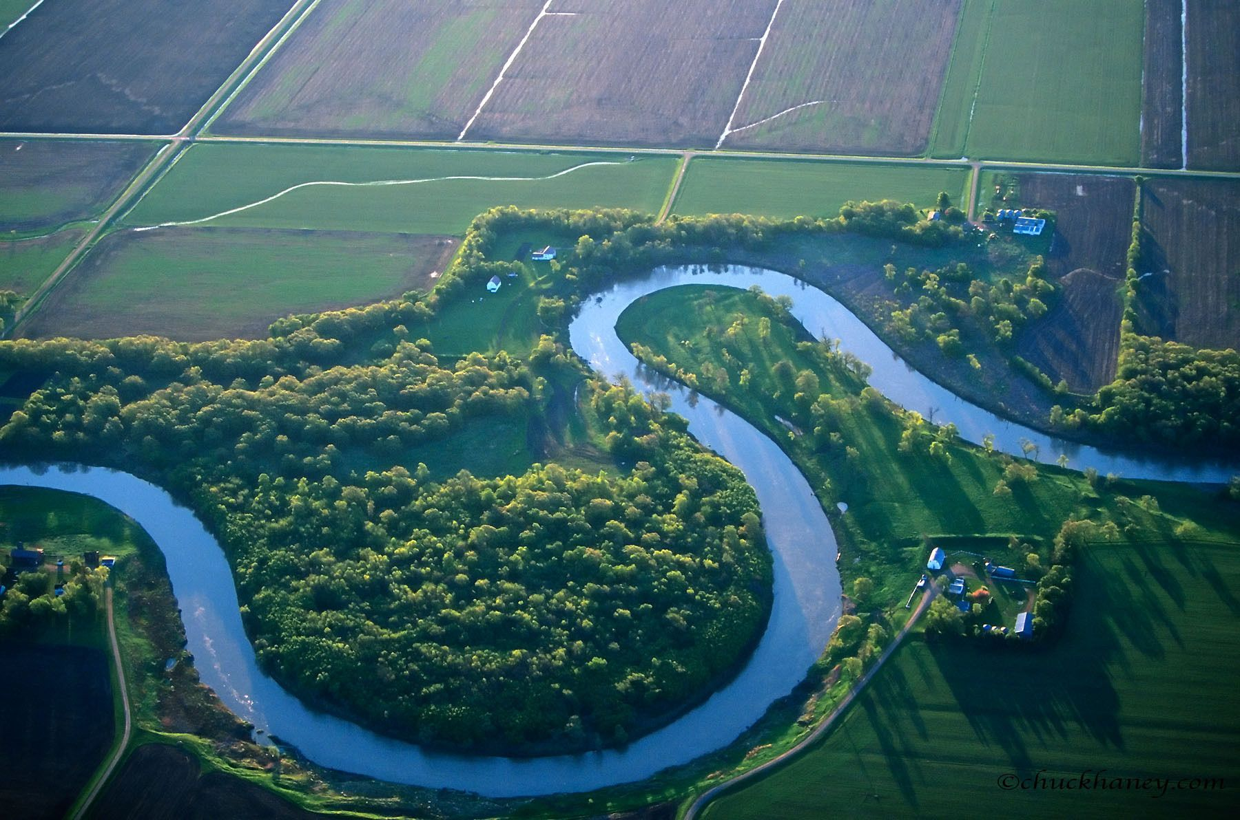
River Anatomy
SWBAT identify and describe the parts of a river.

Slide 4
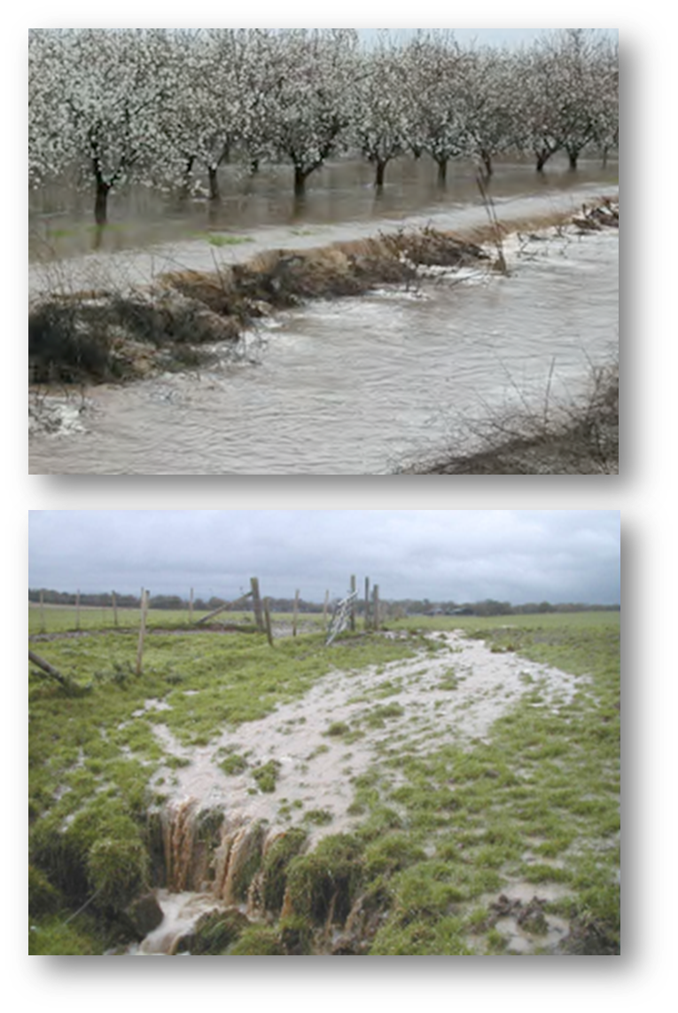
Stream
Any size channelized body of running water (small creeks to giant rivers).
Created when overland flow discharges into channels.
  Overland Flow - Water that falls on the land surface and flows downhill (under the influence of gravity) in thin sheets of water in a process.
Notes:
Slide 3: Stream is the overarching term for any channelized body of running water; a river is a large stream. All rivers are streams, but not all streams are rivers.
Slide 3: Overland flow shows how all watersheds drain to a stream when they aren’t absorbed into the ground.

Slide 5
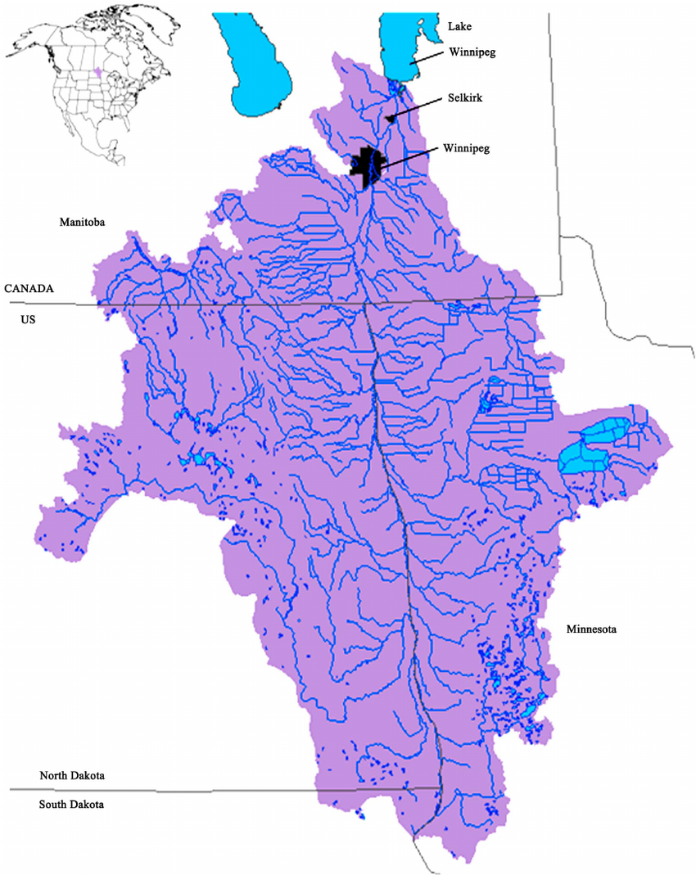
Drainage Networks
As a stream flows downhill, it merges with other streams. The smaller of the two merging streams is known as a tributary.
A branching network of streams known as a drainage system forms where the merging tributaries form progressively larger streams.

Slide 6
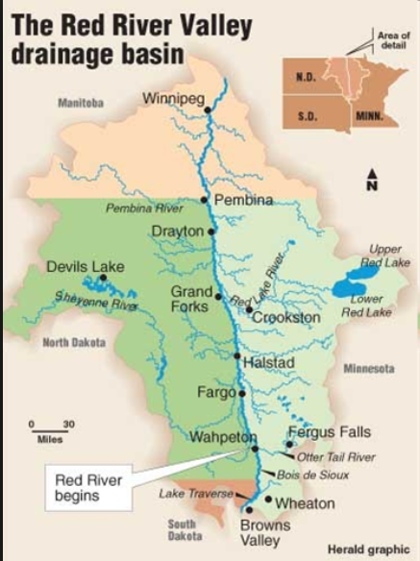
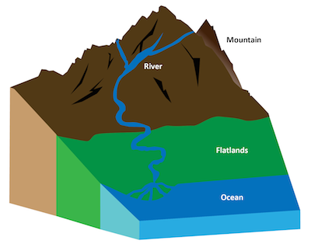
Headwaters / Source
The upper part or start of the stream.
Red River of the North
  At the confluence of the Bois de Sioux and Otter Tail Rivers near Wahpeton, North Dakota.
  Flows from 943 to 714 ft above sea level.
Notes:
A headwater/source can start at a lake, a confluence of two rivers, a spring, a snowmelt in the mountains, etc.

Slide 7
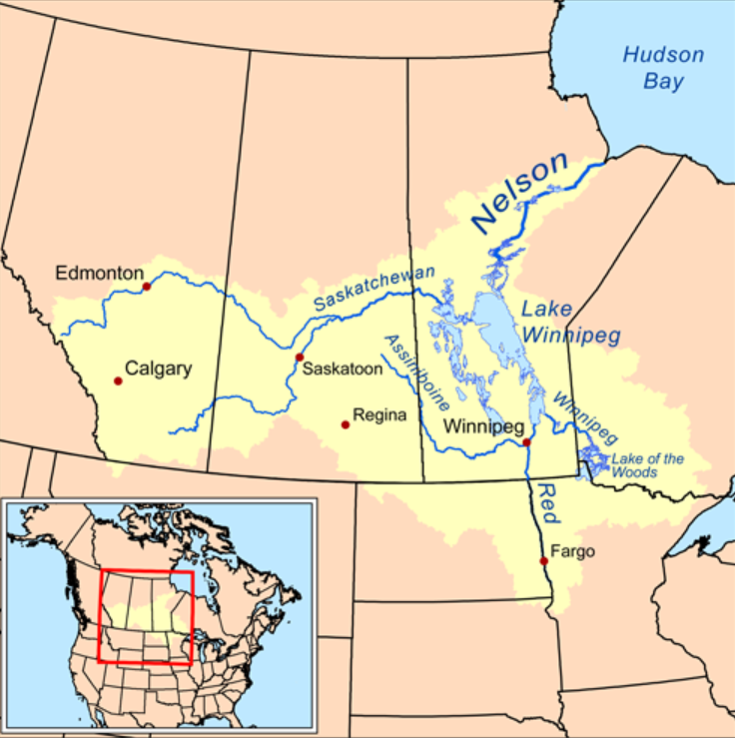
Mouth
Where the stream flows into another river, a lake, a reservoir, a sea, or an ocean; the end of the stream.
Red River of the North
  Empties into Lake Winnipeg

Slide 8
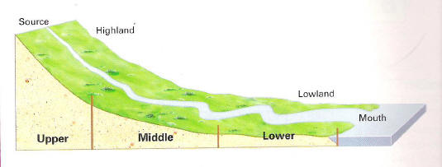
Think About It: What differences do you notice from the upper reaches to the lower reaches on this river?
Notes:
Answer: Stream gets wider, more meanders (curves), and the slope decreases. This is because the river is getting farther from the source and is aging.

Slide 9
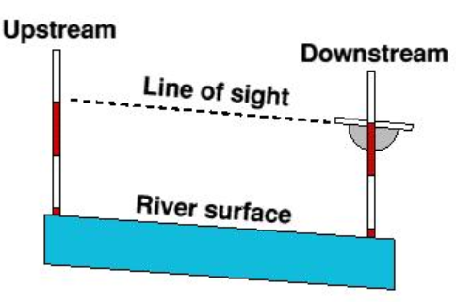
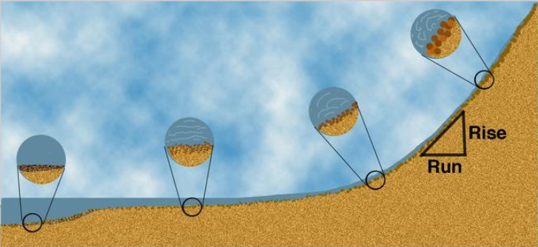
Stream Gradient
Slope (grade) or drop in elevation of a stream.
Units: ft/mile or km/meter
Headwater - steeper slope or higher gradient and a higher water velocity.
Mouth - lower gradient and lower water velocity.
Math Application
Rise over Run

Slide 10
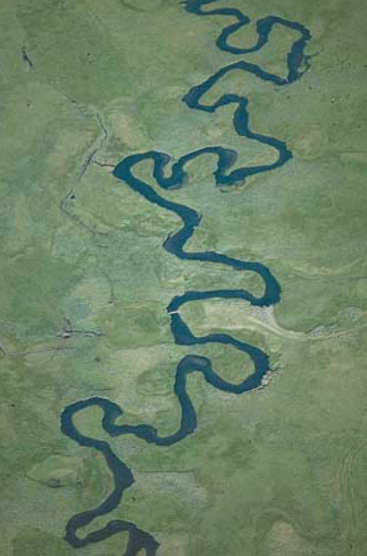
Meander
S-shaped curves that are the result of erosion and deposition on opposite banks of a river.
Forms when moving water in a stream erodes the outer banks and widens its valley.
The inner part of the stream has less energy and deposits silt.

Slide 11
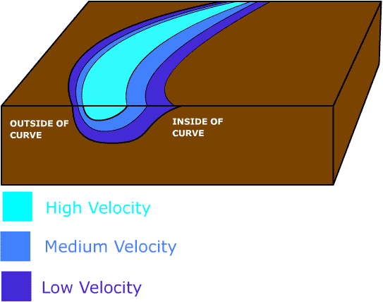
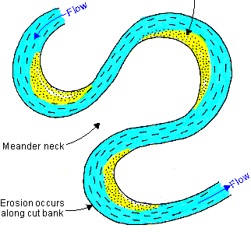
Erosion and Deposition
Erosion – occurs on outer bank, caused by high velocity water flow on the outside bend of the channel.
Deposition – occurs on inner bank, where low velocity allows sediment to settle out.

Slide 12
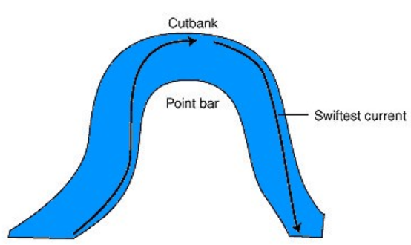
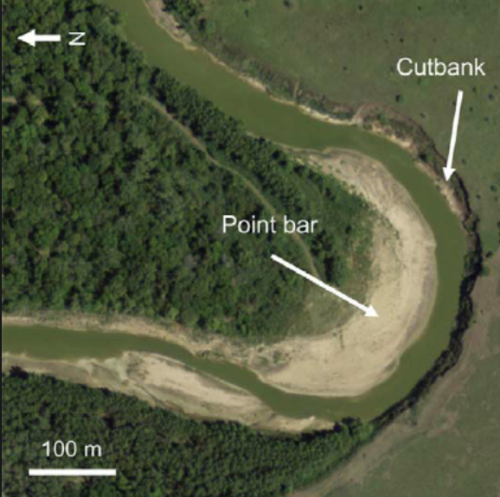
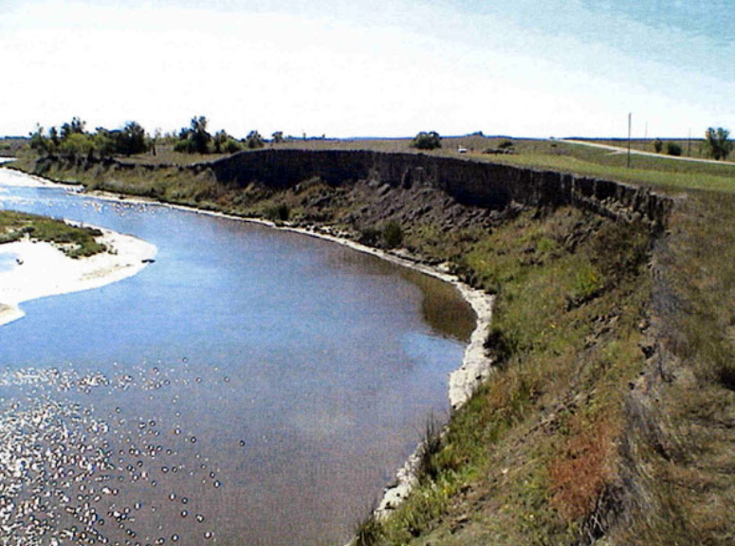
Cutbank
Bank where erosion is occurring the fastest.
Usually steep.
Cutbank

Slide 13
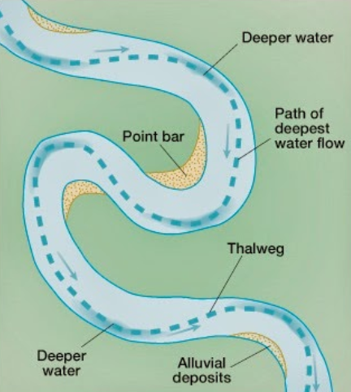
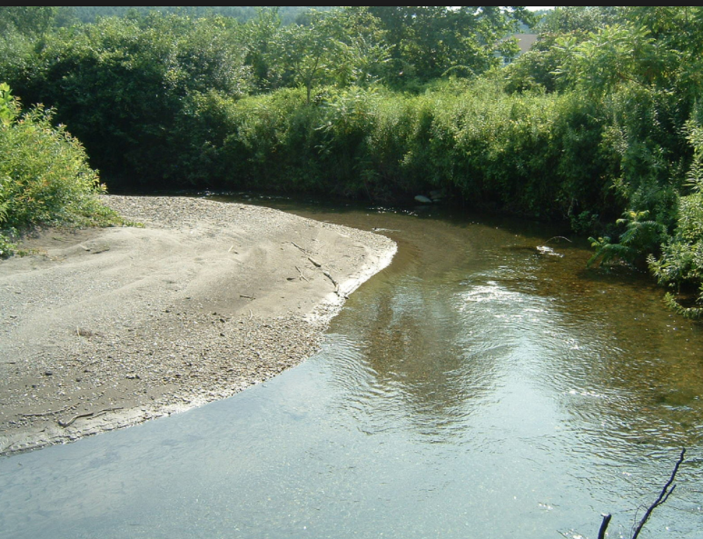
Point Bar
Deposits that form on the inside curve of meanders.
Water velocity is lower, and sediment settles out.
Direction of Flow
Point Bar

Slide 14
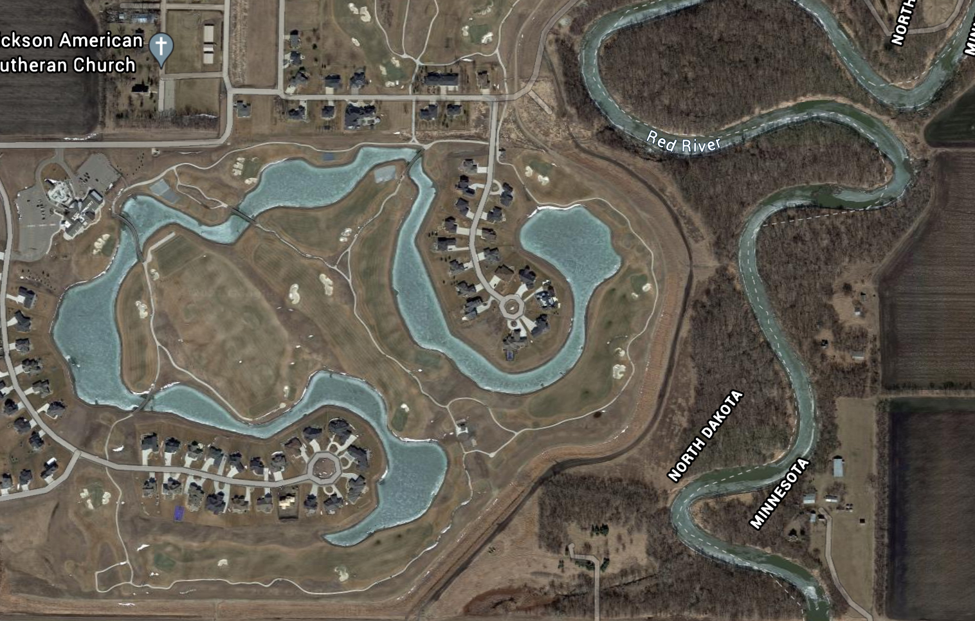
Think About It: The community of Oxbow, North Dakota, is located along this body of water.
This body of water used to be part of the Red River. How do you think it formed?

Slide 15
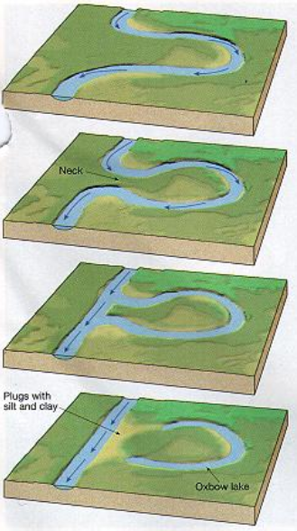
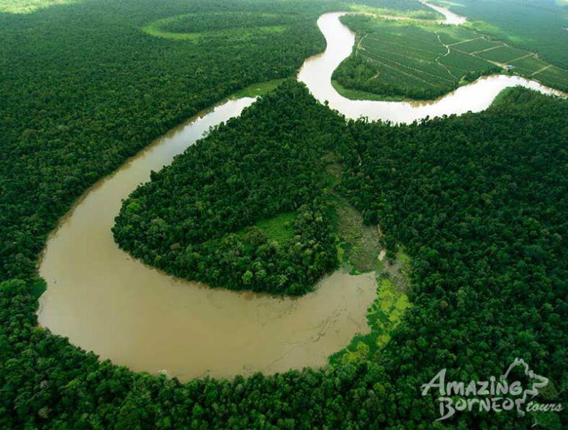
Oxbow Lake
A U-shaped body of water that forms when a wide meander from the main stem of a river is cut off, creating a freestanding body of water.
Deposition and erosion cause the channel to migrate.

Slide 16
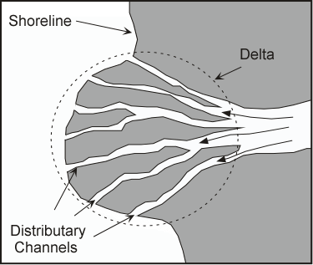
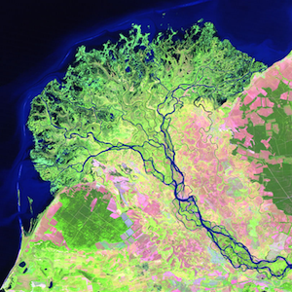
Delta
Forms at the mouth of a stream where it terminates in a lake or ocean; when the gradient and velocity drop, sediment is deposited in the ocean or in a lake.
Highlight the delta in this image

Slide 17
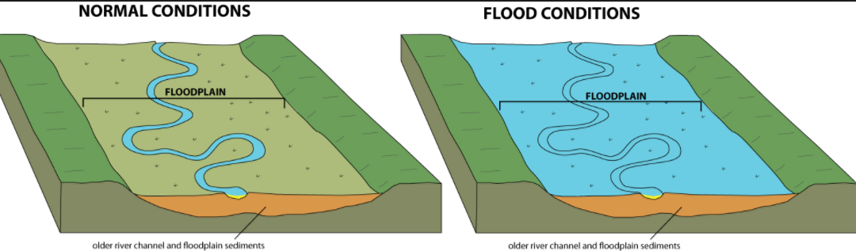
Floodplain
An area of low-lying ground adjacent to a river.
Formed mainly of river sediment.
Stores water during a flood and is an integral part of the drainage system.

Slide 18
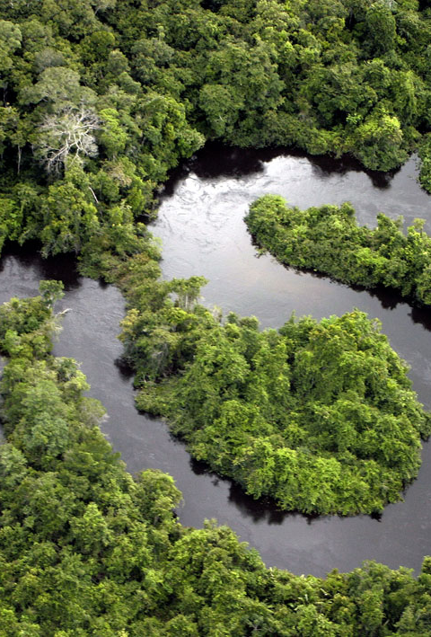
Google Earth
Choose a river. This could be a local river, a small stream they are familiar with, or a major river such as the Mississippi, the Nile, or the Amazon, and locate it on Google Earth.
Save the image and paste it into Word or One Note.
Note: It can be difficult to find the headwaters of many rivers, as they are usually in wooded areas, so you might need more than one picture to label all terms.
Label using the following vocabulary words on the chosen river: headwaters, mouth, meander, cutbank, point bar, oxbow lake, erosion, and deposition.

