Slide 1
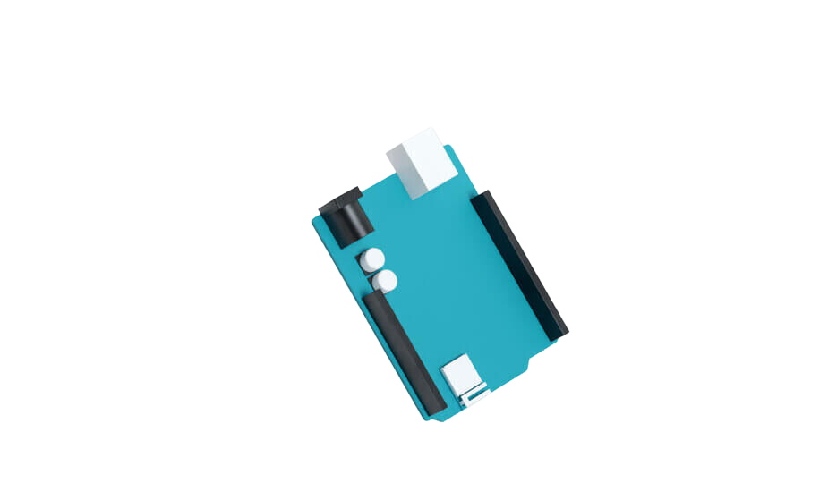


ARDUINO AIR QUALITY MONITOR

Slide 2
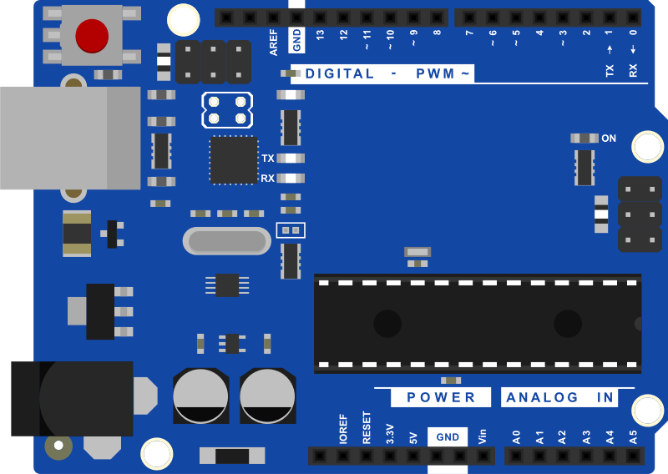
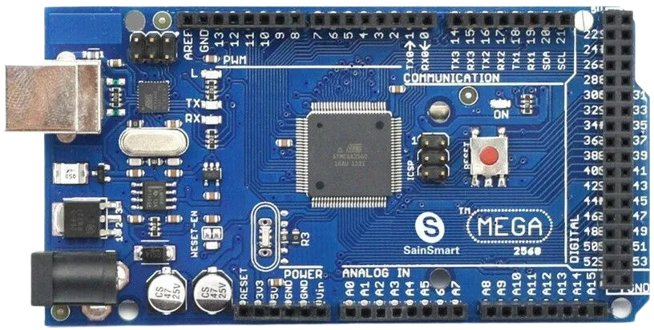
What is Arduino?
  Arduino is an open-source electronics platform based on easy-to-use hardware and software.
  Arduino boards are able to read inputs and turn them into outputs.
  This board allows you to easily create interactive projects.
ARDUINO UNO
ARDUINO MEGA

Slide 3
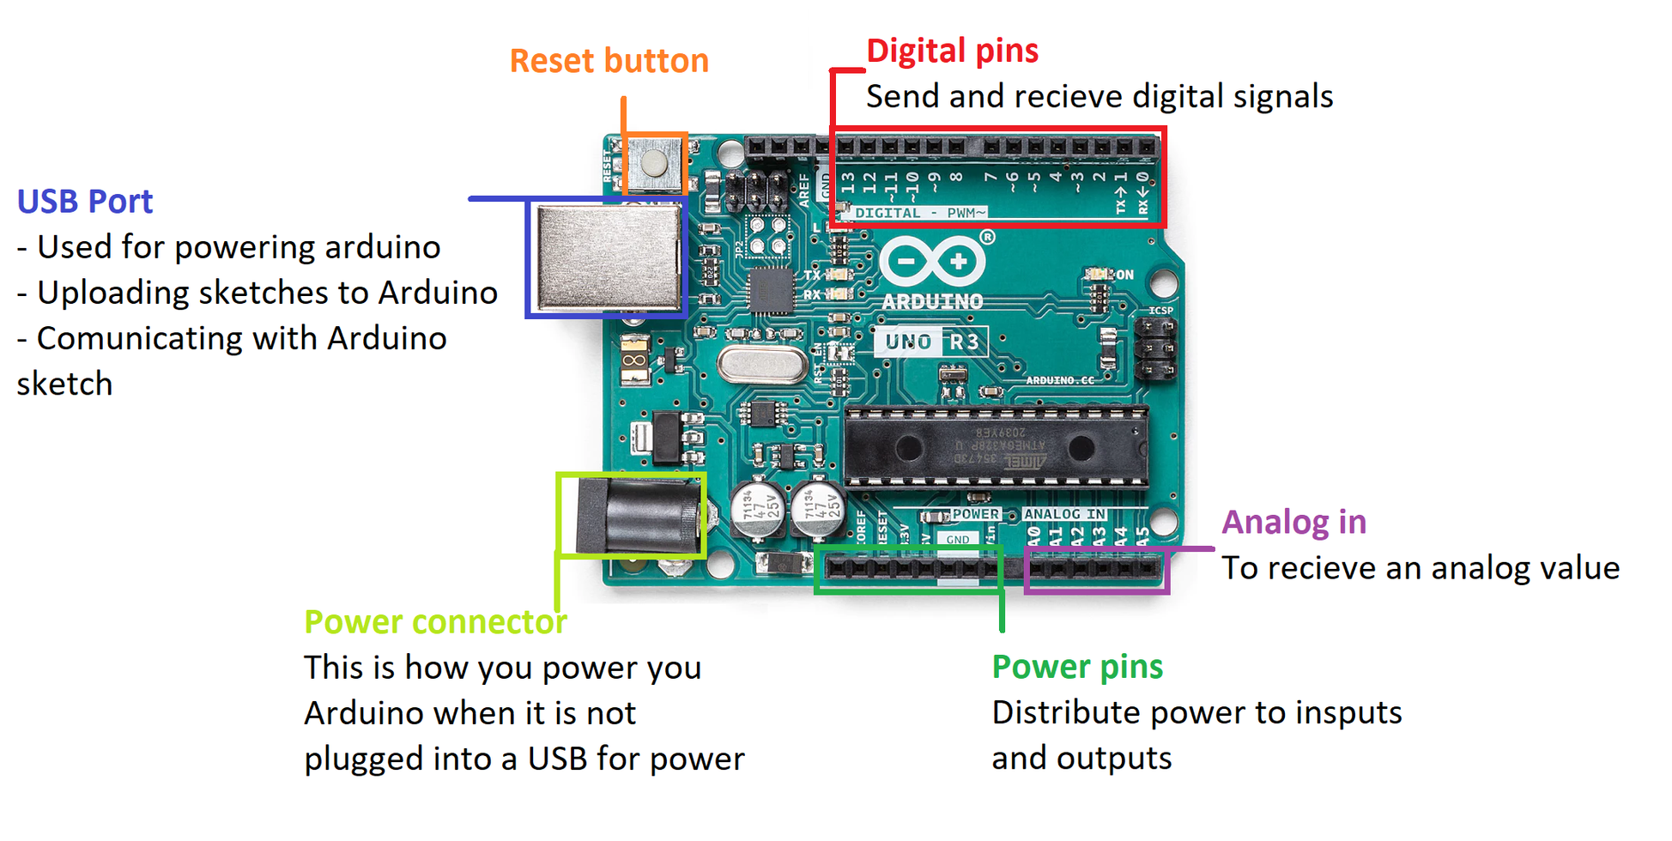
What is Arduino?
Send and receive digital signals
USB port
Used for:
Powering Arduino
Uploading sketches to Arduino
Communicating with Arduino sketch
Receives analog values
This is how you power your Arduino when it is not plugged into a USB.
Distribute power to inputs and outputs

Slide 4
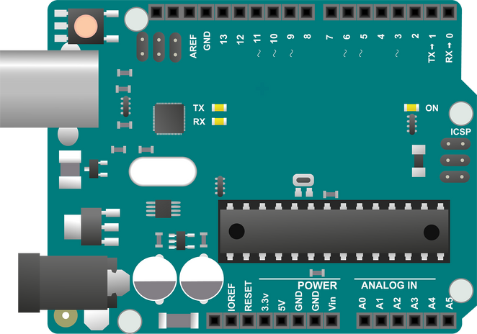
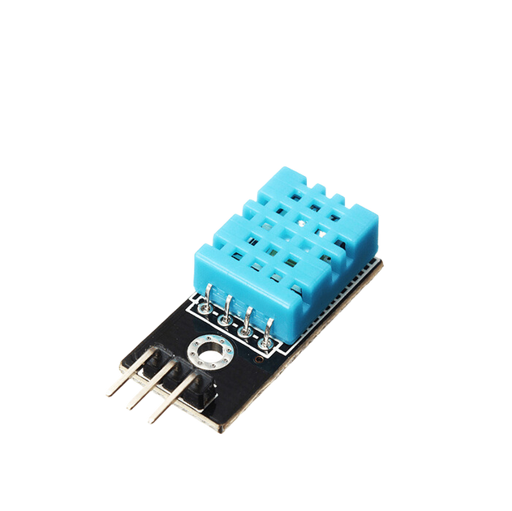
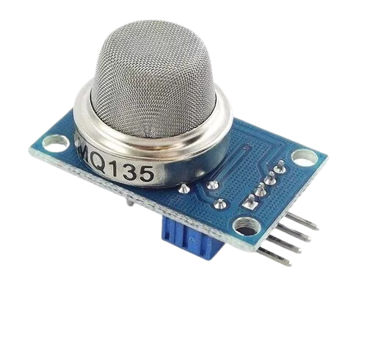
MATERIALS
ARDUINO BOARD
SENSOR DHT11
Using this board, we are going to develop our project.
This sensor measures the relative humidity and temperature of the environment.
SENSOR MQ135
This sensor measures the CO2 in parts per million (ppm).

Slide 5
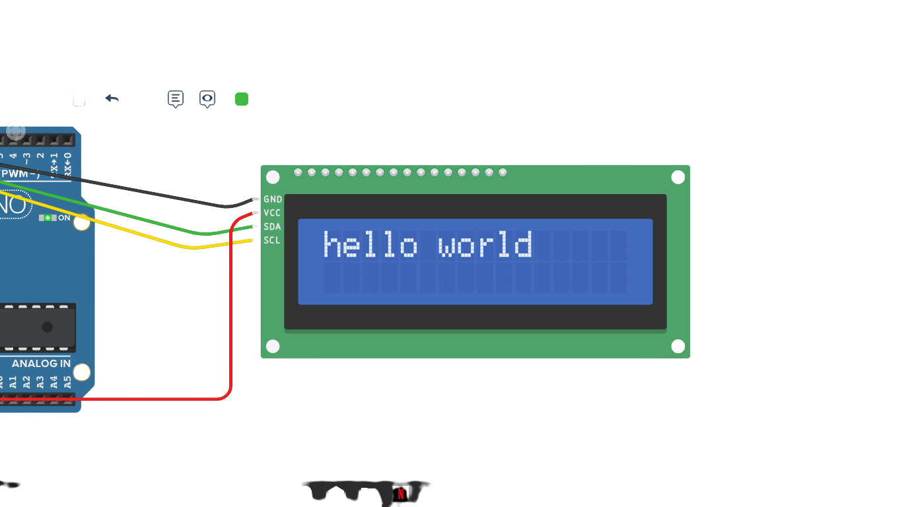
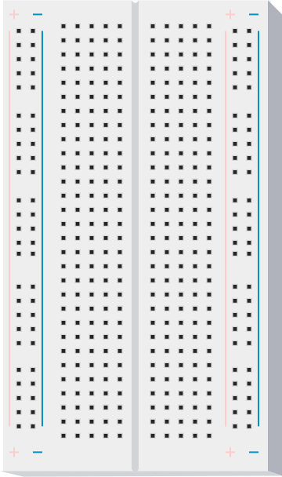
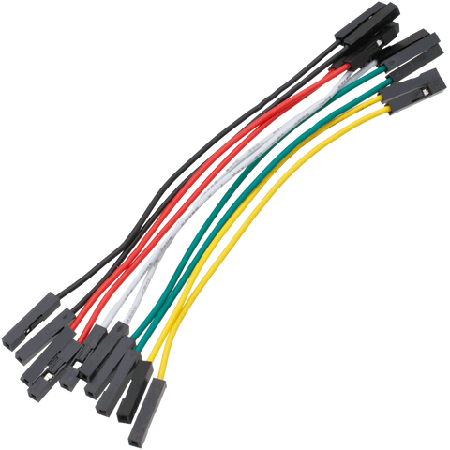
MATERIALS
LCD SCREEN
PROTOBOARD
Displays the air quality data measured by our sensors.
With this tool, we will be able to create and test the electronic connections of our project.
JUMPERS
Used to establish connections on the protoboard.

Slide 6
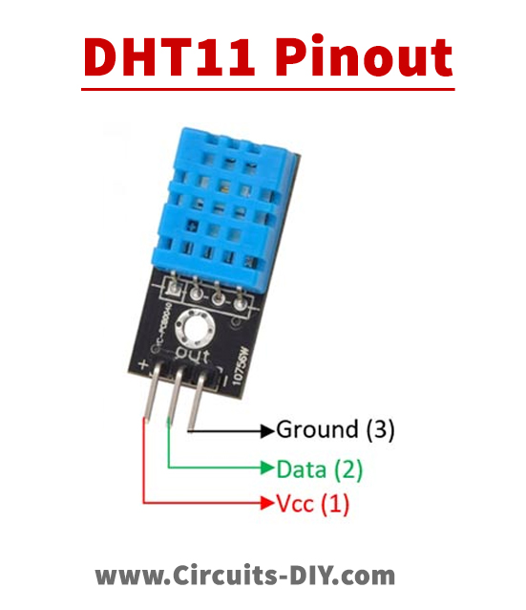
CONNECTIONS
DHT11 TO ARDUINO

Slide 7
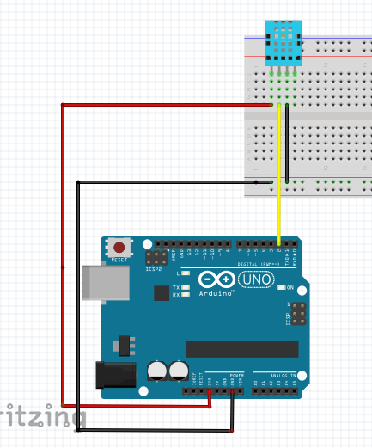
CONNECTIONS
DTH11 TO ARDUINO
SENSOR | ARDUINO
+ | 3.3 V (Power pin)
Data / out | 2 (Digital pin)
- | Ground (Power pin)

Slide 8
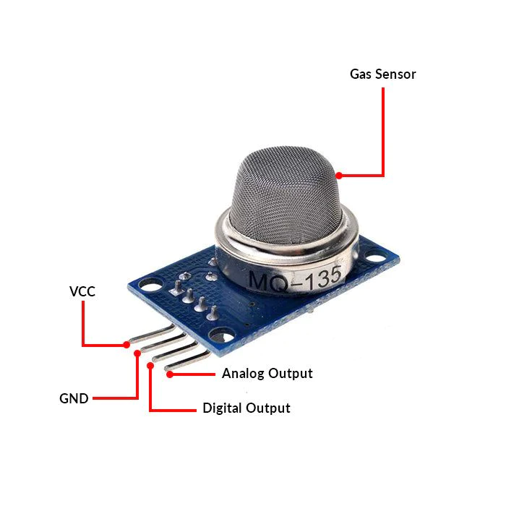
CONNECTIONS
MQ135 TO ARDUINO

Slide 9
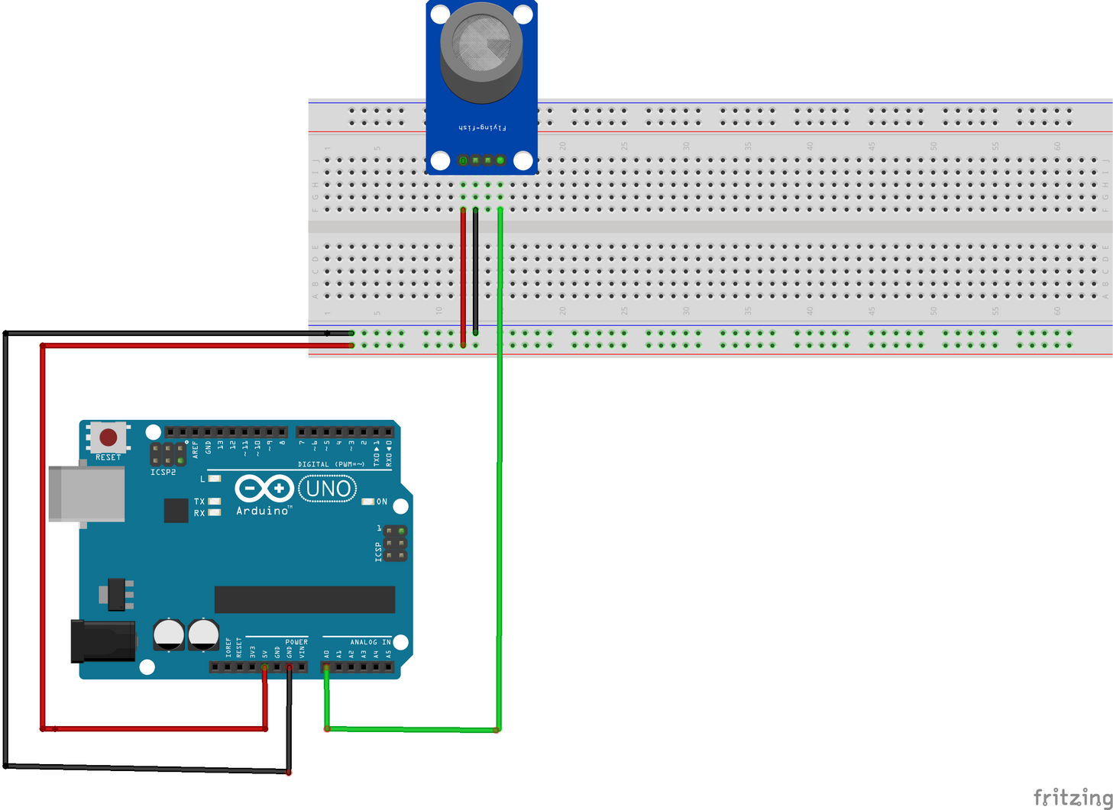
CONNECTIONS
MQ135 TO ARDUINO
SENSOR | ARDUINO
AO (Analog output) | A0 (Analog in)
GND | Ground (Power pin)
VCC | 5 V (Power pin)

Slide 10
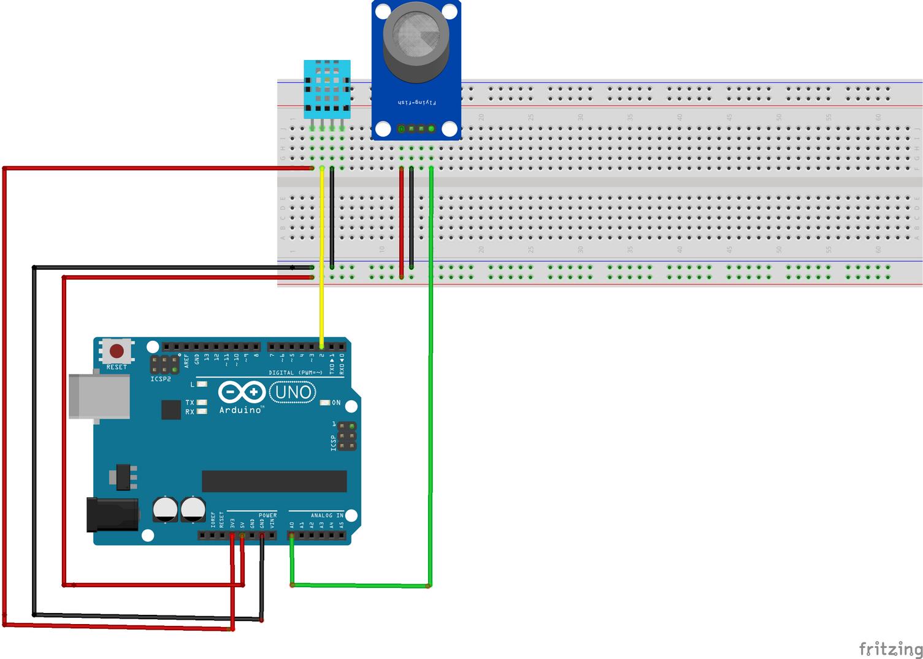
CONNECTIONS
MQ135 AND DTH11 TO ARDUINO

Slide 11
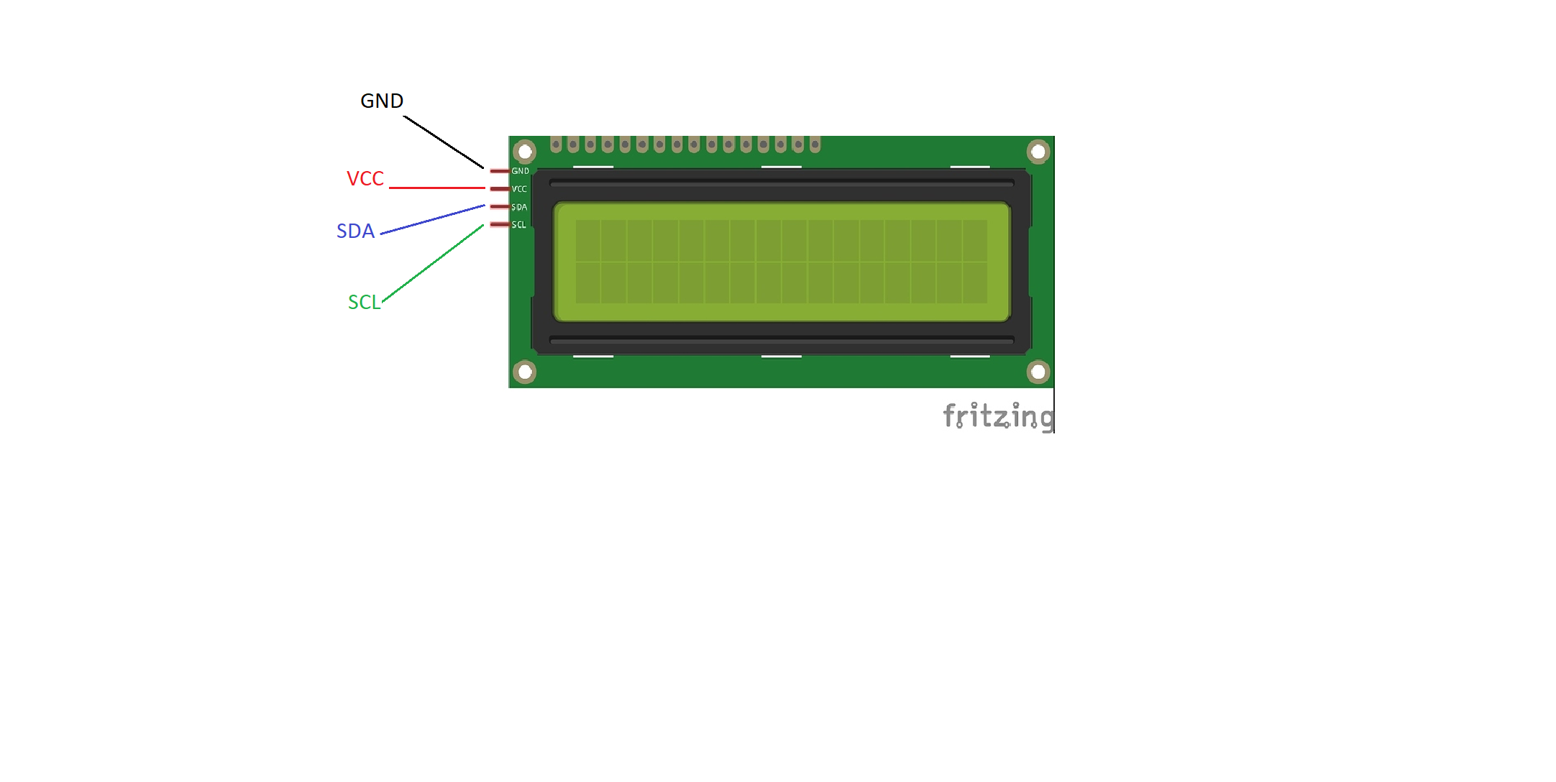
CONNECTIONS
LCD SCREEN TO ARDUINO

Slide 12
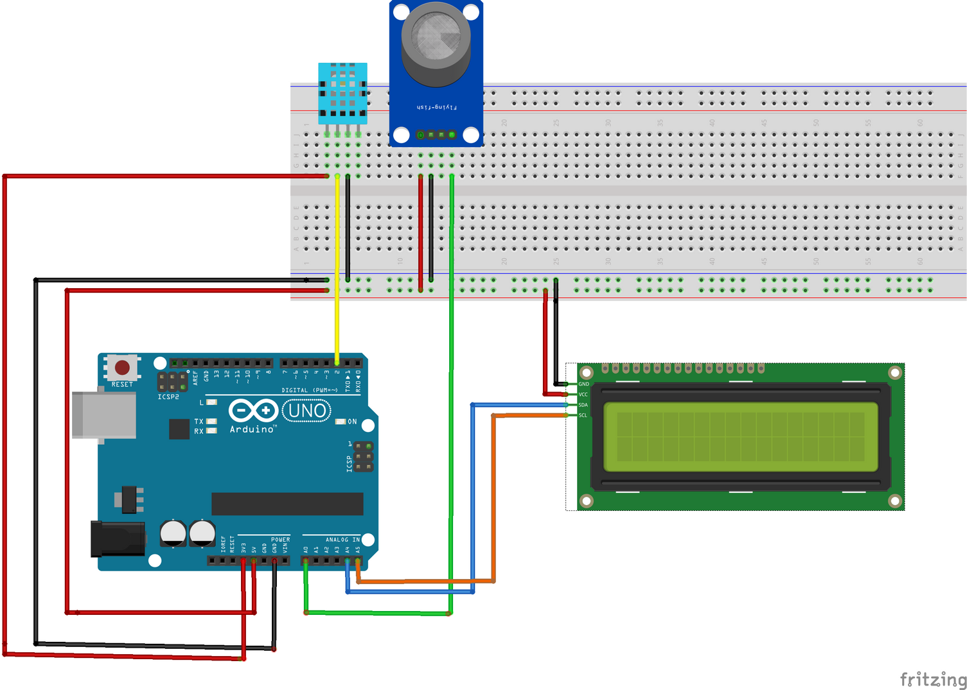
CONNECTIONS
SENSOR | ARDUINO
GND | Ground (Power pin)
VCC | 5v (Power pin)
SDA (Analog output) | A4 (Analog in)
SCL (Analog output) | A5 (Analog in)

Slide 13
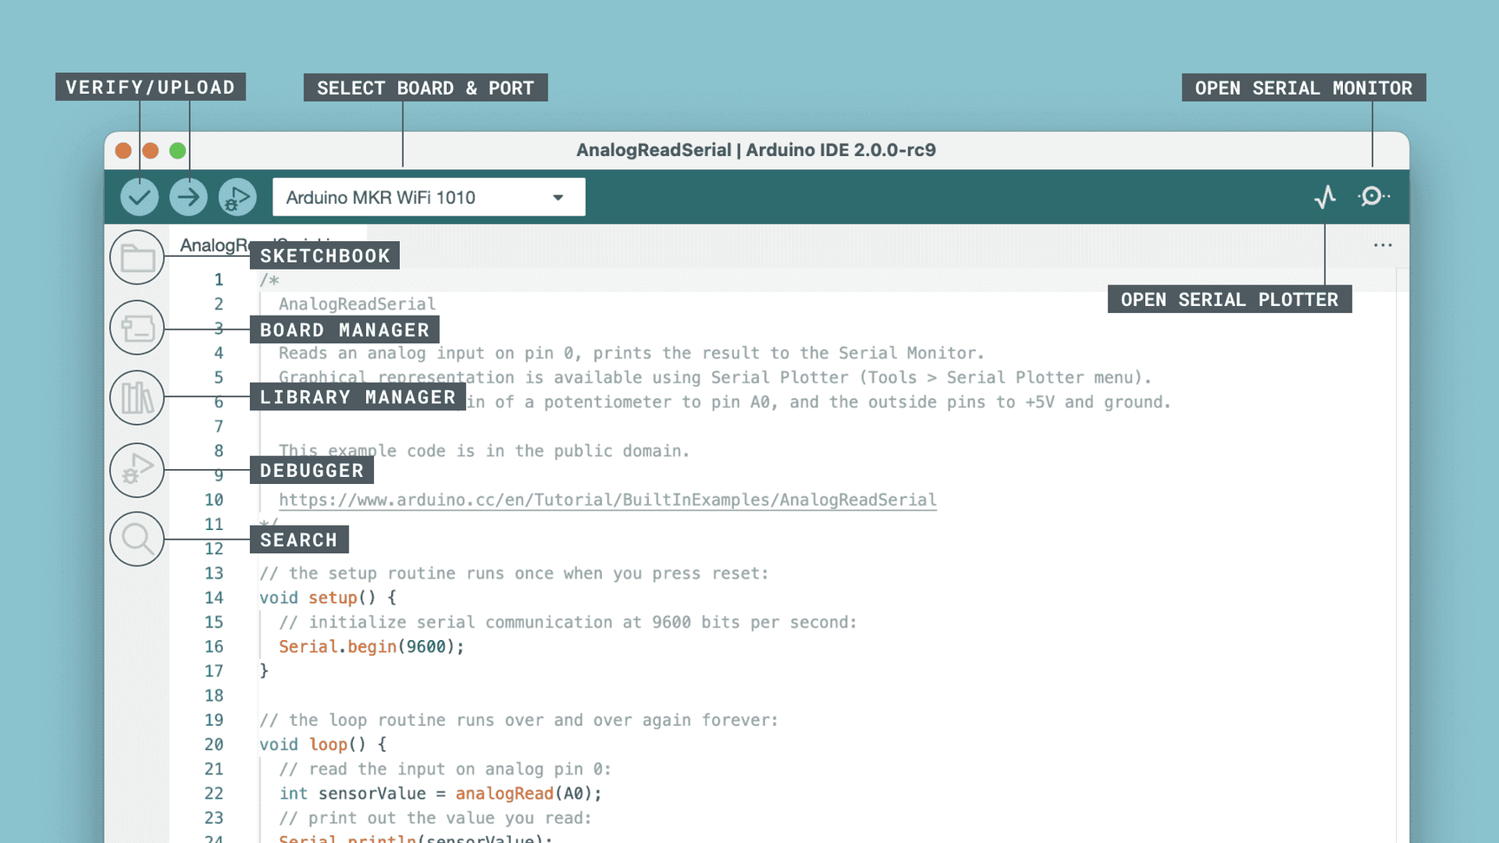
ARDUINO IDE
Is a software application used to program Arduino microcontrollers.
It provides an interface for writing, compiling, and uploading code to Arduino boards.

Slide 14
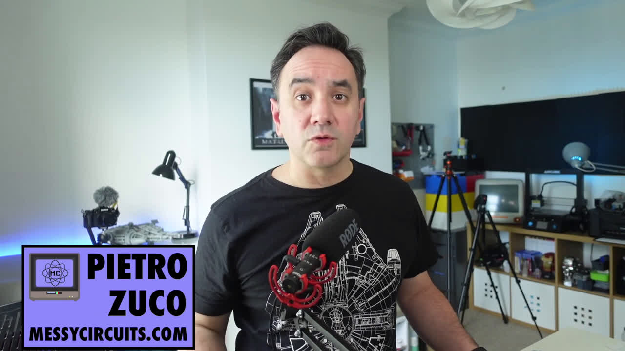
ARDUINO IDE INSTALLATION

Slide 15

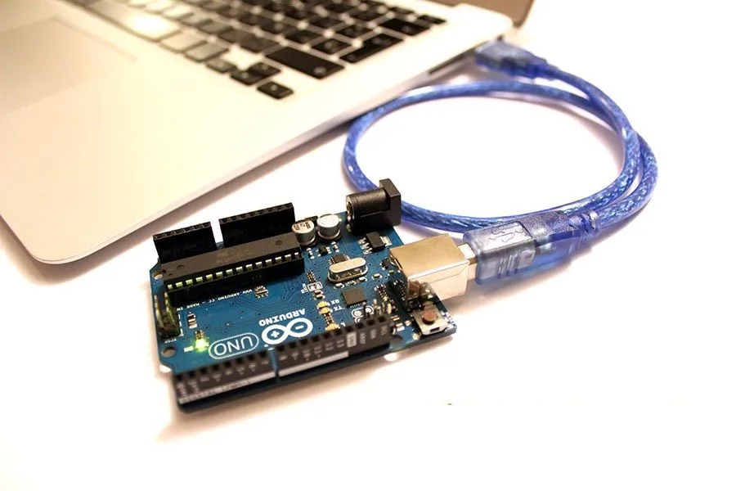
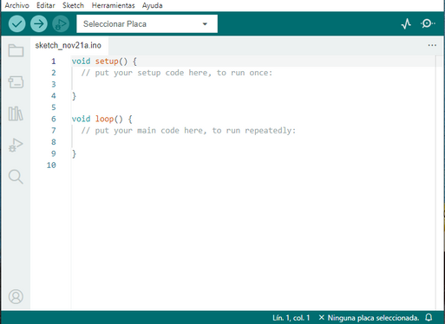
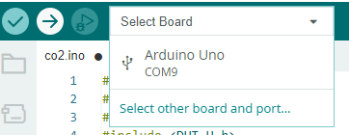
UPLOAD CODE TO THE ARDUINO BOARD
  CONNECT THE ARDUINO BOARD TO YOUR COMPUTER.
2. OPEN THE ARDUINO IDE ON YOUR COMPUTER.
3. SELECT THE BOARD AND PORT.

Slide 16
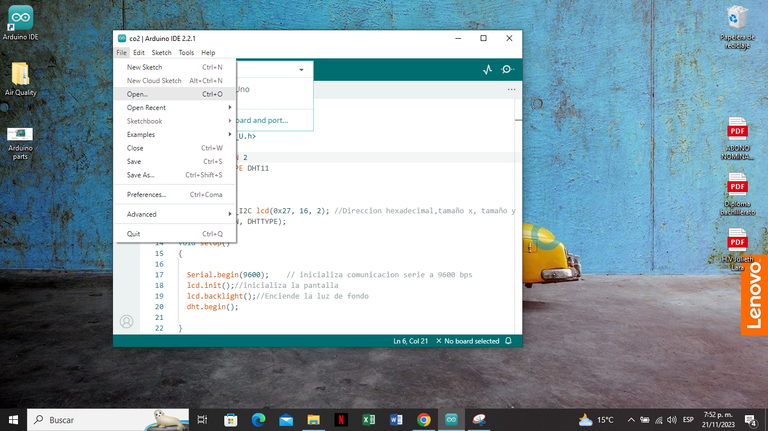

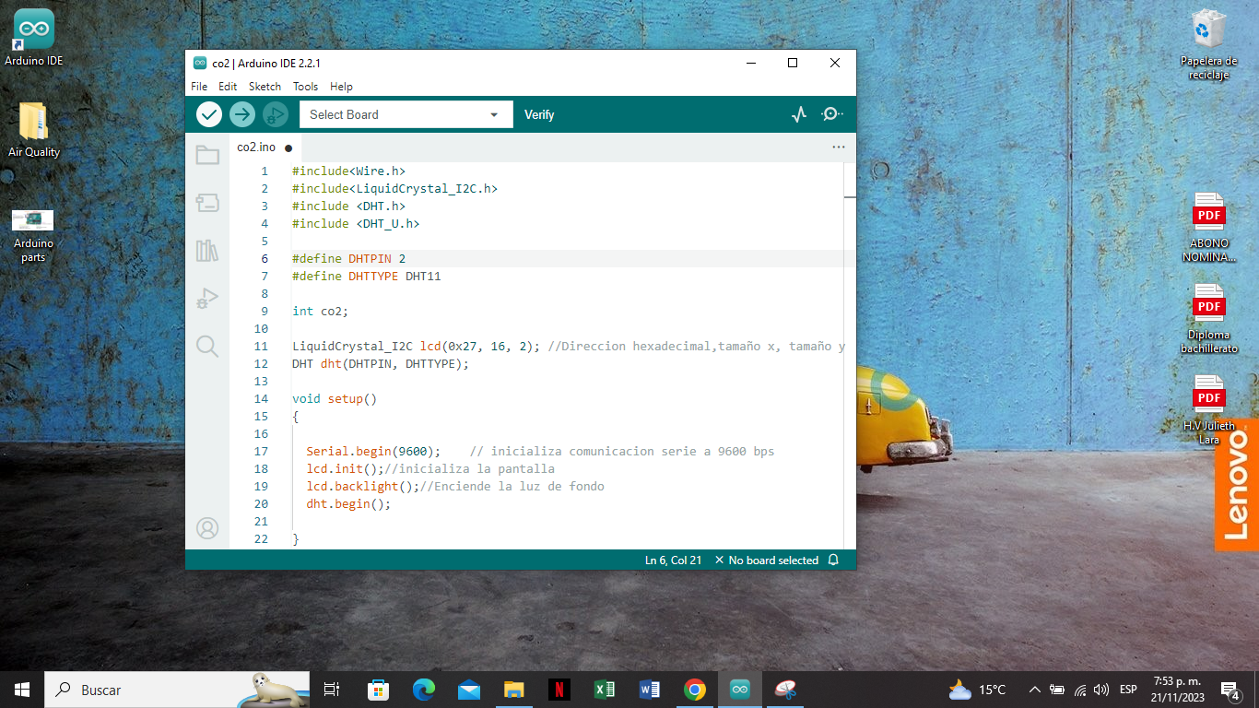
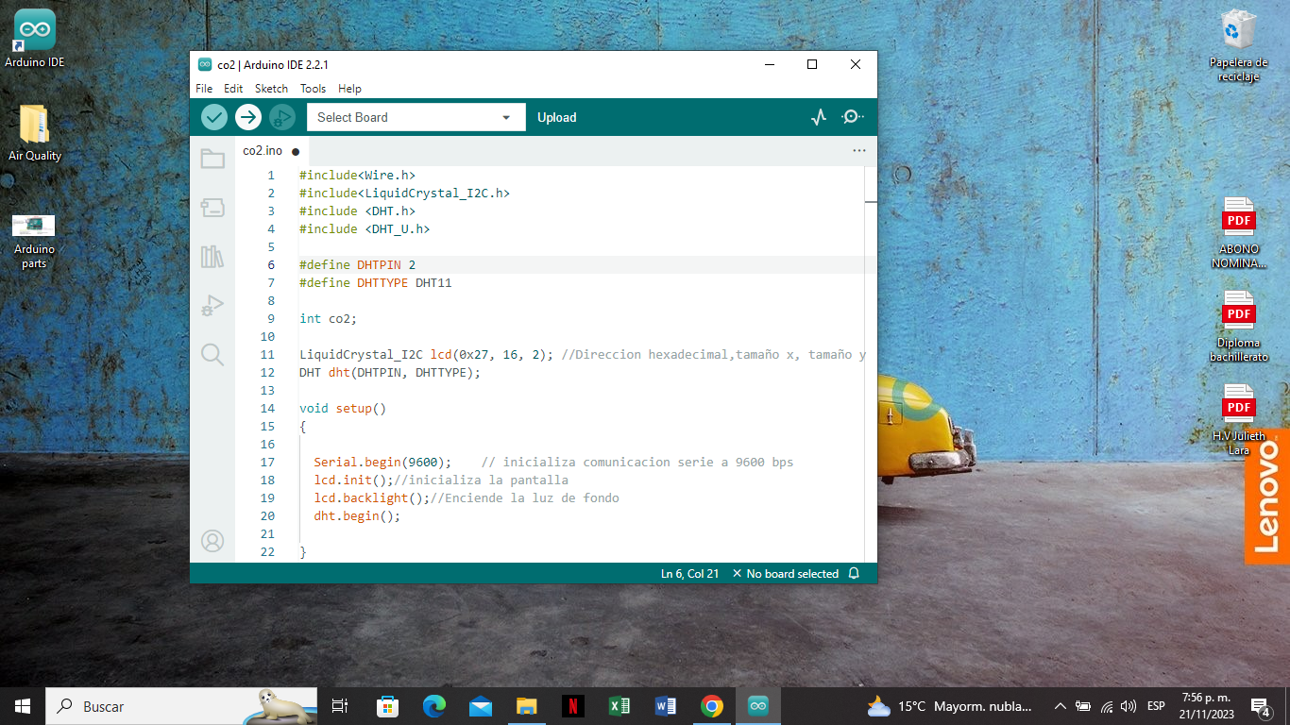
UPLOAD CODE TO THE ARDUINO BOARD
4. WRITE OR OPEN THE CODE.
5. COMPILE THE CODE.
6. UPLOAD THE CODE.
Click the verify button.
Click the upload button.

Slide 17
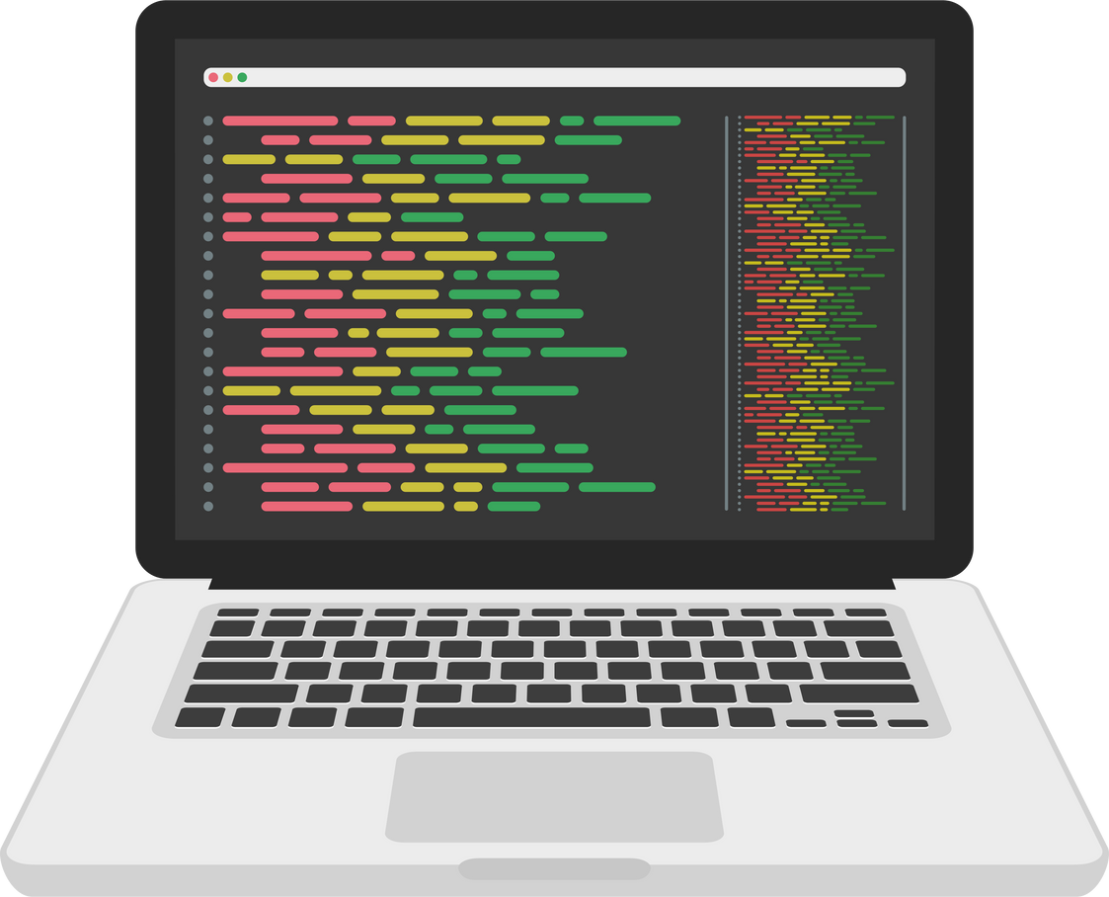
PROGRAMMING THE ARDUINO BOARD
You can ask your teacher for the code.

Slide 18
BIBLIOGRAPHIC REFERENCES
Arduino Project Hub. (s. f.). projecthub.arduino.cc. https://projecthub.arduino.cc
Pietro Zuco - MessyCircuits. Get started with Arduino on your Mac [Vídeo]. YouTube. https://www.youtube.com/watch?v=6eMyKhAx--g
Software. (s. f.). Arduino. https://www.arduino.cc/en/software

