Slide 1


Chasing the Sun: Solar Patterns Presentation

Slide 2
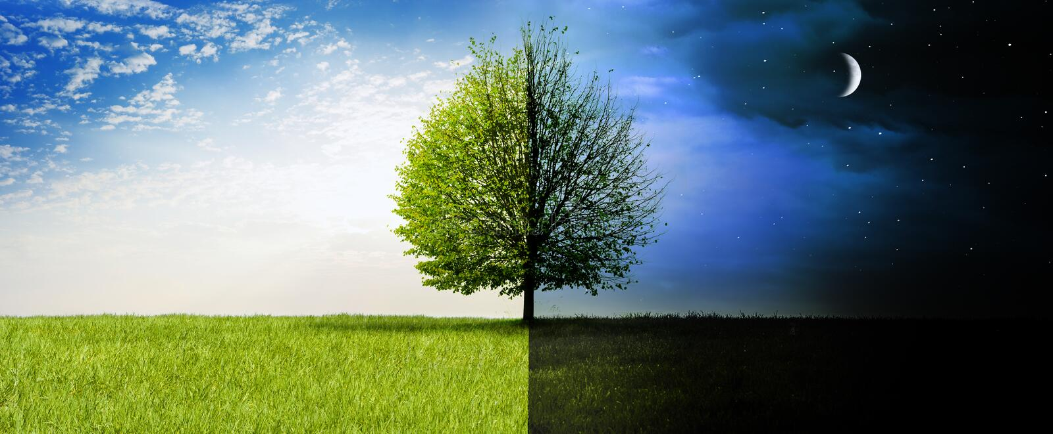
Why do we have day and night?

Slide 3
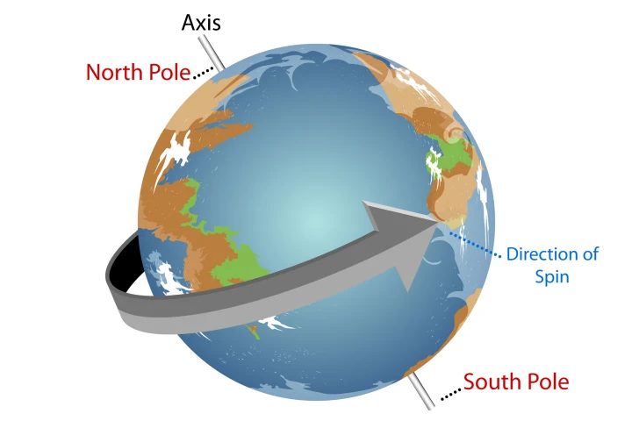
Earth spins on an axis
https://www.youtube.com/watch?v=l64YwNl1wr0
Watch to 1 minute

Slide 4

The sun moves across the sky during the day
The sun moves across our sky during the day because earth is spinning.
In the morning when the sun rises is starts in the east.
Then in the middle of the day the sun usually high above us in the middle of the sky.
At the end of the day the sun is setting in the west

Slide 5

Let’s see where the sun is
The sun just rose a little bit ago so it should be in the east.
We are going to go outside now and find the sun.
Then, after lunch we will stop and look to see if it is in the
same spot.
What did you notice?

Slide 6
Remember…
The Earth is spinning.
Spinning causes day and night because some time our part of earth faces the sun and sometimes it looks away.
We don’t see the sun at night because our part of earth is facing away
The sun moves across the sky throughout the day because earth is spinning.

