Slide 1


Chasing the Sun: Energy Effects Presentation

Slide 2
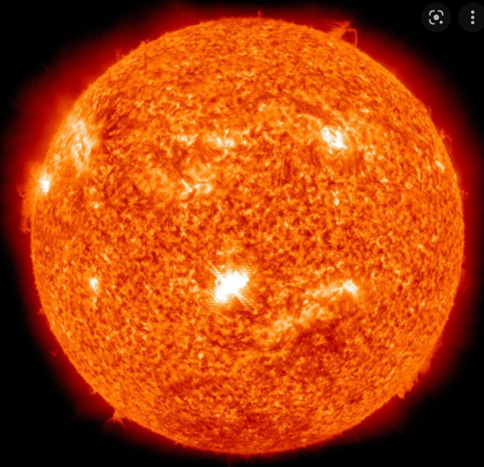
The Sun...
Gives off energy

Slide 3
WHAT IS ENERGY?
HAVING THE ABILITY TO DO WORK

Slide 4
WHAT IS WORK
The ability to move or change matter, this can be a physical or chemical change.

Slide 5
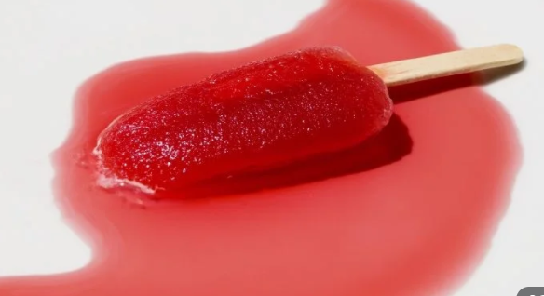
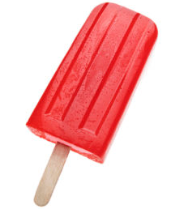
Example: How did the popsicle change when exposed to energy?
Notes:
Turn and talk

Slide 6
WHAT IS ENERGY?
Having the ability to change or move matter.
There are different types of energy.

Slide 7
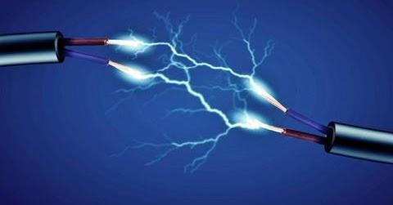
ELECTRICITY
ENERGY THAT PROVIDES POWER FOR MANY THINGS THAT WE USE EACH DAY.

Slide 8
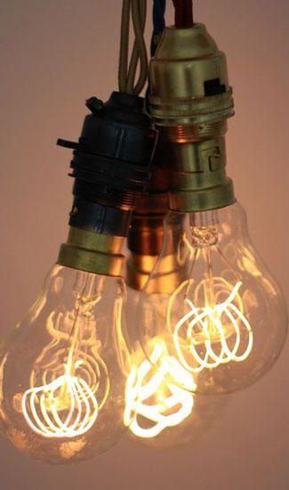
LIGHT
ENERGY THAT LETS US SEE.

Slide 9
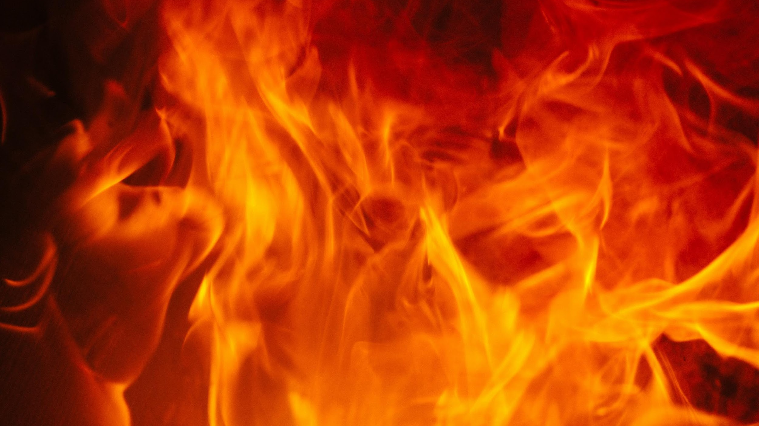
HEAT
ENERGY THAT MAKES THINGS WARMER.

Slide 10
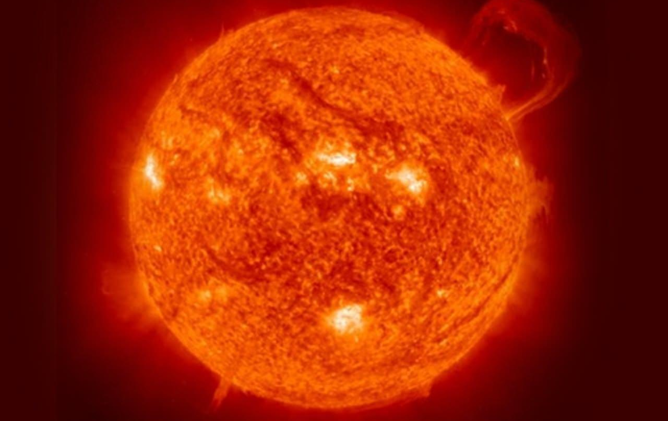
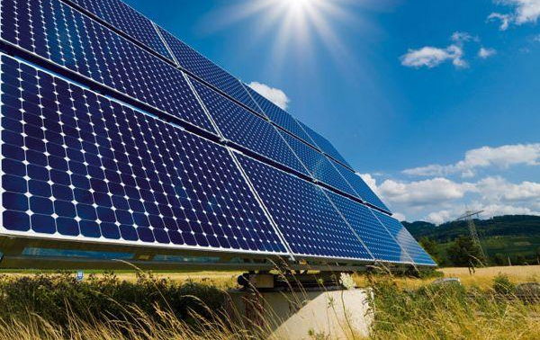
SOLAR ENERGY
A COMBINATION OF HEAT AND LIGHT ENERGY FROM THE SUN.

Slide 11
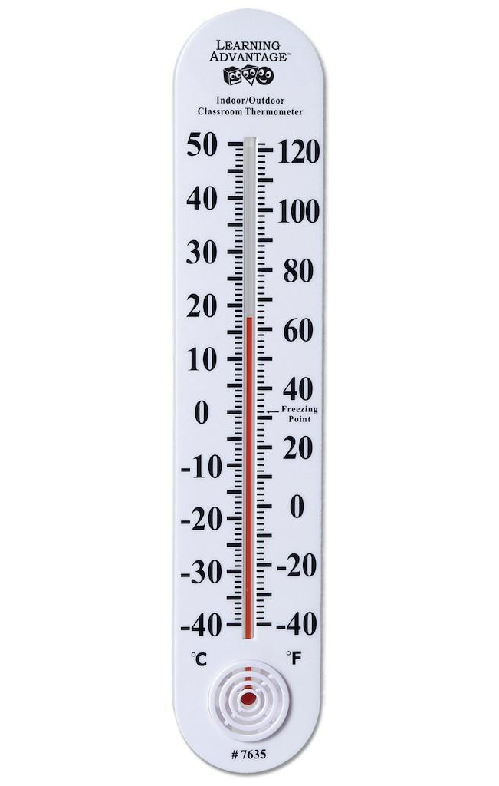
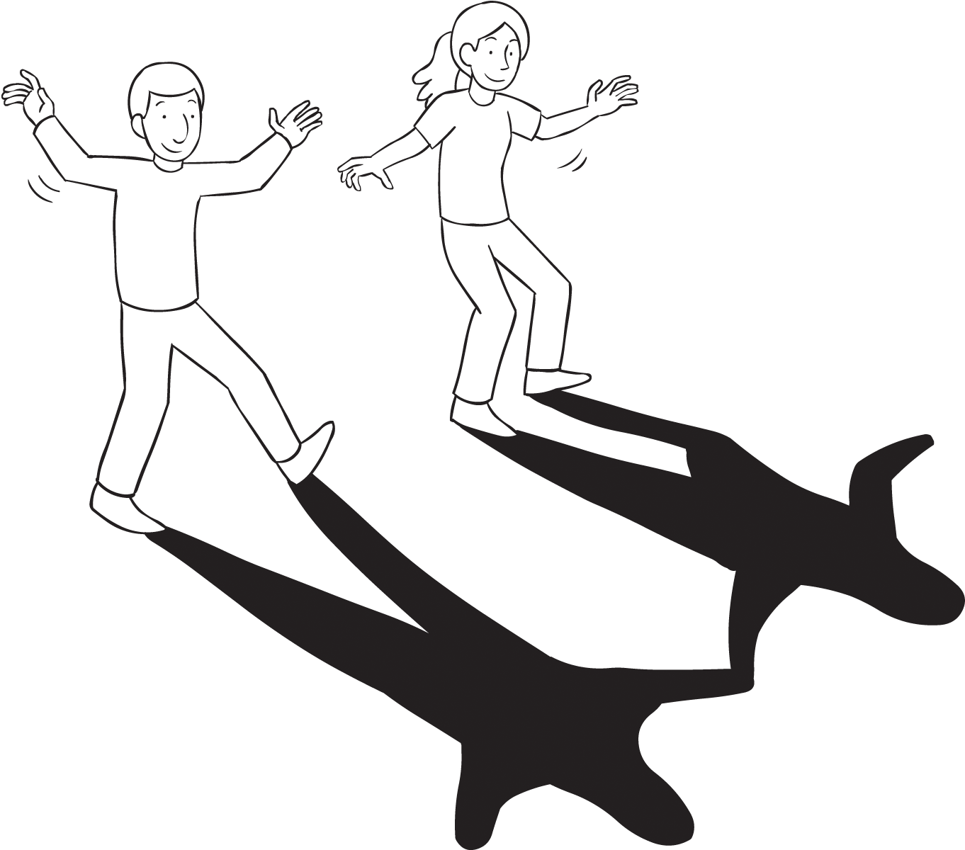

How does solar energy affect you?
Notes:
Pull sticks

Slide 12
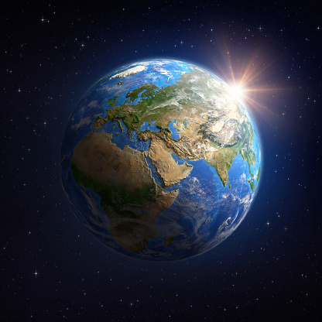
How Does the Sun Affect Earth?

