Slide 1
Tissue Mechanics
Notes:
Tissue Mechanics Presentation, Tissue Mechanics lesson, TeachEngineering.org

Slide 2
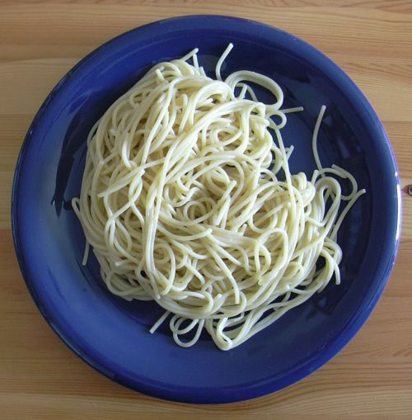
Silly Putty: How does it work?
Glue is a polymer, which means it is made of long chains of molecules.
When borax is added, it cross-links these molecules.
The amount of cross-linking determines the material properties of the silly putty.
Does more borax increase or decrease the stiffness of the silly putty?
  It increases the stiffness!
Notes:
Talk about spaghetti as an analogy: When you have cooked a pot of spaghetti and you first drain away the water, the spaghetti noodles are aligned randomly and the strands easily slide over one another. (This is parallel to glue’s fluid-like properties.) When the water begins to evaporate from the spaghetti, the strands start to stick together and the mass of spaghetti becomes more solid-like and is hard to break apart. (This is like what the borax does to the glue. It bonds the long strands of molecules together and forms a solid.)
Image source: 2004 Tim “Avatar” Bartel, Wikimedia Commons https://commons.wikimedia.org/wiki/File:Spaghetti.jpg

Slide 3
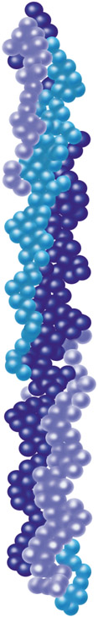
Tissue Mechanics
What does this have to do with tissue mechanics?
Human tissues contain varying degrees of collagen. Collagen is similar to the strands of molecules in glue. It is a long protein strand.
Collagen can also cross-link in our bodies similar to how the borax cross-links the glue.
The amount of collagen cross-linking in our tissues is directly related to the material properties of that tissue.
Notes:
Image: a strand of collagen showing its triple helix structure
Image source: National Institute of General Medical Sciences, National Institutes of Health http://publications.nigms.nih.gov/structlife/ch1_str1.html

Slide 4
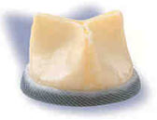
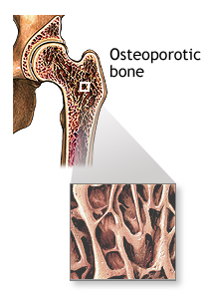
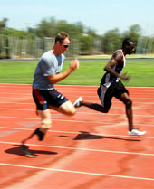
Why study tissue mechanics?
For the engineering design of devices that will be implanted or used inside of the body
  Examples: artificial heart valves,
  arterial stents, surgical devices
  Must be “biocompatible”
To understand pathologies and their effect on tissues
  Examples: valve stenosis, osteoporosis
For the design of prosthetics (artificial body parts)
  Examples: artificial arms, legs, hands, feet
Notes:
Biocompatible: Being able to coexist with living tissues without causing harm. A material that is safe to use in the body
Photo of a mitroflow aortic pericardial heart valve composed of a polyester-covered ring with a material (bovine pericardium) attached to form a closed cylinder. Engineers design artificial heart valves to replace diseased, damaged and malfunctioning heart valves.
Valve image source: U.S. Food and Drug Administration http://www.fda.gov/MedicalDevices/ProductsandMedicalProcedures/DeviceApprovalsandClearances/Recently-ApprovedDevices/ucm074904.htm
Bone image source: ADAM, National Institutes of Health http://www.nlm.nih.gov/medlineplus/ency/imagepages/17285.htm
Prosthetic image source: U.S. Department of Veterans Affairs http://www.oefoif.va.gov/prosthetics.asp

Slide 5
Tissue Mechanics
Proteins that can determine the mechanical properties of tissues:
  Collagen: tissue strength
    Example: tendons
  Elastin: elastic properties
    Example: arteries
  Proteoglycan: allows tissues to retain water that can be used for lubrication
    Example: cartilage

