Slide 1
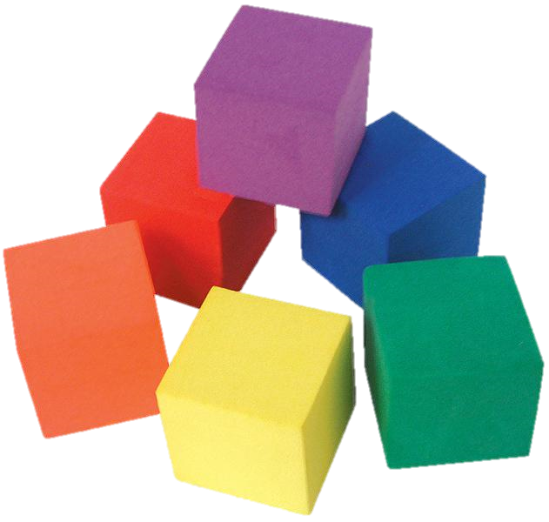
Spatial Visualization
Let’s Learn about Spatial Vis!
Notes:
Hello and welcome! Today we will introduce the topic of spatial visualization—what it is and why we like it. Then, we will take a spatial visualization test to assess where our skills are today. Let’s begin!
Note: The slides are animated so a mouse or keyboard click brings up the next image, text or slide.
///
Spatial Visualization Presentation, Let’s Learn about Spatial Vis! lesson and its four associated activities, TeachEngineering.org
///
Image source: (6 colored cube blocks)
Clip Art Hub (free clip art) http://www.cliparthut.com/cube-clip-art-clipart-eBSHWo.html

Slide 2
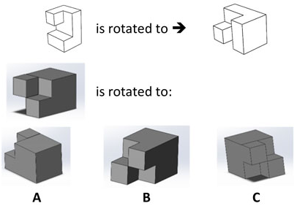
Example spatial visualization quiz question
Imagine rotating the top left (white) shape to look like the top right shape
Then imagine rotating the middle (gray) shape the same way
How would it look?
Pick from the three choices provided
What is the correct answer?
Notes:
Use this slide to support the lesson by showing students an example PSVT:R test question.
///
Image source: 2016 Jacob Segil, College of Engineering and Applied Science, University of Colorado Boulder

Slide 3
ACTIVITY 1:
Connect the Dots: Isometric Drawings and Coded Plans
Notes:
Note: The slides are animated so a mouse or keyboard click brings up the next image, text or slide.

Slide 4
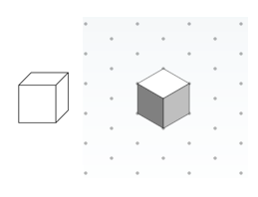
Depicting a 3-D Cube
Isometric view of a cube 
Non-isometric view of a cube 
Corner angles are not equal
Sides have different areas
Sides connect in a corner
All corner angles are equal (120°)
Sides are the same size
Shown on triangle-dot paper
Notes:
Use this slide to support activity 1 on the topic of isometric drawings and coded plans.
///
Image source: (2 drawings of a cube)
2015 Jacob Segil, College of Engineering and Applied Science, University of Colorado Boulder

Slide 5
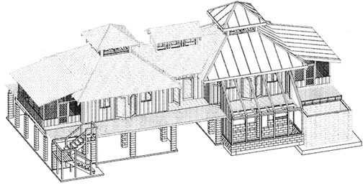
Isometric Drawing Example
Isometric means “equal measure”
A house depicted isometrically using AutoCAD➔
Useful for blueprints
and design plans
Think of the cube:
Equal side faces
Equal corner angles (120°)
Triangle-dot paper: dots are 120° from each other
Notes:
Use this slide to support activity 1 on the topic of isometric views and coded plans.
///
Image source: (drawing of house)
2015 Jacob Segil, College of Engineering and Applied Science, University of Colorado Boulder

Slide 6
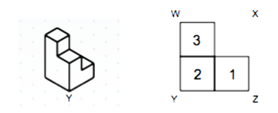
Coded Plans
Click to reveal the solution
A coded plan of the same image ⬇
Once all partners’ eyes are closed, click the mouse or keyboard to reveal the image…
⬆ Describe this image for your non-seeing partner to draw
Corners are labeled by letters
# in squares = # cubes stacked up
Notes:
Use this slide to support activity 1 on the topic of isometric views and coded plans.
///
Image source: (isometric and coded plan drawings of same object)
2015 Jacob Segil, College of Engineering and Applied Science, University of Colorado Boulder

Slide 7
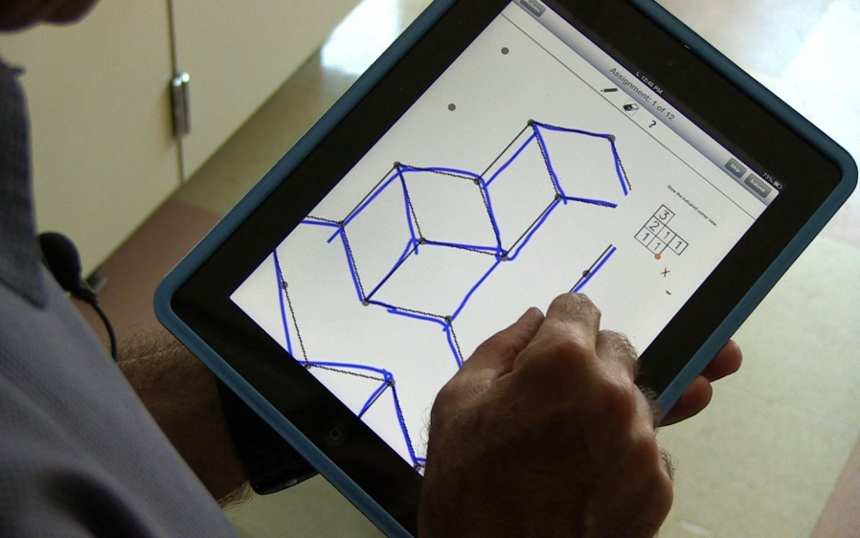
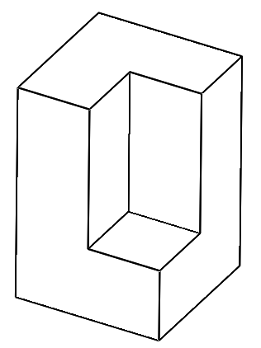

Isometric Views
Tips:
Define your axes on the object and isometric paper
Align paper in “landscape” orientation
Only draw lines where there are edges
Notes:
Use this slide to support activity 1 on the topic of isometric views and coded plans.
///
Image source:
(isometric line drawing) 2016 Jacob Segil, College of Engineering and Applied Science, University of Colorado Boulder
(photo drawing on pad) 2015 Jacob Segil, College of Engineering and Applied Science, University of Colorado Boulder

Slide 8
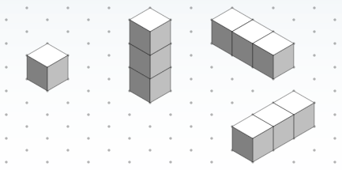
Isometric Views
Click to reveal
Click to reveal
Click mouse/keyboard to reveal
Notes:
Use this slide to support activity 1 on the topic of isometric views and coded plans.
///
Image source: (drawings of various cube shapes)
2015 Jacob Segil, College of Engineering and Applied Science, University of Colorado Boulder

Slide 9
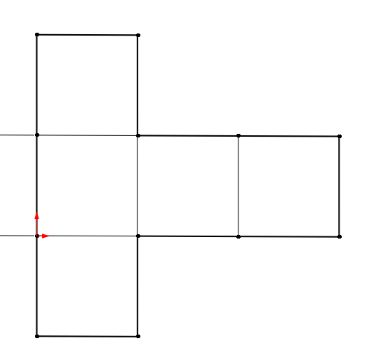
Coded Plans > to Isometric Views
1
1
2
3
1
A
Tips:
Define your axes on a coded plan and isometric paper
Start drawing from perspective
Notes:
Use this slide to support activity 1 on the topic of isometric views and coded plans.
///
Image source: (coded plan)
2016 Jacob Segil, College of Engineering and Applied Science, University of Colorado Boulder

Slide 10
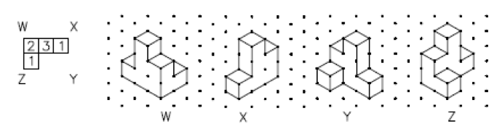
Coded Plans to Isometric Views
Click mouse/keyboard to reveal the possible solutions
Notes:
Use this slide to support activity 1 on the topic of isometric views and coded plans.
///
Image source: (Cube shapes drawn from a coded plan on triangle-dot paper)
2015 Jacob Segil, College of Engineering and Applied Science, University of Colorado Boulder

Slide 11
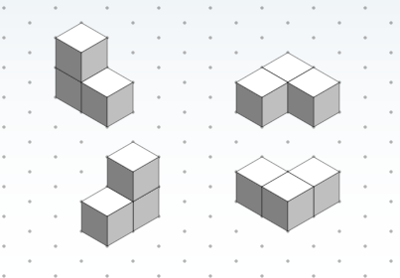
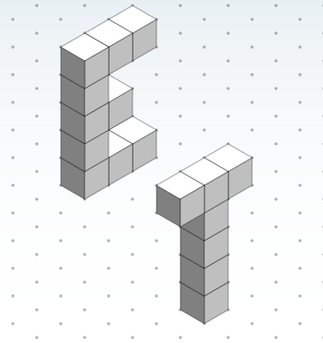
Isometric Views: Extra Credit
4 views of the same multi-cube object
Two capital letters drawn isometrically
Notes:
Use this slide to support activity 1 on the topic of isometric views and coded plans.
///
Image sources: (cube and letter shapes)
2015 Jacob Segil, College of Engineering and Applied Science, University of Colorado Boulder

Slide 12
Activity 2:
Seeing All Sides:
Orthographic Drawings
Notes:
Note: The slides are animated so a mouse or keyboard click brings up the next image, text or slide.

Slide 13
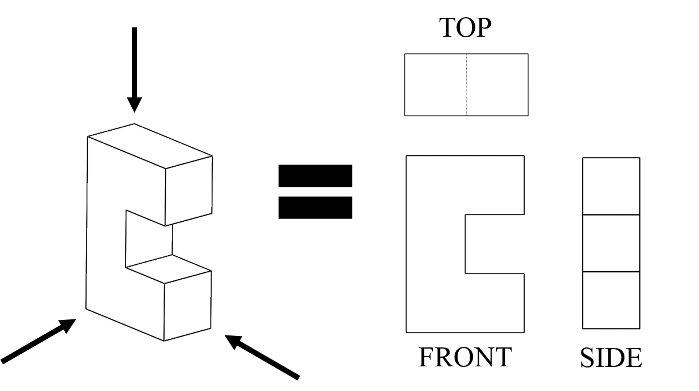
Orthographic Drawings
Click to reveal
What are the three main orthographic views of an object?
Notes:
Use this slide to support activity 2 on the topic of orthographic drawings.
///
Image source: 2016 Jacob Segil, College of Engineering and Applied Science, University of Colorado Boulder

Slide 14
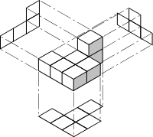
Orthographic Drawings
Also called:
“multiview” drawings
Notes:
Use this slide to support activity 2 on the topic of orthographic drawings.
///
Image source: (orthographic drawings of 3 sides of multi-cube object)
2012 Cdang, Wikimedia Commons https://commons.wikimedia.org/wiki/File:Figure_7_cubes_CRPE_3e_concours_2012_math_solution.svg

Slide 15
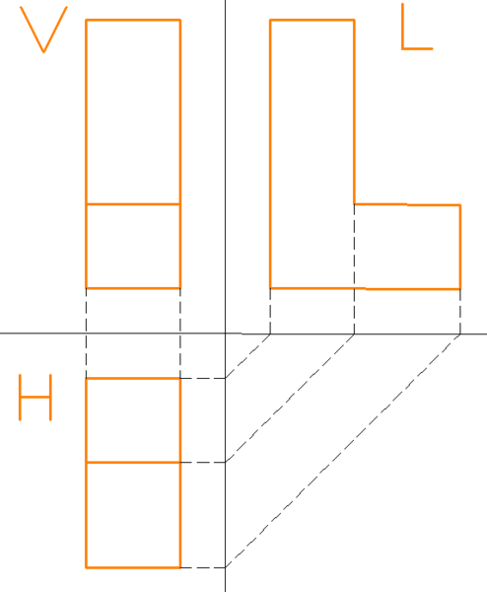
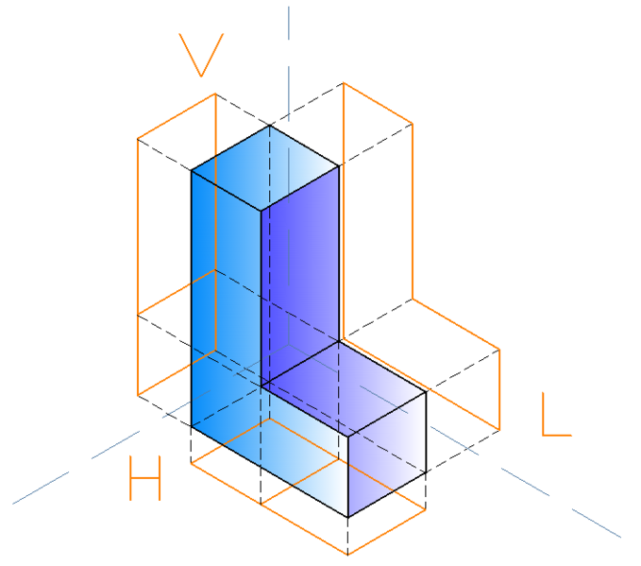
Orthographic Drawings
Notes:
Use this slide to support activity 2 on the topic of orthographic drawings.
///
Image sources:
2007 Zink, Wikimedia Commons https://commons.wikimedia.org/wiki/File:Isometric_projections_of_an_l_shape.png
2007 Zink, Wikimedia Commons https://commons.wikimedia.org/wiki/File:Orthographic_projections_of_L_shape.png

Slide 16
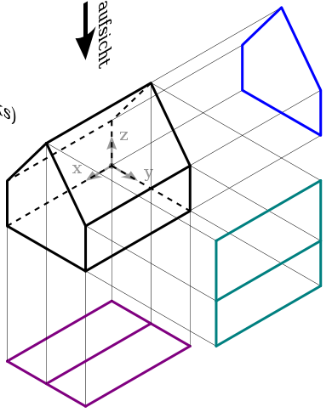
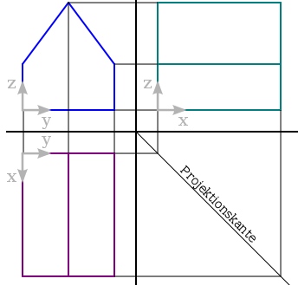
Orthographic Drawings
Top view
Side view (from left)
Front view
Notes:
Use this slide to support activity 2 on the topic of orthographic drawings.
///
Image source:
(3 view drawing) 2009 Biezl, Wikimedia Commons https://commons.wikimedia.org/wiki/File:Dreitafelprojektion.svg
(3-view details of house shape) 2009 Biezl, Wikimedia Commons https://commons.wikimedia.org/wiki/File:Dtp-3d_2.svg

Slide 17
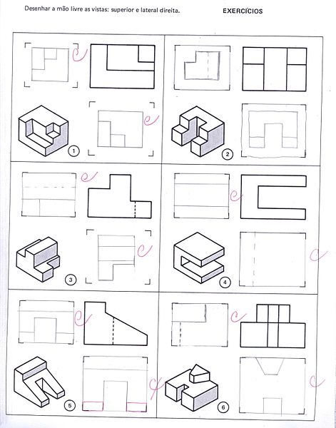
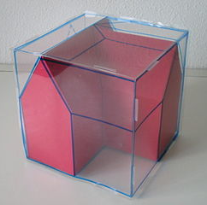
Orthographic Drawings
Notes:
Use this slide to support activity 2 on the topic of orthographic drawings.
///
Image sources:
(house shape inside clear cube worthographic projections marked) 2004 MdeVicente, Wikimedia Commons https://commons.wikimedia.org/wiki/File:Cubo_proyecciones1.JPG
(technical drawing exercise) 2011 Andrevruas, Wikimedia Commons https://commons.wikimedia.org/wiki/File:Desenhotecnico.jpg

Slide 18
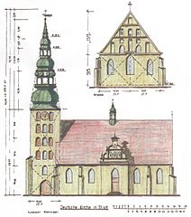
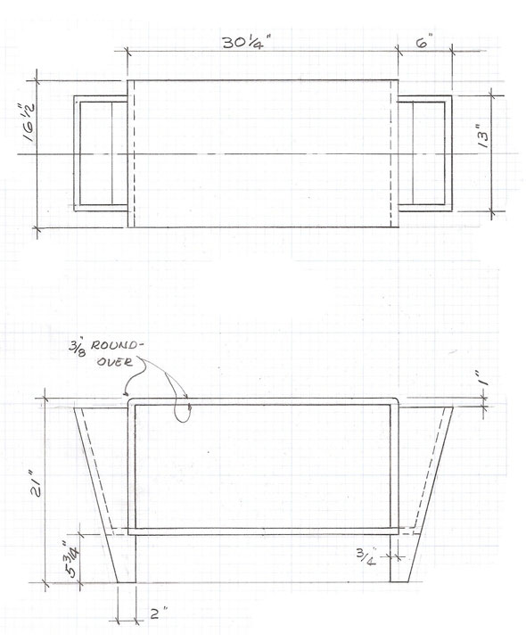
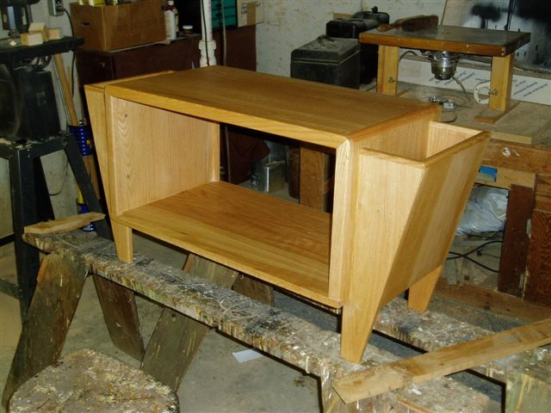
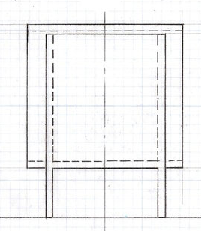
Orthographic Drawings
Engineering examples
Notes:
Use this slide to support activity 2 on the topic of orthographic drawings.
///
Image sources:
(wooden bench photo & top/front/side view hand drawings): © 2009 Richard M. Weidner. Used with permission.
(front and side elevation of a German church in Tilsit): 1980 Siegfried Harbrucker, Wikimedia Commons https://commons.wikimedia.org/wiki/File:Deutsche_Kirche_Tilsit_(Seitenriss).jpg

Slide 19

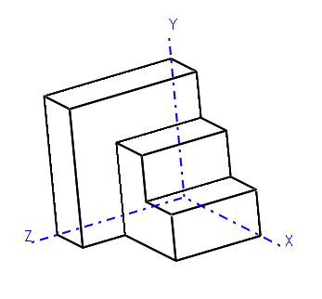
Orthographic Drawings
Tips:
Draw views in order (top → front → side)
Draw lines where there are edges (changes in plane)
Use dotted lines to show hidden edges
Solid lines trump dotted lines
Notes:
Use this slide to support activity 2 on the topic of orthographic drawings.
///
Image source: (line drawing)
2016 Jacob Segil, College of Engineering and Applied Science, University of Colorado Boulder

Slide 20
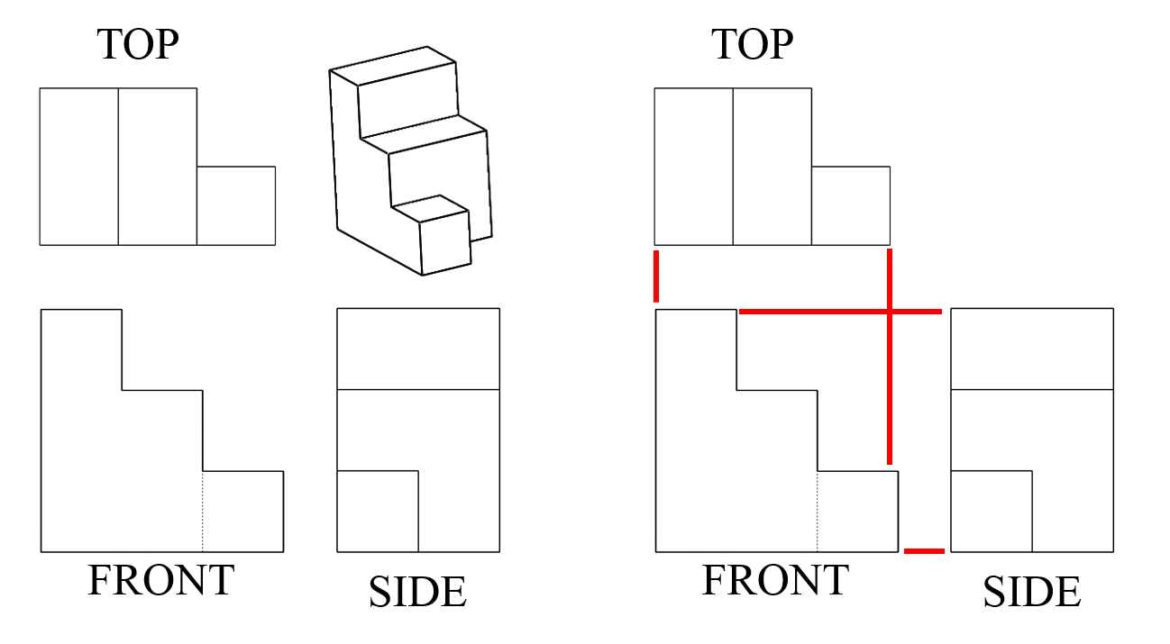
Orthographic Drawings
Notes:
Use this slide to support activity 2 on the topic of orthographic drawings.
///
Image source: 2016 Jacob Segil, College of Engineering and Applied Science, University of Colorado Boulder

Slide 21
ACTIVITY 3:
Let’s Take a Spin:
One-Axis Rotations
Notes:
Note: The slides are animated so a mouse or keyboard click brings up the next image, text or slide.

Slide 22
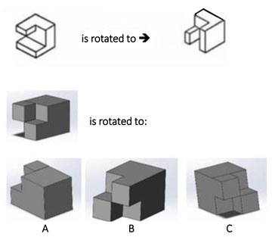
One-Axis Rotations
is rotated to ➔
Can you find the rotation of the gray object that is analogous to the rotation of the white object?
is rotated to:
Notes:
Answer = B: The middle gray object in the last row is rotated 90 degrees about the z-axis—just like the white object in the top row.
Use this slide to support activity 3 on the topic of one-axis rotations.
///
Image source: 2015 Jacob Segil, College of Engineering and Applied Science, University of Colorado Boulder

Slide 23
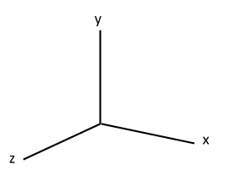
One-Axis Rotations
Three positive axes, x, y and z.
vertical
X = horizontal axis
Y = vertical axis
Z = axis coming towards us
horizontal axis
depth
Notes:
Use this slide to support activity 3 on the topic of one-axis rotations.
///
Image source: (x, y, z axes)
2016 Jacob Segil, College of Engineering and Applied Science, University of Colorado Boulder

Slide 24
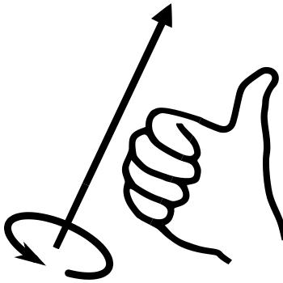
One-Axis Rotations
How to do the right-hand rule
Point your thumb parallel to the axis you are rotating about and curve your fingers naturally towards the palm of your hand
Your fingers will move in the same way that the object will move
Notes:
Use this slide to support activity 3 on the topic of one-axis rotations.
The right-hand rule is a mnemonic, which is a learning tool that helps us remember something.
///
Image sources:
(x, y, z axes) 2016 Jacob Segil, College of Engineering and Applied Science, University of Colorado Boulder
(drawing with hand) 2009 Schorschi2 and 2011 Das steinerne Herz, Wikimedia Commons {PD} https://en.wikipedia.org/wiki/File:Right-hand_grip_rule.svg

Slide 25
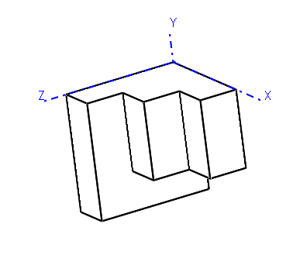
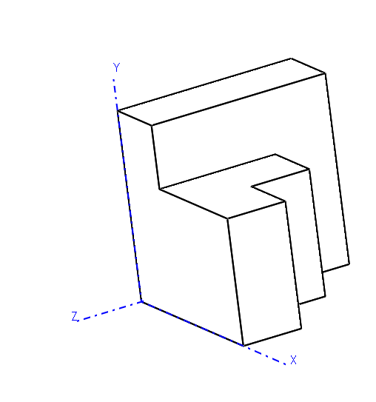
One-Axis Rotations
original object position
+X
-X
Tips:
Right-hand rule!
Clockwise = negative rotation; counter-clockwise = positive rotation
90°, 180°, 270° rotations only
Think of a “flag around a flagpole”
Notes:
Use this slide to support activity 3 on the topic of one-axis rotations.
///
Image source: (line drawing)
2016 Jacob Segil, College of Engineering and Applied Science, University of Colorado Boulder

Slide 26
ACTIVITY 4:
New Perspectives:
Two-Axis Rotations
Notes:
Note: The slides are animated so a mouse or keyboard click brings up the next image, text or slide.

Slide 27
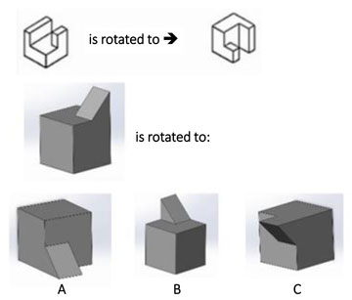
Two-Axis Rotations
Can you find the rotation of the gray object that is analogous to the rotation of the white object?
Notes:
Answer = A: The far left gray object in the last row is rotated 90 degrees about the negative y-axis and 90 degrees about the negative z-axis—just like the white object in the top row.
Use this slide to support activity 4 on the topic of two-axis rotations.
///
Image source: 2015 Jacob Segil, College of Engineering and Applied Science, University of Colorado Boulder

Slide 28
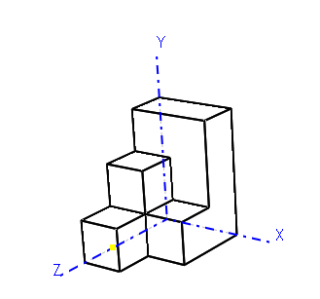
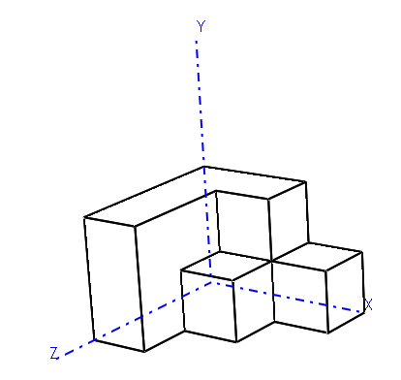
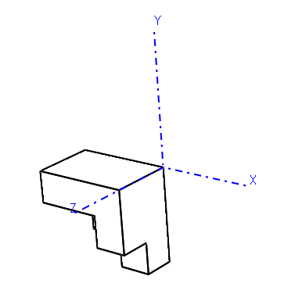
Two-Axis Rotations
Tips:
Use the right-hand rule!
Clockwise = negative rotation
Counter-clockwise = positive rotation
Two-axis rotation is NOT commutative (order matters!)
original object position
+Z
+X
+X
+Z
Notes:
Use this slide to support activity 4 on the topic of two-axis rotations.
As needed, for review, refer to the previous slides on one-axis rotation and the right-hand rule.
///
Image source: (line drawing)
2016 Jacob Segil, College of Engineering and Applied Science, University of Colorado Boulder

Slide 29
Write a Rule Approach
Pick a side
Find the same side after rotation
Write a “rule”!
Pick the same side on a new object
Follow your rule
Compare to answers
Notes:
Use this slide to support activity 4 on the topic of two-axis rotations.
Use the “write a rule” approach to encourage and support students to pay attention to their own logic and method.
///
Image source: 2015 Jacob Segil, College of Engineering and Applied Science, University of Colorado Boulder

