Slide 1

Cars: Engineering for Efficiency
Day 3

Slide 2
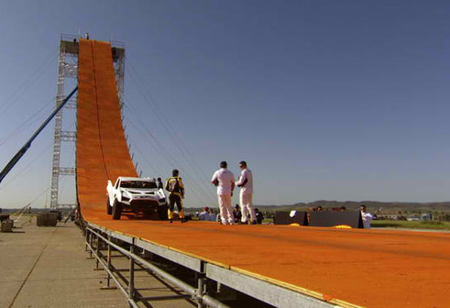
Why do engineers want to design energy-efficient cars?
What kind of energy
does your car have at
the top of the track?
What about at the
bottom of the track?
What is a variable? What is a control?

Slide 3

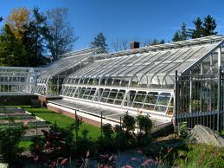
Vocabulary
Variable – Something that is allowed to change during an experiment.
Control – Something kept constant or controlled during an experiment.

Slide 4

Independent vs. Dependent
Independent Variable – This is a
variable you intentionally change
during the experiment, like how
much your car weighs.
Dependent Variable – This is a variable
that changes as a result of a change
in the independent variable, in this
case the time it takes your car to
get down the track.

Slide 5
Graphing Variables
Dependent
Variable
Independent Variable

Slide 6
Working with Variables
What are some variables that may change the speed of our cars (dependent variable)?
Engineering Video (http://pbskids.org/designsquad/profiles/index.html) …click on snowboarding video
Tests / Experiments
Graph the variables

Slide 7
Graph (for display on white board)

Slide 8
Graph (for display on white board)

