Slide 1


Edible Rovers

Slide 2
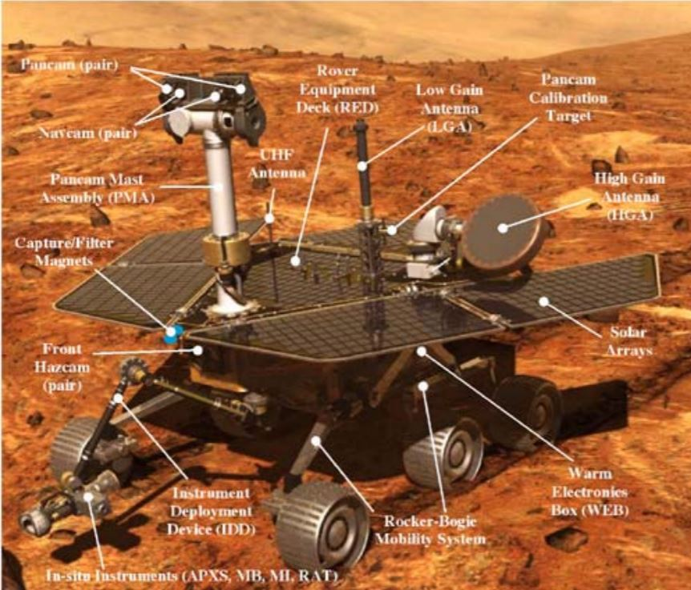
Spirit and Opportunity Rover
Photos should be a
square like this.
Image Source: http://marsrovers.jpl.nasa.gov/mission/spacecraft_surface_rover.html

