Slide 1

Tinkercad 3D Design &
EV Concept Car Workshop
Part 1: Introduction to Tinkercad
& Car Chassis Design

Slide 2
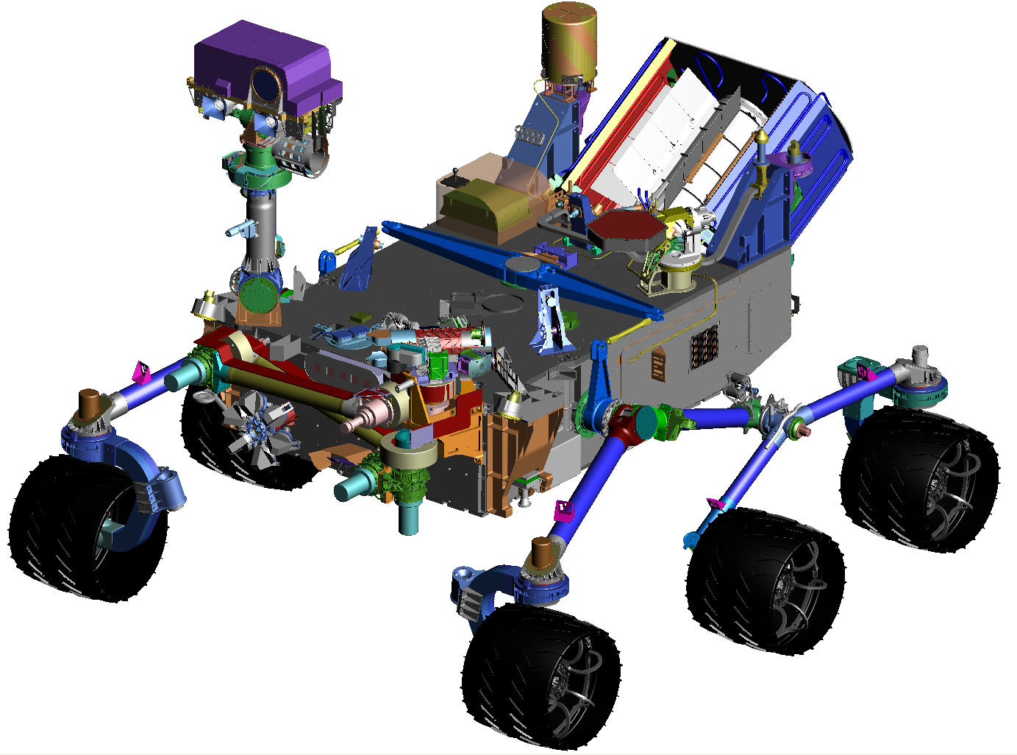
Session 1: Introduction to Tinkercad
Guess what? Even NASA uses CAD!
Notes:
Ask students what they think CAD stands for, and any examples of CAD used in the world around them.

Slide 3

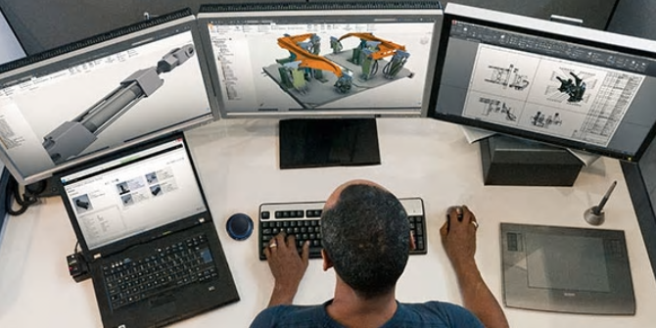
CAD stands for computer-aided design software.
Engineers, architects, artists, and others use CAD to create precise 2D drawings and 3D models.
Notes:
Bottom image https://res.cloudinary.com/engineering-com/image/upload/w_640,h_640,c_limit,q_auto,f_auto/bigstock-Female-Engineer-Using-CAD-Syst-98580293_rfhmuh.jpg
Top Image:
https://damassets.autodesk.net/content/dam/autodesk/www/solutions/cad-software/mechanical-engineers-thumb-600x300.jpg
Text Techopedia.com: https://www.techopedia.com/definition/2063/computer-aided-design-cad
Computer-aided design (CAD) is a computer technology that designs a product and documents the design process. CAD may facilitate the manufacturing process by transferring detailed diagrams of a product’s materials, processes, tolerances and dimensions with specific conventions for the product in question. It can be used to produce either two-dimensional or three-dimensional diagrams, which can then when rotated to be viewed from any angle, even from the inside looking out.
CAD is used as follows:
To produce detailed engineering designs through 3-D and 2-D drawings of the physical components of manufactured products.
To create conceptual design, product layout, strength and dynamic analysis of assembly and the manufacturing processes themselves.
To prepare environmental impact reports, in which computer-aided designs are used in photographs to produce a rendering of the appearance when the new structures are built.
CAD systems exist today for all of the major computer platforms, including Windows, Linux, Unix and Mac OS X. The user interface generally centers around a computer mouse, but a pen and digitizing graphic tablet can also be used.
Most U.S. universities no longer require classes for producing hand drawings using protractors and compasses. Instead, there are many classes on different types of CAD software. Because hardware and software costs are decreasing, universities and manufacturers now train students how to use these high-level tools. These tools have also modified design workflows to make them more efficient, lowering these training costs even further.

Slide 4
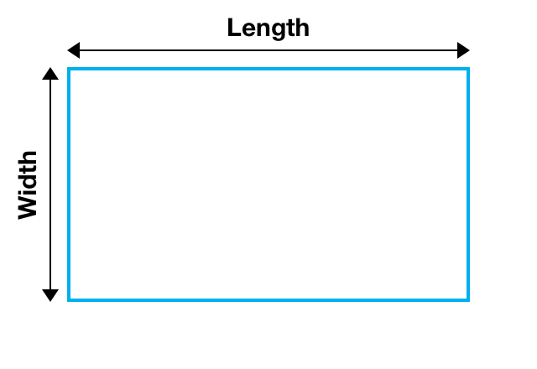
Measuring in 2D
2D objects have a length and width
Notes:
Image: https://www.mapeihome.com/calculating-total-area

Slide 5
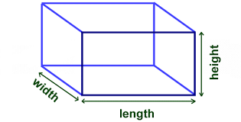
Measuring in 3D
3D objects have a length, width, and height
Notes:
Image: https://www.quora.com/What-is-the-length-of-a-rectangular-prism-How-is-this-determined

Slide 6
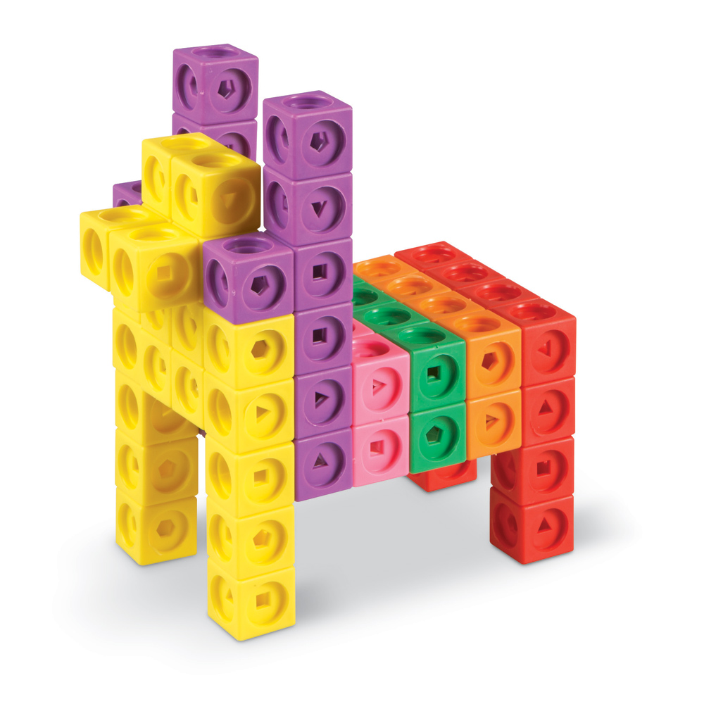
2-dimensional isometric view
3-dimensional orthographic view
Notes:
Illustration of what 2D and 3D objects look like

Slide 7
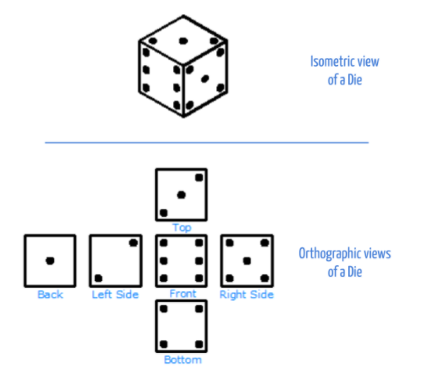
Spatial Visualization:
Looking at objects ALL ways!
Isometric (3D) view
and
Orthographic (2D) view
Notes:
Visual Spatialization - or visual-spatial ability is the ability to mentally manipulate 2-dimensional and 3-dimensional figures
When we talk about 2D shapes (orthographic view), we talk about sides and angles.
The angles of a 2D shape are also sometimes referred to as 'vertices' (singular: vertex).
When we talk about 3D shapes (isometric view), we talk about faces, edges and vertices.
The faces are the flat parts of the shape.
The edges are the lines where two faces meet.
The vertices are the points where two or more edges meet.
Rotation - is a motion of a certain space that preserves at least one point
Measured in degrees (90°, 180°, 270°, 360°)
In planes (about axes x, y, z) - right hand rule

Slide 8


What You’ll Need!
Computer, Mouse & Internet Connection
Microsoft Windows 10, Apple OSX10.10, or Chrome OS on Chromebooks
TinkerCAD Account
Go to https://www.tinkercad.com
+
Browsers that work best with Tinkercad:
- Google Chrome version 50 (or newer), Safari 10 or newer, Microsoft Edge (Chromium)
Notes:
Direct students to Tinkercad.com>Tinker (top menu bar)>3D Design>login or join classroom and enter code generated by the teacher>start “tinkering”>Designs>3D Design>Create

Slide 9
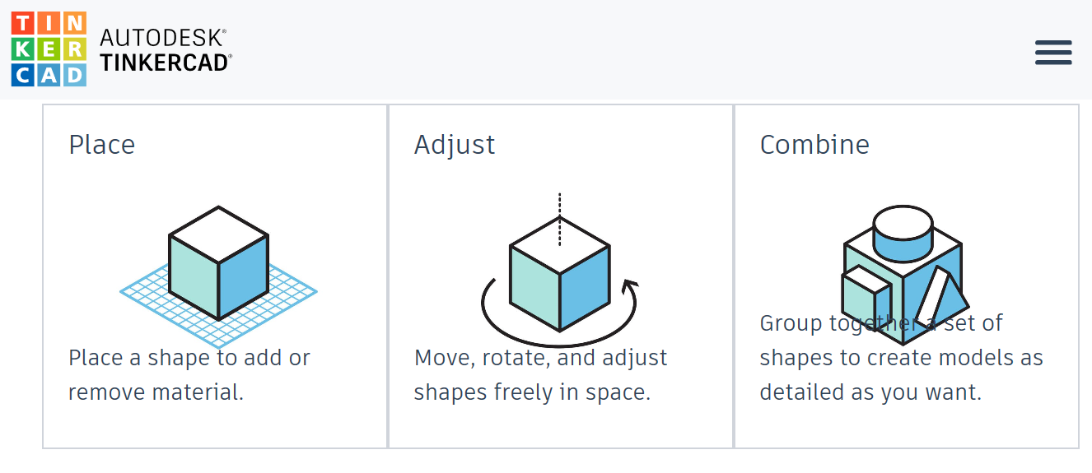
Tinkercad 3D Design
Notes:
Tinkercad is not a true CAD program, but is a fantastic tool to learn the basics of CAD by grouping and changing shape dimensions, etc.

Slide 10
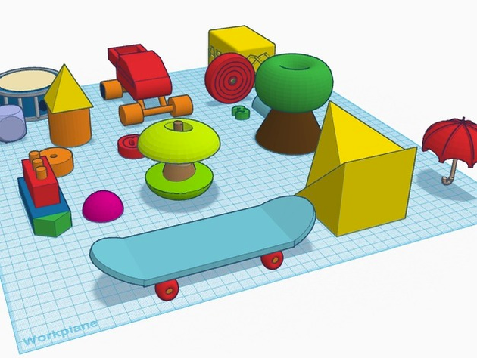
Tinkercad Tips
Combine shapes to create new designs
Make sure shapes are touching
Project is flat on the workplane

Slide 11
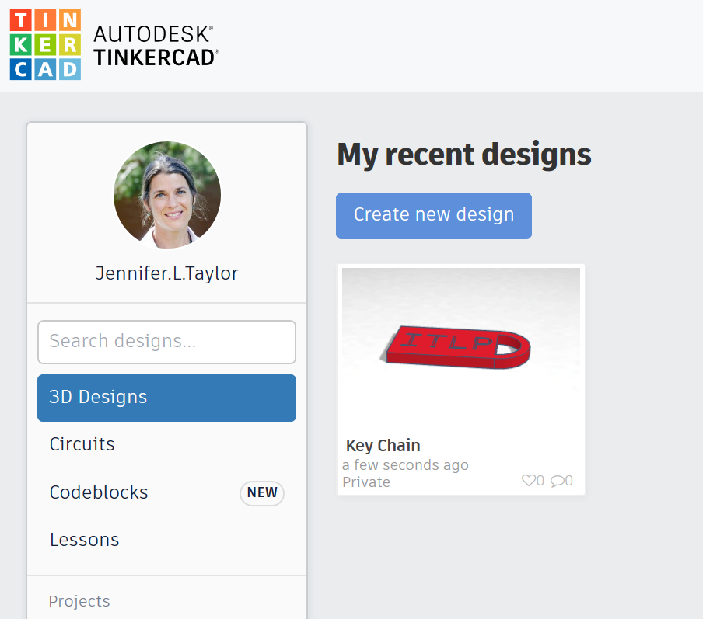
Tinkercad Tips
Use a mouse
Measure in millimeters (mm)
Click on the upper left waffle box icon to return to your project homepage.
Example of Tinkercad project page
Notes:
.

Slide 12
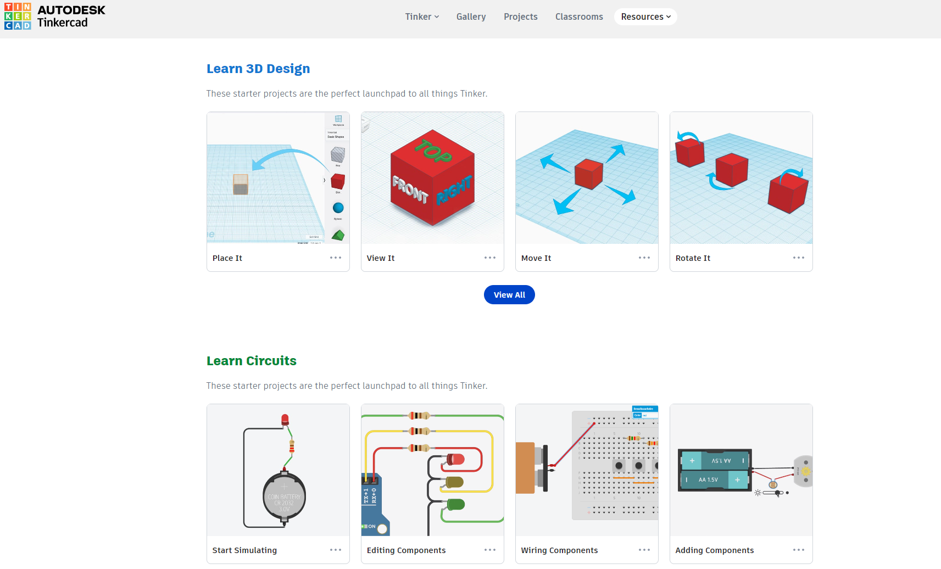
Tinkercad Tutorials
Notes:
Follow the slide instructions. Enable students to peer support each other, and do regular check ins with the class.

Slide 13
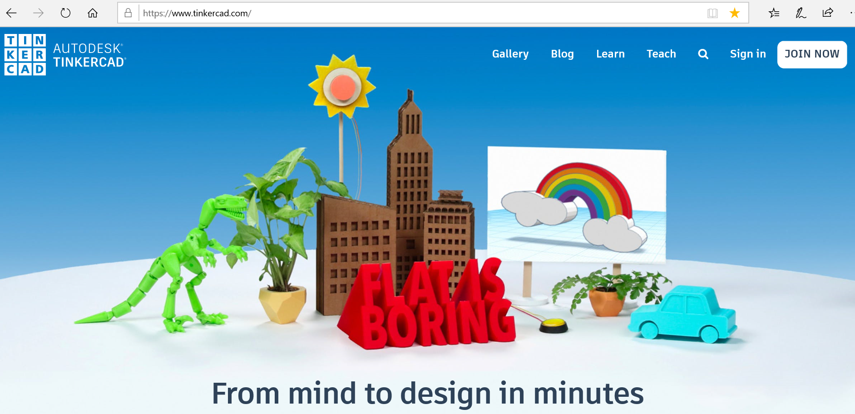
Create Tinkercad.com account
Notes:
Direct students to Tinkercad.com>Tinker (top menu bar)>3D Design>login or join classroom and enter code generated by the teacher>start “tinkering”>Designs>3D Designs>Create
Teachers & Parents Tinkercad blog:
https://blog.tinkercad.com/tag/teachers-parents

Slide 14
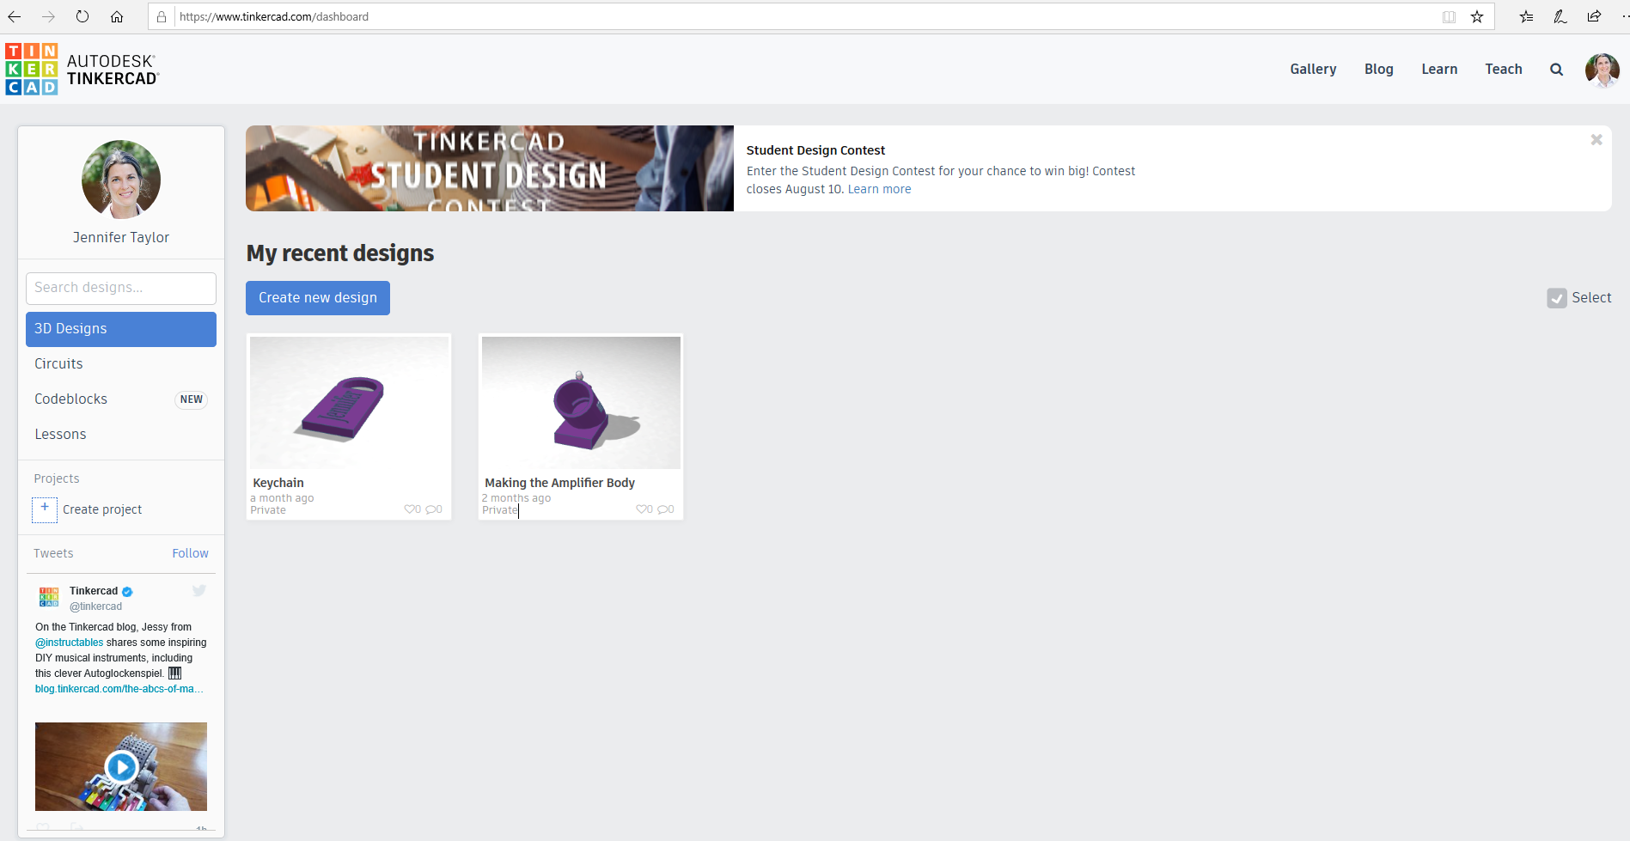
Tinkercad Project Page
Click the “waffle box” icon to return to project home page.
Notes:
Give the class a “tour” of the Tinkercad interface.

Slide 15
Tinkercad Project Page
Tinkercad resources
Notes:
Give the class a “tour” of the Tinkercad interface.

Slide 16
Tinkercad Project Page
Tinkercad applications:
3D Design
Circuits
Codeblocks
Notes:
Give the class a “tour” of the Tinkercad interface.

Slide 17
Tinkercad Project Page
Click a Tinkercad application
Create a new design
Notes:
Give the class a “tour” of the Tinkercad interface.

Slide 18
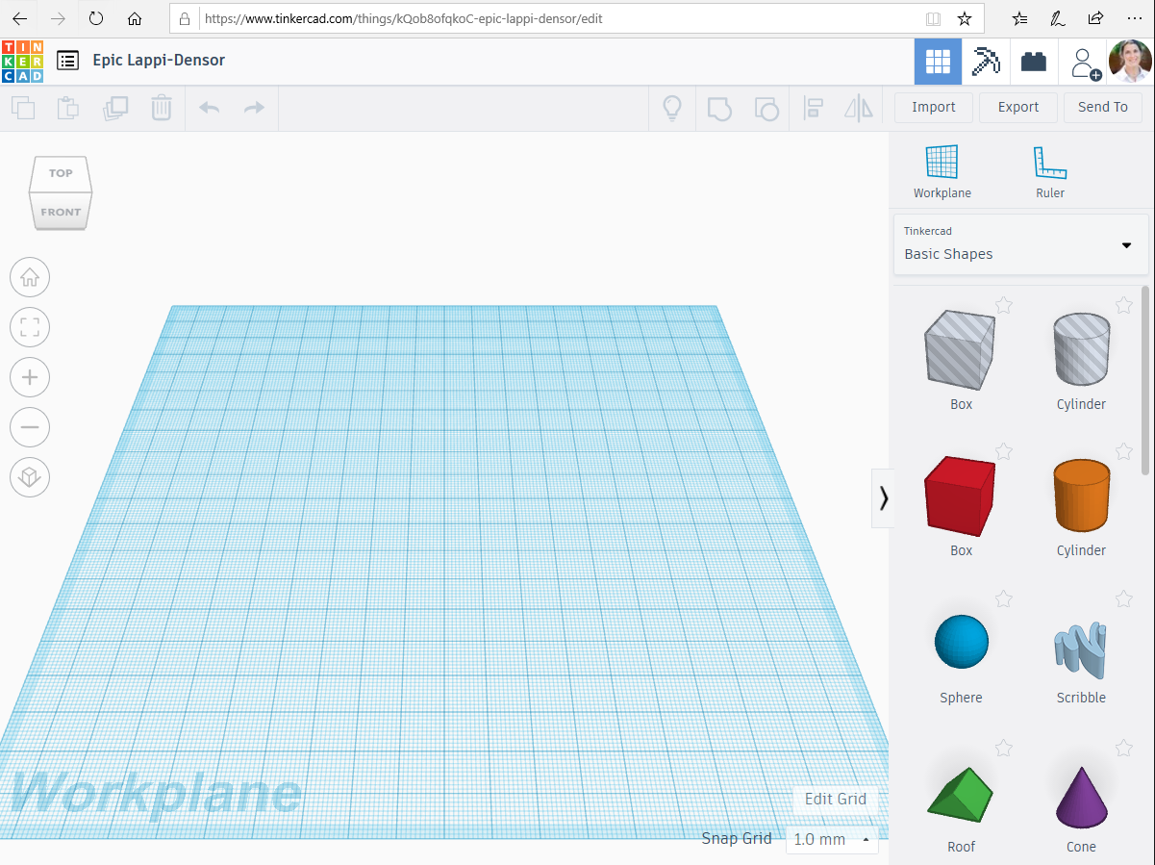
Tinkercad Workplane
Default name
Rename project
Notes:
Give the class a “tour” of the Tinkercad interface.

Slide 19
Tinkercad Workplane
Change 3D design to
Minecraft block design
Lego block design
Notes:
Give the class a “tour” of the Tinkercad interface.

Slide 20
Tinkercad Workplane
Project view options
Right click-rotate
Left click-select, move object
Notes:
Give the class a “tour” of the Tinkercad interface.

Slide 21
Tinkercad Workplane
Copy, paste, duplicate, delete objects
Back arrow or ctrl Z to undo
Forward arrow or ctrl Y to redo
Notes:
Give the class a “tour” of the Tinkercad interface.

Slide 22
Tinkercad Workplane
Show all
Group
Ungroup
Align
Mirror
Notes:
Give the class a “tour” of the Tinkercad interface.

Slide 23
Tinkercad Workplane
Manage 3D files
Notes:
Give the class a “tour” of the Tinkercad interface.

Slide 24
Tinkercad Workplane
Add workplane and ruler options
Notes:
Give the class a “tour” of the Tinkercad interface.

Slide 25
Tinkercad Workplane
Edit workplane settings
Notes:
Give the class a “tour” of the Tinkercad interface.

Slide 26
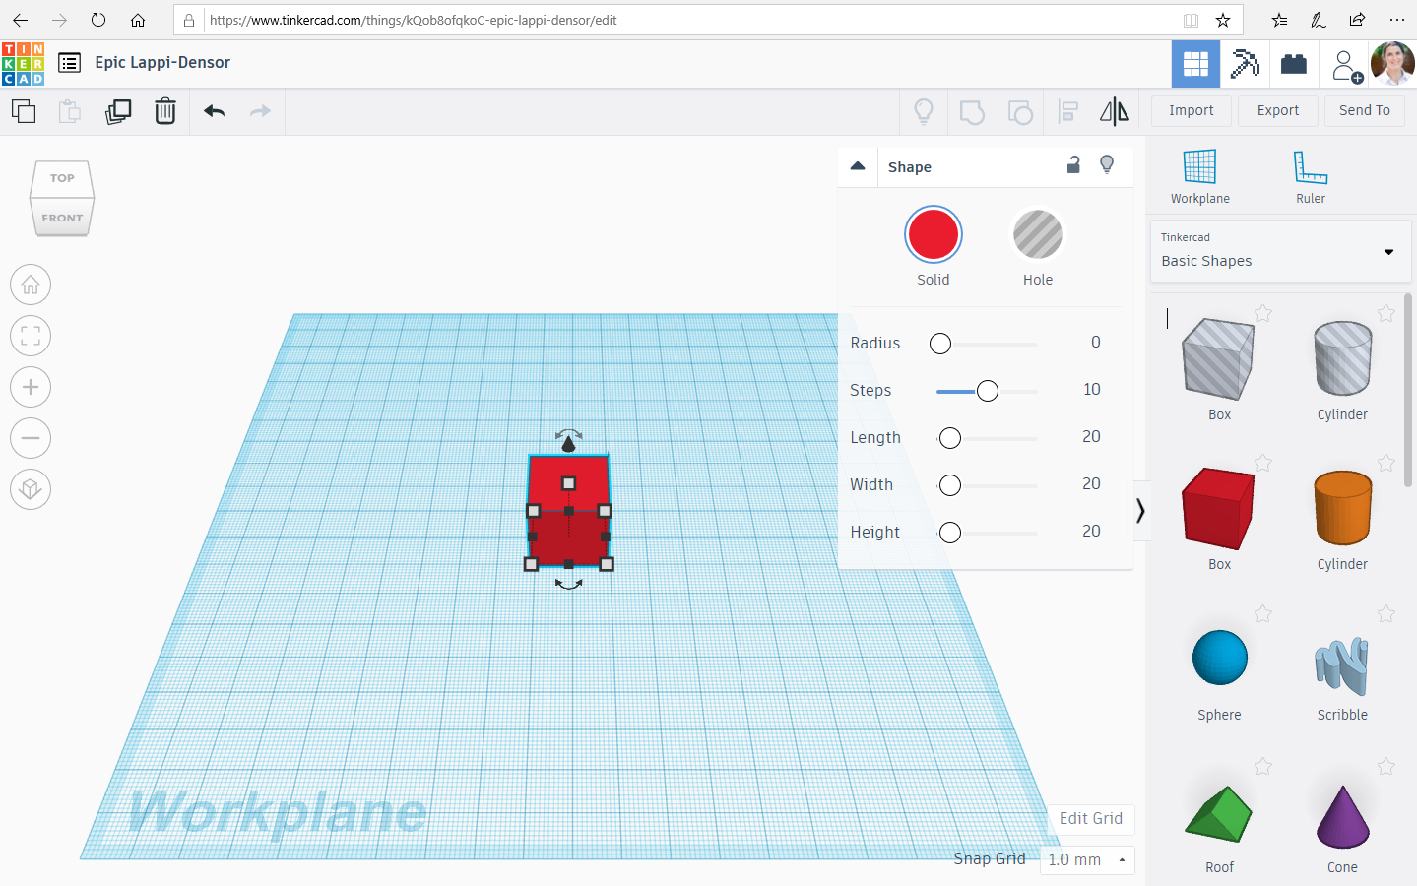
Tinkercad Shape Interface
3D Design options:
Shapes
Text & numbers
Characters
Connectors
Notes:
Give the class a “tour” of the Tinkercad interface.

Slide 27
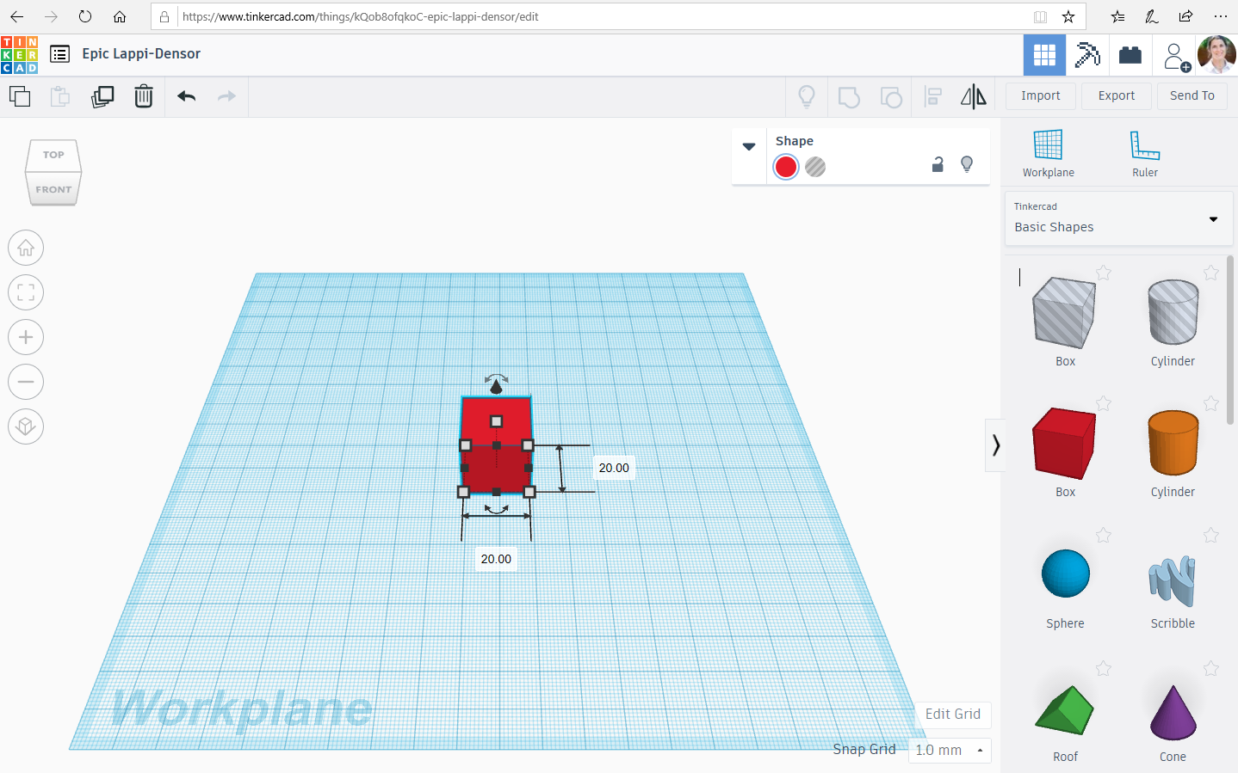
Tinkercad Shape Interface
Click white “handles” to change object dimensions.
Notes:
Give the class a “tour” of the Tinkercad interface.

Slide 28
Tinkercad Shape Interface
Notes:
Give the class a “tour” of the Tinkercad interface.

Slide 29
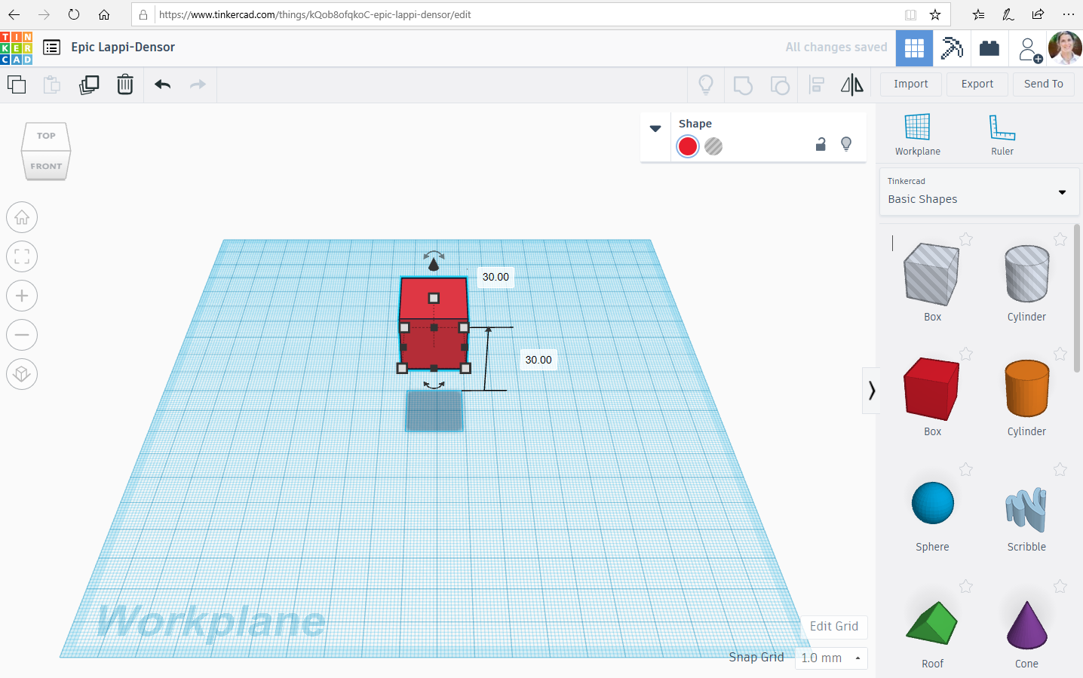
Tinkercad Shape Interface
Left click and drag the top black cone to raise and lower an object.
Notes:
Give the class a “tour” of the Tinkercad interface.

Slide 30
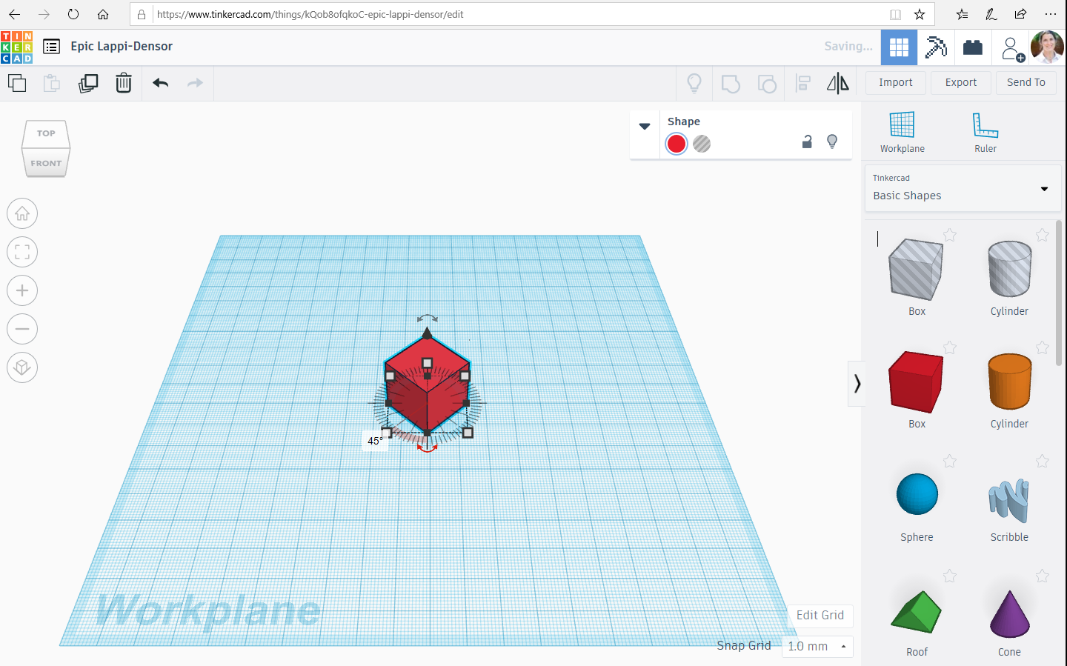
Tinkercad Shape Interface
Left click and drag the lower arrows to rotate an object.
Notes:
Give the class a “tour” of the Tinkercad interface.

Slide 31
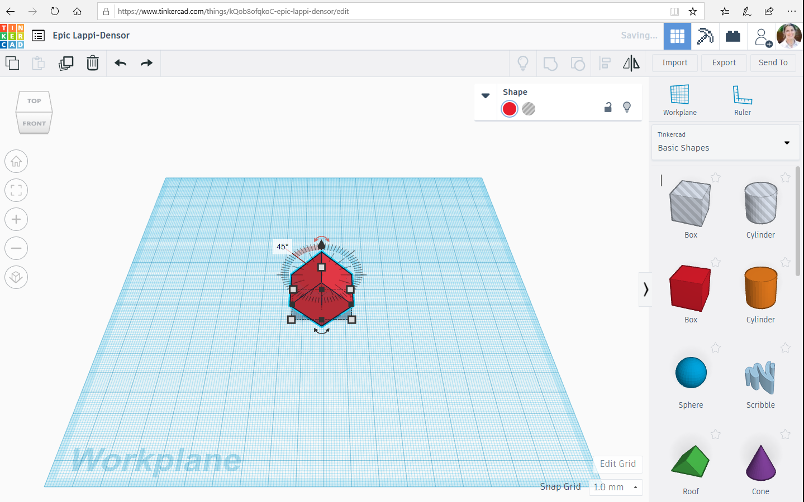
Tinkercad Shape Interface
Left click and drag the upper arrows to tilt an object.
Notes:
Give the class a “tour” of the Tinkercad interface.

Slide 32
It’s YOUR turn to get creative with 3D design!
Instructions:
Go to the “3D” tab in Tinkercad
Click “Create New Design”
File name: “EV Concept Car”
Reminders:
Project is flat on the workspace
Objects are touching
Back arrow or “Control Z” to undo
Click on the Tinkercad “waffle box”. icon to get back to your project page
Don’t get frustrated, have fun!

Slide 33
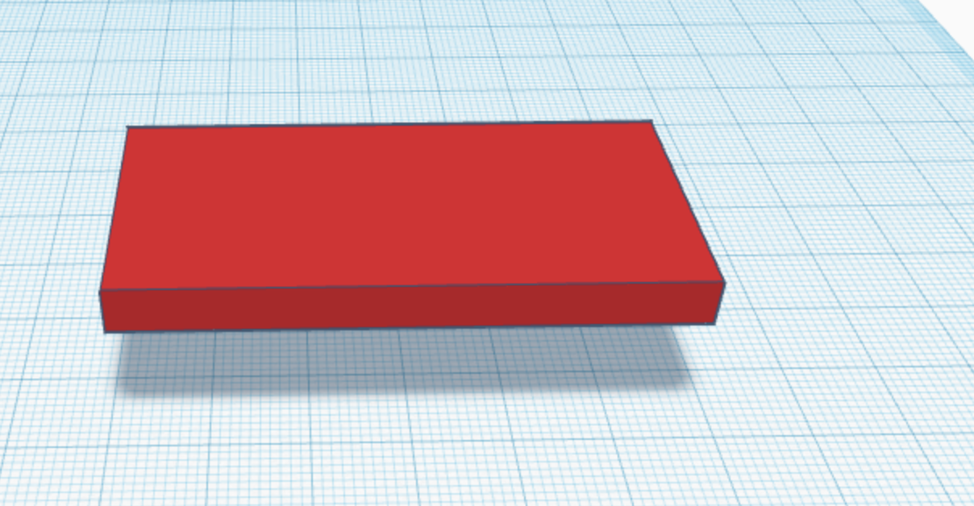
Session 2: Car Chassis Design
Drag a cube onto your workplane, and change the dimensions.
Length: 60 cm
Width: 30 cm
Height: 5 cm
Notes:
Follow the slide instructions. Enable students to peer support each other, and do regular check ins with the class.

Slide 34
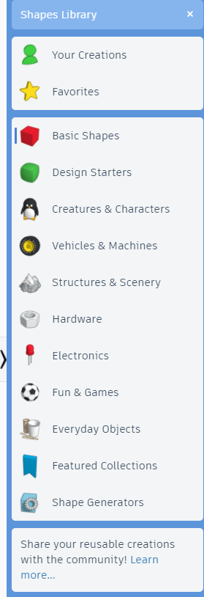
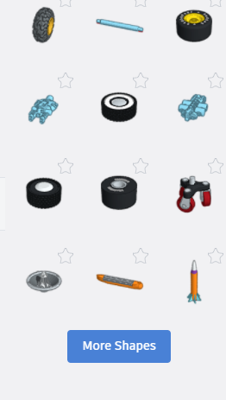


More shapes!
Notes:
Now we can add wheels! If there isn’t an option to add a wheel, you can click on more shapes to see even more options.

Slide 35
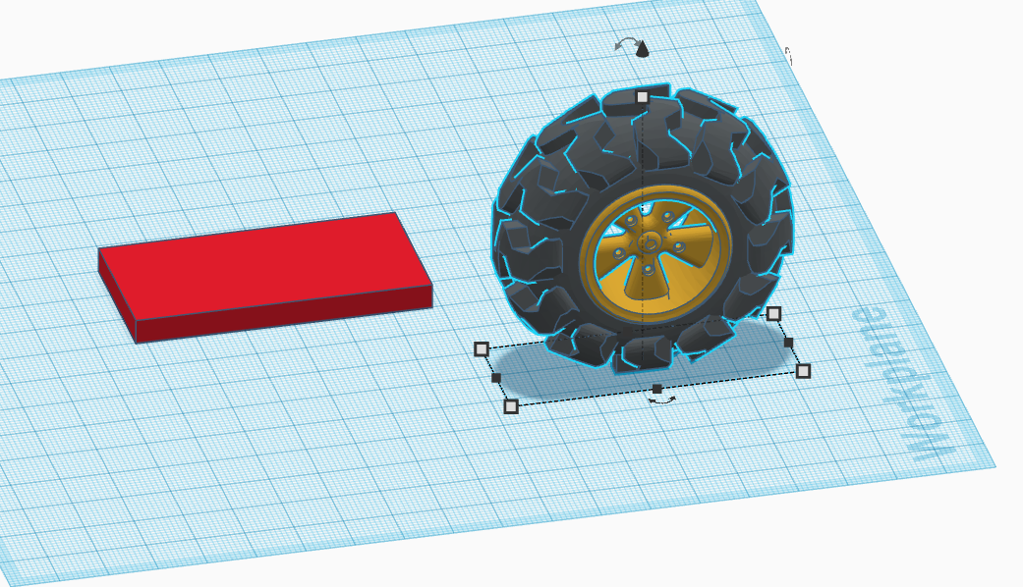
Add a wheel to your project
Notes:
Follow the slide instructions. Enable students to peer support each other, and do regular check ins with the class.

Slide 36
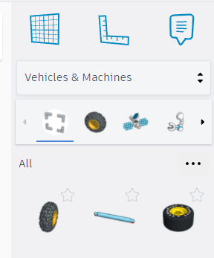
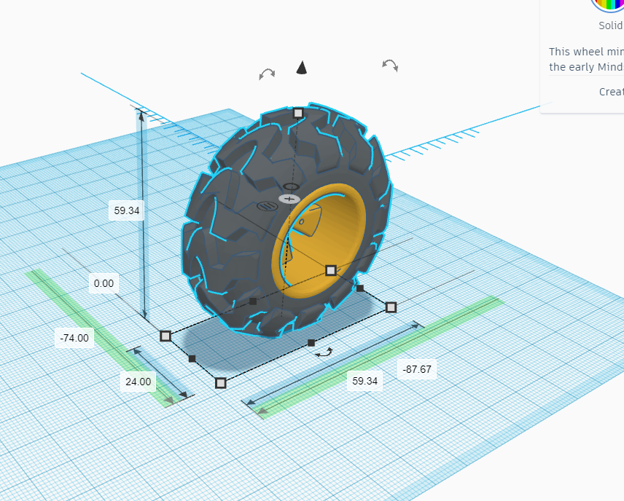
Scale the wheel
Change to 20
Notes:
Click on the measurements tool and then click on the wheel.

Slide 37
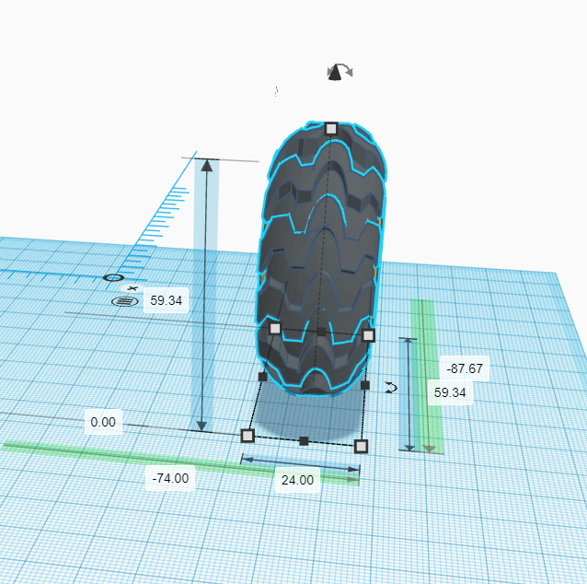
Scale the wheel (cont.)
Change to 12
Notes:
Click on each measurement to edit the numbers.

Slide 38
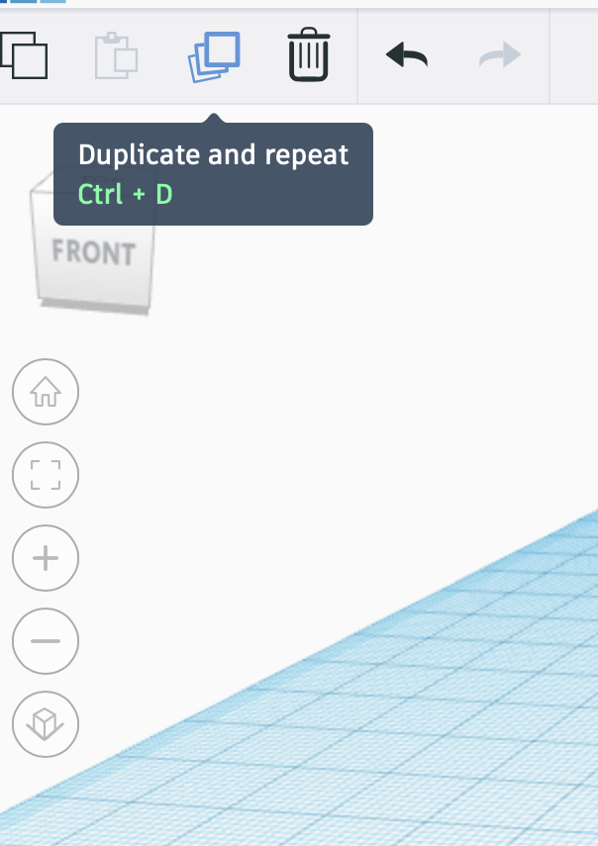
Duplicate your first wheel
Notes:
Follow the slide instructions. Enable students to peer support each other, and do regular check ins with the class.

Slide 39
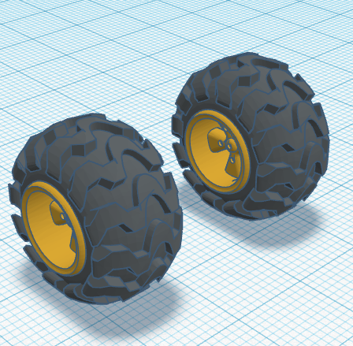
Pull it out from the first wheel
Notes:
Follow the slide instructions. Enable students to peer support each other, and do regular check ins with the class.

Slide 40
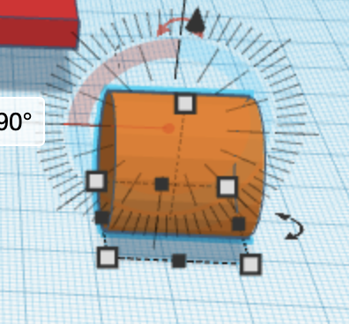
Make an axle
To create an axle, take a new cylinder and rotate it 90°
(click on the 0° and type in 90).
Notes:
Follow the slide instructions. Enable students to peer support each other, and do regular check ins with the class.

Slide 41
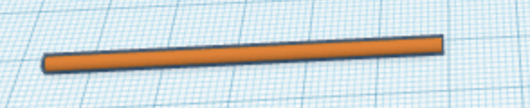
Make an axle (cont.)
Length = 55 cm
Width = 2 cm
Height = 2 cm
Make it thin
Adjust the dimensions to your liking, you are able to modify this as you work.
Notes:
Follow the slide instructions. Enable students to peer support each other, and do regular check ins with the class.

Slide 42
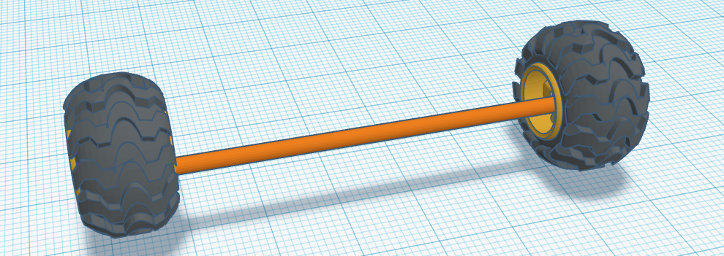
Centering objects
Pull the axle off the ground and try to put it in the center of the two wheels.
Notes:
Follow the slide instructions. Enable students to peer support each other, and do regular check ins with the class.

Slide 43
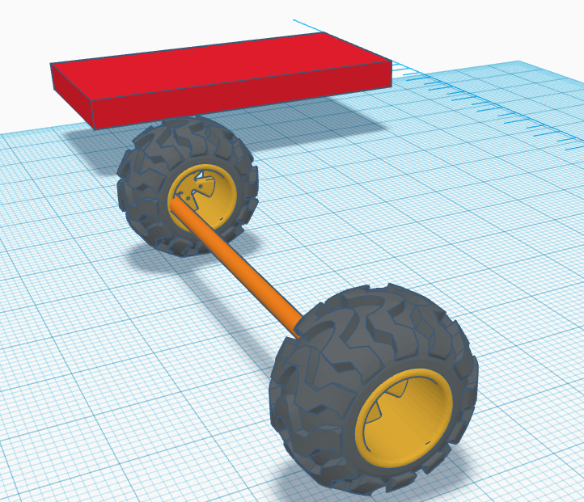
Centering (cont.)
Your design does not have to be perfect yet.
Just make sure the chassis is between the axle and wheels.
Notes:
Follow the slide instructions. Enable students to peer support each other, and do regular check ins with the class.

Slide 44
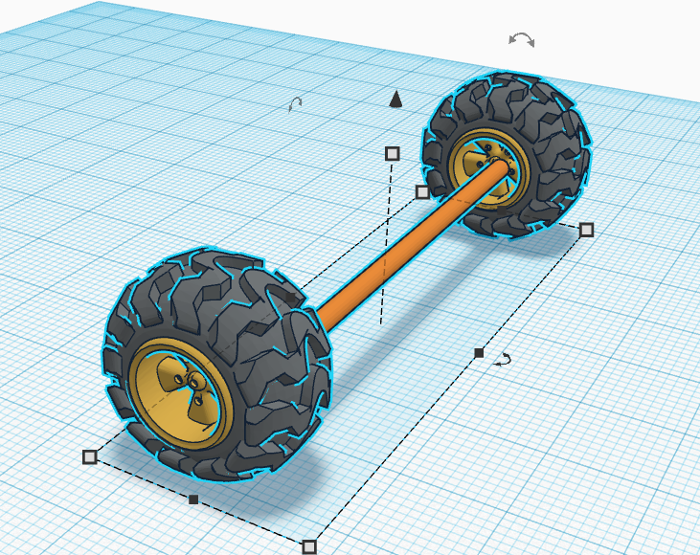
Selecting a group
Hold shift, click on your axle and wheels, all three should be highlighted in blue.
Notes:
Follow the slide instructions. Enable students to peer support each other, and do regular check ins with the class.

Slide 45
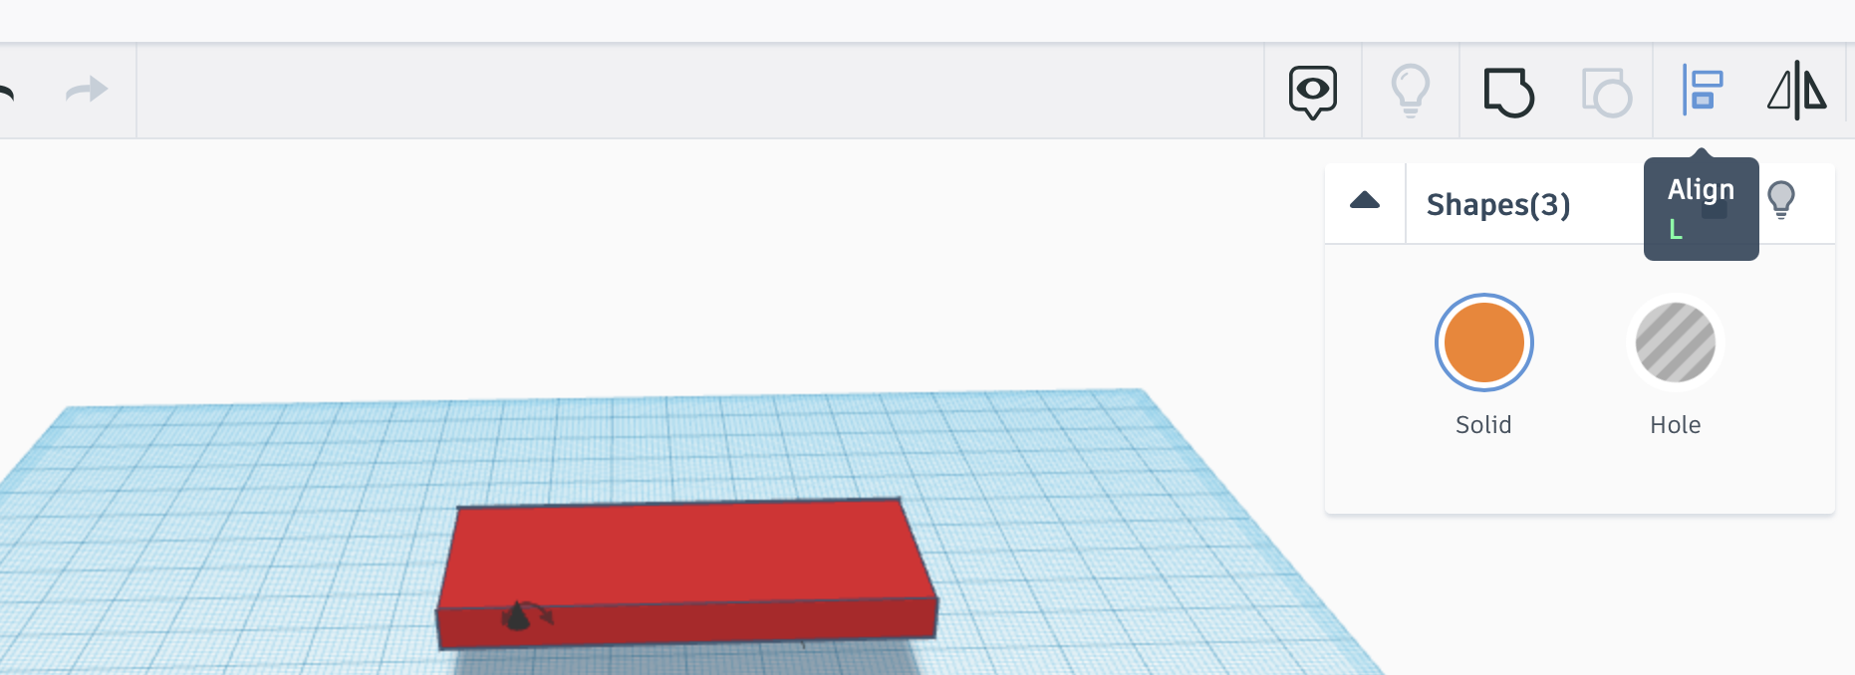
Align objects
Click on the align tool.
Notes:
Follow the slide instructions. Enable students to peer support each other, and do regular check ins with the class.

Slide 46
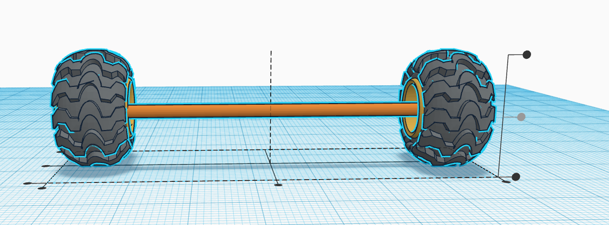
Align (cont.)
Align the centre two dots, which will align it in the center of this view.
Then view it from the side and align it again.
Notes:
Follow the slide instructions. Enable students to peer support each other, and do regular check ins with the class.

Slide 47
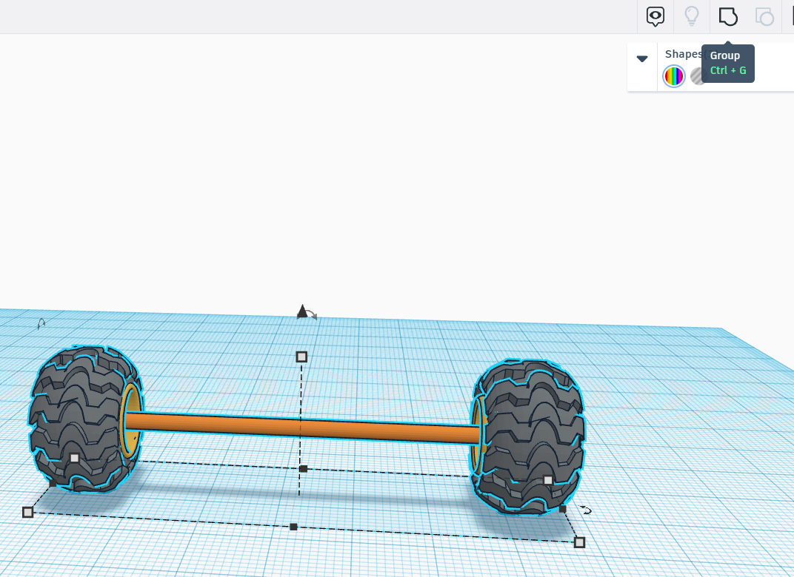
Grouping parts
Group the axle and the wheels to prevent them from separating.
Notes:
Follow the slide instructions. Enable students to peer support each other, and do regular check ins with the class.

Slide 48
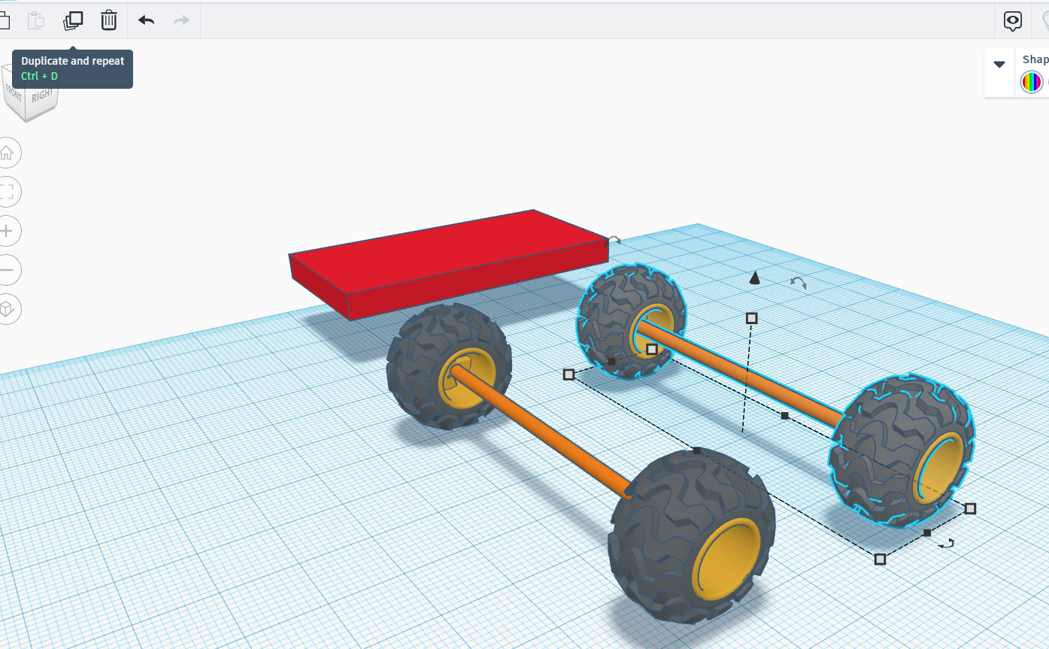
Create more wheels
Duplicate again!
Notes:
Follow the slide instructions. Enable students to peer support each other, and do regular check ins with the class.

Slide 49
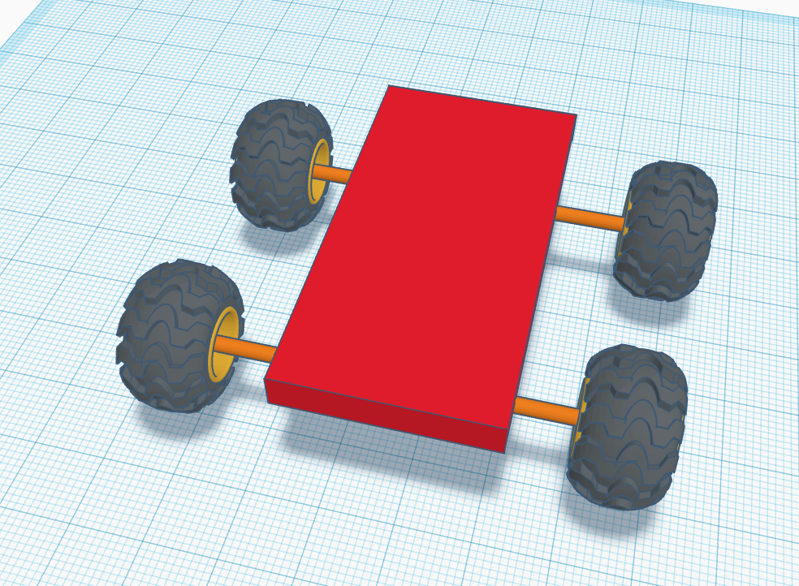
Changing sizes
If one part is too narrow or too wide, you can always change the dimensions.
Notes:
Follow the slide instructions. Enable students to peer support each other, and do regular check ins with the class.

Slide 50
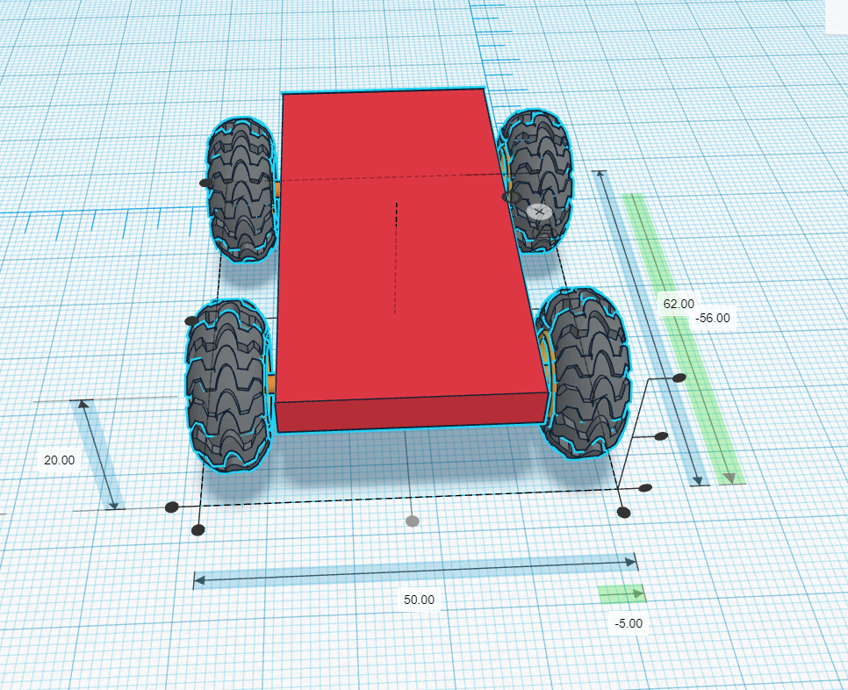
Chassis design
Use the “Align” tool to align the wheels, axles, and chassis.
Notes:
Follow the slide instructions. Enable students to peer support each other, and do regular check ins with the class.

Slide 51
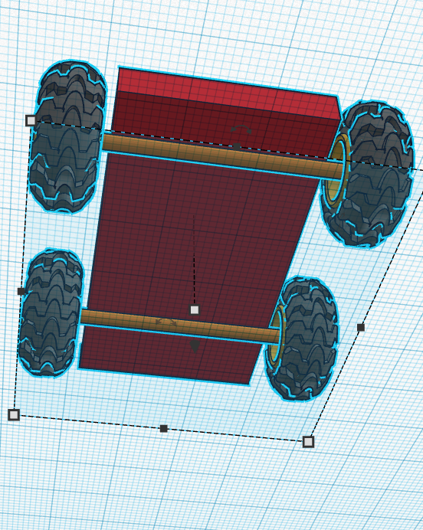
Keeping wheels on the road
Place the axle below the chassis.
Notes:
Follow the slide instructions. Enable students to peer support each other, and do regular check ins with the class.

Slide 52
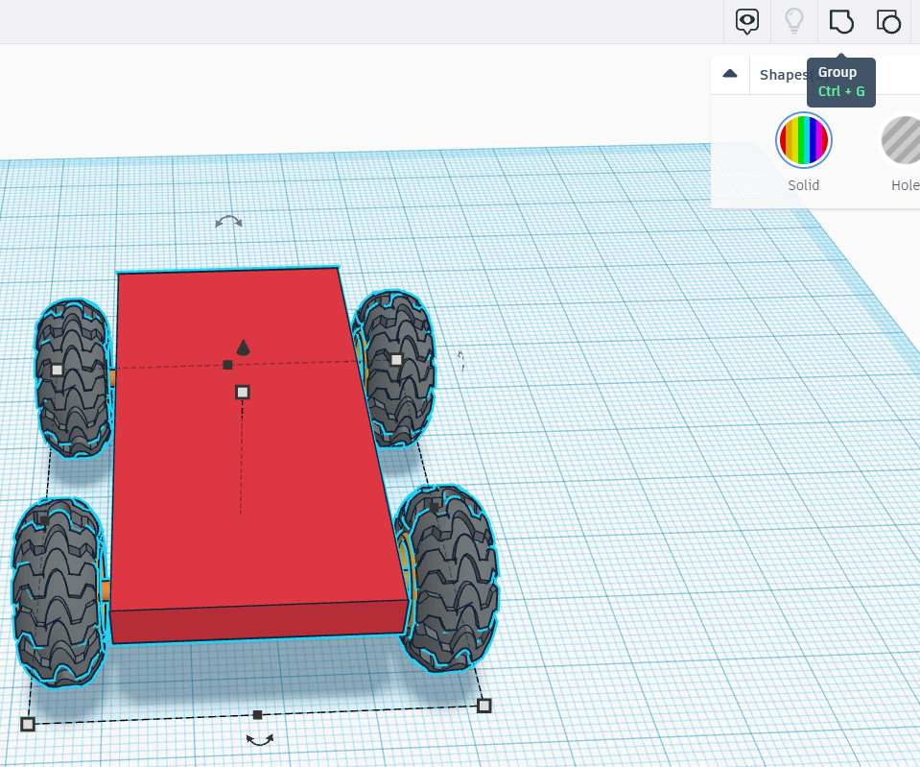
Finish the chassis
Group all items together.
Notes:
Follow the slide instructions. Enable students to peer support each other, and do regular check ins with the class.

Slide 53
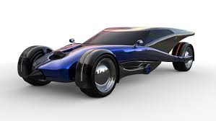
Tinkercad 3D Design &
EV Concept Car Workshop
Part 2: Concept Car Body Design & Review

Slide 54
What You’ll Need!
Computer, Mouse & Internet Connection
Microsoft Windows 10, Apple OSX10.10, or Chrome OS on Chromebooks
TinkerCAD Account
Go to https://www.tinkercad.com
+
Browsers that work best with Tinkercad:
- Google Chrome version 50 (or newer), Safari 10 or newer, Microsoft Edge (Chromium)
Notes:
Direct students to Tinkercad.com>Tinker (top menu bar)>3D Design>login or join classroom and enter code generated by the teacher>start “tinkering”>Designs>3D Design>Create

Slide 55
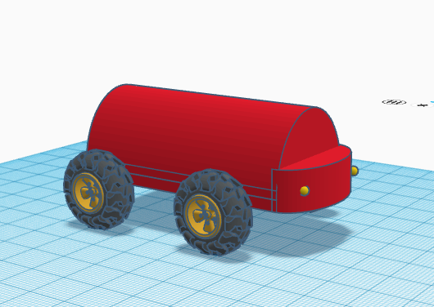
Session 3: Concept Car Body Design
Get creative!
Choose shapes to combine to form the custom car body (fit within 30cm by 60cm chassis)
Select color(s)
Make “holes” and then group them with a body
Customize the wheels, body shape, etc.
Group objects as you go and on the final draft
design
What shapes work best?
Notes:
Follow the slide instructions. Enable students to peer support each other, and do regular check ins with the class.

Slide 56
Session 4: Concept Car Design Review
Take a screenshot of your 3D model EV Concept Car design.
Share it with the class!
What was the best part of creating your design?
What was the most challenging part of creating your design?
How would you change your design next time?
Notes:
Follow the slide instructions. Enable students to peer support each other, and do regular check ins with the class.

Slide 57

End of Workshop
You CAD do it!

